Slide 1


SPORTS PARTICIPATION OF WOMEN IN INDIA
SUBJECT : PHYSICAL EDUCATION
CHAPTER NUMBER: 05
CHAPTER NAME : CHILDREN AND WOMEN IN SPORTS

Slide 2


WHAT WE EXPECT TO LEARN?
01
History of women participation.
02
Sports participation of women in India.
03
Introducing women sports personality.
04
Reasons for less participation.

Slide 3
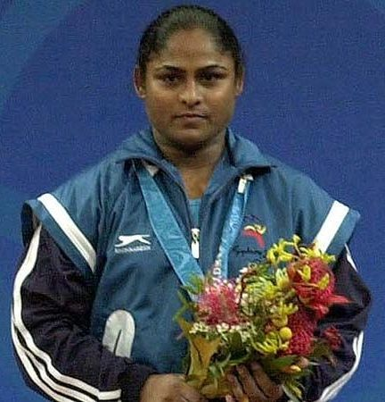
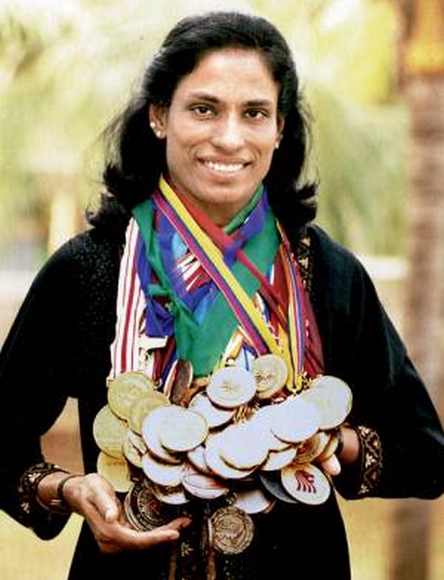
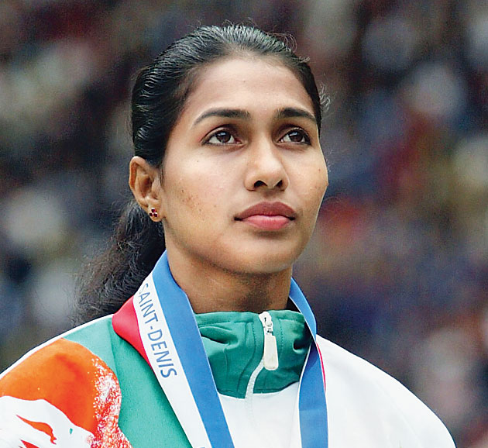
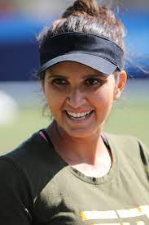
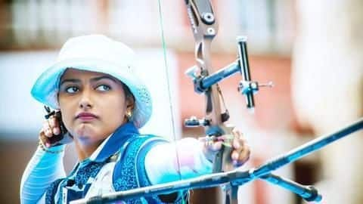
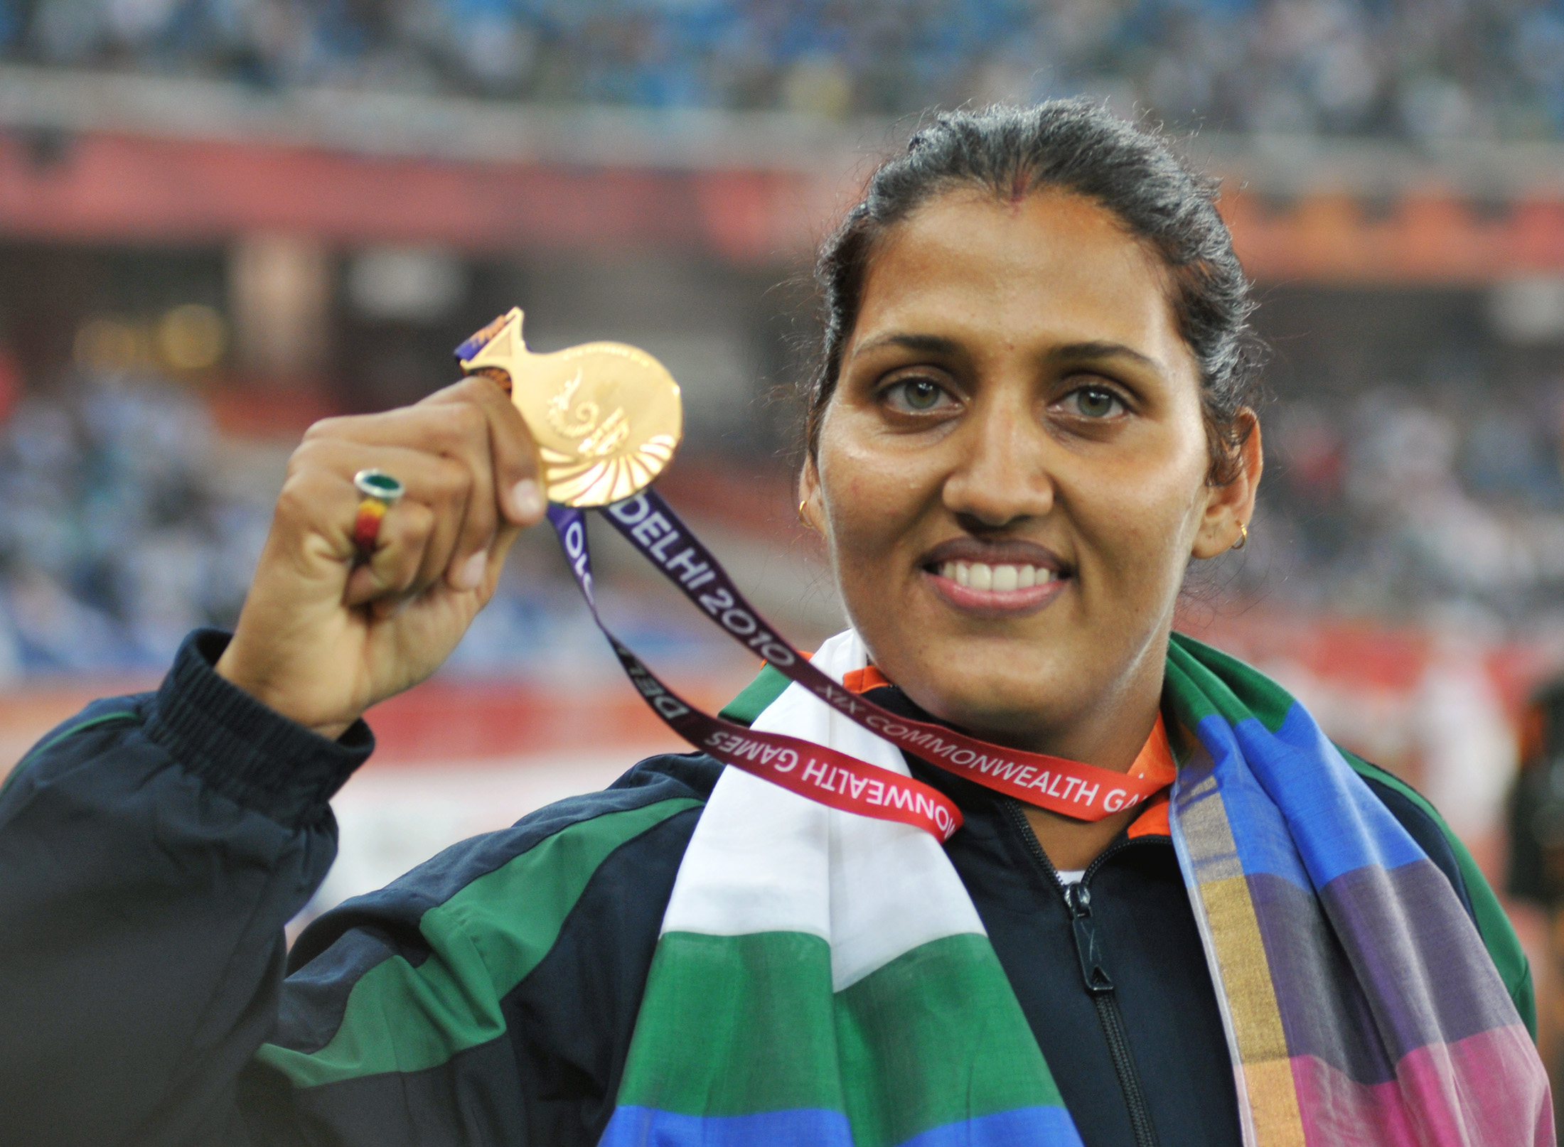
SPORTS PARTICIPATION OF WOMEN
Ancient Olympics, women were not allowed to watch competitions.(776 BCE)
Women started participating in the modern Olympic Games from 1900 onwards.(only 2 events, 22 women)
1904 Olympic – only 6 women.
2000 Sydney Olympic – 4,069(38.2 %) from 199 countries.
2008 Beijing Olympic - 4,637(42.4 %) [26 women was Indian] from 205 countries.
2012 London Olympic - 4862 (SAINA NEHWAL, MC MARY KOM,)

Slide 4
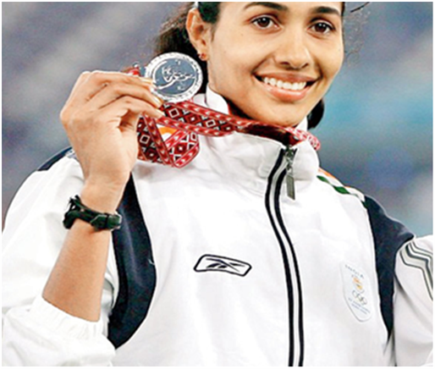
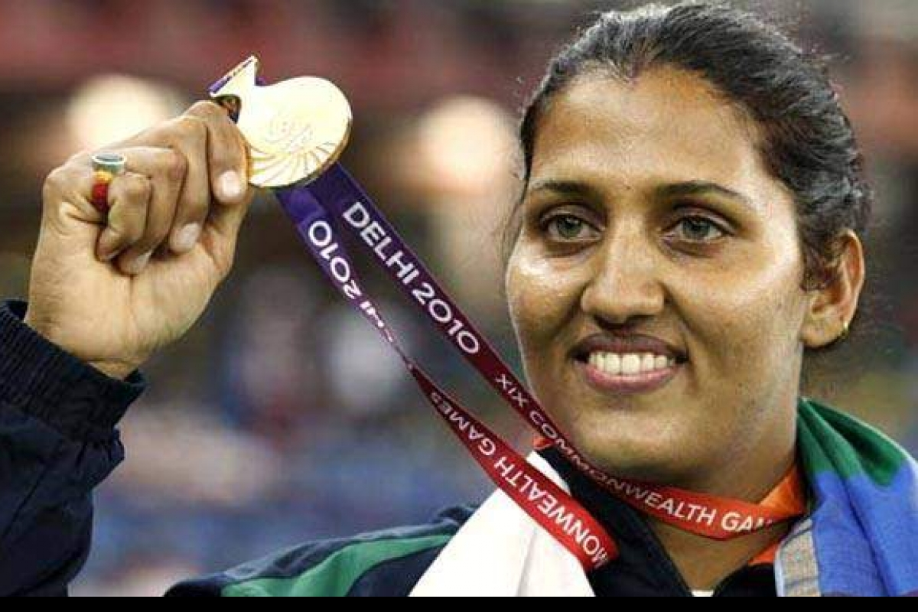
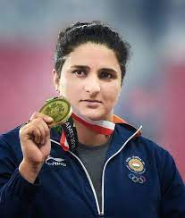
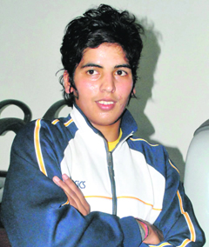
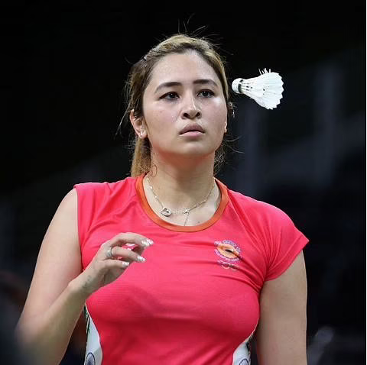
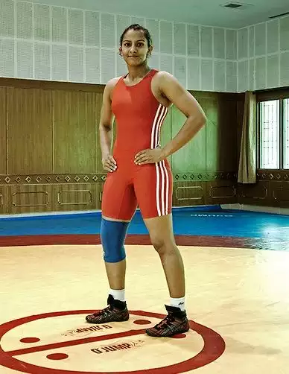
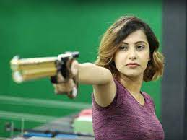
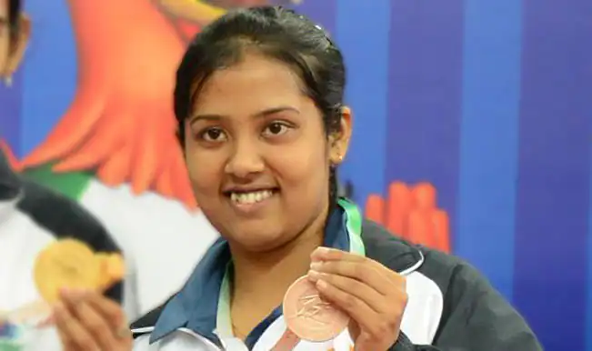
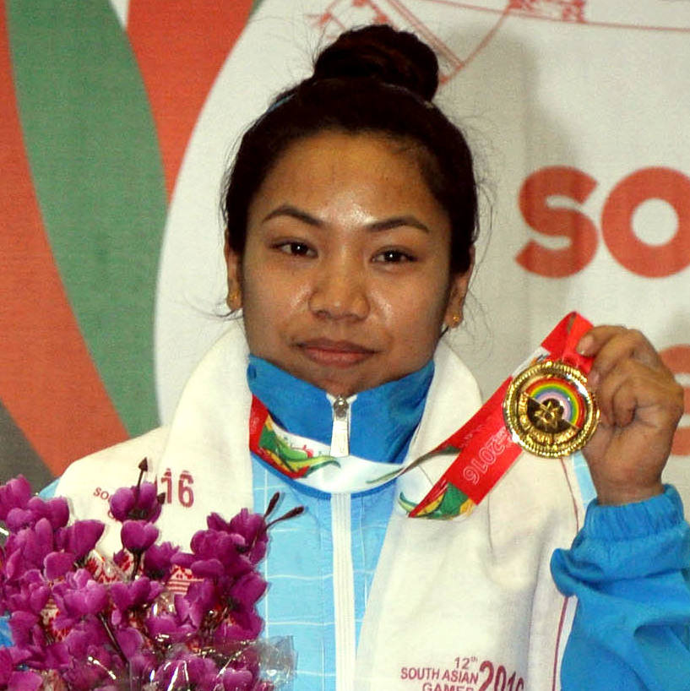
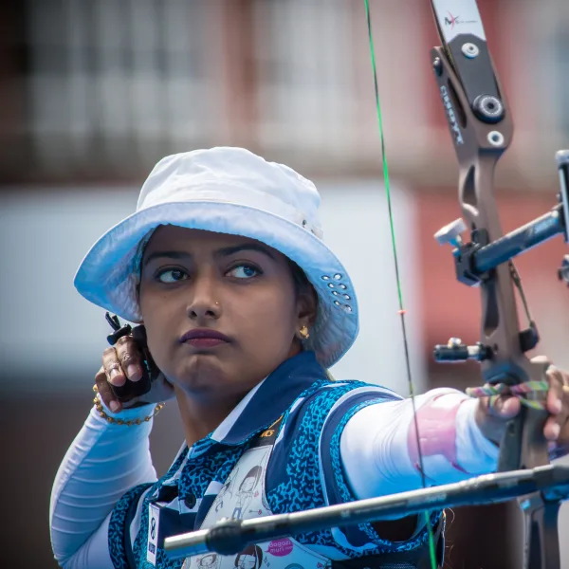
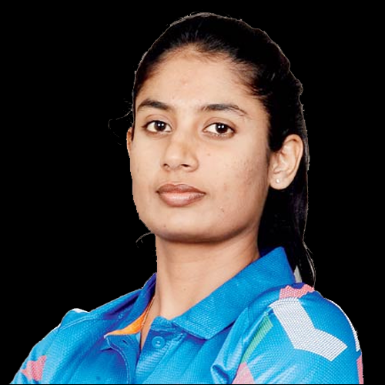
WOMEN SPORTS PERSONALITY
KARNAM MALLESWARI - WEIGHTLIFTING
PT USHA – TRACK AND FIELD
ANJU B GEORGE – LONG JUMP
SANIA MIRZA – TENNIS
KRISHNA POONIA – DISCUS
SEEMA ANTIL – DISCUS
GARIMA CHAUDHARY – JUDO
JWALA GUTTA – BADMINTON
GEETA PHOGAT – WRESTLING
HEENA SIDHU – SHOOTING
ANKITA DAS – TABLE TENNIS
NS CHANU –WEIGHTLIFTING
DEEPIKA KUMARI – INDIVIDUAL RECURVE EVENT
MITHALI RAJ - CRICKET

Slide 5
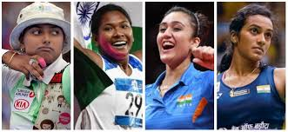
REASONS FOR LESS PARTICIPATION OF WOMEN IN SPORTS
Lack of legislation
Lack of time
Lack of self-confidence
Male-dominated culture of sports
Lack of spectators & no coverage of women’s sports
Lack of female sportspersons as role models
Lack of fitness & wellness movements
Lack of awareness among women
Less number of women coaches
Attitude of society towards women’s participation in sports
Lack of personal safety
Lack of proper access to facilities

Slide 6
REASONS FOR LESS PARTICIPATION OF WOMEN IN SPORTS
REASONS
Physical factors
Low physical fitness & efficiency
Female athlete triad
Mental factors
Gender inequality
Social factors
Lack of education
Lack of confidence
Lack of media support
Fear
safety
Financial help
Lack of time
Lack of facilities

Slide 7

REASONS FOR LESS PARTICIPATION OF WOMEN IN SPORTS
LACK OF LEGISLATION
In 1972, a legislation was passed to prevent discrimination and to provide equal opportunities to women to participate in sports at all levels.
In India, there is a lack of such legislation.
For providing sports facilities less budget is allocated in comparison to that in western countries.
There is lack of facilities for women in many colleges and schools.

Slide 8
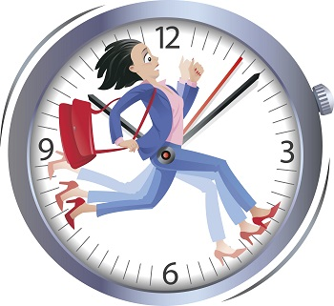
REASONS FOR LESS PARTICIPATION OF WOMEN IN SPORTS
LACK OF TIME
Majority of women usually have less leisure time than men because they take on greater responsibility for household work.
Some of them have full time jobs to earn a living.

Slide 9
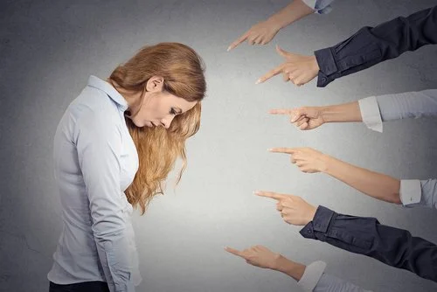
REASONS FOR LESS PARTICIPATION OF WOMEN IN SPORTS
LACK OF SELF-CONFIDENCE
Owing to social pressures, women tend to have less self-confidence in comparison to men.
Indeed, self-confidence is also linked to sports competitions.

Slide 10
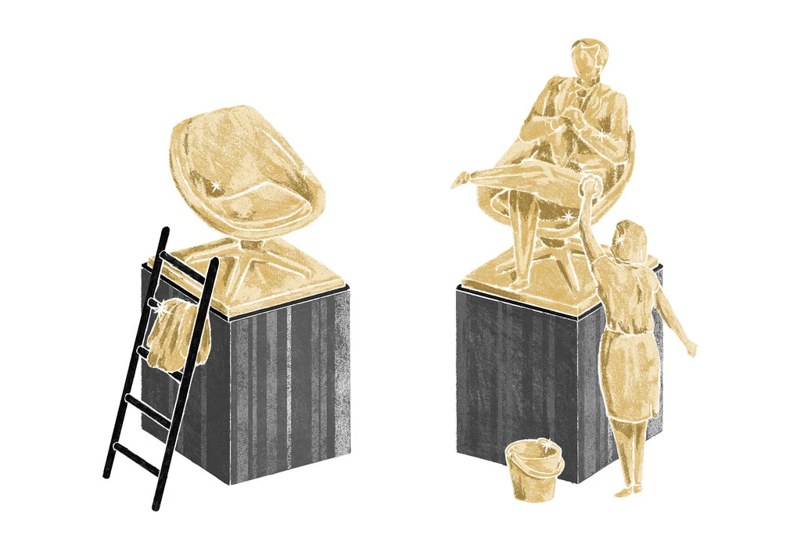
REASONS FOR LESS PARTICIPATION OF WOMEN IN SPORTS
MALE-DOMINATED CULTURE OF SPORTS
As culture of sports is perceived to be mail dominated, some women seem to hesitate to take part in sports activities.

Slide 11
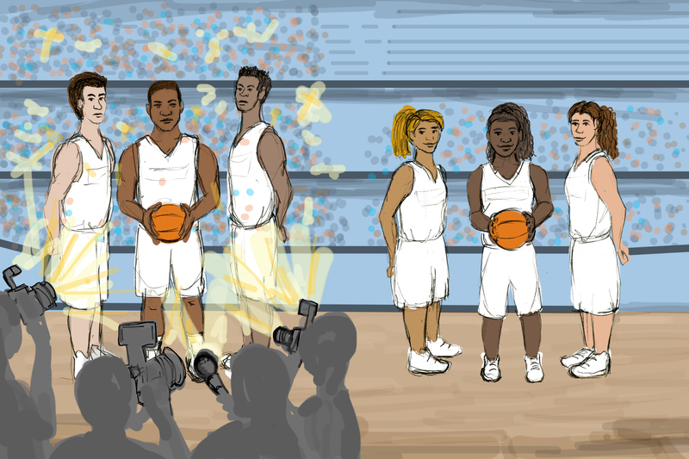
REASONS FOR LESS PARTICIPATION OF WOMEN IN SPORTS
LACK OF SPECTATORS & NO COVERAGE OF WOMEN’S SPORTS
It is not surprising that there is less number of spectators in sports competitions of women.
A cricket match may be termed as an exception where there is always a huge number of spectators but this is not true for women’s cricket match.
How many time do we watch any sports played by women in India on TV?
We hardly watch women’s Cricket World Cup, Women’s Kabaddi World Cup, Women Hockey World Cup, etc., on TV.
A designated space on women’s sports is not given in newspapers even.

Slide 12

REASONS FOR LESS PARTICIPATION OF WOMEN IN SPORTS
LACK OF FEMALE SPORTSPERSONS AS ROLE MODELS
There are a few of sportspersons as role models, such as
    PT Usha
    Karnam Malleshwari
    Sania Mieza
    Saina Nehwal
    MC Mary Kom
    Mithali Raj
    PV Sindhu
But they are not popularized on TV or other media.
They did not get their due place on TV as role models.
Even proper space is not allocated to the achievements of such women players in various newspapers and magazines.

Slide 13
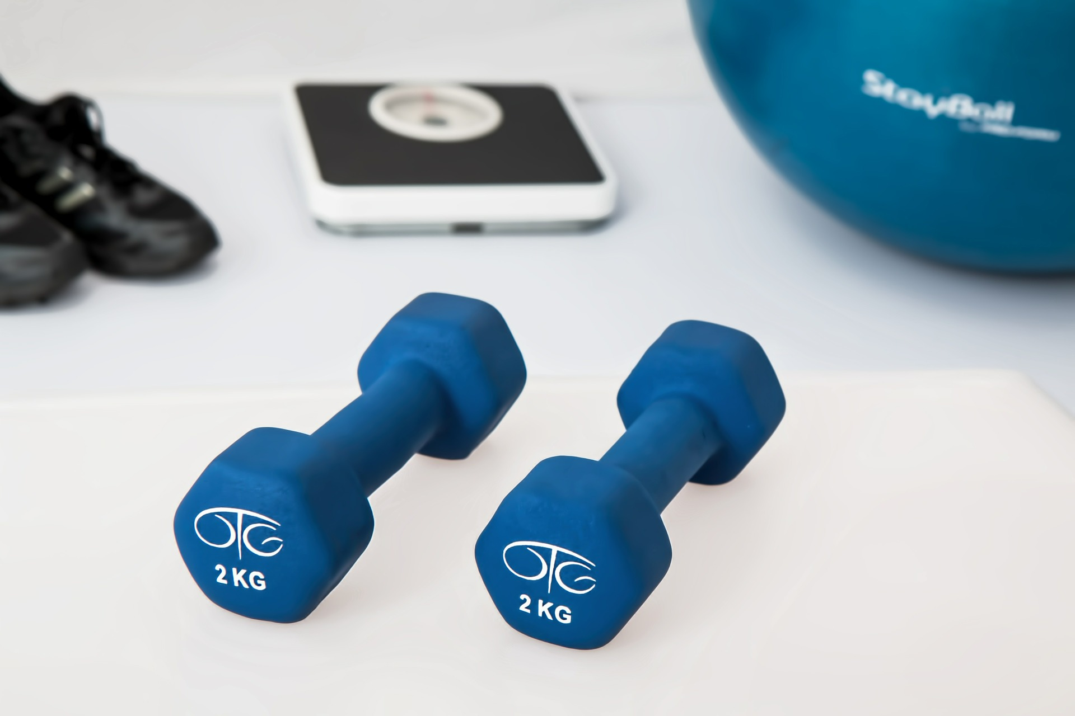
REASONS FOR LESS PARTICIPATION OF WOMEN IN SPORTS
LACK OF FITNESS & WELLNESS MOVEMENTS
Nowadays, women are aware of the benefits of fitness and wellness.
Yet some women are not aware of the various programmes and movements related fitness and wellness.
They need to alert about their health and fitness.

Slide 14

REASONS FOR LESS PARTICIPATION OF WOMEN IN SPORTS
LACK OF AWARENESS AMONG WOMEN
It is considered in our society that physical, social, and psychological characteristics or qualities of women who participate in games and sports show a marked change.
It is also considered that women who participate in sports face a number of problems at the time of child birth.
This is far from being true.

Slide 15
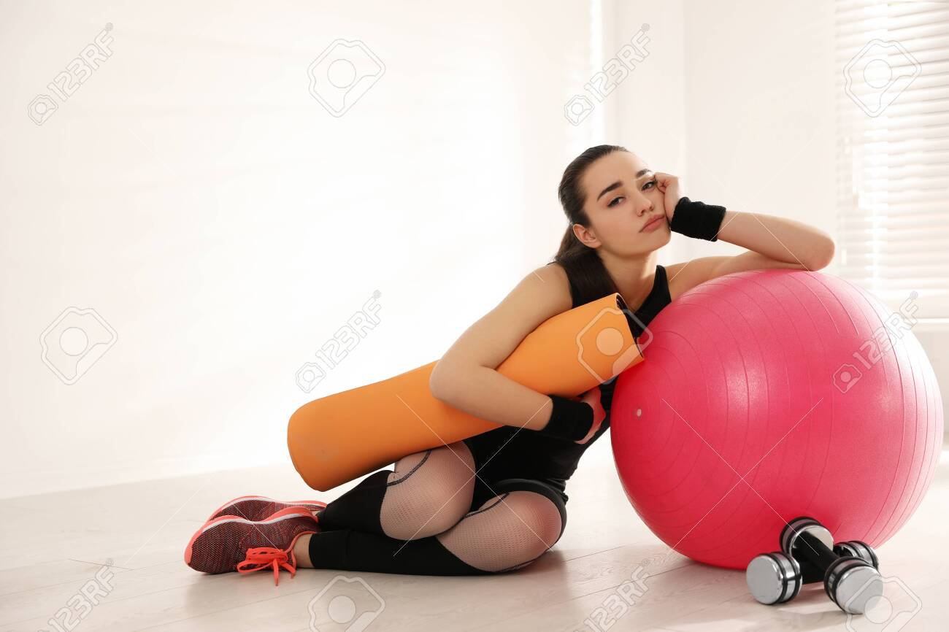
REASONS FOR LESS PARTICIPATION OF WOMEN IN SPORTS
LESS NUMBER OF WOMEN COACHES
If the number of women coaches is enhanced there will definitely be an increases in women’s participation in sports and games.
Women may feel more comfortable in the company of female coaches, they can take part without any hesitation.

Slide 16
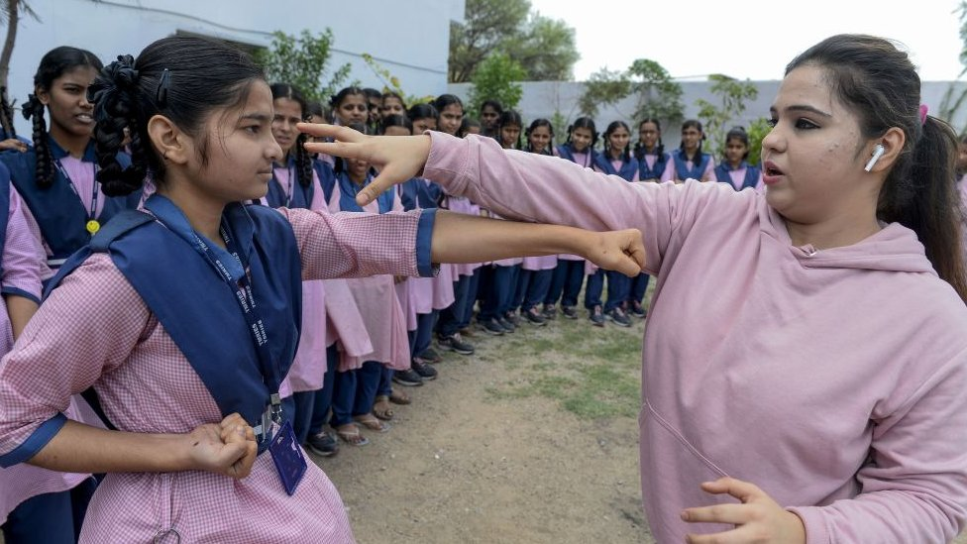
REASONS FOR LESS PARTICIPATION OF WOMEN IN SPORTS
ATTITUDE OF SOCIETY TOWARDS WOMEN’S PARTICIPATION IN SPORTS
India and others countries in the world which have a negative point of view regarding sports participation.
In male dominated society, the views of male sportspersons about female sportspersons are definitely regressive.
It is said, “why don’t they stay in kitchen, where they belong”.

Slide 17

REASONS FOR LESS PARTICIPATION OF WOMEN IN SPORTS
LACK OF PERSONAL SAFETY
Personal safety on the roads, streets, public transport, and in and around sports venues is a common as well as persistent problem for women.
They may be easy target of bullying and abuse.
Due to this reason parents discourage them to take part in sports.

Slide 18
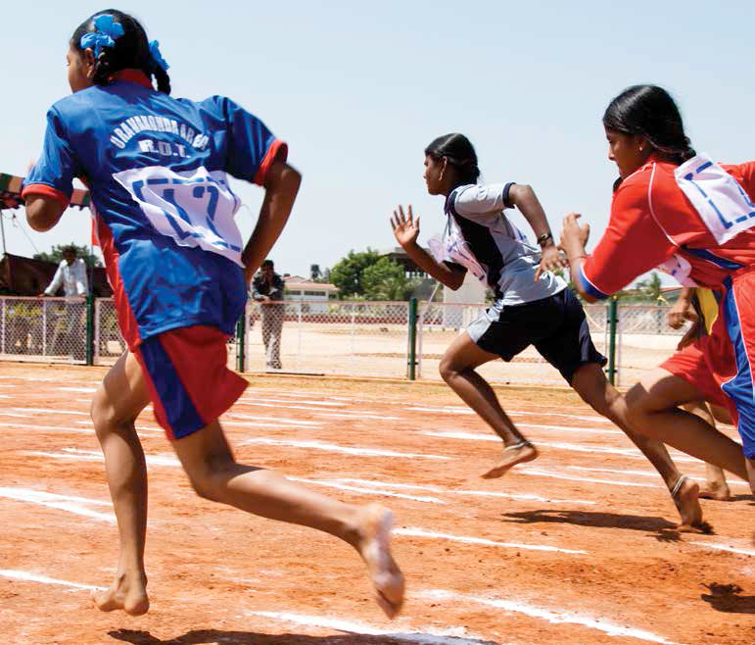
REASONS FOR LESS PARTICIPATION OF WOMEN IN SPORTS
LACK OF PROPER ACCESS TO FACILITIES
Facilities in terms of equipment, training, coaching, etc., are not usually provided to women.
The programmes related to games and sports in girls’ school and colleges are less.
Women do not have adequate playing facilities near their homes.

Slide 19
Explain the Reasons for Less Participation of Women in Sports
SR. NO.
1
2
3
4
5
6
7
8
9
10
11
12
L….. PERSONAL SAFETY
L…... TIME
L…… SELF-CONFIDENCE
LACK OF …..
L…… SPECTATORS
L…… ROLE MODELS
L……. FITNESS
L…… AWARENESS
L……. PROPER ACCESS TO FACILITIES
L…… WOMEN COACHES
MALE-DOMINATED CULTURE OF SPORTS
LEGISLATION
ATTITUDE OF SOCIETY TOWARD WOMEN’S PARTICIPATION IN SPORTS

Slide 20

1. In which Olympics did women participate for the first time ….
1896
1904
1908
1900
2. Who is related to Archery?
DEEPIKA KUMARI
GEETA PHOGAT
HEENA SIDHU
PT USHA
3. 2000 Sydney Olympics, the number of women participants are …
4,059
4,049
4,069
NONE OF THESE

Slide 21
THANKING YOU
ODM EDUCATIONAL GROUP

