Slide 1


CORREVTIVE MEASURES FOR KNOCK-KNEES
SUBJECT : PHYSICAL EDUCATION
CHAPTER NUMBER: 05
CHAPTER NAME : CHILDREN AND WOMEN IN SPORTS

Slide 2

WHAT WE EXPECT TO LEARN?
WE WILL BE ABLE TO KNOW ABOUT THE ‘CORRECTIVE MEASURES FOR ALL DEFORMITIES.’

Slide 3
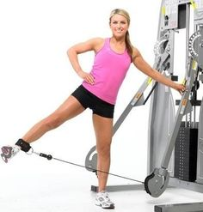
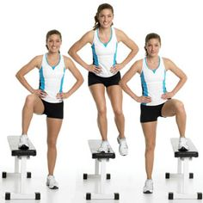
CORRECTIVE MEASURES FOR POSTURAL DEFORMITIES
FOR KNOCK-KNEES
Horse-riding.
Keep a pillow between the knees.
Cod-liver oil is also helpful in removing the deformity.
Lifting leg from straight position.
Use of walking calipers.
Perform PADMASANA and GOMUKHASANA.

Slide 4
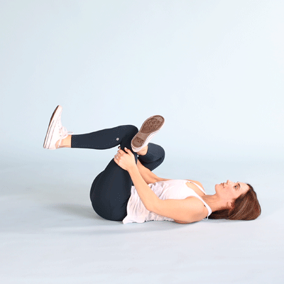
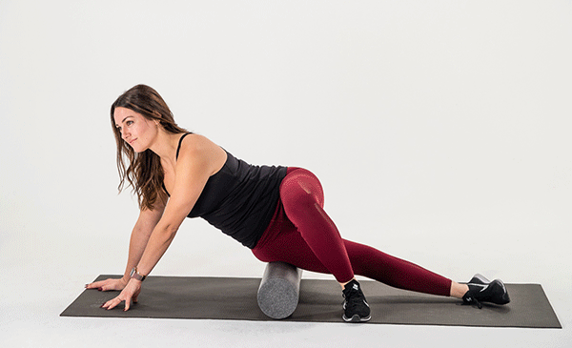
CORRECTIVE MEASURES FOR POSTURAL DEFORMITIES
FOR BOW LEGS
Foam roller Exercise.
Piriformis Stretch.
Perform ARDHMATSEYENDRASANA, GARUDASANA and ARDHA CHAKRASANA.
Walk by bending the toes inward.
Walk on the inner edge of the feet.

Slide 5
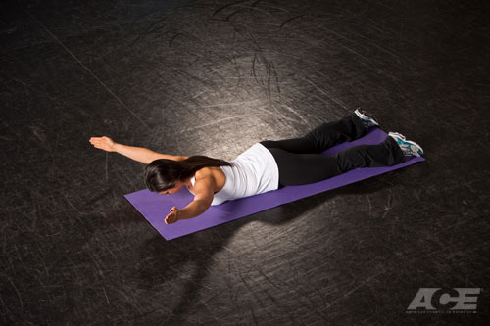
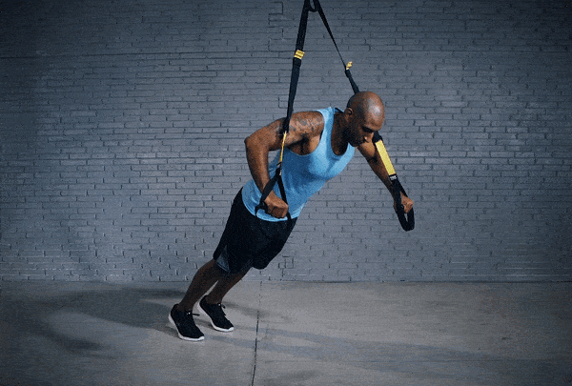
CORRECTIVE MEASURES FOR POSTURAL DEFORMITIES
FOR ROUND SHOULDERS
Keep your tips of fingers on your shoulders and rotate your elbows.
Hold the horizontal bar.
Perform CHAKRASANA and DHANURASANA.
Chest Stretch forward.
Prone Y Stretch.
Close Grip Row.

Slide 6
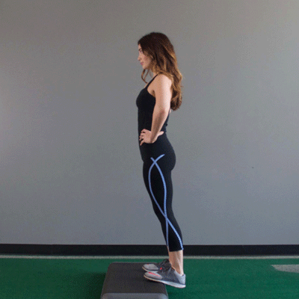
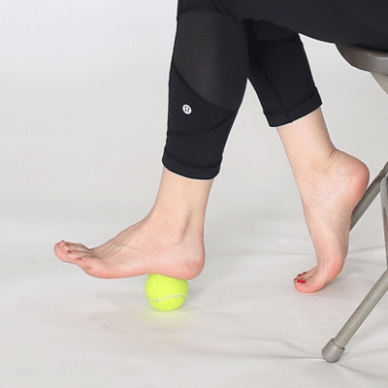
CORRECTIVE MEASURES FOR POSTURAL DEFORMITIES
FOR FLATFOOT
Tennis/golf ball rolls.
Walling on inner and outer side of feet.
Calf raises.
Stand up and down on the heels.
Jumping on toes, skip on rope.
Put a handkerchief in the middle of the shoe and wear it.
Perform VAJRASANA & TADASANA.

Slide 7

Explain the corrective measures for Knock-knees.
Explain the corrective measures for Bow legs.
Explain the corrective measures for Flatfoot.
Explain the corrective measures for Round Shoulder.

Slide 8
THANKING YOU
ODM EDUCATIONAL GROUP

