Slide 1


THE PITFALLS OF DIETING & FOOD INTOLERANCE
SUBJECT : PHYSICAL EDUCATION
CHAPTER NUMBER: 2
CHAPTER NAME : SPORTS & NUTRITION

Slide 2

COMPONENTS OF DIET
NUTRITIVE COMPONENTS OF DIET
PROTEINS
CARBOHYDRATES
NON-NUTRITIVE COMPONENTS OF DIET
FIBER OR ROUGHAGE
FATS
VITAMINS
MINERALS
WATER
COLOUR COMPOUNDS
FLAVOUR COMPOUNDS
PLANT COMPOUNDS

Slide 3
VITAMINS
FAT SOLUBLE
WATER SOLUBLE
VITAMIN A
VITAMIN D
VITAMIN E
VITAMIN K
VITAMIN B COMPLEX
VITAMIN B1
VITAMIN C
VITAMIN B2
VITAMIN B3
VITAMIN B5
VITAMIN B6
VITAMIN B7
VITAMIN B9
VITAMIN B12
VITAMIN B112
TYPES OF VITAMINS

Slide 4

WHAT WE EXPECT TO LEARN?
We will be able to know about ‘THE PITFALLS OF DIETING’.
We will be familiar with the ‘FOOD INTOLERANCE’.
We will be described the Symptoms of food intolerance.
All the concepts will create knowledge among the students of the side effects of the pitfalls of dieting.

Slide 5




THE PITFALLS OF DIETING
AFTER THAT
BEFORE
AFTER
Everybody wants to remain slim and trim.
Those who are overweight use various methods to lose weight. (dieting)
In the beginning, dieting produces good results or success.
Then 90% of the dieters gain all of their weight back.
Eat less and exercise more to burn calories.

Slide 6
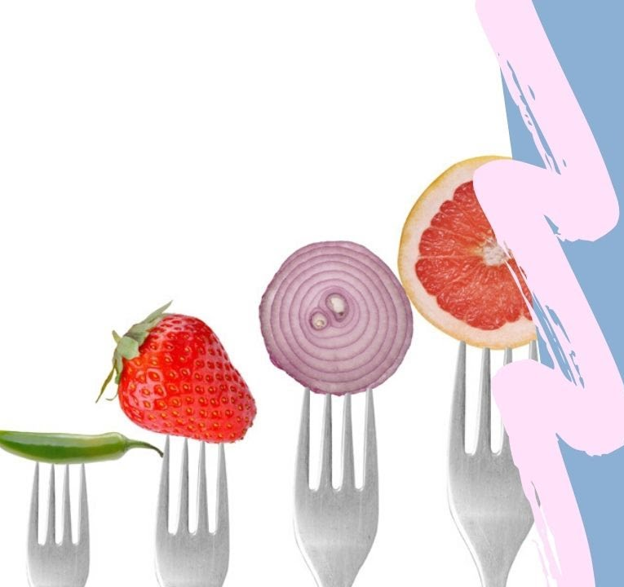
THE PITFALLS OF DIETING
EXTREME REDUCTION OF CALORIES
In dieting, people take just 1500-1800 calories per day.
But this is not sufficient to meet the daily requirements.
This may result in massive weight loss and other related health problems.
It will be definitely lower your metabolism.

Slide 7
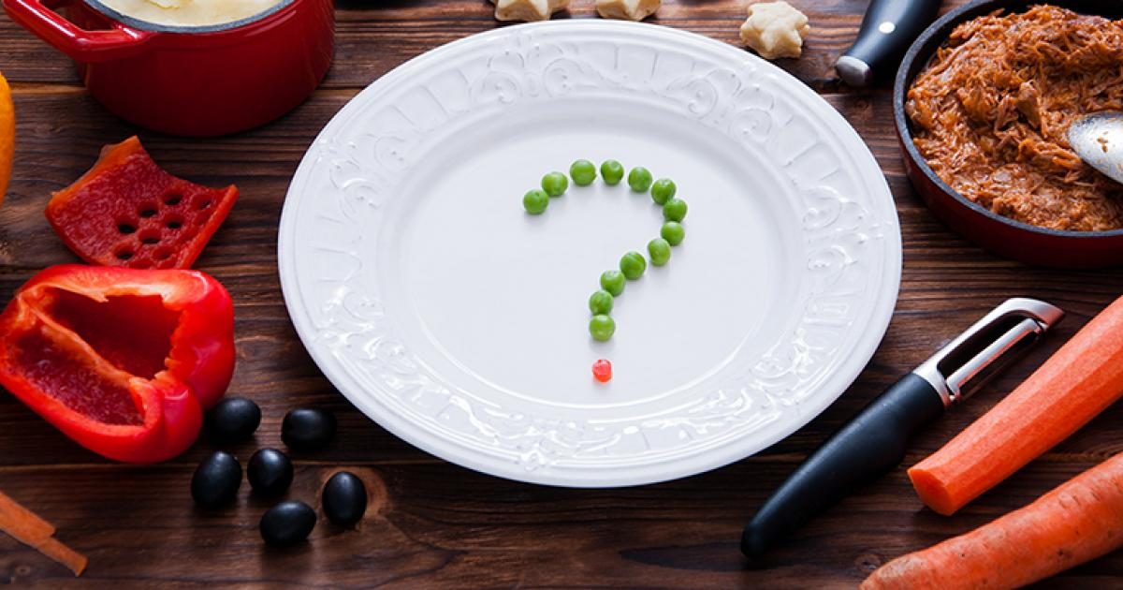
THE PITFALLS OF DIETING
RESTRICTION ON SOME NUTRIENTS
Some nutrients like carbohydrates & fats are restricted in dieting.
Your body needs all types of nutrients.
Otherwise, the proper functioning of the body will be impaired.

Slide 8
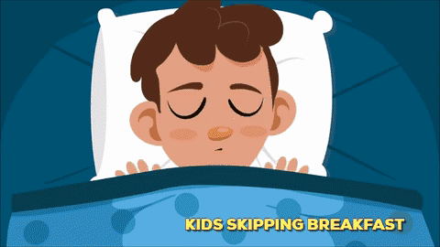
THE PITFALLS OF DIETING
Not taking breakfast, lunch, dinner, or proper meals reduces the metabolic rate.
Then the body starts conserving energy, the next time it gets food.
This also results in more intake of calories in the next meal.
SKIPPING MEALS

Slide 9
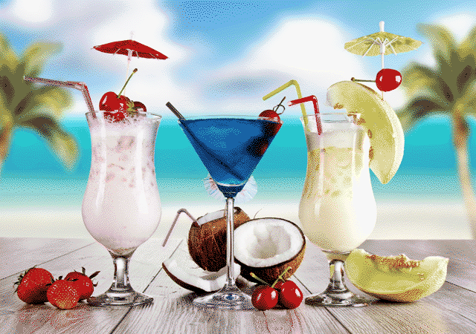
THE PITFALLS OF DIETING
INTAKE OF CALORIES THROUGH BEVERAGES
You lay stress on not eating more and not on what you drink.
Beverages, coffee with cream and sugar, sweetened juices, and sodas really contribute to weight gain.

Slide 10
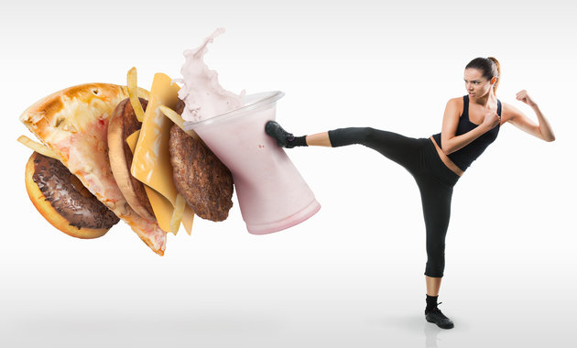
THE PITFALLS OF DIETING
UNDERESTIMATING THE CALORIES
Those who go on dieting usually underestimate the number of calories they consume.
It is essential to be more aware of the number of calories you take into your diet.

Slide 11
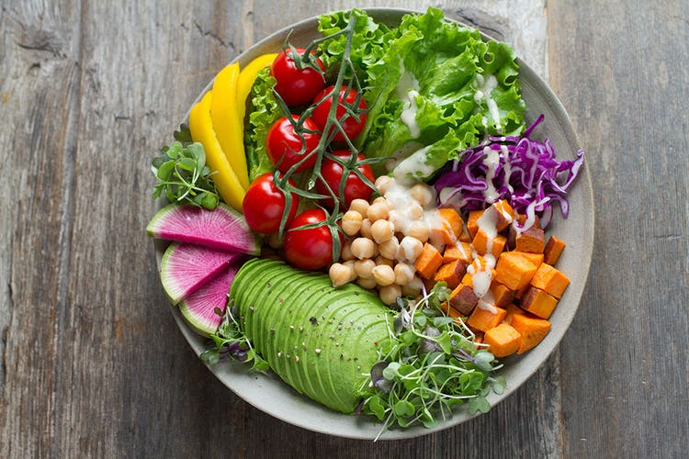
THE PITFALLS OF DIETING
INTAKE OF LABELLED FOODS
By taking foods that are labelled as -
  Too fat
  Fat-free
  Too sugar
  Too calories
  Low calories
  Sugar-free
It does not meet all the nutrient requirements of your body.
For example, drinking more tea with sugar-free results in more intake of tea and hence greater calorie consumption.

Slide 12

THE PITFALLS OF DIETING
No exercises reduce the level of metabolism drastically and there is no burning of calories.
In that case, dieting will not be effective.
NOT EXERCISING

Slide 13
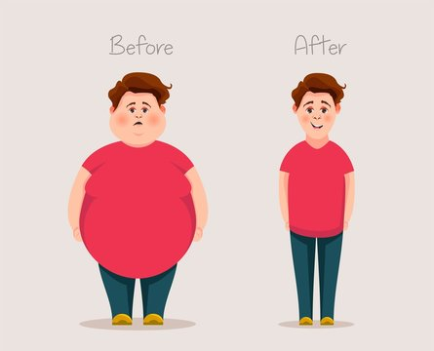
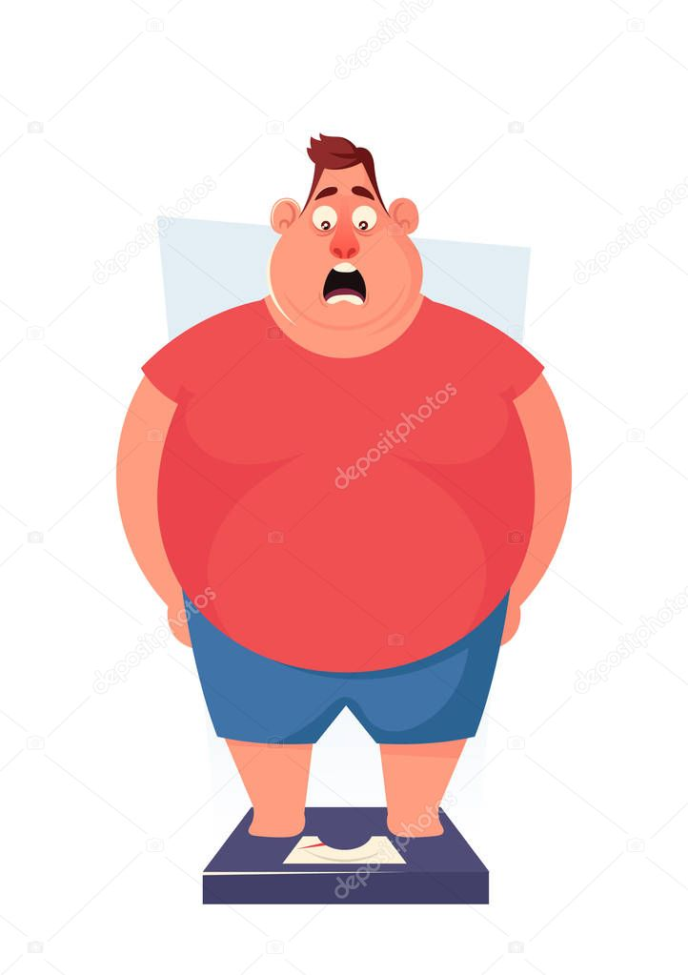
Explain about the Pitfalls of Dieting
SR. NO.
1
2
3
4
5
6
7
Extreme Reduction of Calories
Extreme
Restriction on Some Nutrients
Restriction
Skipping Meals
Skipping
Intake of Calories through Beverages
Intake of
After that
Underestimating
Underestimating the Calories
Intake of Labelled Foods
Intake of
Not Performing
Not Performing Exercising

Slide 14


WHAT IS FOOD ALLERGY ?

Slide 15
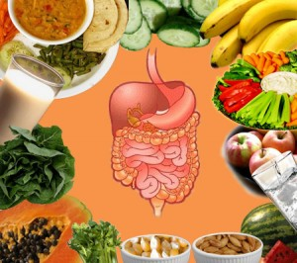
FOOD INTOLERANCE
Food intolerance is a term used widely for various physiological responses associated with a particular food.
Food intolerance is the intolerance of certain elements in some foods that cannot be properly processed by our digestive system.
Although intolerance and allergy may have similar symptoms, a food allergy can be more serious and it usually comes on suddenly.
FEATURES OF FOOD INTOLERANCE ARE AS FOLLOWS
Usually comes on gradually.
May only happen when you eat a lot of a particular food.
May only happen if you eat the food often.

Slide 16
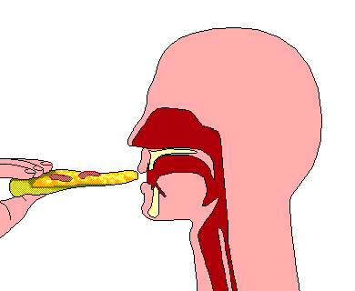
CAUSES OF FOOD INTOLERANCE
Food intolerance is caused by part or complete absence of activity of the enzymes responsible for breaking down or absorbing the food elements.
Food intolerance can be diet-related.
Food intolerance can be due to illness.

Slide 17
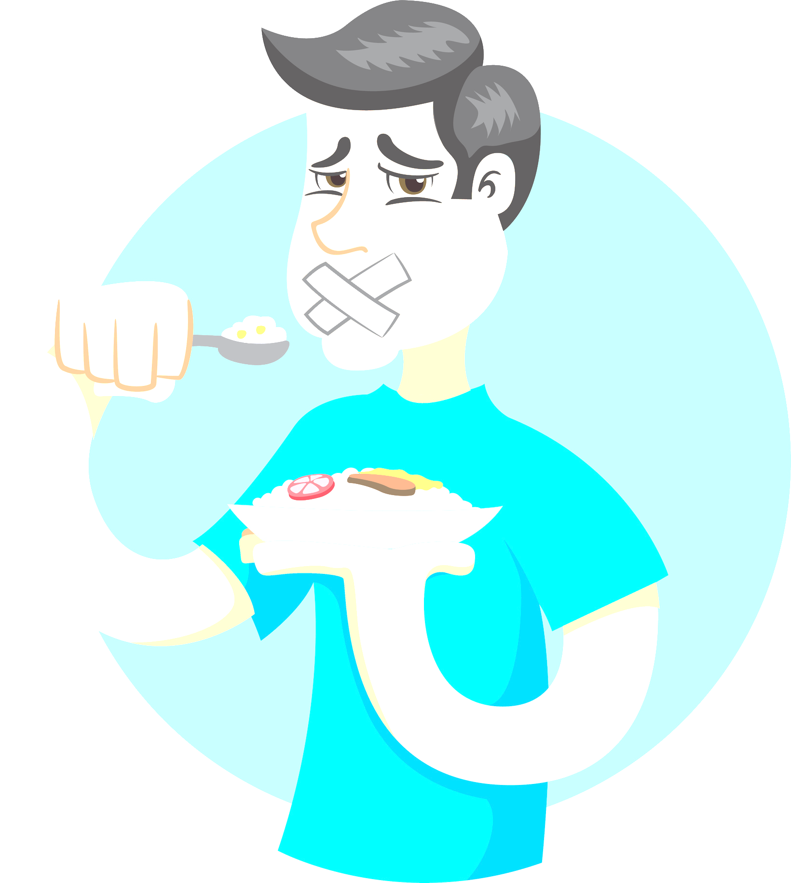
Nausea. (feeling of sickness, vomiting)
Stomach pain.
Gas, cramps, or bloating( Feeling full, tight, swollen in the abdomen).
Vomiting.
Heartburn. (burning sensation in the chest)
Diarrhoea.
Headaches.
Irritability or nervousness.
SYMPTOMS OF FOOD INTOLERANCE

Slide 18
MANAGEMENT OF FOOD INTOLERANCE
1ST
ELIMINATION FOLLOWED BY REINTRODUCTION
2ND
PROLONGED ELIMINATION BUILDS TOLERANCE
4TH
3RD
FRUCTOSE INTOLERANCE THERAPY
LACTOSE INTOLERANCE THERAPY
5TH
HISTAMINE INTOLERANCE THERAPY

Slide 19

1. What is the Symptoms of Food Intolerance?
STOMACH PAIN
DIARRHOEA
VOMITING
ALL OF THESE
2. The Pitfalls of Dieting Methods are apply for
LOSS WEIGHT
GAIN WEIGHT
MAINTAIN WEIGHT
NONE OF THESE
3. What do you mean by ‘Labelled Foods’?
SUGAR FREE FOODS
BRANDED FOODS
COSTLY FOODS
NONE OF THESE

Slide 20

Discuss any four pitfalls of dieting.
Discuss the causes and management of food intolerance.
What do you mean by food intolerance? Explain the causes, symptoms & management of food intolerance in detail.

Slide 21
THANKING YOU
ODM EDUCATIONAL GROUP

