Slide 1


CORRECTIVE MEASURES FOR POSTURAL DERORMITIES
SUBJECT : PHYSICAL EDUCATION
CHAPTER NUMBER: 05
CHAPTER NAME : CHILDREN AND WOMEN IN SPORTS

Slide 2

WHAT WE EXPECT TO LEARN?
WE WILL BE ABLE TO KNOW ABOUT THE ‘CORRECTIVE MEASURES FOR ALL DEFORMITIES.’

Slide 3
PHYSICAL ACTIVITIES AS A CORRECTIVE MEASURE
POSTURAL DEFORMITIES
Functional Deformities
Structural Deformities
Only the soft tissues, i.e., the muscles and the ligaments are affected.
The correction is possible through various corrective measure.
The bone structure is affected.
This type of deformities can be corrected by surgery only.

Slide 4
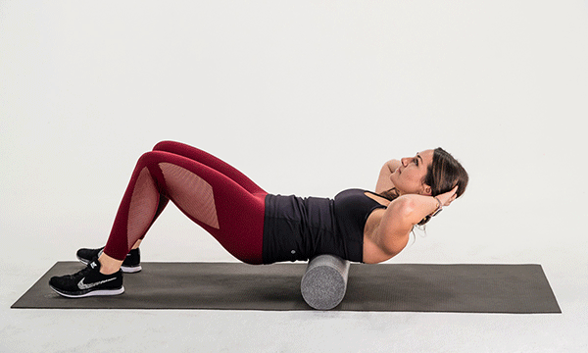
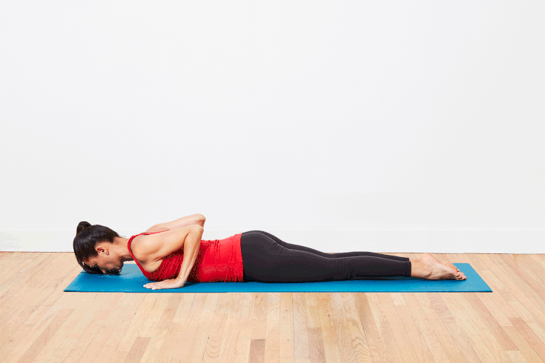
CORRECTIVE MEASURES FOR POSTURAL DEFORMITIES
FOR KYPHOSIS
Lay on the belly and put your hands behind the neck, then a partner will pull your hands backwards.
Lie down in the prone position, and perform DHANURASANA regularly.
CHAKRASANA & BHUJANGASANA is recommended.
Swimming is recommended.
Finger behind back and pull your shoulders upward and backward.
Always keep a pillow under your back while sleeping.

Slide 5
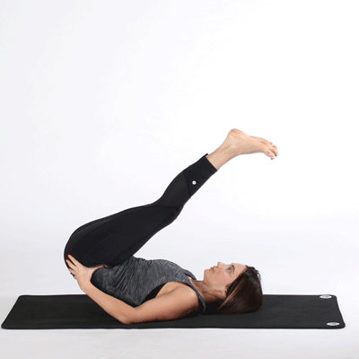
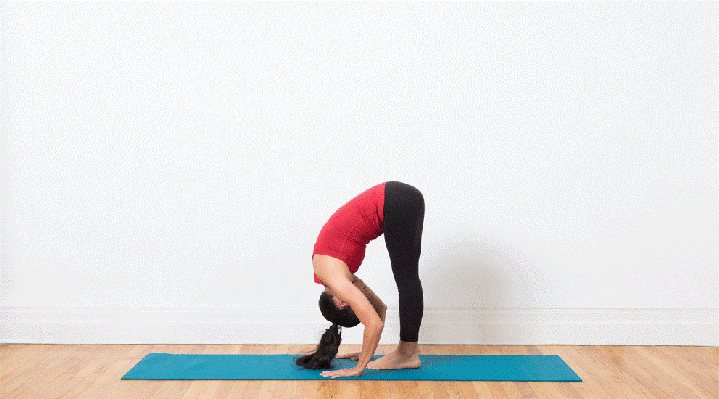
CORRECTIVE MEASURES FOR POSTURAL DEFORMITIES
FOR LORDOSIS
Lie down in prone position, with hands under abdomen. Then keep hips and shoulder down, press your hands up on the abdomen and raise the lower back.
From standing position, bend forward from hip level. Repeat this exercise for 10 times.
You should lie down in supine position,(back) then should raise your legs at 45 degree angle.
Perform sit-ups regularly.
HALASANA should be performed regularly.

Slide 6
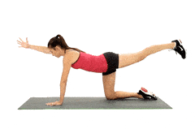
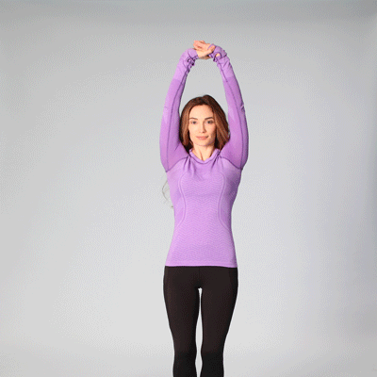
CORRECTIVE MEASURES FOR POSTURAL DEFORMITIES
FOR SCOLIOSIS
Arm and leg raises.
Latissimus dorsi stretch.
Practice alternate toe-touch.
For the curve of ‘C’ bend in the opposite direction of the curve.
Swimming with breast-stroke techniques is the best.
Do plank.

Slide 7

Explain the corrective measures for kyphosis.
Explain the corrective measures for Lordosis.
Explain the corrective measures for Scoliosis.

Slide 8
THANKING YOU
ODM EDUCATIONAL GROUP

