Slide 1


FIRST AID: AIM AND OBJECTIVE
SUBJECT : (PHYSICAL EDUCATION)
CHAPTER NUMBER: 7
CHAPTER NAME : PHYSIOLOGY AND INJURIES IN SPORTS

Slide 2

MATCH LIST I WITH LIST-II AND SELECT THE CORRECT ANSWER.
List I |  | List II
1 | Abrasion | A | Joint injuries
2 | Greenstick | B | Soft tissue injuries
3 | Shoulder dislocation | C | Cause if sports injuries
4 | Lack of fitness | D | Bone injuries
B | Soft tissue injuries
D | Bone injuries
A | Joint injuries
C | Cause if sports injuries
List I |  | List II
1 | The bone is broken into small pieces | A | Comminuted fracture
2 | Small cracks but difficult to see | B | Stress fracture
3 | The bone breaks diagonally | C | Impacted fracture
4 | When the broken ends of the bone are jammed | D | Oblique fracture
A | Comminuted fracture
B | Stress fracture
D | Oblique fracture
C | Impacted fracture

Slide 3

WHAT WE EXPECT TO LEARN?
We will be able to know about the ‘FIRST AID’
We will be familiar with the various types of Treatments.
We will be described the AIM OF FIRST AID.
We will be described the OBJECTIVES OF FIRST AID.
All the concepts will create interest among the students to procure early first aid to the victim.

Slide 4

THREE ‘P’ s OF FIRST AID
1st P
Preserve Life
2nd P
Prevent Deterioration
3rd P
Promote Recovery

Slide 5
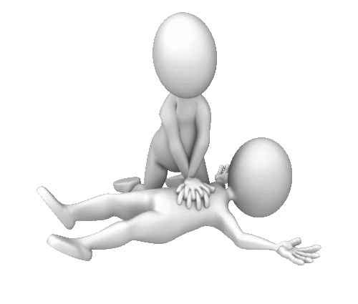
MEANING OF FIRST AID
First aid is a way of preparing an individual to respond to emergencies quickly.
First aid is the first help that is given to the wounded or accidental victim before the arrival of the doctor.
First aid refers to the emergency or immediate care you should provide when a person is injured or ill until full medical treatment is available.
When you provide basic medical care to someone experiencing a sudden injury or illness, it's known as first aid.

Slide 6




Slide 7
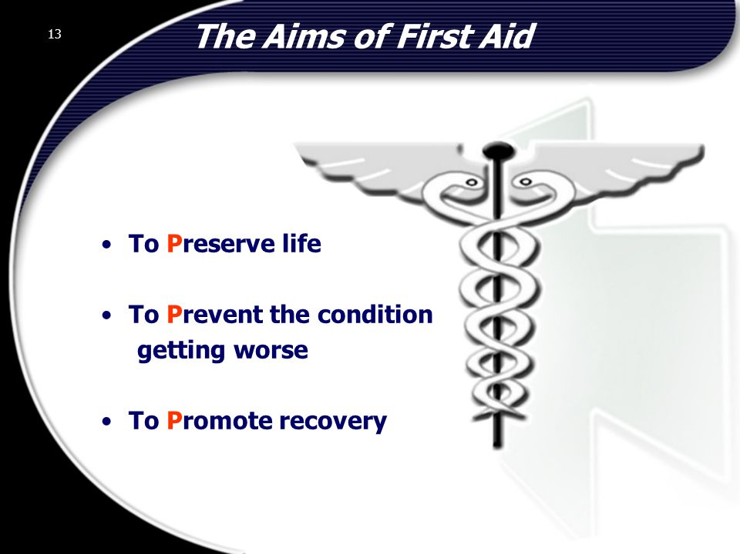
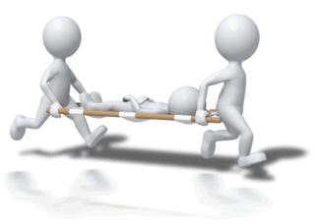
The main aim of first aid is to save the precious life of the wounded person or victim.

Slide 8
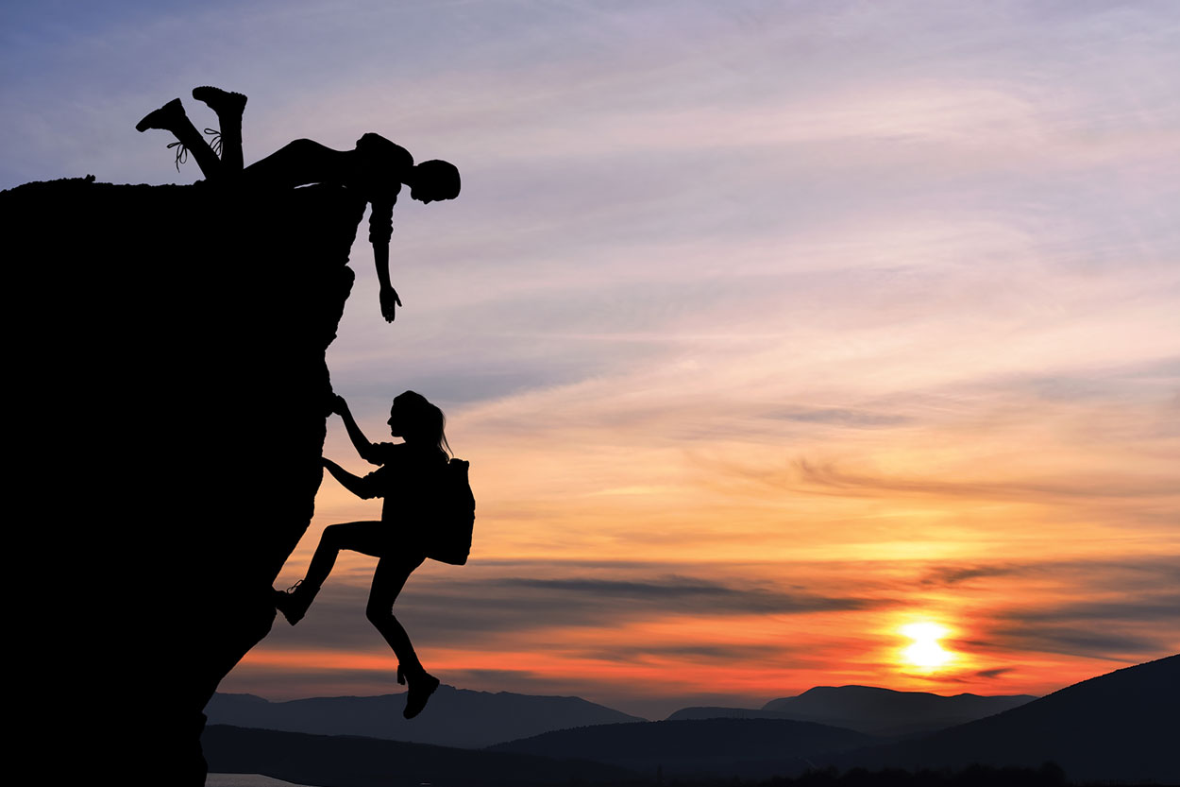
THE OBJECTIVES OF FIRST AID - TO PRESERVE LIFE
To save the life of the victim/wounded person.
There are limitations of first aid.
Every possible effort is done to save a life.

Slide 9
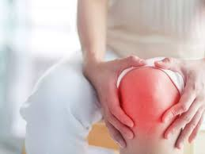
THE OBJECTIVES OF FIRST AID - TO ALLEVIATE PAIN & SUFFERING
Pain is natural in any type of accident.
The Pain becomes unbearable in case of fracture or dislocation of joints.
We should reduce such unbearable pain.

Slide 10
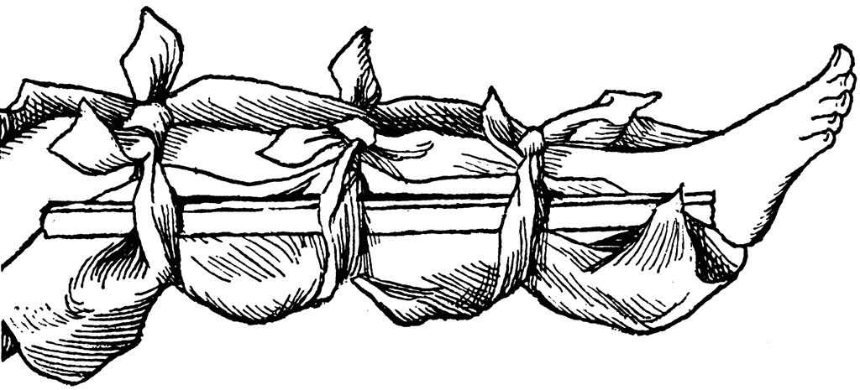
THE OBJECTIVES OF FIRST AID - TO PREVENT THE CONDITION FROM WORSENING
The victim’s condition should not be worsened.
When first aid is provided, the victim’s condition does not worsen while taken to the doctor.

Slide 11

THE OBJECTIVES OF FIRST AID - TO PROMOTE RECOVERY
The main objective of first aid is to start the process of recovery as early as possible.
The treatment of injury is also included in this objective.

Slide 12
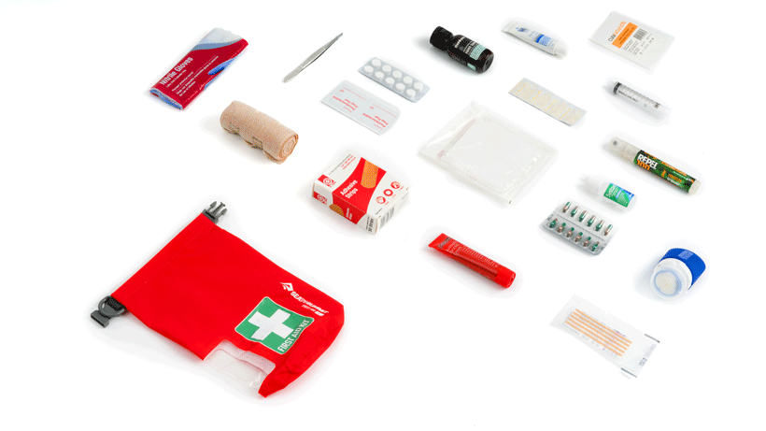
THE OBJECTIVES OF FIRST AID - TO PROCURE EARLY MEDICAL AID
May be certain situations where there is a dire need for medical assistance.
The first aider should pay attention to provide first aid.
Must efforts should be made to seek medical aid as early as possible.

Slide 13
Explain the Objectives of First Aid
SR. NO.
1
2
3
4
5
To Preserve Life
To Preserve
To Alleviate
To Alleviate pain & Suffering
To Prevent the Condition From Worsening
To Prevent the
To Promote Recovery
To Promote
To Procure
To Procure Early Medical Aid

Slide 14

1. The main aim of First Aid is …………
PROMOTE RECOVERY
PRESERVE LIFE
PREVEN DETERIORATION
ALL OF THESE
2. What is the third ‘P’ in First Aid?
PROMOTE RECOVERY
PRESERVE LIFE
PREVEN DETERIORATION
NONE OF THESE
3. What do you mean by First Aid?
4. Enlist all the objectives of First Aid.

Slide 15

Make a First Aid Kit with all necessaries for emergency purposes.
Learn and write the meaning and aims of First Aid.
Learn and write the objectives of First Aids.

Slide 16
THANKING YOU
ODM EDUCATIONAL GROUP

