Slide 1

What type of questions are asked in 12th board exam (Term 1)?
ALL MCQ
MULTIPLE-CHOICE QUESTIONS
MATCH THE FOLLOWING
ASSERTION-REASON TYPE QUESTIONS
DATA-BASED QUESTIONS
PICTURE-BASED QUESTIONS
CASE-BASED QUESTIONS

Slide 2
MULTIPLE-CHOICE QUESTIONS
Which of the following points must be taken into consideration while planning a balanced diet?
{A} Age, gender and body weight
{B} Activity level and eating habits
{C} Income level and social customs
{D} All of these
ANSWER - {D} All of these

Slide 3
MULTIPLE-CHOICE QUESTIONS
Which of the following are not macronutrients?
{A} Carbohydrates
{B} Minerals
{C} Water
{D} Proteins
ANSWER - {B} Minerals

Slide 4
MULTIPLE-CHOICE QUESTIONS
Which of the following is not a step to maintaining a healthy body weight?
{A} Goal setting
{B} Yoga
{C} Intake of calories through drinking
{D} Avoiding carbohydrate rich food
ANSWER - {C} Intake of calories through drinking

Slide 5
MULTIPLE-CHOICE QUESTIONS
Cut calories a day if you have exceeded your ideal weight.
{A} 200
{B} 100
{C} 250
{D} 150
ANSWER - {B} 100

Slide 6
MULTIPLE-CHOICE QUESTIONS
Which of the following can be listed under food myths?
{A} Potatoes make you fat
{B} Spicy food causes ulcer
{C} Fat-free products help you lose weight
{D} All of these
ANSWER - {D} All of these

Slide 7

MATCH THE FOLLOWING
Match List I with List-II and select the correct answer from the code given below:
List I |  | List II
1 | Chromium | A | Helps in blood clotting
2 | Calcium | B | Yellow in colour
3 | Vitamin B2 | C | Deficiency - Pellagra
4 | Vitamin B3 | D | Deficiency - Diabetes
D | Deficiency - Diabetes
A | Helps in blood clotting
B | Yellow in colour
C | Deficiency - Pellagra
CODE
 | 1 | 2 | 3 | 4
[A] | D | A | C | B
[B] | D | A | B | C
[C] | B | D | A | C
[D] | D | C | B | A

Slide 8
ASSERTION-REASON TYPE QUESTIONS
Given below are the two statements labeled Assertion (A) and Reason (R).
Assertion (A) : Even what is considered nutritious, such as carbohydrates, should be consumed in appropriate amounts.
Reason (R) : A balanced diet therefore has a standard or fixed structure.
Which one of the following is correct?
(a) Both (A) and (R) are true and (R) is the correct explanation of (A)
(b) Both (A) and (R) are true and (R) is not the correct explanation of (A)
(c) (A) is true, but (R) is false
(d) (A) is false, but (R) is true
Ans : (c) (A) is true, but (R) is false

Slide 9
DATA-BASED QUESTIONS
Given below is the data which depicts the percentage of school students suffering from the deficiency of various vitamins.
On the basis of the above data; answer the following questions:-
1. Which of the deficiency can be reduced by adding a morning outdoor-play-period in the timetable?
(a) Vitamin A (b) Vitamin D (c) Vitamin K (d) Vitamin E
2. If a student has deficiency of Vitamin A, what is he likely to suffer from?
(a) Anaemia (b) Paralysis (c) Scurvy (d) Night blindness
3. What is common about the vitamins given above in the pie-chart?
They are all water soluble. (b) They are all fat soluble.
(c) They are all fat insoluble. (d) They all affect the immune system.
Answer – 1 (b), 2 (d), 3 (b)

Slide 10
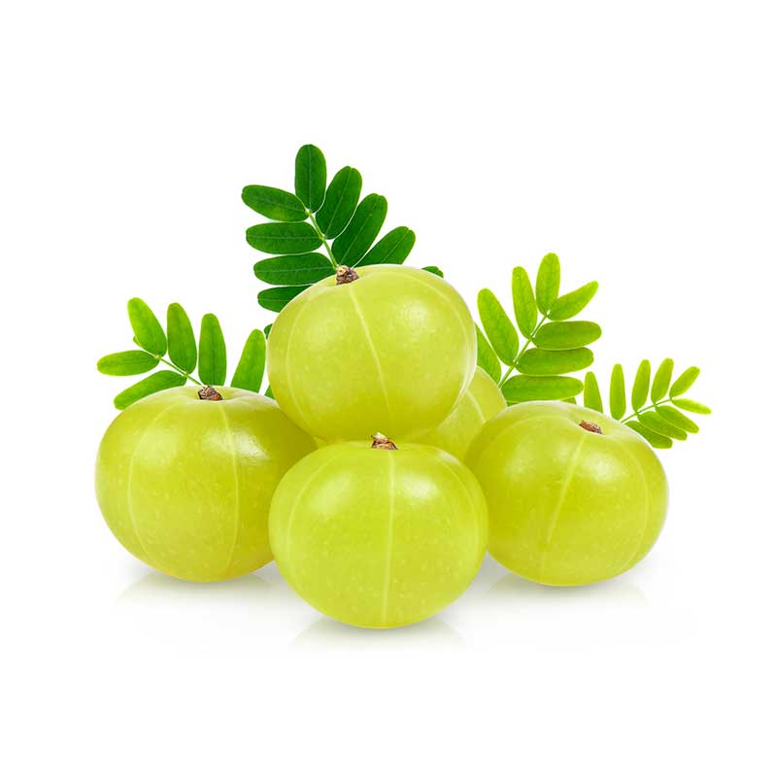
PICTURE-BASED QUESTIONS
Identify the food item, answer the following questions.
Which vitamin we can found very high in this food?
If you don’t take this food may be the deficiency of ___
This food items helps us _____
ANSWER –
Vitamin C
Scurvy
Wounds are healed, increasing the metabolic rate.

Slide 11
CASE-BASED QUESTIONS
The Body Mass Index or the BMI of a male was found to be 30.1.
On the basis of the case given, answer the following questions:
1. In which category does the person fall?
(a) Normal weight (b) Overweight (c) Obesity class 1 (d) Obesity class 2
2. What does the person need to do in order to achieve the ideal weight?
Have a normal and wise attitude towards food selection and portion.
Have only cooked carrots
Only opt for fat-free products and avoid potato.
Reduce the calorie intake to nil.
3. The ideal BMI for a person should lie between …….
(a) 25 – 29.9 (b) 18.3 – 24.9 (c) < 20 (d) < 40
Answer – 1 (c), 2 (a), 3 (b)

Slide 12

MEANING OF HEALTHY WEIGHT
SUBJECT : PHYSICAL EDUCATION
CHAPTER NUMBER: 2
CHAPTER NAME : SPORTS & NUTRITION

Slide 13

WHAT WE EXPECT TO LEARN?
We will be able to know about the ‘MEANING OF HEALTHY WEIGHT’.
We will be familiar with the ‘METHODS OF CONTROL HEALTHY BODY WEIGHT’.
We will be familiar with the ‘BMI’.
All the concepts will create interest among the students to Perform exercise every day for maintains healthy body weight.

Slide 14

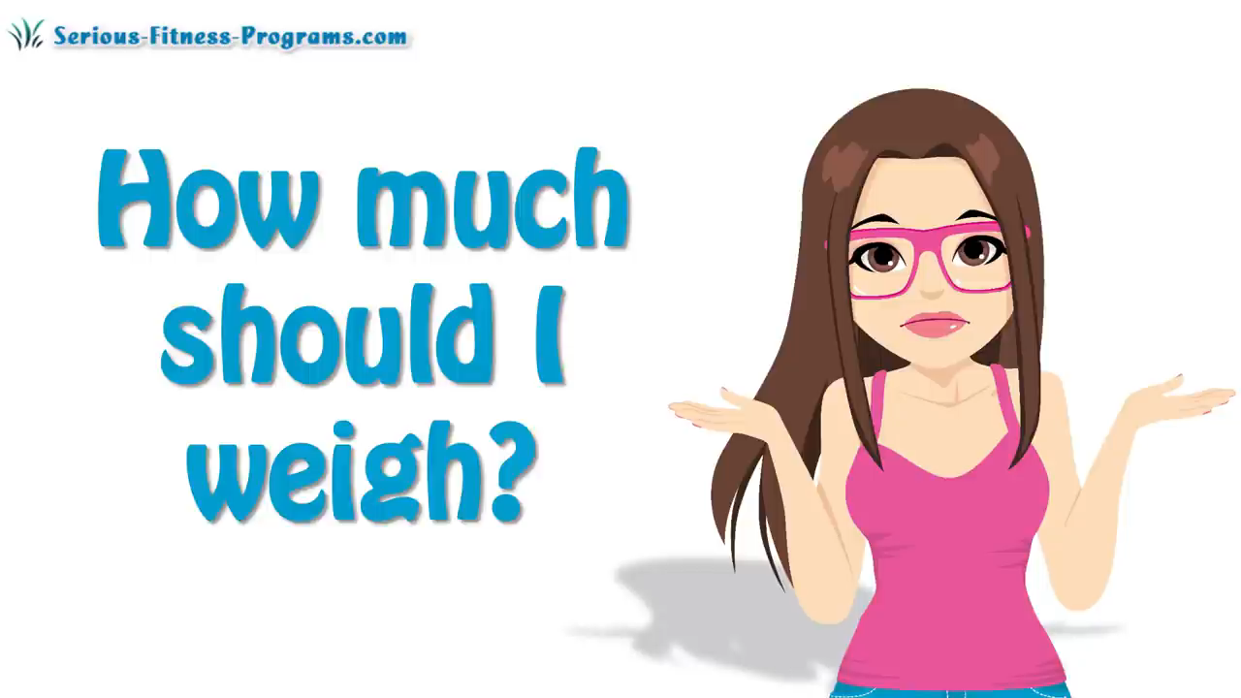
WHAT IS IDEAL BODY WEIGHT ?

Slide 15
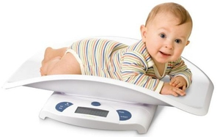
EATING FOR WEIGHT CONTROL – A HEALTHY WEIGHT
According to the National Institute of Health (NIH), “A HEALTHY WEIGHT is considered to be the one that is between 19 and 25 (BMI). If the BMI is between 25 to 29 an adult is considered OVERWEIGHT. If the BMI is 30 or greater, the person is considered to be OBESE.”

Slide 16

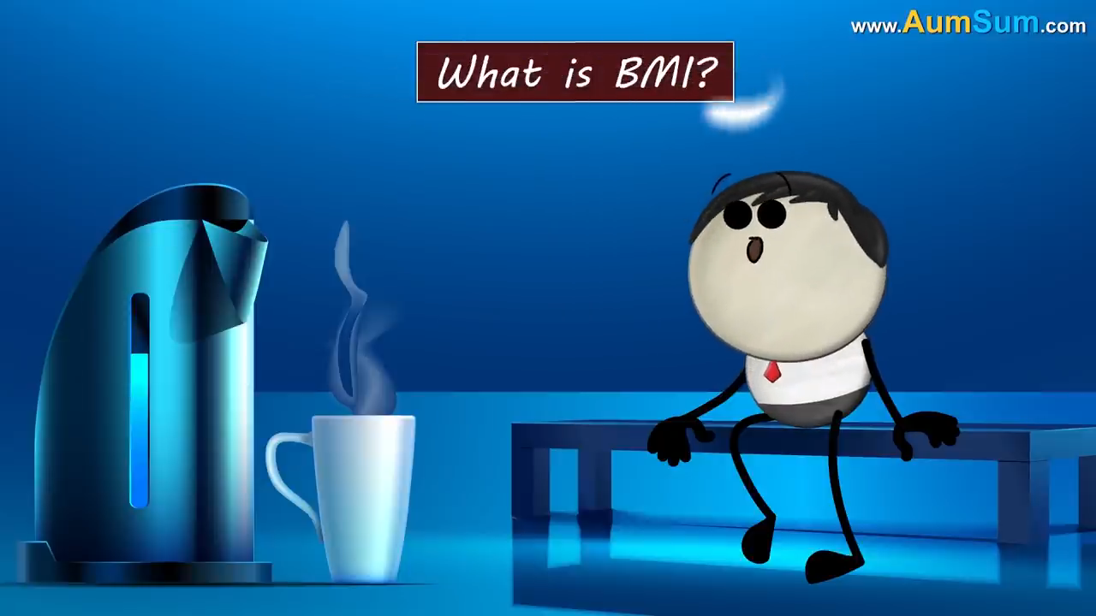

WHAT IS BMI & BP ?

Slide 17
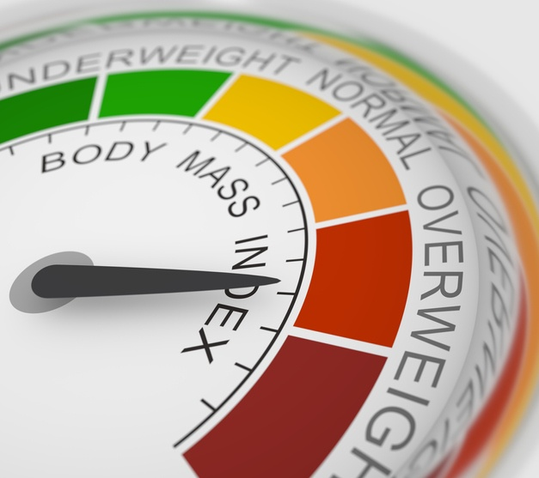
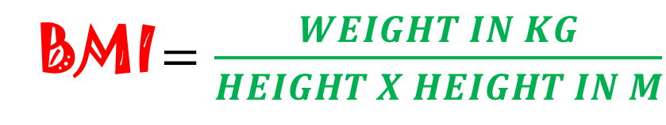
METHOD TO CALCULATE BMI
BMI $=\frac{WEIGHT IN KG}{HEIGHT X HEIGHT IN M}$

Slide 18






BMI & CATEGORY
<18.5
18.5 – 24.9
25 – 29.9
30 – 34.9
35 – 39.9
>40
UNDER WEIGHT
NORMAL WEIGHT
OBESITY CLASS I
OBESITY CLASS II
OBESITY CLASS III
OVERWEIGHT

Slide 19
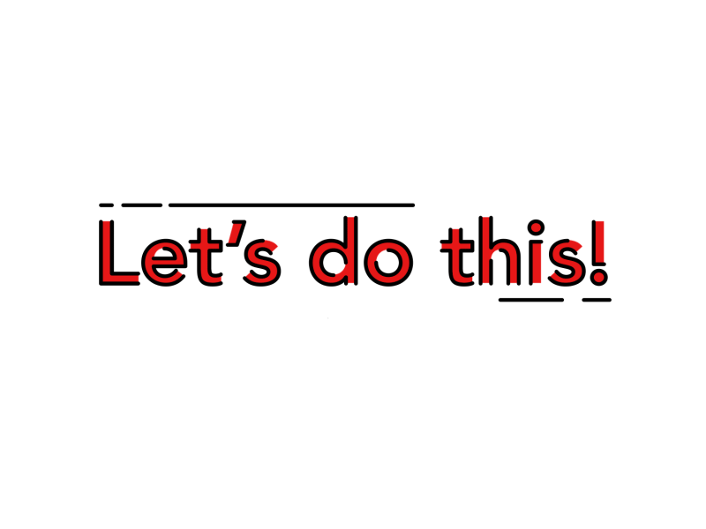





Find out the BMI with Category of Suraj, if his weight is 87 kg and his height is 1.75 m.
BMI =
$$\frac{Weight in Kg}{Height X Height in M}$$
$$\frac{87}{1.75 X 1.75}$$
$$\frac{87}{3.0625}$$
28.408 (Overweight)
Find out the Weight with Category of Kumar, if his BMI is 27.34 kg/m2 and his height is 1.60 m.
BMI =
$$\frac{Weight in Kg}{Height X Height in M}$$
$$\frac{?}{2.56}=27.34$$
69.9904 kg (Overweight)

Slide 20
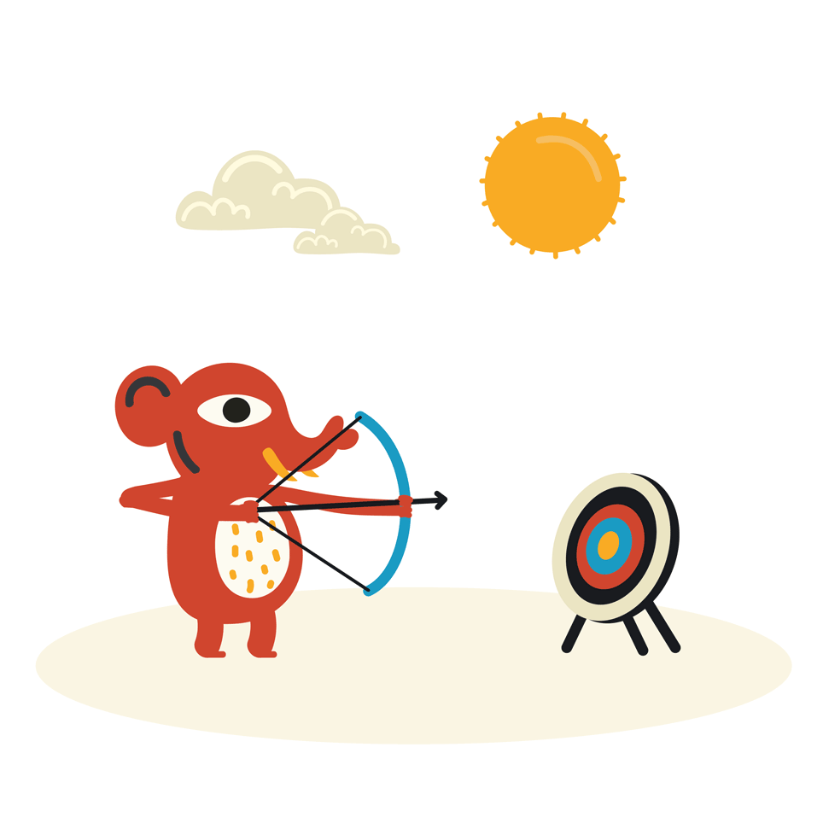
METHODS TO CONTROL HEALTHY BODY WEIGHT
SET AN APPROPRIATE GOAL
We should set an appropriate goal, for losing bodyweight.
We should know about our capacities & limitations.
Make a short-term goal then move to a long-term goal.

Slide 21
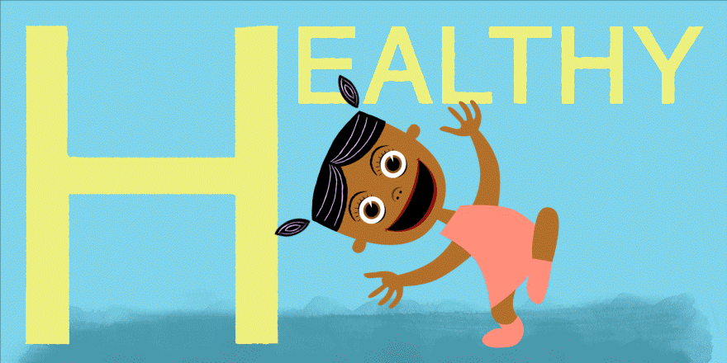
METHODS TO CONTROL HEALTHY BODY WEIGHT
LAY STRESS ON HEALTH NOT ON WEIGHT
We should make efforts to achieve or maintain a BMI between the range of 18.5 to 24.9.
If your BMI and WHR measures beyond these limits, you may be at risk of various diseases.

Slide 22
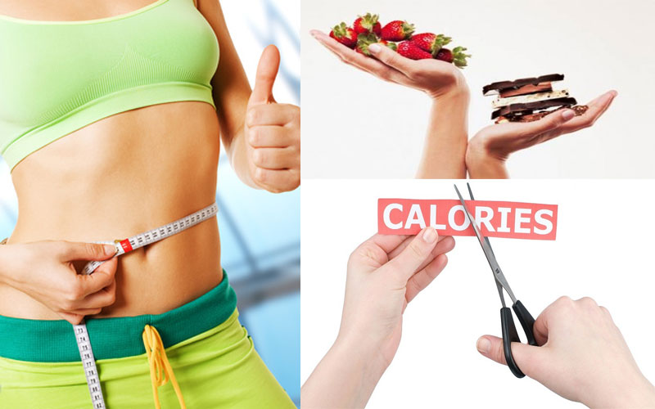
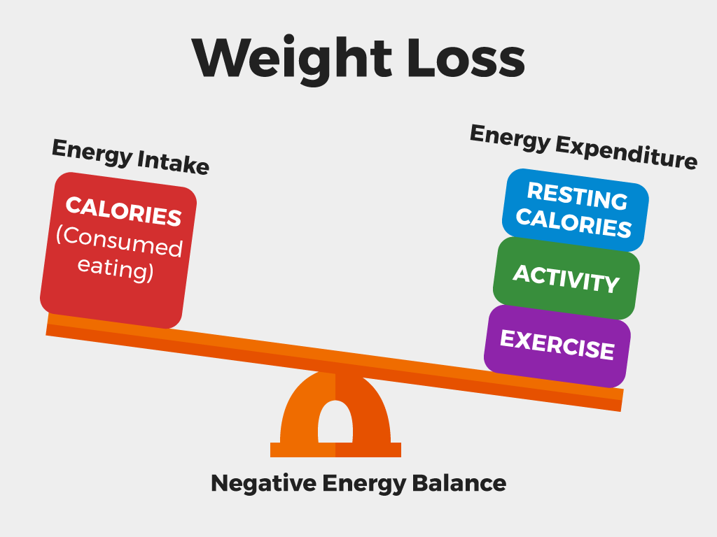
METHODS TO CONTROL HEALTHY BODY WEIGHT
CUT YOUR CALORIES
Keep a plan ready to get back on track if your body weight begins to exceed the required level.
Just subtract only 100 calories a day.

Slide 23
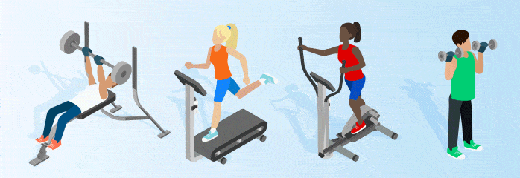
METHODS TO CONTROL HEALTHY BODY WEIGHT
ACTIVE LIFESTYLE
School children should prefer to walk to school instead of going by car or motorbike.
Instead of watching TV for more hours, they should play outdoor games.

Slide 24

METHODS TO CONTROL HEALTHY BODY WEIGHT
BRING OUT SUPPORT
Tell people who are close to you about your intention that you are serious and committed to losing weight.
Tell them that you would appreciate their support.
Promising to meet your partner for the regularly scheduled gym time.

Slide 25
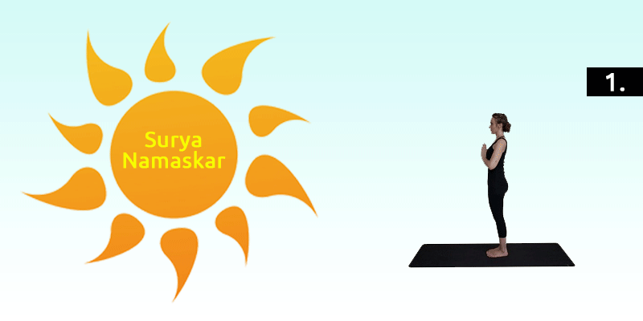
METHODS TO CONTROL HEALTHY BODY WEIGHT
YOGIC EXERCISES
It can help in controlling as well as maintaining a proper weight.
Research studies have proved that stress and tension tend to increase weight.
Meditative asanas are beneficial in relieving stress & tension.

Slide 26
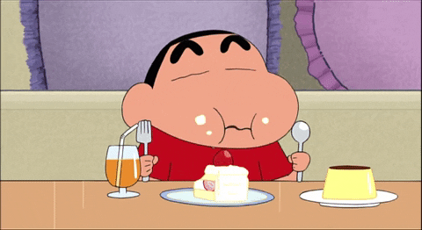
METHODS TO CONTROL HEALTHY BODY WEIGHT
AVOID FATTY FOODS
If you want to lose or maintain weight, you should avoid fatty foods.
Fats are known to have a maximum number of calories.
These extra calories will be accumulated in your body.

Slide 27
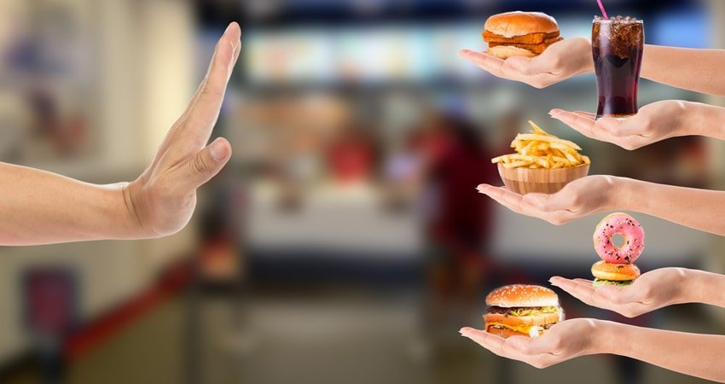
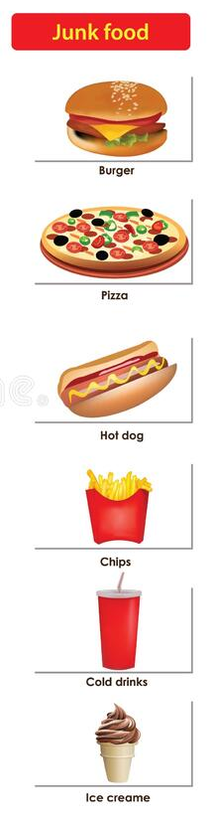
METHODS TO CONTROL HEALTHY BODY WEIGHT
AVOID JUNK & FAST FOODS
These foodstuffs are also rich in empty calories.
Intake of such foodstuffs leads to the condition of overweight.

Slide 28
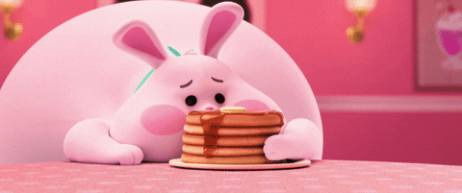
METHODS TO CONTROL HEALTHY BODY WEIGHT
AVOID OVEREATING
You should eat food as per the requirement of your body.
Suppose, you require 2,000 calories per day, then you should take the food that consists of only 2,000 calories.

Slide 29
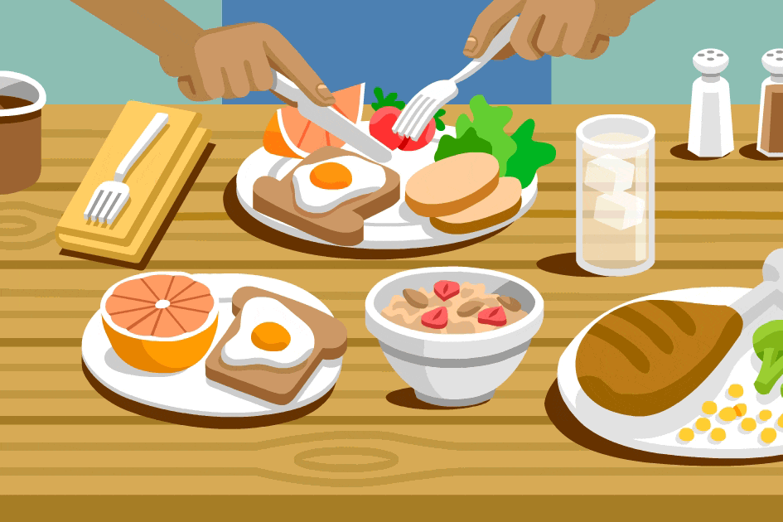
METHODS TO CONTROL HEALTHY BODY WEIGHT
DON’T EAT SMALLER MEALS FREQUENTLY
You should not form a habit of eating smaller meals frequently.
So, avoid eating smaller meals frequently to avoid adding excess fat to the body.

Slide 30
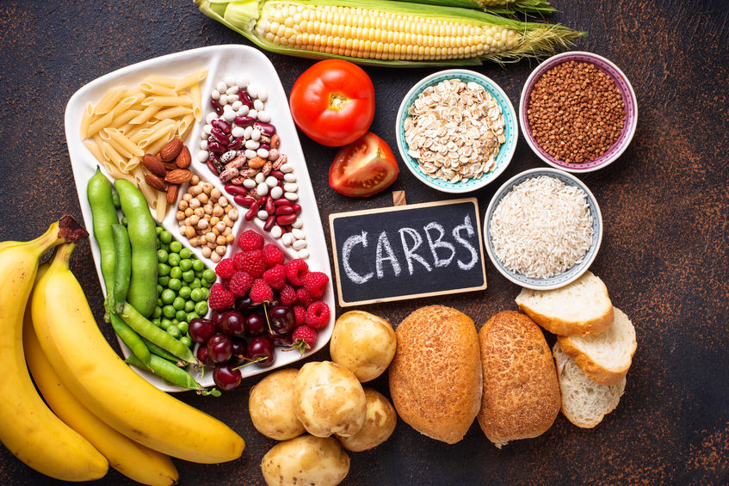
METHODS TO CONTROL HEALTHY BODY WEIGHT
AVOID RICH CARBOHYDRATE FOOD
It does not mean that you should not take carbohydrates at all.
Carbohydrate is necessary to increase the level of energy.
Just reduce the number of carbohydrates in your diet.
Try to avoid sugar, rice, potatoes, chocolates, etc.

Slide 31
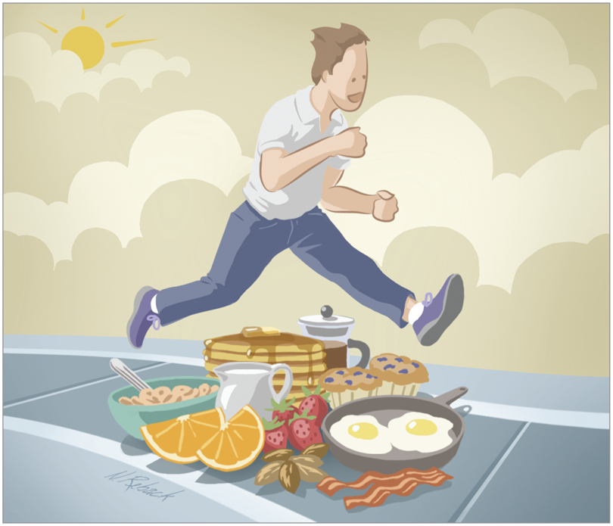
METHODS TO CONTROL HEALTHY BODY WEIGHT
DON’T SKIP MEALS
If you skip your meal, the next time you will definitely indulge in overeating which may lead to obesity.
Skipping meals increases hunger.

Slide 32
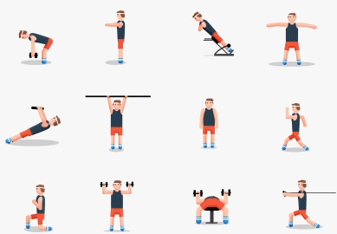
METHODS TO CONTROL HEALTHY BODY WEIGHT
REGULAR EXERCISE OR PHYSICAL ACTIVITY
Exercise helps to control your weight by using up excess calories.
Calories are used while breathing, sleeping, and digesting food.
You should never forget the significant role of exercise/physical activity.

Slide 33
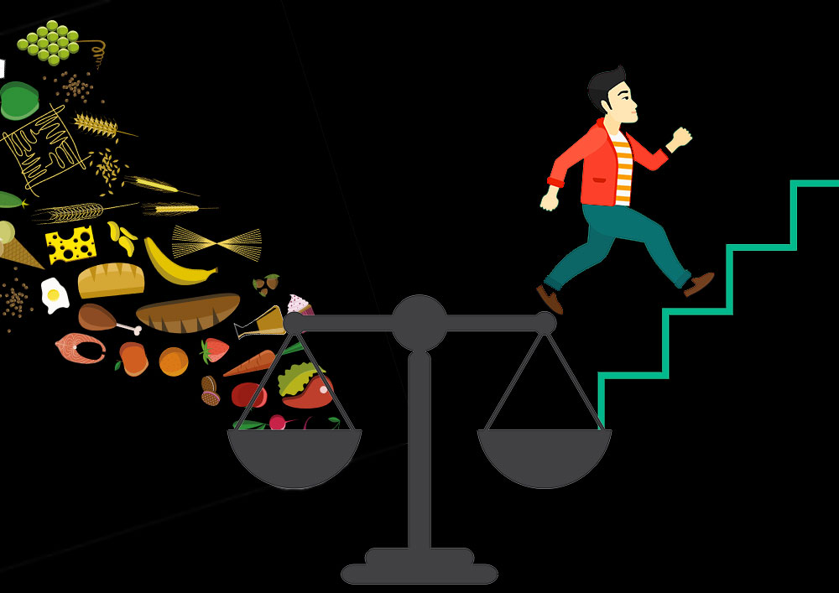
METHODS TO CONTROL HEALTHY BODY WEIGHT
BALANCING THE INTAKE & EXPENDITURE OF CALORIES
You should always try to strike a balance between your intake & expenditure of calories.
WEIGHT GAIN = intake more calories than you require.
WEIGHT LOSS = intake fewer calories than you require.
WEIGHT CONSISTENCY =intake & expenditure of calories remain the same.

Slide 34
Explain the Methods to Control Healthy Body weight
SR. NO.
1
2
3
4
5
6
7
8
9
10
11
12
13
14
Cut
Cut your Calories
Active Lifestyle
Active
Bring Out Support
Bring
Set
Set an Appropriate Goal
Balancing the Intake of Calories and Expenditure of Calories
Balancing
Ignore
Ignore Rich Carbohydrate Food
Regular Exercise or Physical Activity
Regular
Don’t
Don’t Skip Meals
Lay Stress
Lay Stress on Health Not on Weight
Yogic Exercises
Yogic
Avoid Smaller Meals Frequently
Avoid
Avoid Fatty Foods
Avoid
Avoid Overeating
Avoid
Avoid Junk and Fast Foods
Avoid

Slide 35





What is the full form of NIH?
NATIONAL INFORMATION OF HEALTH
NATIONAL INSTITUTE OF HEART
NATIONAL INSTITUTE OF HEALTH
NONE OF THESE
According to WHO criteria, the Obesity II BMI should be _
25 – 29.9
30 – 34.9
35 – 39.9
30 – 39.9
The formula to calculate the BMI of an individual is
$$\frac{Weight in kg}{Height in m}$$
$$\frac{Height in m}{Weight in kg}$$
$$\frac{Weight in kg}{Height in Cm}$$
$$\frac{Weight in kg}{Height X Height in m}$$

Slide 36

What is BMI?
What do you mean by healthy weight?
Discuss the methods to control healthy body weight for a lifetime.
Explain the categories of BMI with the help of WHO criteria.

Slide 37
THANKING YOU
ODM EDUCATIONAL GROUP

