Slide 1


BOW LEGS & ROUND SHOULDERS
SUBJECT : PHYSICAL EDUCATION
CHAPTER NUMBER: 05
CHAPTER NAME : CHILDREN AND WOMEN IN SPORTS

Slide 2


WHAT WE EXPECT TO LEARN?
01
What is Bow Legs?
02
What is Round Shoulder?
03
Causes of Bow Legs.
04
Causes of Round Shoulder.

Slide 3
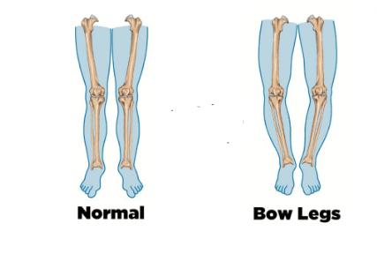
WHAT IS BOW LEGS?
Bow legs or genu varum is the legs curve outward at the knees while the feet and ankles touch.
There remains a wide gap between knees when a bow legged person keeps his feet together.
This deformity can be observed easily, when an individual walks or runs.
It is opposite to knock-knees.

Slide 4
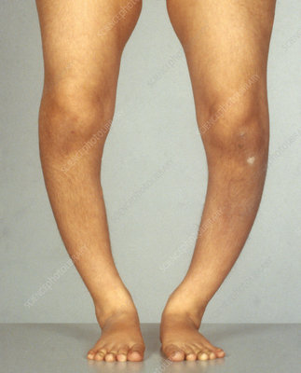
CAUSES OF BOW LEGS
The deficiency of calcium, phosphorus and vitamin D in bones.
Long bones of legs become soft, hence they bent outwards.
When children become overweight.
Babies should not be forced to walk at early age.

Slide 5
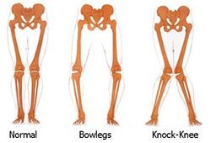
PRECAUTIONS FOR BOW LEGS
Don’t force babies to walk at an early age.
Don’t let the children become overweight.
Balanced diet should be given to children.
They should not be any deficiency of calcium, phosphorus, and vitamin ‘D’ in the diet.

Slide 6
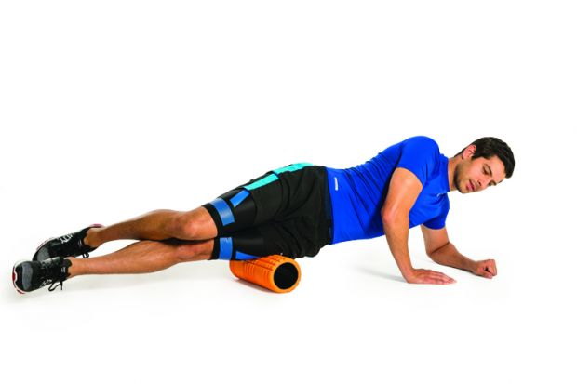
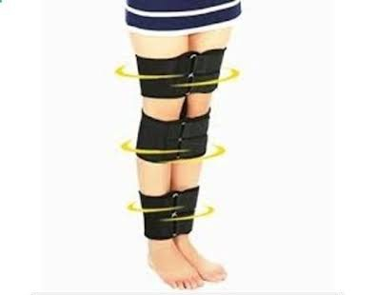
REMEDIES FOR BOW LEGS
Balanced diet should be given to children.
Walk by bending the toes inward.
Bow legs can be corrected by walking on the inner edge of the feet.

Slide 7
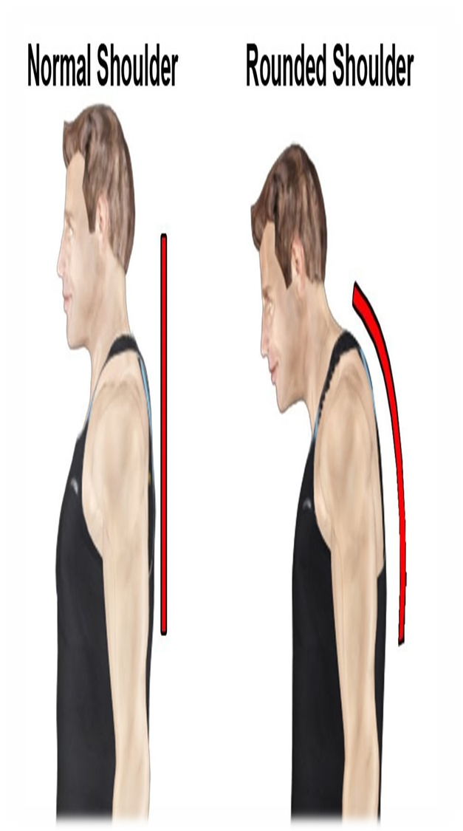
WHAT IS ROUND SHOULDER?
Round-shouldered definition, having the shoulders bent forward, giving a rounded form to the upper part of the back.
Rounded shoulders is used to describe a resting shoulder position that has moved forward from the body's ideal alignment.

Slide 8
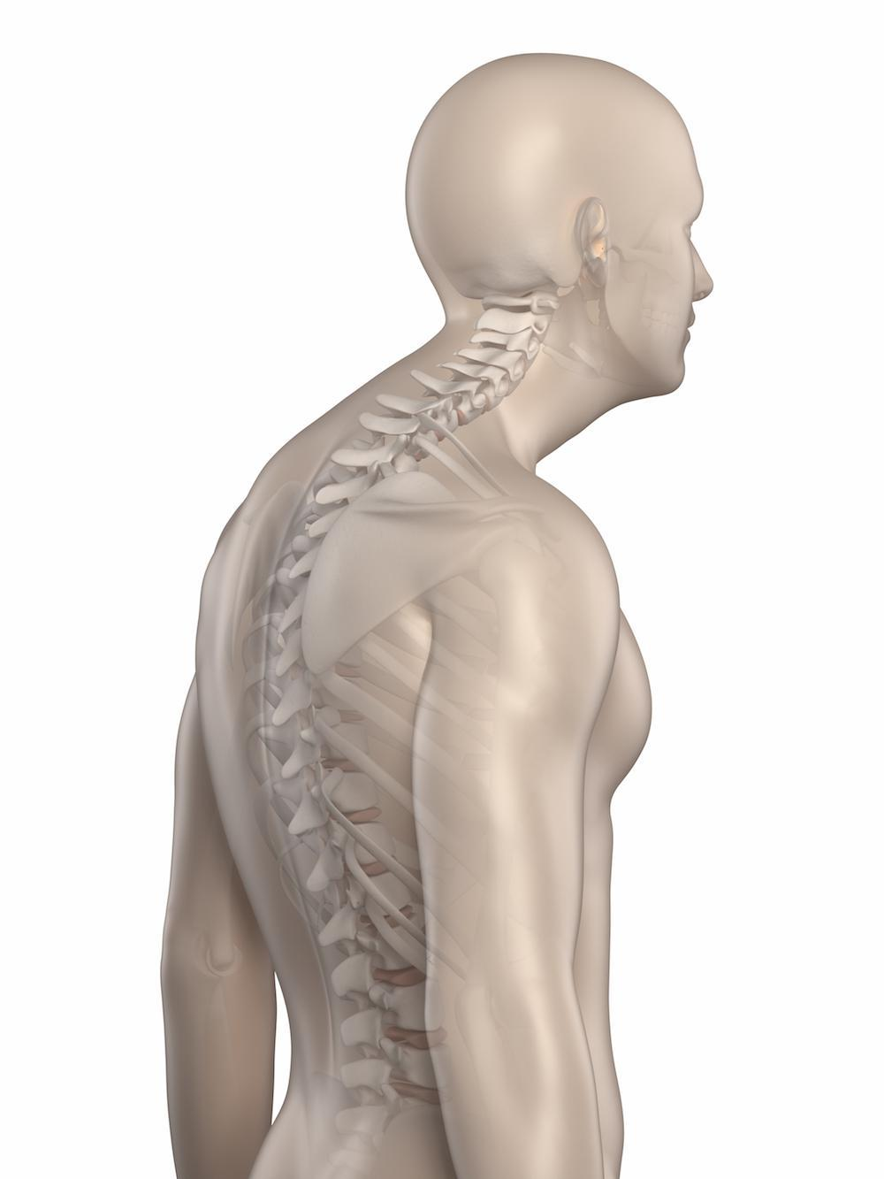
CAUSES OF ROUND SHOULDETR
Due to heredity
Wearing very tight clothes
Sitting on improper furniture
Lack of proper exercise
Sitting, standing and walking in bent position

Slide 9
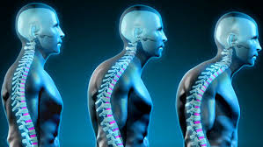
PRECAUTIONS FOR ROUND SHOULDER
Don’t walk, sit or stand in bent position
Avoid tight-fitting clothes
Avoid sitting on uncomfortable furniture

Slide 10
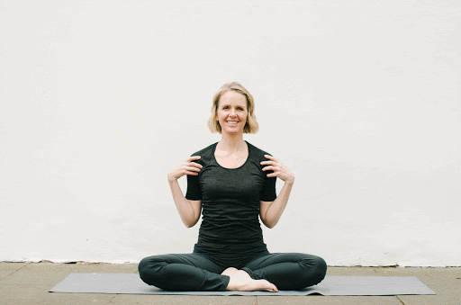
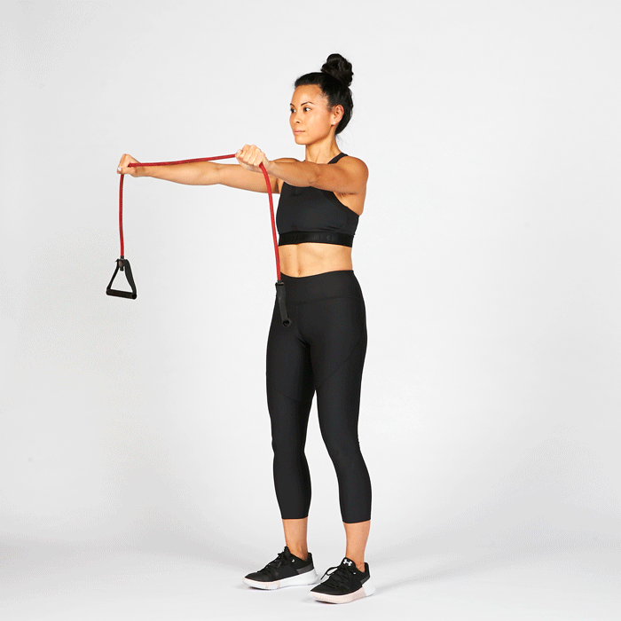
REMEDIES FOR ROUND SHOULDER
Shoulder rotation
Hold the horizontal bar
Perform CHAKRASANA and DHANURASANA

Slide 11

1. If there is a wide gap between the knees when standing with feet together, is called ___
KNOCK-KNEES
FLATFOOT
FLAT LEGS
BOW LEGS
2. Which deformities is also called genu varum?
BOW LEGS
FLATFOOT
FLAT LEGS
KNOCK-KNEES
3. What is the best remedies for Round Shoulder?
CHAKRASANA
DHANURASANA
BOTH OF THESE
NONE OF THESE

Slide 12

What is bow legs?
What is round shoulder?
Explain the precautions of round shoulder.

Slide 13
THANKING YOU
ODM EDUCATIONAL GROUP

