Slide 1


CAUSES, PREVENTION, AND TREATMENT OF SPORTS INJURIES
SUBJECT : (PHYSICAL EDUCATION)
CHAPTER NUMBER: 7
CHAPTER NAME : PHYSIOLOGY AND INJURIES IN SPORTS

Slide 2

CLASSIFICATION OF SPORTS INJURIES
SPORTS INJURIES
SOFT TISSUE INJURIES
BONE INJURIES
JOINTS INJURIES
CONTUSION
STRAIN
SPRAIN
ABRASION
BRUISES
SIMPLE
COMPOUND
COMPLICATED
GREENSTICK
COMMINUTED
IMPACTED
LOWER JAW
SHOULDER
HIP JOINT
WRIST
FRACTURE
DISLOCATION

Slide 3

WHAT WE EXPECT TO LEARN?
We will be able to know about the ‘CAUSES & PREVENTION OF SPORTS INJURIES’
We will be familiar with the TREATMENT OF SPORTS INJURIES.
We will be described as the process of treatments.
All the concepts will create interest among the students in the Rehabilitation process.

Slide 4
COMMON CAUSES OF SPORTS INJURIES
Improper Conditioning :-
Improper Worming-up :-
Improper Sports Equipment :-
Improper Use Protective Equipment :-
Lack of scientific Training :-
Lack of Fitness :-
Lack of Nutrients :-
Lack of Sports Facilities :-
Lack of concentration During The Game :-
Practice During The Stage Of Fatigue :-
Overuse of Muscles :-

Slide 5
COMMON PREVENTION OF SPORTS INJURIES
Proper Warming-Up :-
Proper Conditioning :-
Proper Sports Facilities :-
Proper Use of Protective Equipment's :-
Proper Knowledge of the Sports Skills :-
Proper Technique should be used:-
Improves Balanced Diet :-
Improves the essential Fitness :-
Improves concentration During The Game :-
Don’t do Overtraining :-

Slide 6
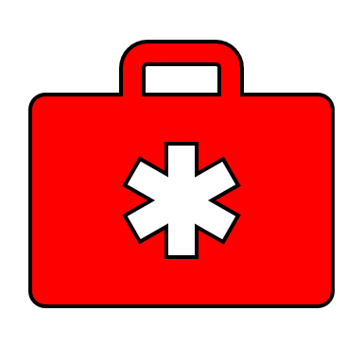
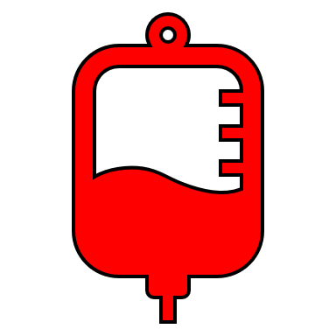
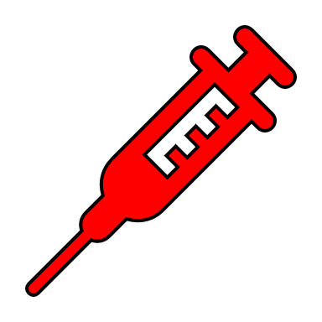


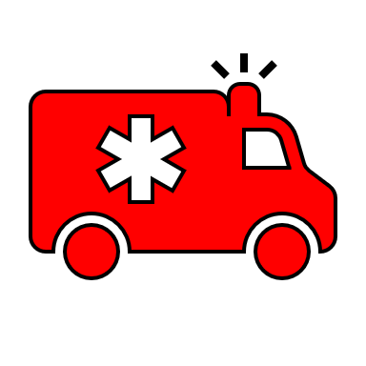
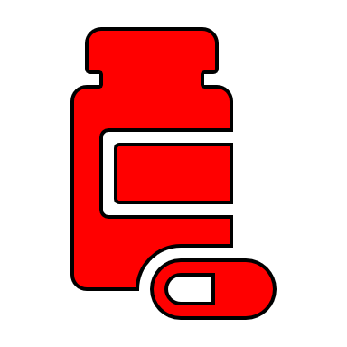
TREATMENT OF INJURIES

Slide 7
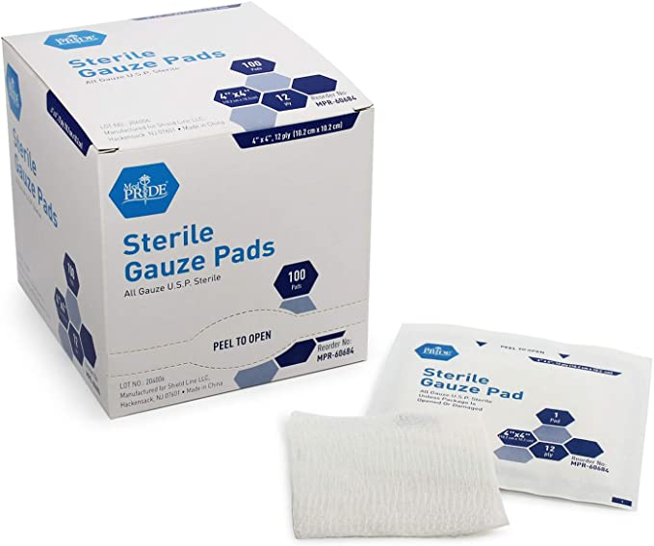
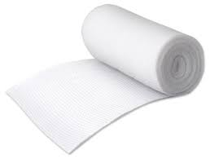
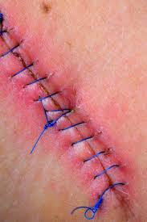
USEFUL MEDICAL TERMINOLOGY
Sterile Gauze –
It's made to resist bacteria and keep open wounds clean.
Roller Gauze –
It is used for dressing wounds, packing wounds.
Anti-inflammatory drugs –
It is a drug class that reduces pain, decreases fever, prevents blood clots.
Stitches –
Doctors use to join the edges of a cut on your skin.
Antiseptic ointment –
It is a substance used to kill or inhibit microorganisms on intact skin.

Slide 8
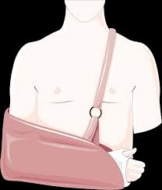
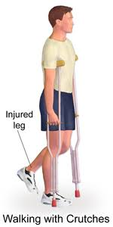
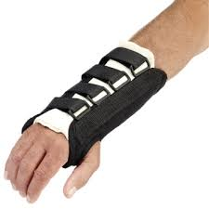
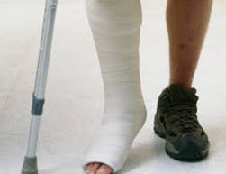
USEFUL MEDICAL TERMINOLOGY
Sling –
Slings are mobility aids or medical devices that are used to immobilize a person's arm, shoulder, or both.
Splint –
It is a medical equipment used to keep an injured body part from moving and to protect it from any further damage.
Crutches –
It is a mobility aid that transfers weight from the legs to the upper body.
Plasters –
It is a mixture of materials that hardens; used for immobilizing or making impressions of body parts.

Slide 9
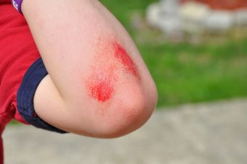
TREATMENT OF INJURIES - ABRASION
Clean the affected part with freshwater, Dettol then pick out the dead tissue.
A topical antibiotic (Neosporin) should be applied.
Wipe the affected part by sterile gauze after apply medicinal ointment.
Use a big piece of gauze for dressing. (optional)
Visit to doctor for proper dressing & tetanus injection.
Abrasion is a skin injury.
An abrasion is a type of open wound, where the bone is very close to the skin rubbing against a rough surface.

Slide 10
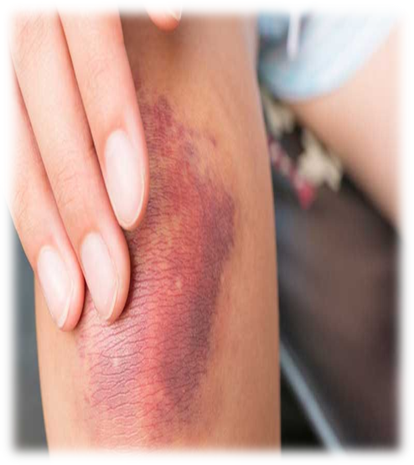
TREATMENT OF INJURIES - CONTUSION
Cold compression should be immediately. (not more then 40 Min), 5 to 6 times daily.
If more swilling, should be given anti-inflammatory medicine.
If swelling still persists, consult a doctor immediately.
Follow – RICE (Rest, Ice, Compression, Elevation
Contusion is the muscle injury.
Blood or bleeding under the skin. (blood vessels are broken)
Blood capillaries have been ruptured.

Slide 11
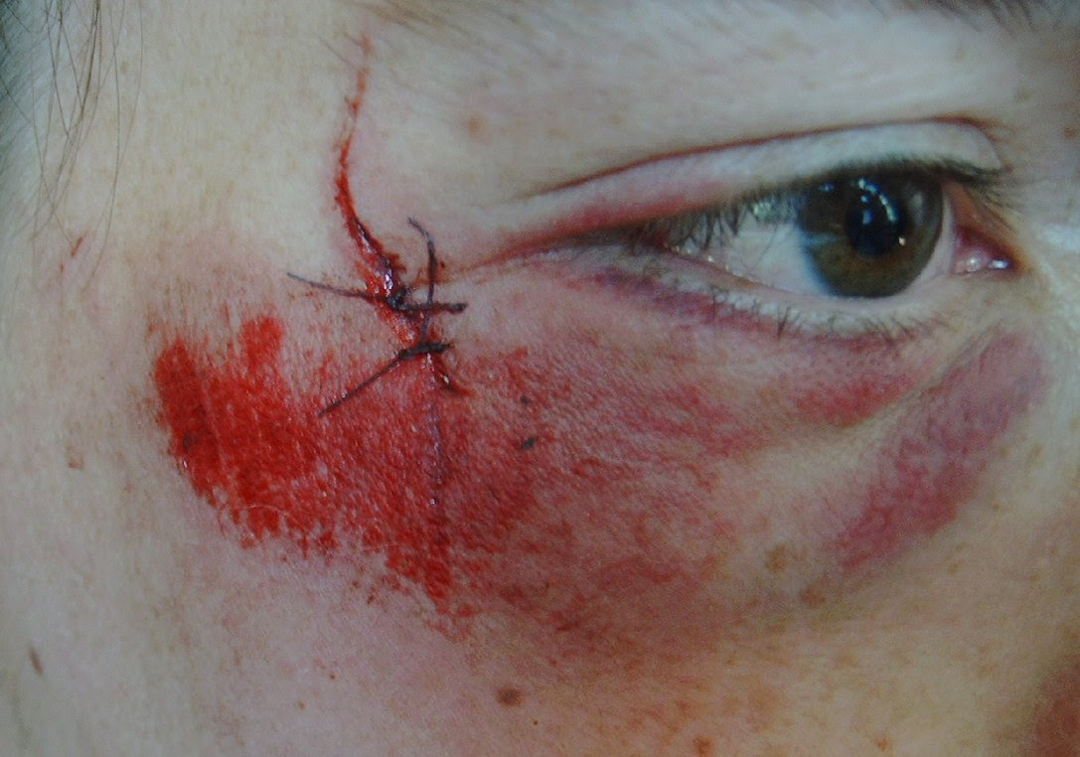
TREATMENT OF INJURIES - LACERATION
1st step
To stop bleeding, put pressure directly, and holding it above the level of heart for 15 min.
2nd step
Wash the laceration with warm water. If bleeding starts again repeat stop one.
3rd step
If required stitches, immediately consult to doctor.
4th step
It stitches are not required, then use antiseptic ointment. And cover with sterile gauze, and roller gauze.
5th Step
Change the dressing regularly and take painkiller it pain persists.
A laceration is a wound that occurs when skin, tissue and muscle are torn, or irregular cut open.

Slide 12
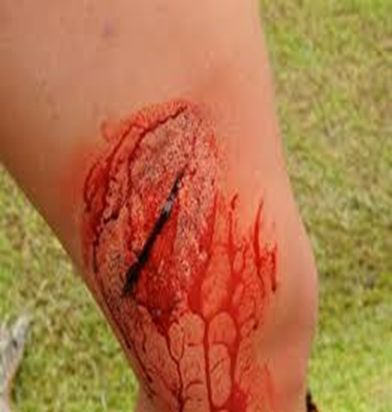
1st step
If the wound is not deep, let the blood come out. (germs also come out with the blood.
2nd step
Wash the incision with iodine tincture or spirit.
If required stitches, immediately consult to doctor.
4th step
It stitches are not required, then use antiseptic ointment. And cover with sterile gauze, and roller gauze.
5th Step
AFTER 48 HOURS, Change the dressing regularly, and take painkiller its pain persists.
3rd step
TREATMENT OF INJURIES - INCISION
An incision is a wound that occurs when skin, tissue and muscle are torn or cut open. Sometime arteries or veins may be cut.

Slide 13
PROTECTION
Protect the injured area from further injury by using a support.
REST
It should be rested, no additional force should be applied on site of the Sprain.
ICE
Ice should be applied immediately for reduce swelling & pain. Ice apply not more then 20 min. longer and 4 to 8 times a day.
COMPRESSION
ELEVATION
Its helps in reducing the swelling & bleeding, compression should not be applied very hard as it may hinder blood circulation.
If possible, keep the injured area on a pillow, above the level of heart to reduce swelling.
TREATMENT OF INJURIES – SPRAIN BY PRICE-R
PRICE
R – REFER TO DOCTOR (If situation is not under control immediately)

Slide 14

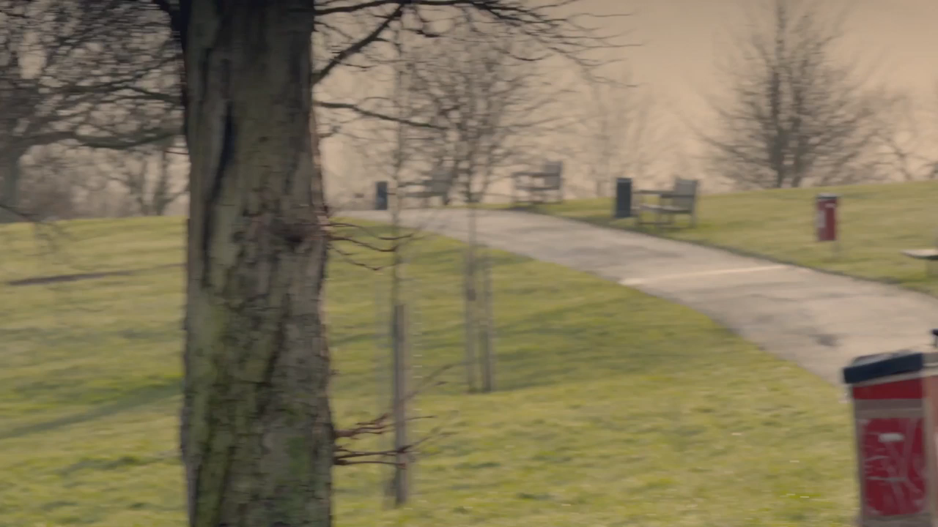


Slide 15
PRICE PROCEDURE PICTURES
PROTECTION
REST
ICE
COMPRESSION
ELEVAATION

Slide 16
TREATMENT OF INJURIES – SPRAIN BY MICE-R
MOBILISATION
Can be started full range of movement. This will prevent wasting of the muscles through lack of use. Try to increase the range of movement gradually.
Ice should be applied immediately for reduce swelling & pain. Ice apply not more then 20 min. longer and 4 to 8 times a day.
COMPRESSION
ELEVATION
Its helps in reducing the swelling & bleeding, compression should not be applied very hard as it may hinder blood circulation.
If possible, keep the injured area on a pillow, above the level of heart to reduce swelling.
ICE
After 4 to 5 days, heat treatment can be applied, it’s the best for blood circulation.
Only for few days after that it is not required.
Its should be done until all signs of swelling, heat and redness have vanish.
R – REFER TO DOCTOR (If situation is not under control immediately)

Slide 17
TREATMENT OF INJURIES - STRAIN
PROTECTION
Protect the injured area from further injury by using a support.
REST
It should be rested, no additional force should be applied on site of the Sprain.
ICE
Ice should be applied immediately for reduce swelling & pain. Ice apply not more then 20 min. longer and 4 to 8 times a day.
COMPRESSION
ELEVATION
Its helps in reducing the swelling & bleeding, compression should not be applied very hard as it may hinder blood circulation.
If possible, keep the injured area on a pillow, above the level of heart to reduce swelling.
NOTE :-
Avoid any kind of heat such as hot baths, sauna bath or heat packs. (first 72 hours)
Avoid running or exercise – may be cause more damage.
Avoid massage – may be cause bleeding.

Slide 18
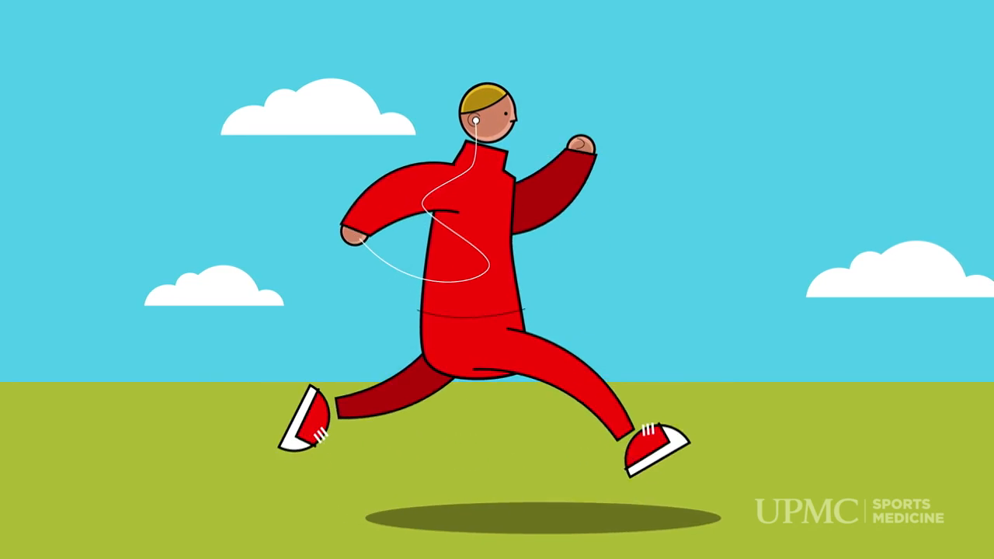

Slide 19
TREATMENT OF INJURIES - DISLOCATION
1st
Call medical help immediately
2nd
Don’t try to move the joint or to place it back in the socket.
3rd
Apply cold pack around the dislocated area to relieve the pain & swelling.
4th
Sling or splint the affected area into its fixed position.

Slide 20
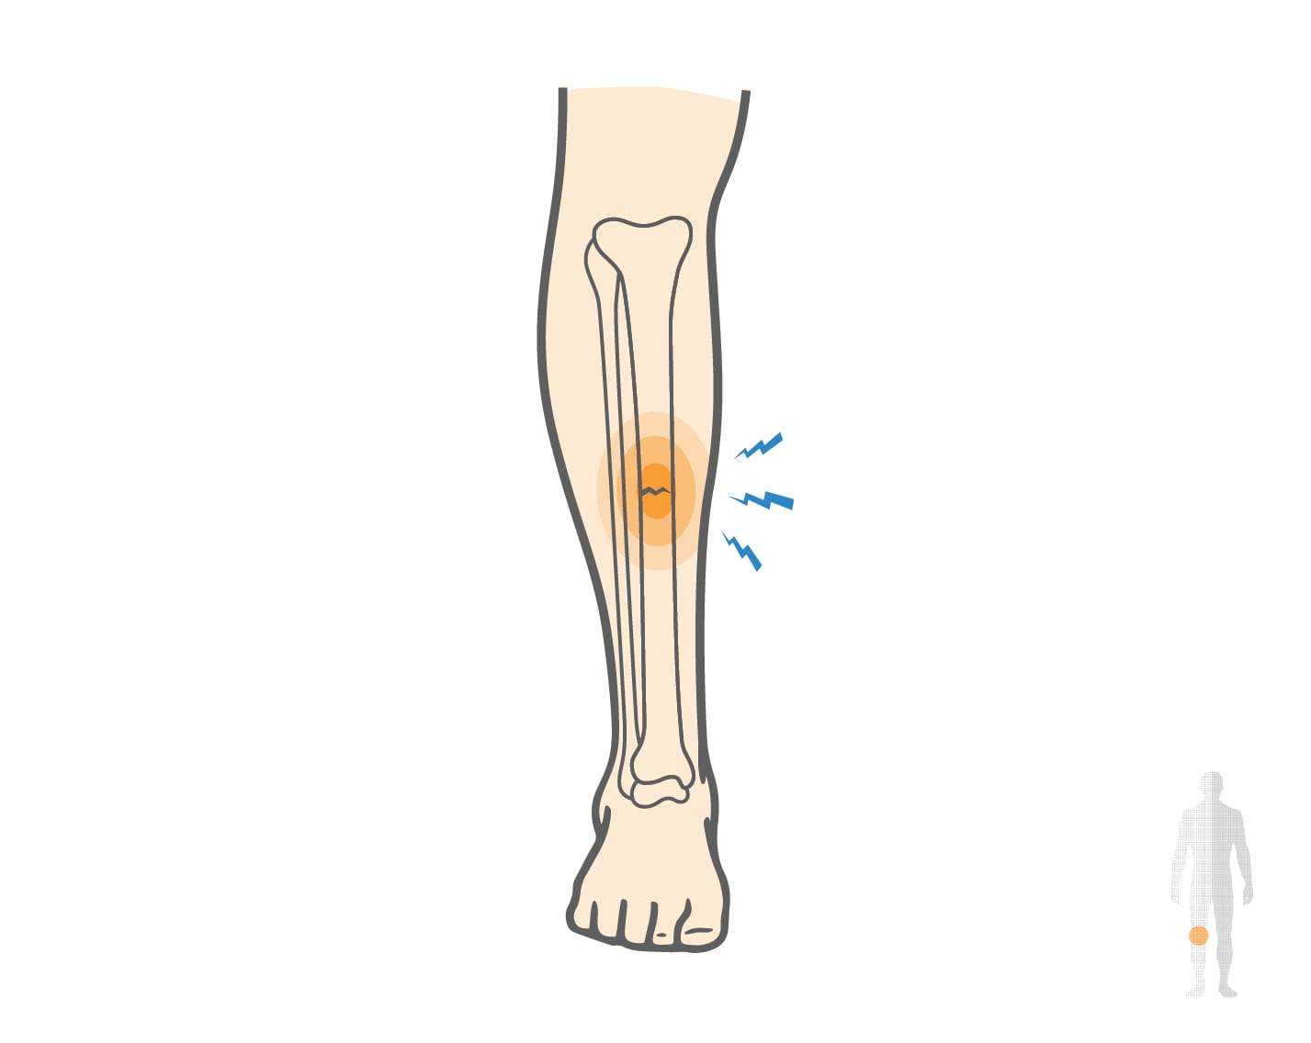
TREATMENT OF INJURIES – STRESS FRACTURE
A small crack that takes place in the bone. (Hairline fracture)
1ST STEP
Elevate the extremely & rest whole the bone.
2ND STEP
Apply ice to the affected area for 24 to 48 hours.
3RD STEP
If pain persists, give some painkillers.
4TH STEP
5TH STEP
As per requirement immobilization of the affected area.
When swelling is reduced, start putting partial weight on the area, crutches or walking stick may be used in the beginning.
6TH STEP
Avoid the activity that caused stress fracture, for 6 to 8 weeks.

Slide 21
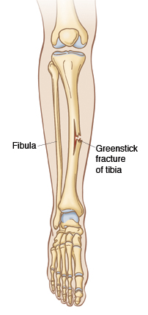
TREATMENT OF INJURIES – GREENSTICK FRACTURE
These fractures are commonly seen in children because their bones are very soft & delicate. The bone cracks on one side.
1ST STEP
Require immobilizations (involve arms and legs)
2ND STEP
A removable splint is the most recommended.
3RD STEP
If pain persists, give some painkillers.
4TH STEP
Swelling may be reduced with anti-inflammatory drugs.
It takes 8 weeks for complete bone healing, so take rest as much as possible.
6TH STEP
Avoid the high impact activities in the beginning.
5TH STEP

Slide 22
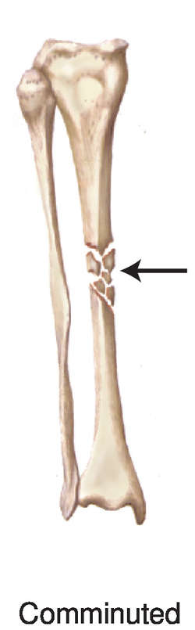
1ST STEP
Immobilization above & below the area with the help of plasters and splints.
^{2ND} STEP
If pain persists, give some painkillers.
^{3RD} STEP
Infections should be avoided by using antibiotics.
It takes few months for complete bone healing, so take rest as much as possible.
^{5TH} STEP
After that physical therapy should be used to treat completely.
^{4TH} STEP
TREATMENT OF INJURIES – COMMINUTED FRACTURE
The fracture, a bone is broken into three or more pieces.

Slide 23
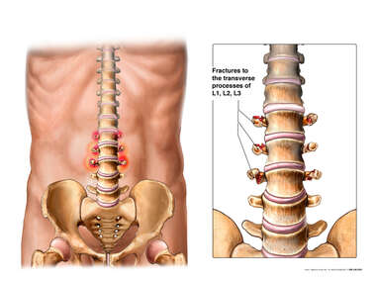
TREATMENT OF INJURIES – TRANSVERSE FRACTURE
It is a break in one of the bones of spine or part of it (thoracic region).
1ST STEP
Hospital care is not necessary, medication for pain control should be given. (if required)
^{2ND} STEP
In case of intricate or multiple fractures of spinal cord and may require operation.
^{3RD} STEP
Complete rest should be given to the person.
Neck and back braces may also be helpful in reducing pain and increasing mobility.
^{5TH} STEP
After that physical therapy and exercise should be done to improve motion.
^{4TH} STEP
They should not join any activity.

Slide 24
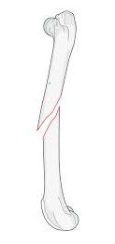
TREATMENT OF INJURIES – OBLIQUE FRACTURE
When the breaking of bone has a diagonally to the axis.
Due to the bone gets trapped and another bone twists over it.
1ST STEP
It is depending on the amount of damage to the bone.
^{2ND} STEP
If the damage is minimum, then – plaster may be used.
^{3RD} STEP
Most of the fractures surgical treatment is required.
If the damage is extensive then – metal rods, nails, screws, wires are used.
^{4TH} STEP
Anti-inflammatory medications and painkiller may be required.

Slide 25
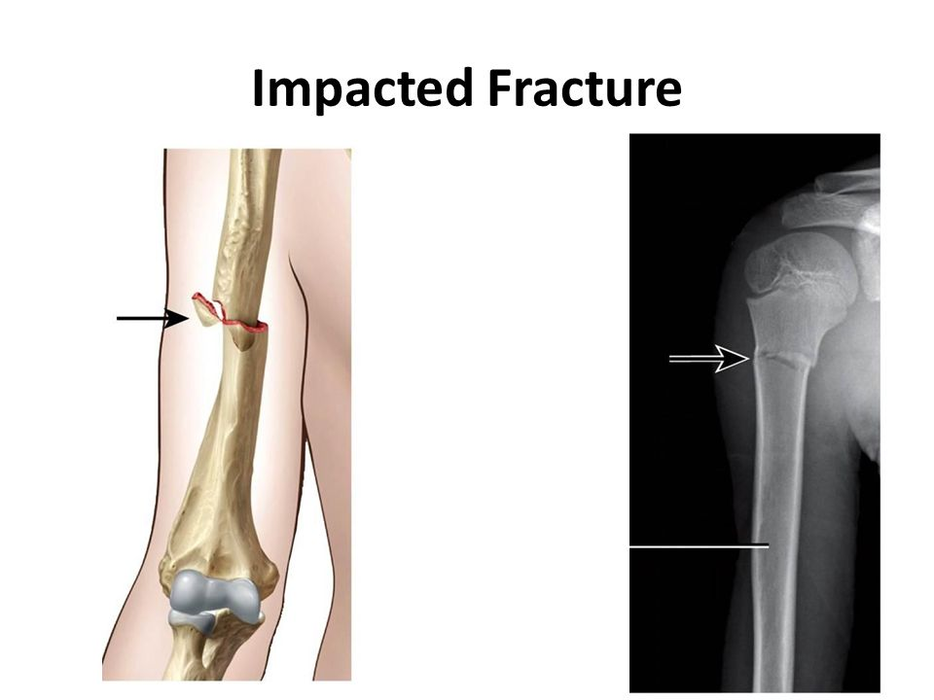
TREATMENT OF INJURIES – IMPACTED FRACTURE
The end of a fractured bone enters another bone.
1ST STEP
A splint or sling may be sufficient to held the fractured bone.
^{2ND} STEP
Immobilization required.
^{3RD} STEP
In severe cases, surgery treatment is required.
These fractures usually take more time to heal.
^{4TH} STEP
Anti-inflammatory medications and painkiller may be required.
The movement of the affected part should be minimized.
After some time, splint is removed.

Slide 26
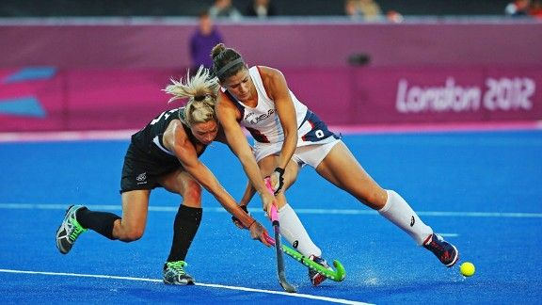
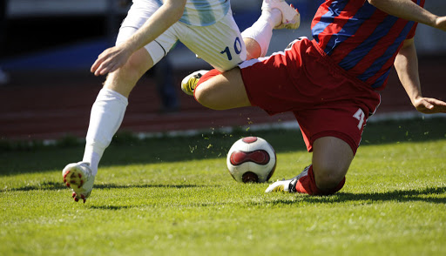
Explain the Causes of Sports Injuries
SR. NO.
1
2
3
4
5
6
7
8
9
10
11
12
13
Improper Conditioning
Improper
Improper Worming-up
Improper
Unscientific
Unscientific Way Of Training
Lack Of
Lack Of Fitness
Nutritional Inadequacy
Nutritional
Lack Of Sports Facilities
Lack Of
Injudicious
Injudicious Officiating
No Use
No Use Protective Equipment
Practice During
Practice During The Stage Of Fatigue
Pressure Of Competition
Pressure Of
Carelessness During The Game
Carelessness
Improper Sports Equipment
Improper
Overuse Of
Overuse Of Muscles

Slide 27

1. The first aid given must be…….
WISE
RICE
NICE
VICE
2. The injury can be prevented by ……..
PROPER WARM UP
PROPER UNIFORM
ICING
ELEVATION
3. Which is helping to resist bacteria and keep open wounds clean?
SLING
SPLINT
ROLLER GAUZE
STERILE GAUZE
4. What is the process for treatment of STRAIN?
MICE
MICER
PRICE
NICER

Slide 28

Explain in detail the management of dislocation of joints.
Explain in detail the management of Abrasion.
What is the treatment of oblique fracture?

Slide 29

THANKING YOU
ODM EDUCATIONAL GROUP

