Slide 1


NON-NUTRITIVE COMPONENTS OF DIET
SUBJECT : PHYSICAL EDUCATION
CHAPTER NUMBER: 2
CHAPTER NAME : SPORTS & NUTRITION

Slide 2

WHAT WE EXPECT TO LEARN?
We will be able to know about the ‘NON-NUTRITIVE COMPONENTS OF DIET’.
All the concepts will create knowledge among the students of HEALTHY DIET.

Slide 3
NON-NUTRITIVE COMPONENTS OF DIET
FIBRE OR ROUGHAGE
WATER
COLOUR COMPOUNDS
FLAVOUR COMPOUNDS
PLANT COMPOUNDS
NON-NUTRITIVE COMPONENTS OF DIET

Slide 4
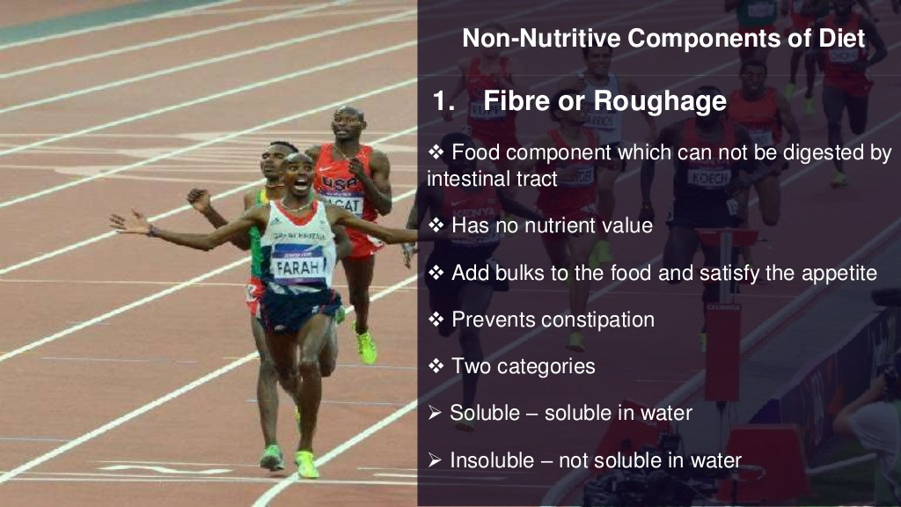
SOLUBLE FIBRE- It dissolves in water and reduces cholesterol and blood sugar level.
INSOLUBLE FIBRE- It does not dissolve in water and soften the stool, brings relief from constipation.

Slide 5
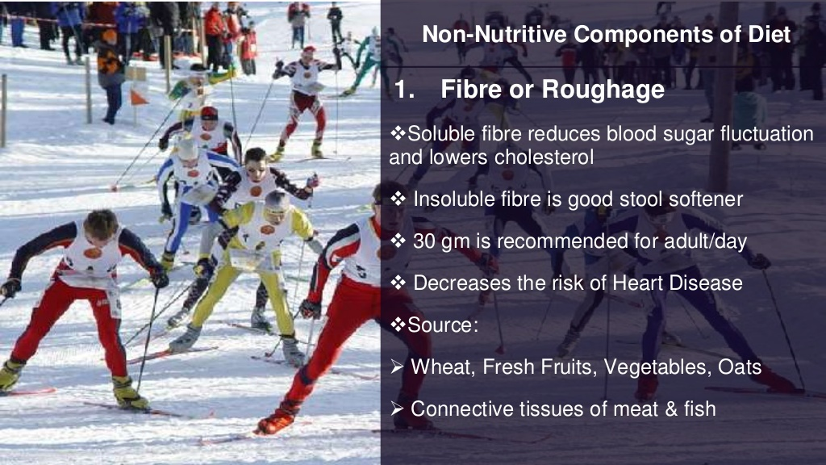

Slide 6
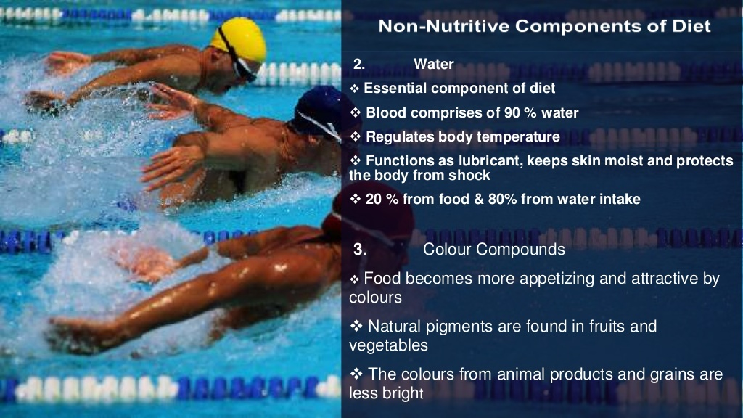

Slide 7
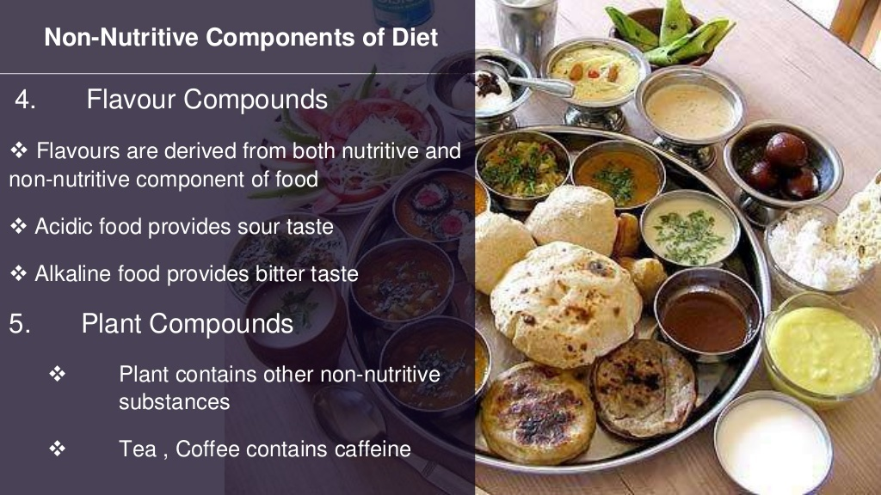

Slide 8

1. ________deficiency may cause Rickets.
VITAMIN A
VITAMIN B
VITAMIN C
VITAMIN D
2. ‘Building Blocks of Life’ known as ________
PROTEINS
VITAMIN
FATS
ALL OF THESE
3. _____deficiency may cause anaemia.
B7
B9
B12
NONE OF THESE

Slide 9

“Vitamins are essential for our metabolic process”, what happens if we devoid our diet of vitamins?
Discuss minerals as a nutritive component of the diet.
Why roughage essential to our body?

Slide 10
THANKING YOU
ODM EDUCATIONAL GROUP

