Slide 1


FLATFOOT & KNOCK-KNEE
SUBJECT : PHYSICAL EDUCATION
CHAPTER NUMBER: 05
CHAPTER NAME : CHILDREN AND WOMEN IN SPORTS

Slide 2


WHAT WE EXPECT TO LEARN?
01
What is Flatfoot?
02
What is Knock-knee?
03
Causes of Flatfoot.
04
Causes of Knock-knee.

Slide 3
COMMON POSTURAL DEFORMITIES
SPINAL CURVATURE
FLATFOOT
KNOCK-KNEES
BOW LEGS
ROUND SHOULDERS
KYPHOSIS
LORDOSIS
SCOLIOSIS
MIND MAP

Slide 4
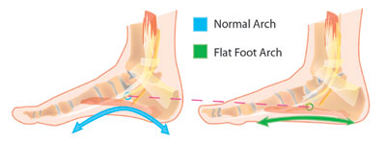
WHAT IS FLAT FOOT?
A condition in which the entire sole of the foot touches the floor when standing.
Absence of an arch in the sole of the foot that causes the foot to lie flat when the person is standing.
Such person feel pain in feet, they face problem in standing and walking.

Slide 5
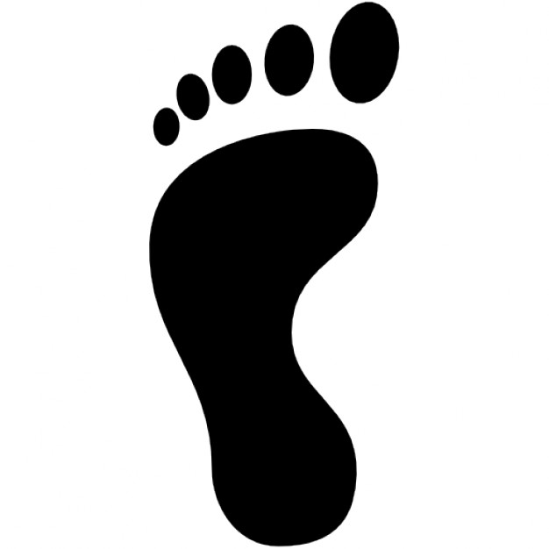
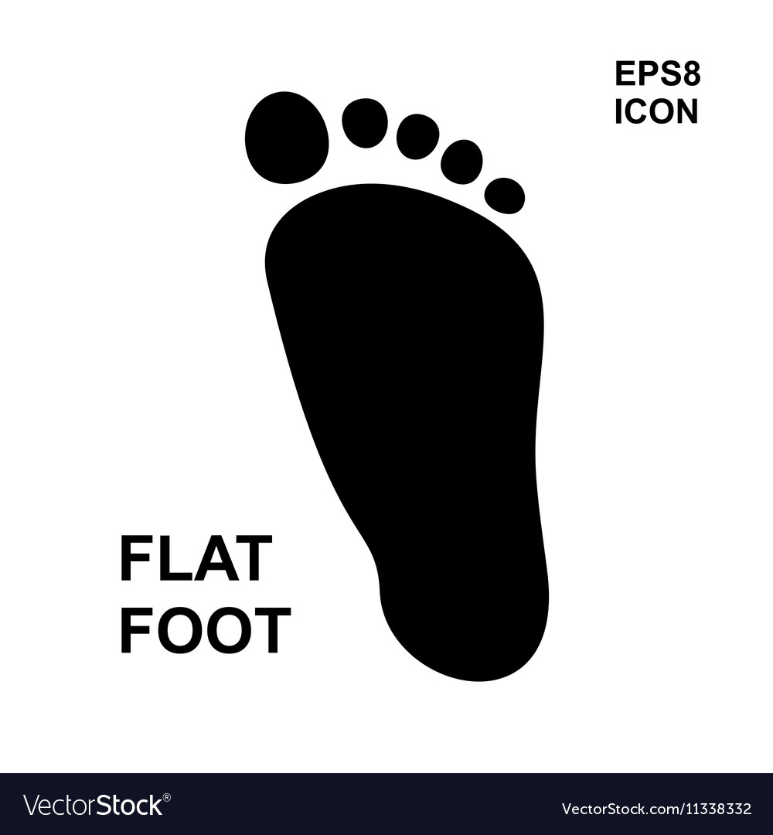
How we can observe a person has flat foot deformity or not?
Dip your feet in cold water and walk on the foot. If there is not a proper arch of footprints on the floor, then you have the deformity of flat foot.
Healthy foot
Flat foot

Slide 6
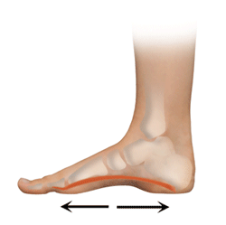
CAUSES OF FLAT FOOT
Week muscles of the foot can’t bear the body weight.
Rapid increase in body weight, improper shoes.
Carrying heavy weight for a longer period.
Flatfoot are also more common during pregnancy.

Slide 7
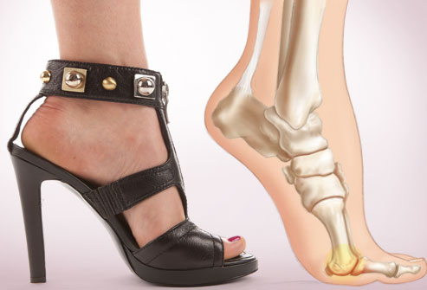
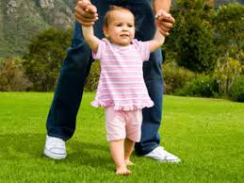
PRECAUTIONS FOR FLAT FOOT
The shoes should be of proper shape and size.
Don’t walk bare feet for a long duration.
Obesity should be avoided.
Don’t encourage babies to walk at an early stage.
High heeled shoes should be avoided.

Slide 8
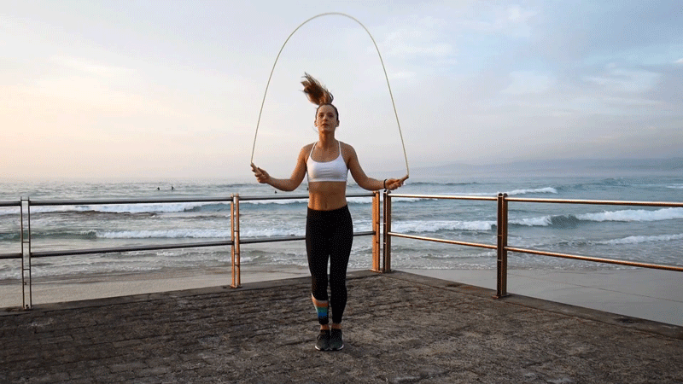
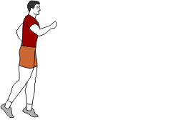
REMEDIES FOR FLAT FOOT
Walking on heels
Walking on inner and outer side of feet
Walking on toes
To perform up and down the heels
Stand up and down on the heels
Jumping on toes, skip on rope/rope climbing
Perform VAJRASANA

Slide 9
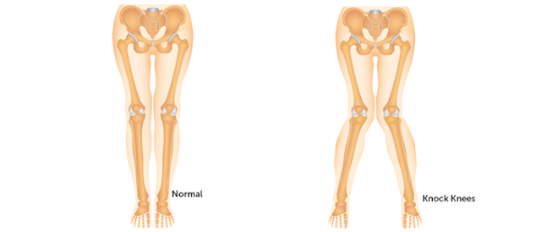
WHAT IS KNOCK-KNEES?
When both the knees knock or touch each other while in normal standing position.
The gap between the ankles goes on increasing (2 to 3 inches).
The individual faces difficulty in walking and running.
Owing to this deformity, they can’t be good players and even they are not selected in defense services.

Slide 10
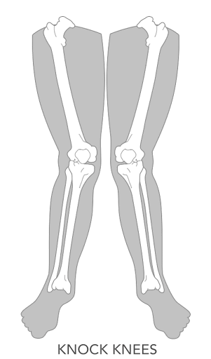
CAUSES OF KNOCK-KNEES
The lack of balanced diet.(especially vitamin D, calcium and phosphorus)
Due to rickets
Due to chronic illness
Due to obesity
Due to flatfoot
Carrying heavy weight in early age

Slide 11
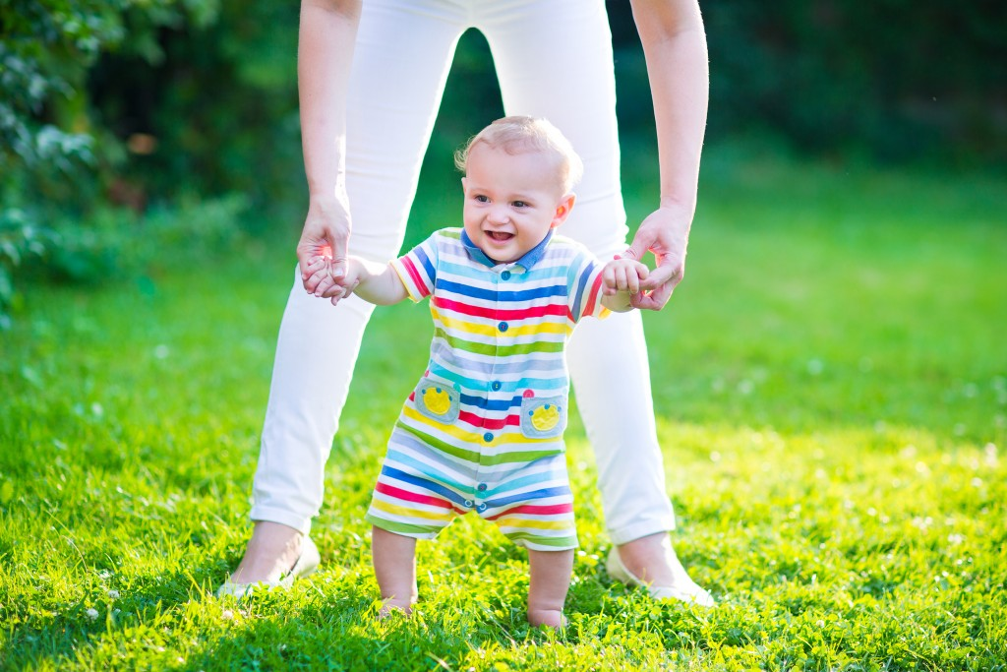
PRECAUTIONS FOR KNOCK-KNEES
Balanced diet should be taken
Babies should not be forced to walk at early age
Be careful while you walk and avoid prolonged standing
Always wear branded shoes/slippers

Slide 12
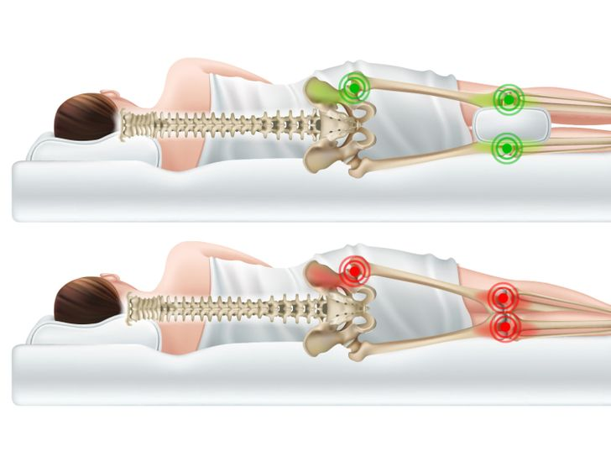
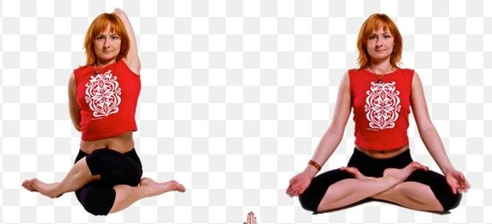
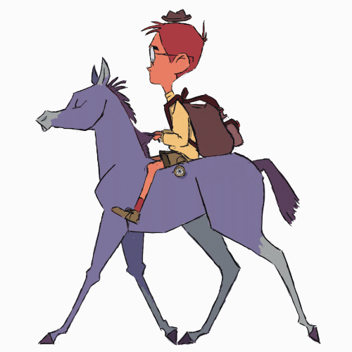
REMEDIES FOR KNOCK-KNEES
Perform GOMUKHASANA and PADMASANA regularly
Horse-riding is the best exercise
Keep a pillow between the knees
Use of walking calipers
Cod liver may be beneficial

Slide 13

1. If there is not a proper arch of footprints on the floor, is called ____
KNOCK-KNEES
LORDOSIS
SCOLIOSIS
FLATFOOT
2. Which one of the following is not a remedies of flatfoot?
HIGH HEELED SHOES
WALKING ON HEELS
SKIP ON ROPE
WALKING ON TOES
3. Which of the following yoga is the best for the remedies of Knock-knees?
PADMASANA
GOMUKHASANA
BOTH OF THESE
NONE OF THESE

Slide 14

What is flatfoot?
What is knock-knees?
Enlist any three causes of flatfoot.
Explain all the precautions of knock-knees.

Slide 15
THANKING YOU
ODM EDUCATIONAL GROUP

