Slide 1


CLASSIFICATION OF SPORTS INJURIES
SUBJECT : (PHYSICAL EDUCATION)
CHAPTER NUMBER: 7
CHAPTER NAME : PHYSIOLOGY AND INJURIES IN SPORTS

Slide 2

RECAPITULATION
SPORTS INJURIES
SOFT TISSUE INJURIES
BONE INJURIES
JOINTS INJURIES

Slide 3

WHAT WE EXPECT TO LEARN?
We will be able to know about the ‘SPORTS INJURIES’
We will be familiar with the various types of Sports Injuries.
We will be described the FRACTURE, DISLOCATION.
All the concepts will create interest among the students to prevents sports injuries.

Slide 4
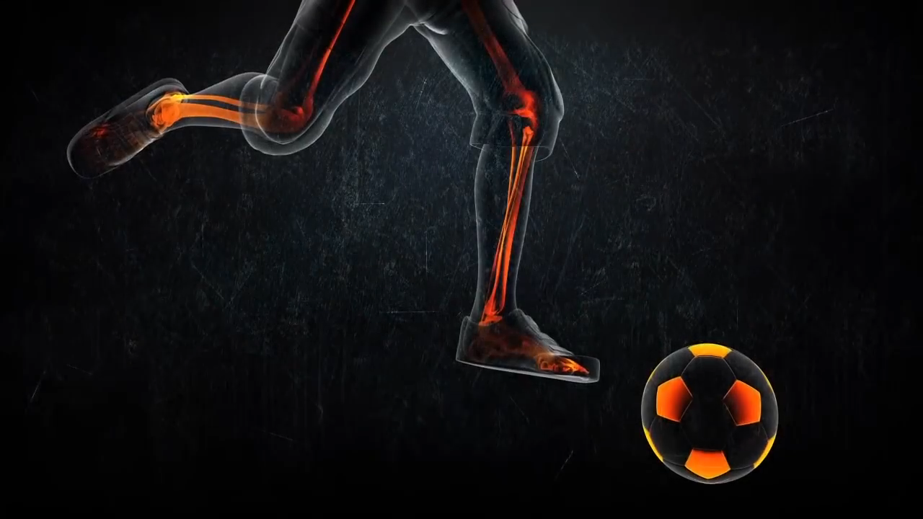



Slide 5
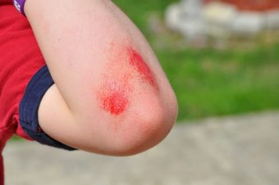
SOFT TISSUE INJURIES - ABRASION
WHAT IS ?
Abrasion is a skin injury.
An abrasion is a type of open wound, where the bone is very close to the skin rubbing against a rough surface.
CAUSES
Due to friction, falling or sliding on a hard surface.
FEATURES/ SYMPTOMS
Deep abrasion – Pain, bleeding, laceration.
Mild abrasions are known as grazes or scraps. – pain, but no bleeding.
POSSIBILITY GAMES
Basketball, kabaddi, football, hockey, and athletics, etc.

Slide 6
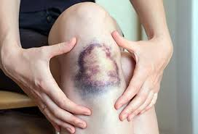
SOFT TISSUE INJURIES - BRUISES
WHAT IS ?
A Bruise is a skin injury that results in a discoloration of the skin.
It’s not clearly seen because upper skin unaffected, but inner tissues are damaged and blood vessels ruptured.
CAUSES
Due to bump into something or when something bumps into them.
Due to rigorously work-out.
FEATURES/ SYMPTOMS
Blood spreads under the skin, a fresh bruise may reddish after a few hours it turns blue or dark purple.
POSSIBILITY GAMES
Football, hockey, and boxing.

Slide 7
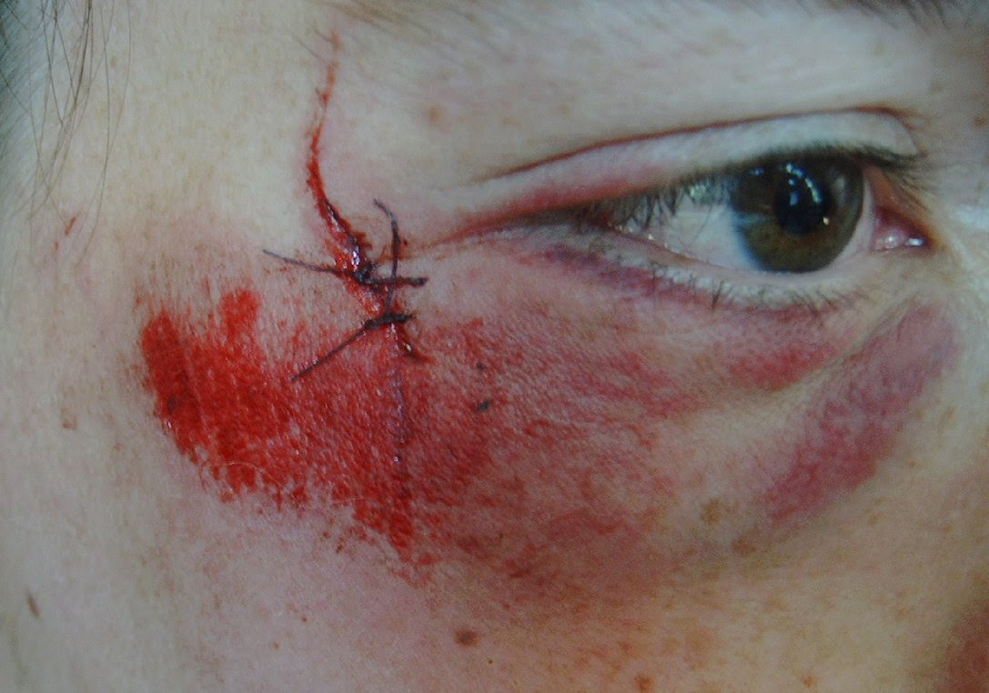
SOFT TISSUE INJURIES - LACERATION
WHAT IS ?
A laceration is a wound that occurs when skin, tissue and muscle are torn, or irregular cut open.
CAUSES
Due to the skin hitting (with force) a sharp object or sharp-edged sports equipment.
FEATURES/ SYMPTOMS
Wounds are not smooth, bleeding is less, rough marks remain even after treatment.
POSSIBILITY GAMES
Cricket, Boxing, etc. (Weapon – stones, bricks, punch, kicks, iron bars)

Slide 8
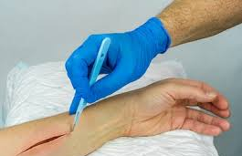
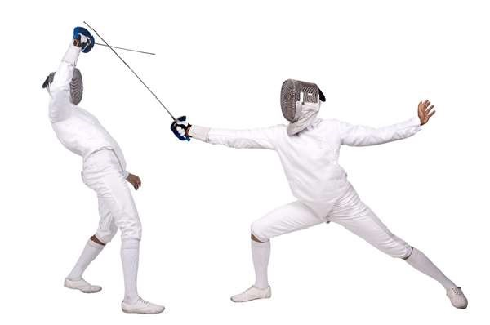
SOFT TISSUE INJURIES - INCISION
WHAT IS ?
An incision is a wound that occurs when skin, tissue and muscle are torn or cut open. Sometime arteries or veins may be cut.
CAUSES
Due to the skin hitting (with force) a sharp object or sharp-edged sports equipment.
FEATURES/ SYMPTOMS
Blood usually comes out freely from incisions.
Incision pain and swelling are often worst on day 2 and 3 after surgery
POSSIBILITY GAMES
Fencing. (Weapon – knife, surgical operation tools)

Slide 9
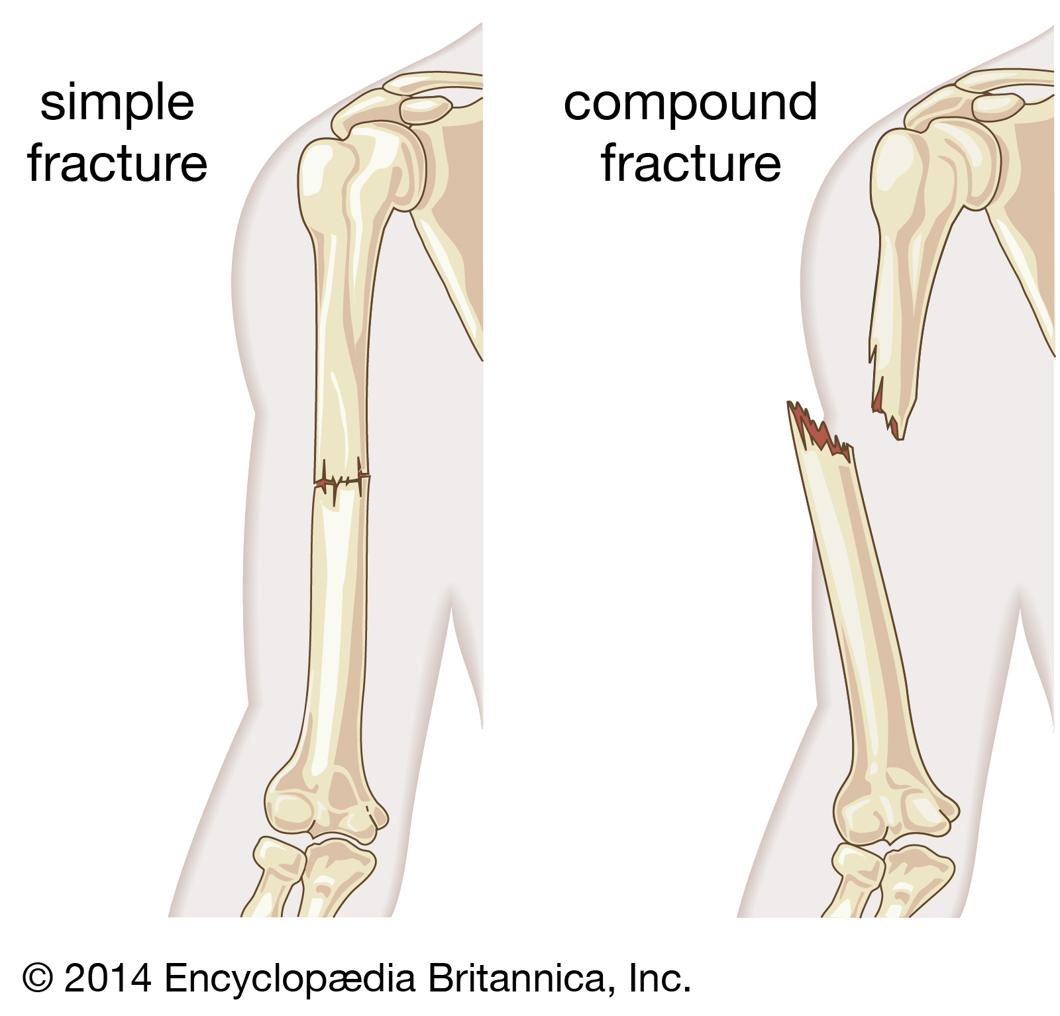
BONE INJURIES (FRACTURE) – SIMPLE FRACTURE
The fracture without any wound, where the bone is broken in one place is called simple fracture. (CLOSED)
WHAT IS ?
The skin is not broken, and the bone is not exposed to the air.
POSSIBILITY GAMES
Football, hockey, and kabaddi.

Slide 10
BONE INJURIES (FRACTURE) – COMPOUND FRACTURE
The fracture in which skin & muscles are damaged, generally, the broken bone comes out through the skin by tearing it. (OPEN)
WHAT IS ?
The skin is broken, and the bone is exposed to the air.
POSSIBILITY GAMES
Gymnastics , high jump, and pole vault.

Slide 11
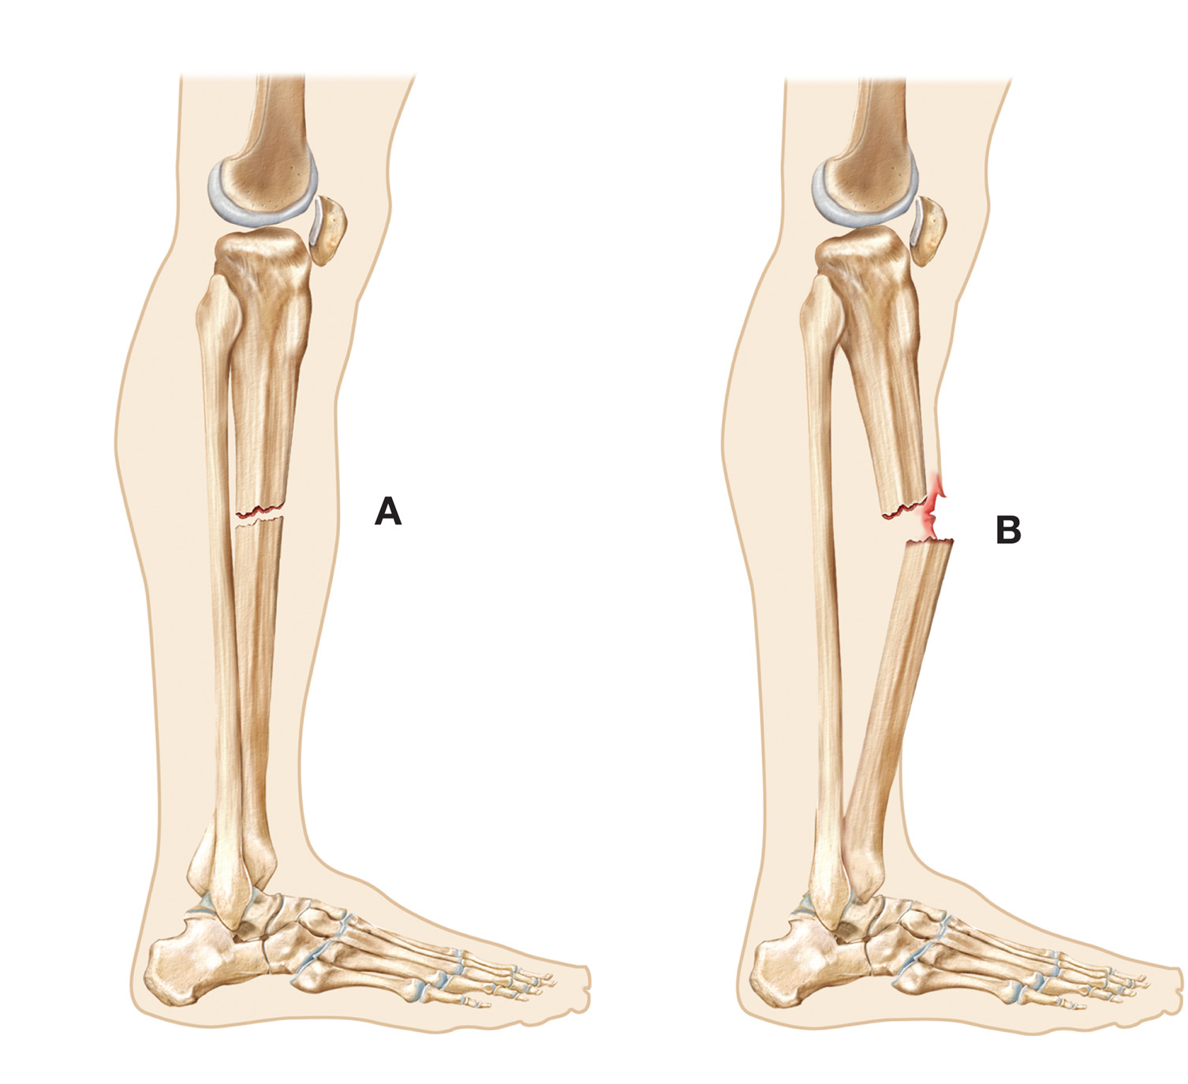
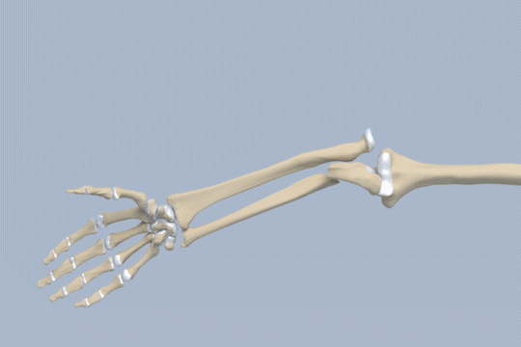
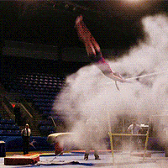
SIMPLE FRACTURE & COMPOUND FRACTURE

Slide 12
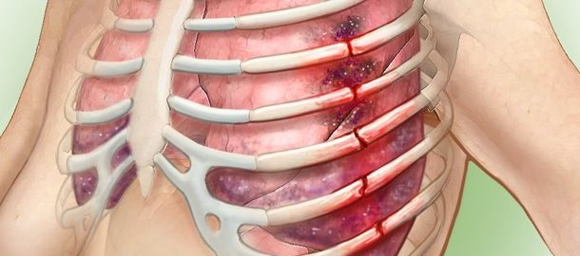
BONE INJURIES (FRACTURE) – COMPLICATED FRACTURE
The fracture, a bone is broken & damages the internal organs, the internal organ may be tissues, nerve or artery.
It is very complicated / dangerous.
WHAT IS ?
POSSIBILITY GAMES
Gymnastics , high jump, and pole vault.

Slide 13
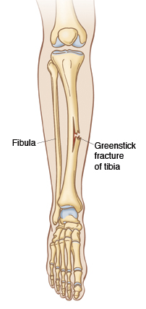
BONE INJURIES (FRACTURE) – GREENSTICK FRACTURE
These fractures are commonly seen in children because their bones are very soft & delicate. The bone cracks on one side.
Whenever there is any stress on the bone it is bent.
WHAT IS ?
POSSIBILITY GAMES
Weight lifting and wrestling in childhood.

Slide 14
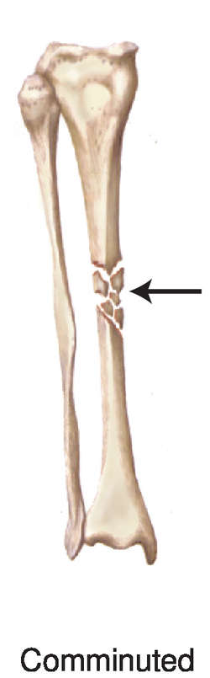
BONE INJURIES (FRACTURE) – COMMINUTED FRACTURE
WHAT IS ?
The fracture, a bone is broken into three or more pieces.
POSSIBILITY GAMES
Cycle race, motorcycle race, gymnastics.

Slide 15
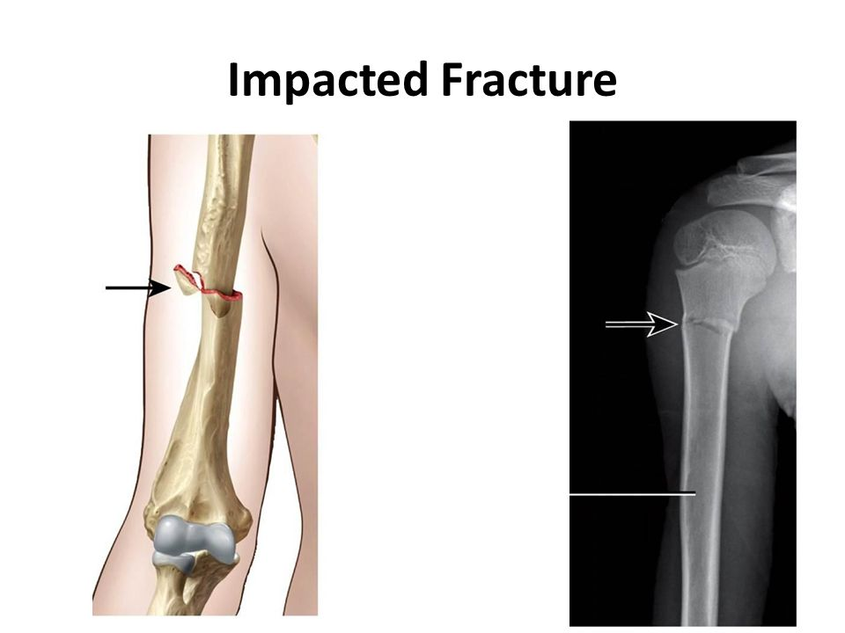
BONE INJURIES (FRACTURE) – IMPACTED FRACTURE
When the end of a fractured bone enters another bone, it is called impacted fracture. (Its also called buckle fracture)
WHAT IS ?
POSSIBILITY
Motor vehicle accident or other high-impact accident.

Slide 16
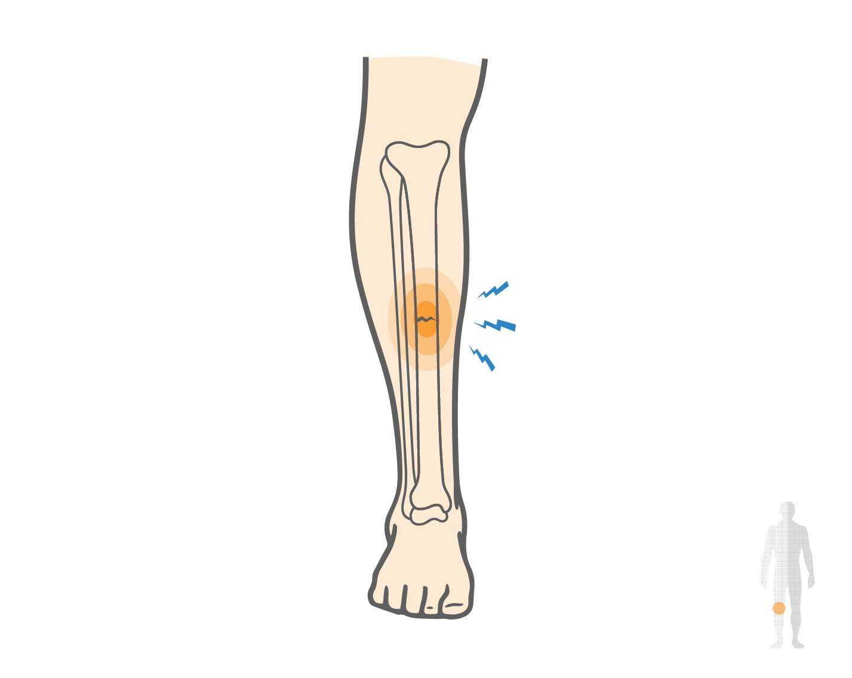
BONE INJURIES (FRACTURE) – STRESS FRACTURE
A small crack that takes place in the bone. (Hairline fracture)
WHAT IS ?
Due to increase in activity without proper recovery.
CAUSES
FEATURES/ SYMPTOMS
Very painful and Swelling.
POSSIBILITY GAMES
High impact sports – long distance race, basketball, etc.

Slide 17
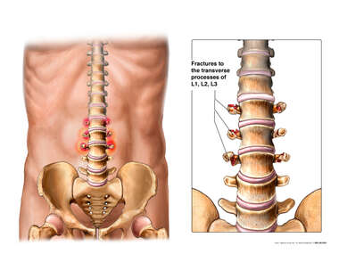
BONE INJURIES (FRACTURE) – TRANSVERSE FRACTURE
WHAT IS ?
It is a break in one of the bones of spine or part of it. It is shaped like a wing.
Location – thoracic region.
POSSIBILITY GAMES
Weightlifting, wrestling, jumping events, etc.

Slide 18
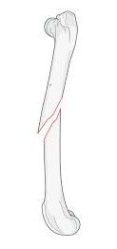
BONE INJURIES (FRACTURE) – OBLIQUE FRACTURE
WHAT IS ?
When the breaking of bone has a diagonally to the axis.
Due to the bone gets trapped and another bone twists over it.
It occurs at the humerus or femur bones. (long bones)
POSSIBILITY GAMES
kabaddi, wrestling, etc.

Slide 19
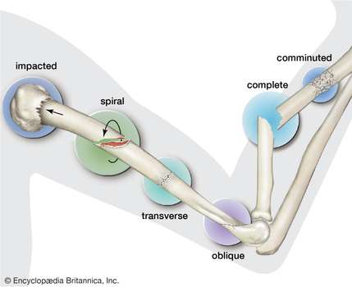
FRACTURE

Slide 20
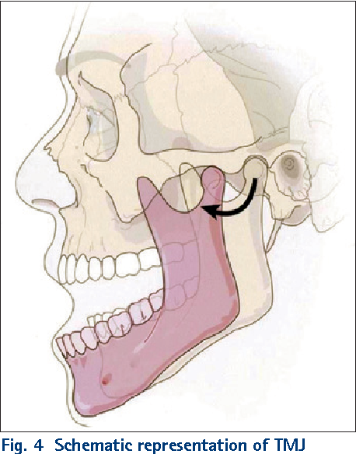
JOINT INJURIES (DISLOCATION) – LOWER JAW
WHAT IS ?
When the mandible bone of temporomandibular joint lie out from the skull, it’s called dislocation of Lower Jaw.
CAUSES
Due to the chin strikes or mouth is opened wide.
TEMPOROMANDIBULAR JOINT
POSSIBILITY GAMES
MANDIBLE
Boxing, wrestling.

Slide 21
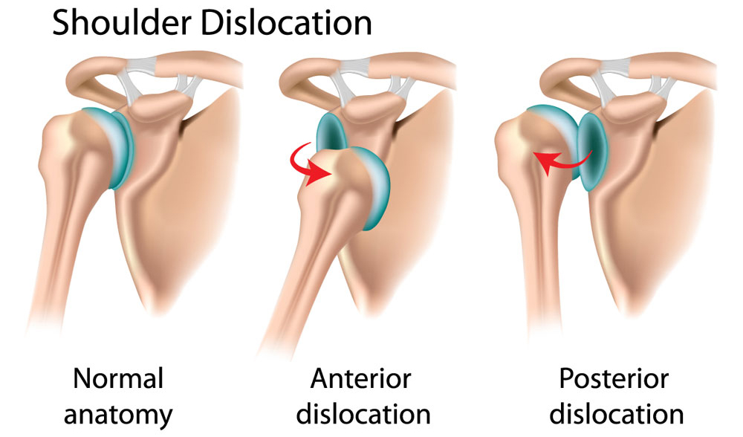
JOINT INJURIES (DISLOCATION) – SHOULDER JOINT
WHAT IS ?
When the end of the humerus comes out from the shoulder socket (scapula)
CAUSES
Due to sudden jerk or pulls.
Due to fall on hard surface, etc.
POSSIBILITY GAMES
Kabaddi, Football

Slide 22
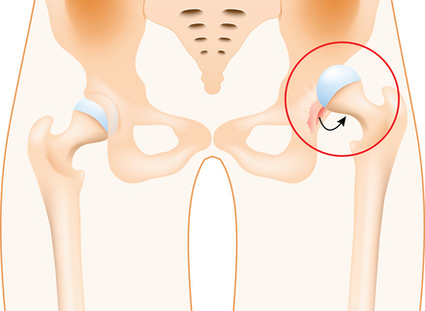
JOINT INJURIES (DISLOCATION) – HIP JOINT
WHAT IS ?
When the end of the femur (ball-shaped head) comes out from the socket (Pelvis)
CAUSES
Due to putting maximum strength spontaneously.
POSSIBILITY GAMES
Kabaddi, Football, Hockey

Slide 23
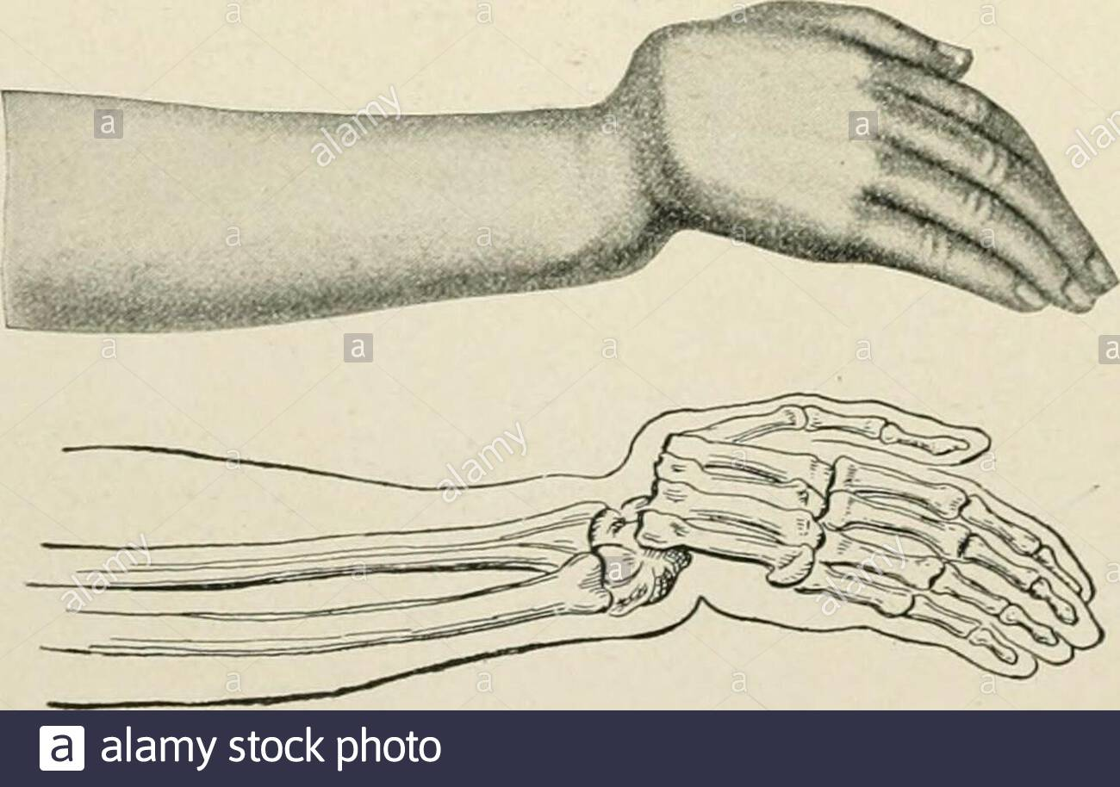
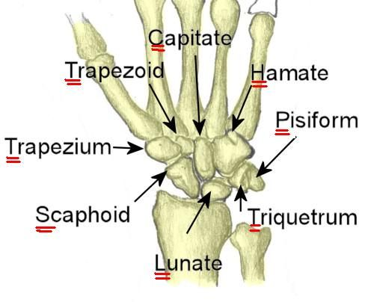
JOINT INJURIES (DISLOCATION) – WRIST
WHAT IS ?
When the wrist (contains eight bones) tear or dislocate the ligaments. (carpals)
CAUSES
Due to miscalculated landing, moving, falling, etc.
POSSIBILITY GAMES
Football, Ice Sports – Hockey, Skating.

Slide 24

1. ‘Scapula’ is related to in which dislocation?
LOWER JAW
SHOULDER JOINT
HIP JOINT
WRIST
2. Arteries or veins may be cut, and blood comes out freely from……
CONTUSION
ABRASION
LACERATION
INCISION
3. When The fracture, a bone is broken into three or more pieces is know as _____
SIMPLE FRACTURE
STRESS FRACTURE
COMMINUTED FRACTURE
IMPACTED FRACTURE

Slide 25

What are bone injuries? discuss the types, causes and prevention of fracture.
What do you mean by joint injuries? the type and preventive measures of joint injury.

Slide 26
THANKING YOU
ODM EDUCATIONAL GROUP

