Slide 1


WATER SOLUBLE VITAMINS
SUBJECT : PHYSICAL EDUCATION
CHAPTER NUMBER: 2
CHAPTER NAME : SPORTS & NUTRITION

Slide 2

WHAT WE EXPECT TO LEARN?
We will be able to know about the ‘WATER SOLUBLE VITAMINS’.
We will be familiar with the various types of vitamin C and B complex.

Slide 3
WATER SOLUBLE VITAMINS
VITAMIN C ASCORBIC ACID
VITAMIN B1 THIAMIN
VITAMIN B2 RIBOFLAVIN
VITAMIN B3 NIACIN
VITAMIN B5 PANTOTHENIC ACID
VITAMIN B6 PYRIDOXINE
VITAMIN B9 FOLIC ACID
VITAMIN B12 COBALAMINS
VITAMIN B7 BIOTIN
VITAMIN B COMPLEX

Slide 4
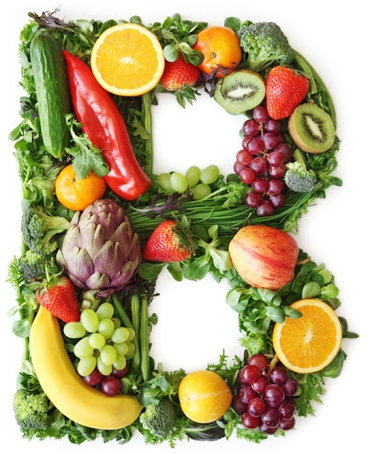
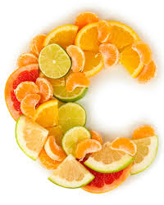
WATER SOLUBLE VITAMINS
&

Slide 5
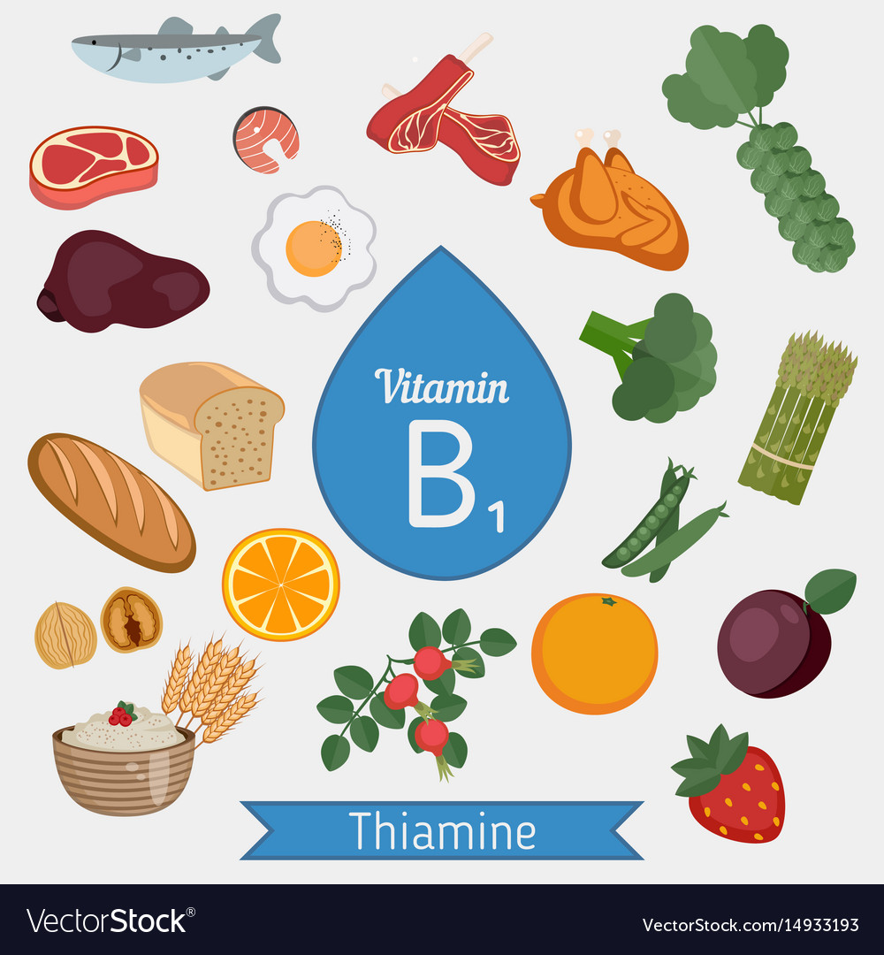
WATER SOLUBLE VITAMINS
VITAMIN B1 (THIAMIN)
It is a colourless vitamin.
Its taste is salty.
Its smell is just like yeast.
It helps in metabolising carbohydrates.
It helps in the efficiency of nerves and muscles.
It helps in the assimilation of vitamin A into our body.
It helps to release energy from foods.
DEFICIENCY
‘beriberi’, constipation, irritation, and anger.
SOURCES
Wheat, groundnuts, green peas, orange, pig meat, etc.

Slide 6
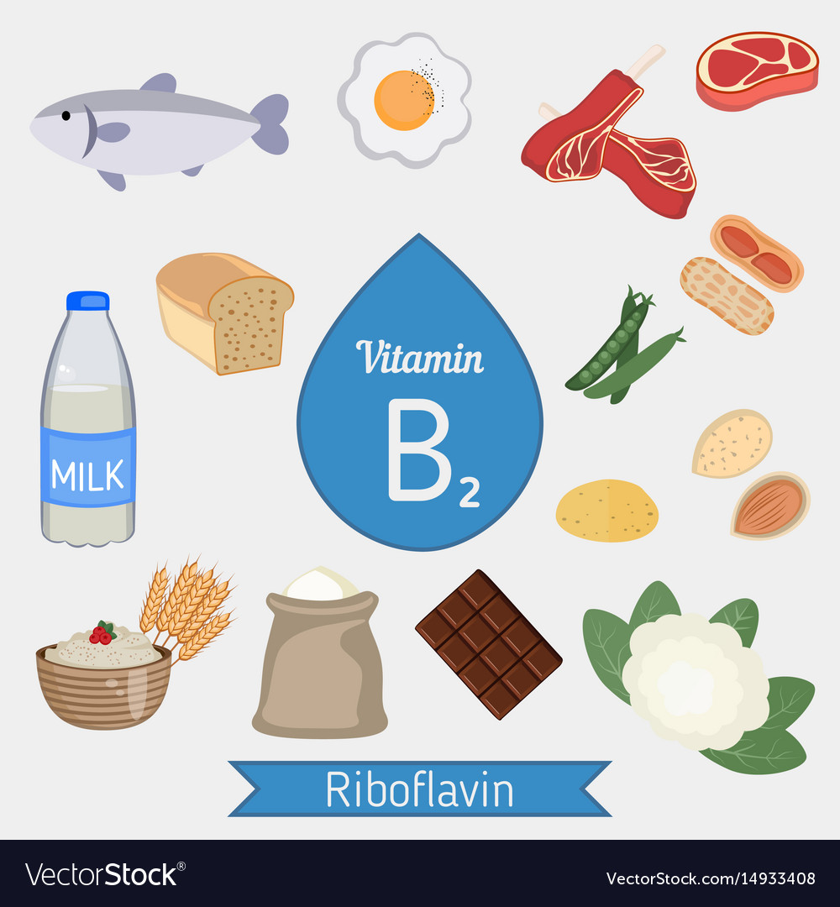
WATER SOLUBLE VITAMINS
VITAMIN B2 (RIBOFLAVIN)
It is yellow in colour.
It is usually destroyed in sunlight and food cooking for a longer time.
It is essential to keep the eyes, nose, mouth, lips, and tongue in a healthy state.
It helps to release energy from foods, promotes good vision, and healthy skin.
It also helps to produce RBC.
DEFICIENCY
Unhealthy skin, inflammation in eyes, decreases immunity power of WBC
SOURCES
Egg yolk, fish, wheat, green vegetables, etc.

Slide 7
COMMON SOURCES

Slide 8
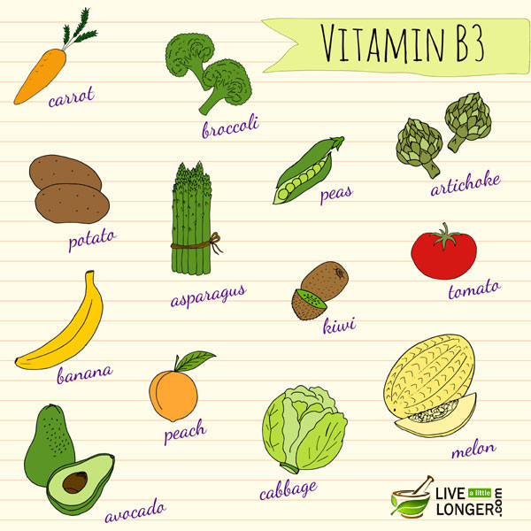
WATER SOLUBLE VITAMINS
VITAMIN B3 (NIACIN)
It is a water-soluble vitamin.
Our body does not store it.
Niacin helps to metabolise food and provides energy for the body.
It helps in digestion, promoting normal appetite, healthy skin and nerves.
DEFICIENCY
Pellagra, Symptoms – indigestion, fatigue, vomiting, and depression.
SOURCES
Meat, fish, milk, eggs, nuts, green vegetables, beans, etc.

Slide 9
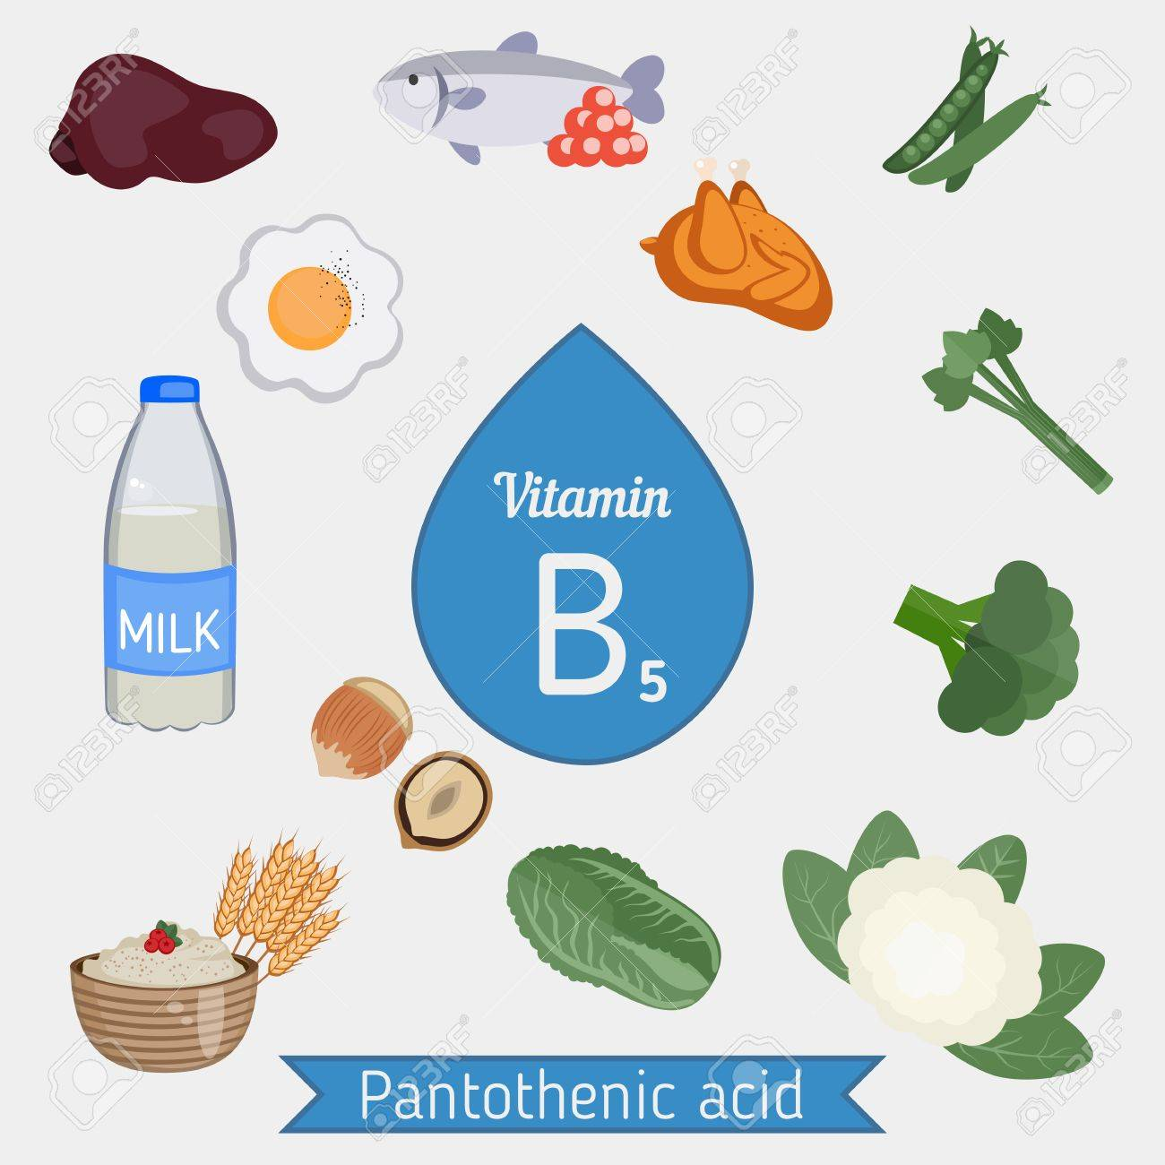
WATER SOLUBLE VITAMINS
VITAMIN B5(PANTOTHENIC ACID)
It is necessary for making blood cells.
It helps in the breakdown of fats and carbohydrates for energy.
Helps in the production of hormone and cholesterol.
DEFICIENCY
Insomnia, depression, fatigue, irritability, vomiting, stomach pain, etc.
SOURCES
Meat, fish, whole grains, egg, yolk, milk products and soybeans, etc.

Slide 10
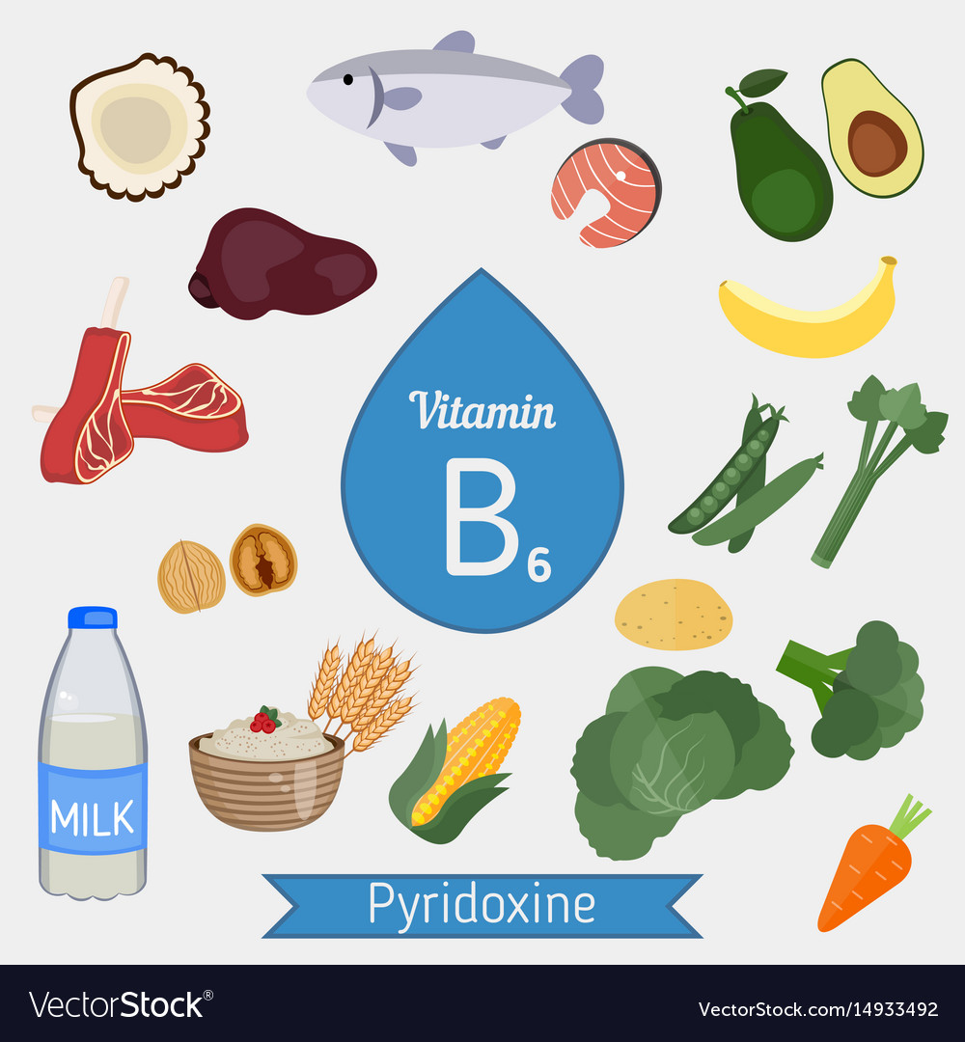
WATER SOLUBLE VITAMINS
VITAMIN B6 (PYRIDOXINE)
Vitamin B6 is a key factor in protein and glucose metabolism as well as in the formation of haemoglobin.
Haemoglobin is a component of red blood cells(it carries oxygen).
It keeps our immune system and nervous system healthy.
DEFICIENCY
Depression (sadness), dizziness (faintness), nausea (vomiting), sores in the mouth, etc.
SOURCES
Meat, fish, egg yolk, yeast, rice, wheat, etc.

Slide 11
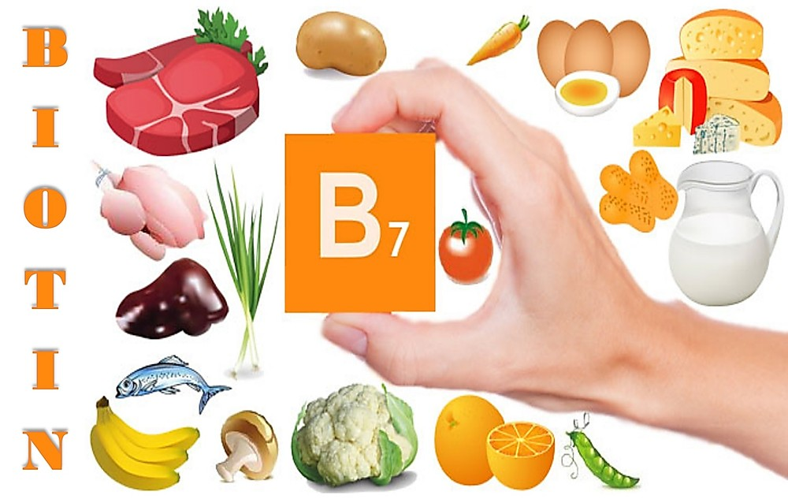
WATER SOLUBLE VITAMINS
VITAMIN B7 (BIOTIN)
It helps release energy from carbohydrates and acid in the metabolism of fats, proteins.
Strengthens hair and nail, helps in the production of energy, and produces fatty acids and amino acids.
DEFICIENCY
Impaired growth, Hair loss, hallucinations, loss of appetite, muscle pain, conjunctivitis, etc.
SOURCES
Egg yolk, milk, fresh vegetables, yeast bread, cereals, etc.

Slide 12
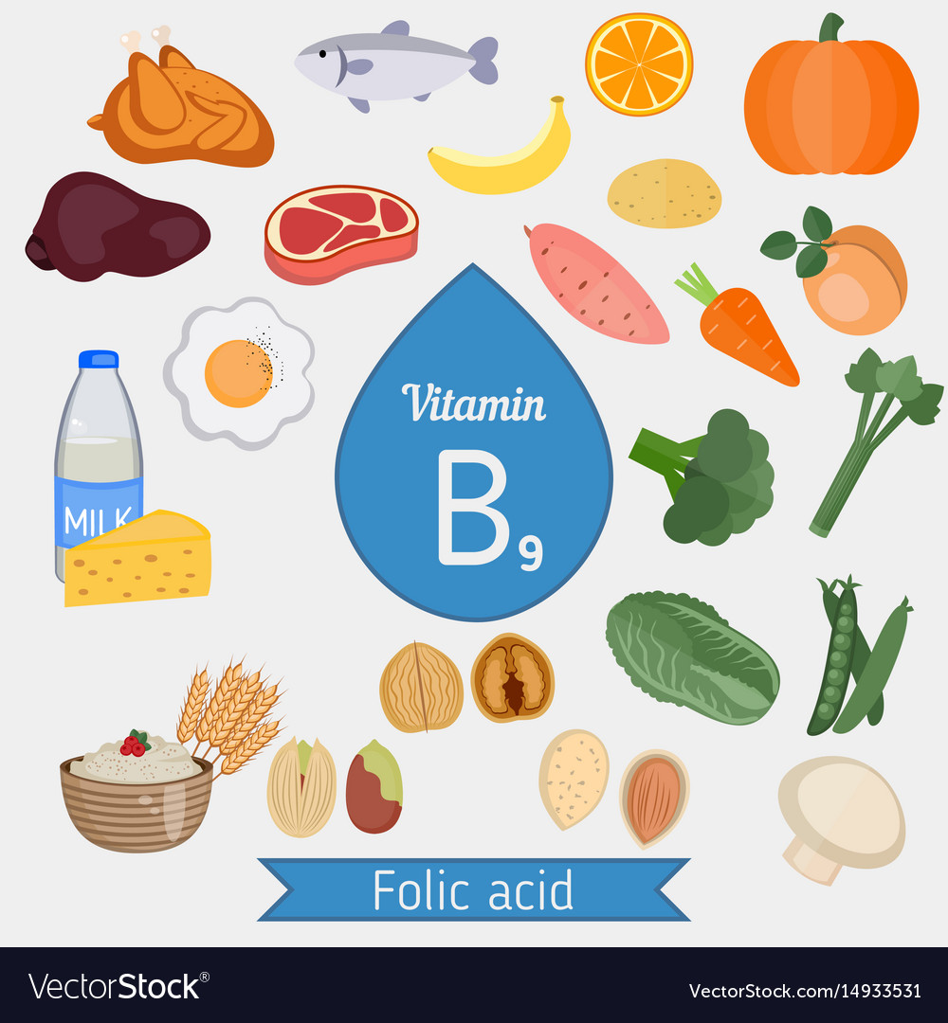
WATER SOLUBLE VITAMINS
VITAMIN B9 (FOLIC ACID)
It is tasteless, odourless, and yellow.
Simple cooking can destroy this vitamin.
It is very essential for reproduction.
It is helpful in blood formation.
Helps for cell division and cell growth, helps for various body function.
DEFICIENCY
Loss of leucocytes, sensations of weakness, ulcer in the mouth, etc.
SOURCES
Yeast, spinach, liver, etc.

Slide 13
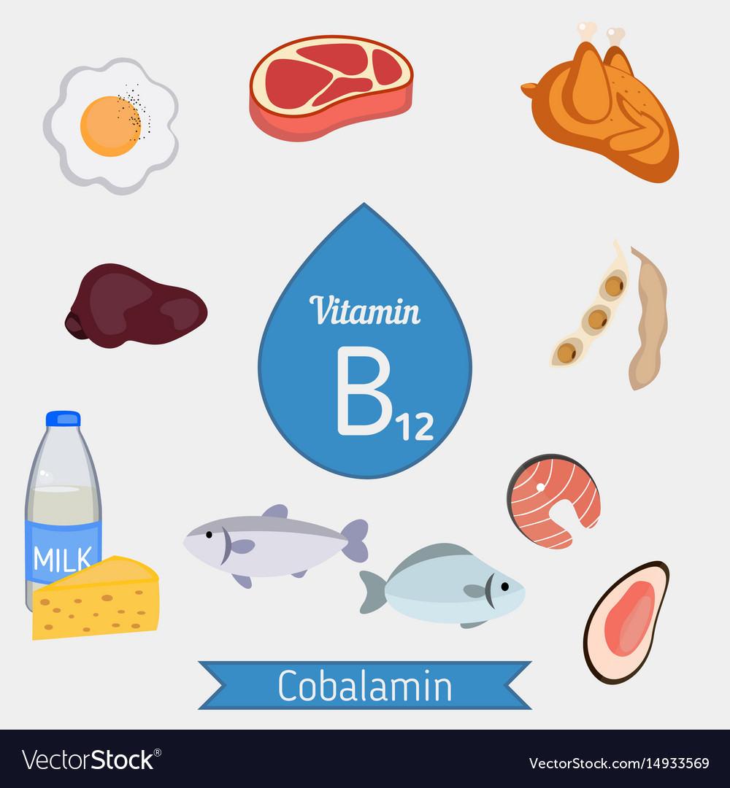
WATER SOLUBLE VITAMINS
VITAMIN B12 (COBALAMIN)
Its colour is red.
It is destroyed if food is cooked for a longer time.
It is Helps in protein metabolism, production of normal red blood cells, and maintenance of the nervous system.
DEFICIENCY
Anemia, headache, balance problems, dizziness, etc.
SOURCES
Milk products, eggs, meat, fish, etc.

Slide 14
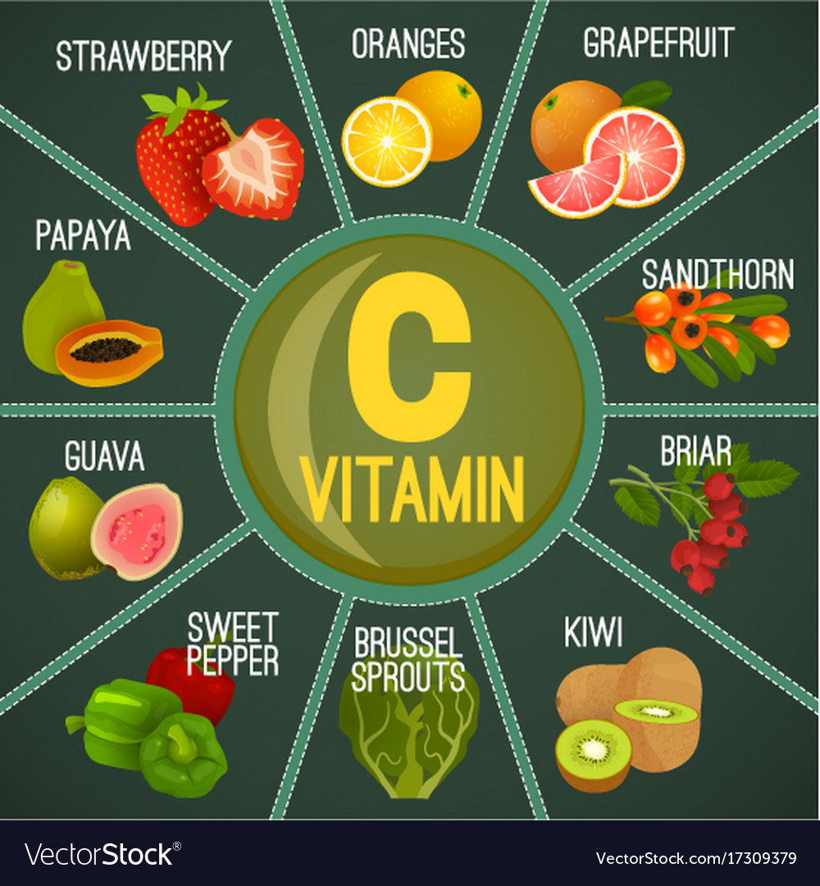
WATER SOLUBLE VITAMINS
VITAMIN C (ASCORBIC ACID)
It is a water-soluble vitamin and cannot be stored in the body.
It is a white crystalline substance. (white colour)
Most plants and animals can produce their own vitamin C but humans cannot.
It is needed for proper growth, development, and to heal wounds.
DEFICIENCY
Scurvy, weakness, irritability, etc.
SOURCES
Amla, green chilies, and tomatoes (very high).

Slide 15
VITAMIN B COMPLEX
VITAMINS | SCIENTIFIC NAME | APPROX. DAILY VALUE | DEFICIENCY DISEASES
B1 | THIAMIN | 1.5 mg | ‘beriberi’, constipation, irritation and anger.
B2 | RIBOFLAVIN | 1.7 mg | Unhealthy skin, inflammation in eyes, decreases immunity power of WBC
B3 | NIACIN | 20 mg | Pellagra, Symptoms – indigestion, fatigue, vomiting and depression.
B5 | PANTOTHENIC ACID | 10 mg | Insomnia, depression, fatigue, irritability, vomiting, stomach pain, etc.
B6 | PYRIDOXINE | 2 mg | Depression (sadness), dizziness (faintness), nausea (vomiting), sores in the mouth, etc.
B7 | BIOTIN | 30 mg | Impaired growth, Hair loss, hallucinations, loss of appetite, muscle pain, conjunctivitis, etc.
B9 | FOLIC ACID | 400 mcg | Loss of leucocytes, sensations of weakness, ulcer in the mouth, etc.
B12 | COBALAMINS | 2.4 mcg – for 14 years and above, 2.6 mcg for pregnant women | Anemia, headache, balance problems, dizziness, etc.

Slide 16
THANKING YOU
ODM EDUCATIONAL GROUP

