Slide 1


COMMON POSTURAL DEFORMITIES
SUBJECT : PHYSICAL EDUCATION
CHAPTER NUMBER: 05
CHAPTER NAME : CHILDREN AND WOMEN IN SPORTS

Slide 2


WHAT WE EXPECT TO LEARN?
01
What is Deformities?
02
What is postural deformities?
03
Types of postural deformities
04
Causes, precautions, and remedies of these deformities.

Slide 3
COMMON POSTURAL DEFORMITIES
SPINAL CURVATURE
FLATFOOT
KNOCK-KNEES
BOW LEGS
ROUND SHOULDERS
KYPHOSIS
LORDOSIS
SCOLIOSIS

Slide 4

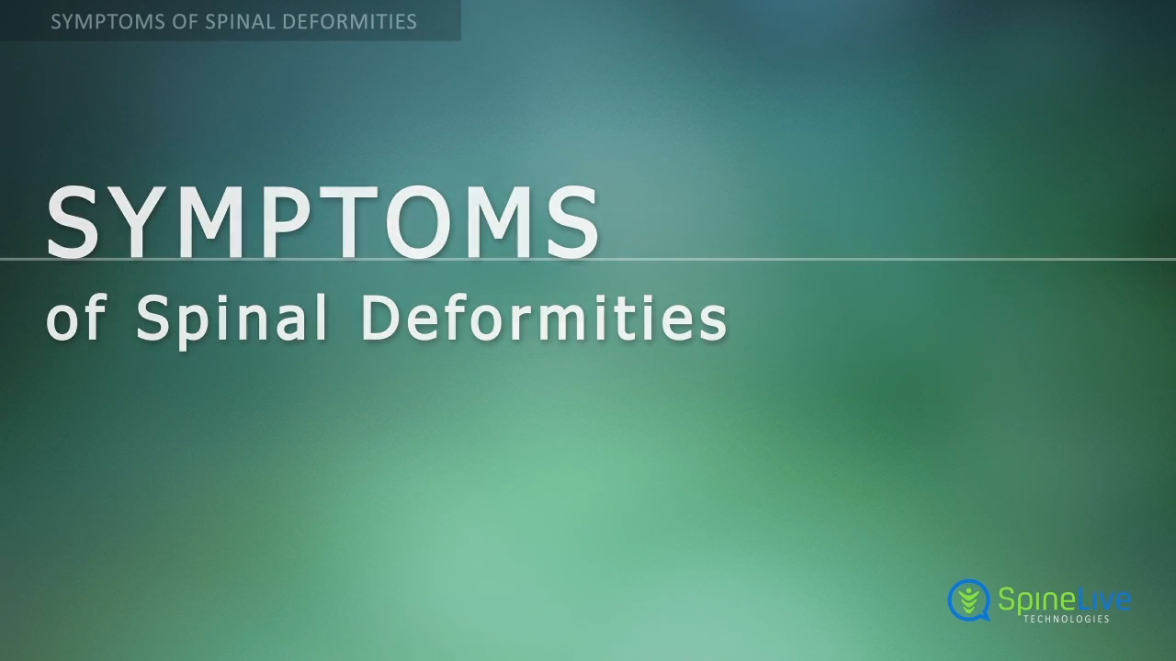

WHAT IS SPINAL CURVATURE?

Slide 5
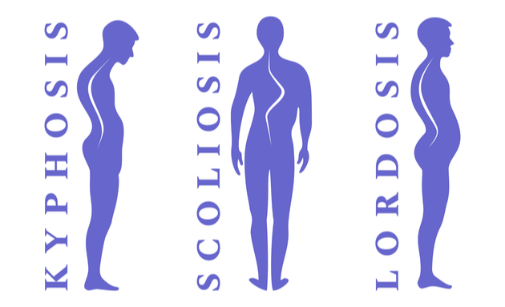
WHAT IS SPINAL CURVATURE?
This type of deformity is related to the spine.
Spinal curvature is the back muscles take curve due to weakness.
This deformity is due to carrying overload continuous.
Many times the bones of the spine imbalances due to bad sleep posture.
Spinal curvature can refer to the normal concave and convex curvature of the spine.

Slide 6
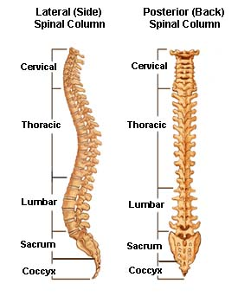
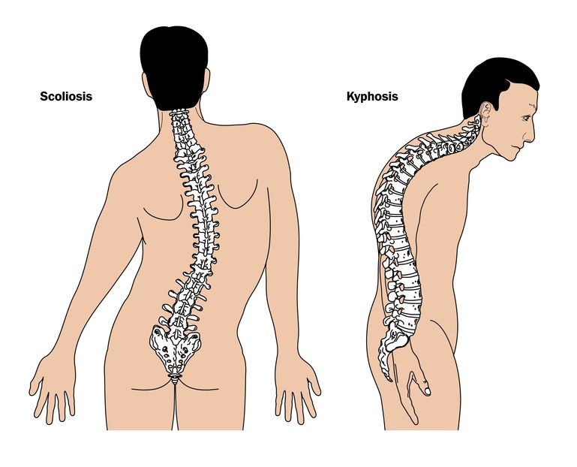
NORMAL SPINE & SPINAL CURVATURE
NORMAL SPINE
SPINAL CURVATURE

Slide 7
TYPES OF SPINAL DEFORMITIES
KYPHOSIS
LORDOSIS
SCOLIOSIS
HUMP AT BACK
HUMP AT FRONT
THE SPINE BENDING ‘S’ & ‘C’

Slide 8
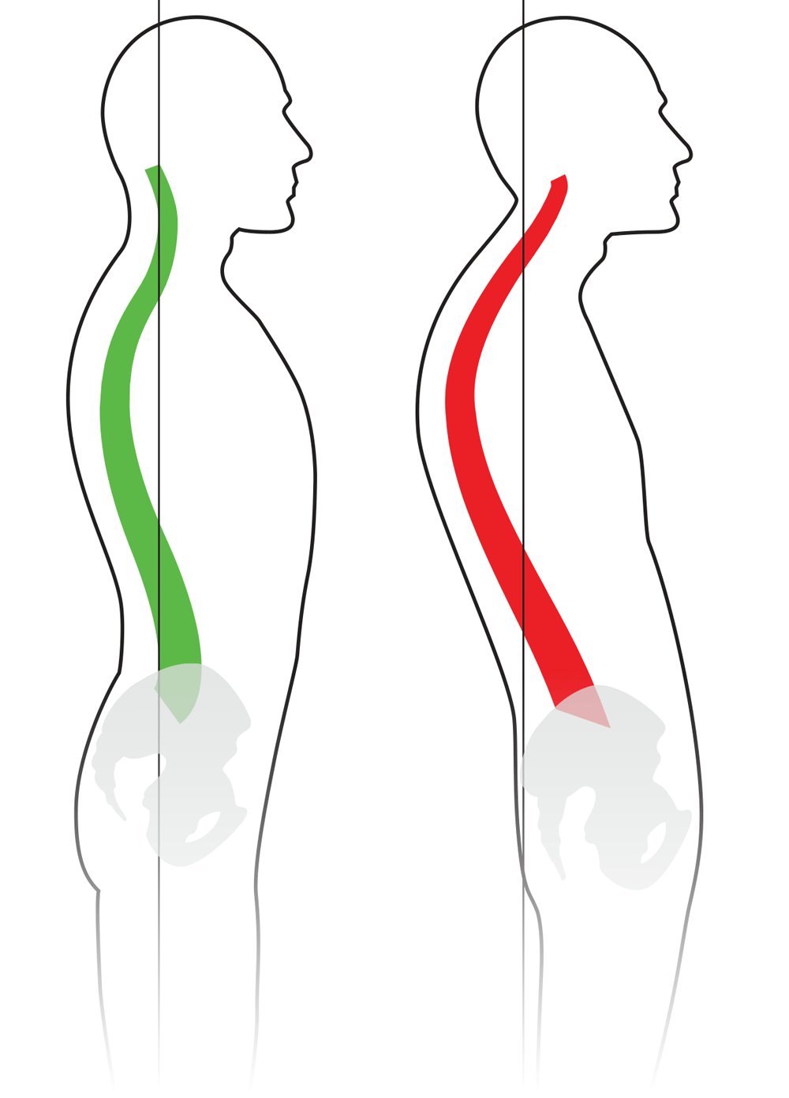
SPINAL CURVATURE
KYPHOSIS
Kyphosis implies an increase or exaggeration of a backward or posterior curve or a decrease or reversal of a forward curve.
Depression of chest is common in Kyphosis.
It is also called ‘round upper back’.

Slide 9
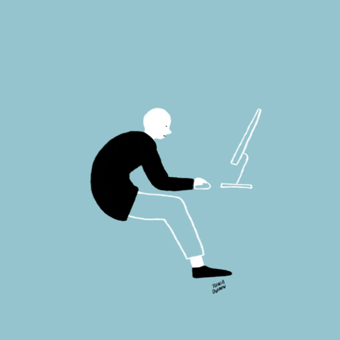
SPINAL CURVATURE
CAUSES OF KYPHOSIS
Aging
Poor body posture, rickets
Muscle weakness in the upper back
Malnutrition
Illness, lack of pure air
Insufficient exercises
Carrying heavy loads on shoulders
Unsuitable furniture
Osteoporosis
The loss of bone strength due to age

Slide 10

SPINAL CURVATURE
PRECAUTIONS FOR KYPHOSIS
They should teach appropriate posture of sitting, standing, walking and running to children.
Avoid carrying heavy schoolbags that can pull on the back muscles and ligaments.
Take regular exercise to help strengthen the back and keep it flexible.

Slide 11
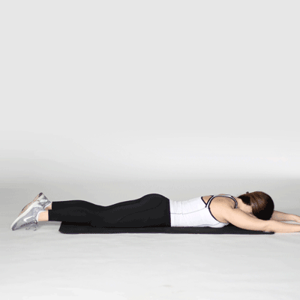
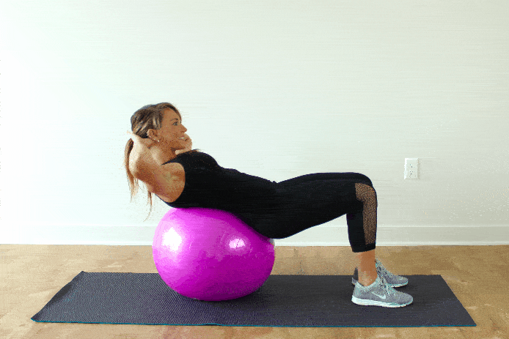
SPINAL CURVATURE
REMEDIES FOR KYPHOSIS
Always keep a pillow under your back while sleeping.
Perform DHANURASANA & BHUJANGASANA regularly.
Bend your hand backward in standing position.
Keeping your head in a neutral position, looking toward the floor, lift your arms, and legs up toward the ceiling.

Slide 12
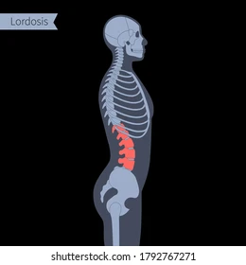
SPINAL CURVATURE
LORDOSIS
Lordosis is a curving inward of the lower back spine.
Increased forward curve in the lumber region.
It creates problem in standing and walking.
Lordosis can be corrected in an early stage.

Slide 13
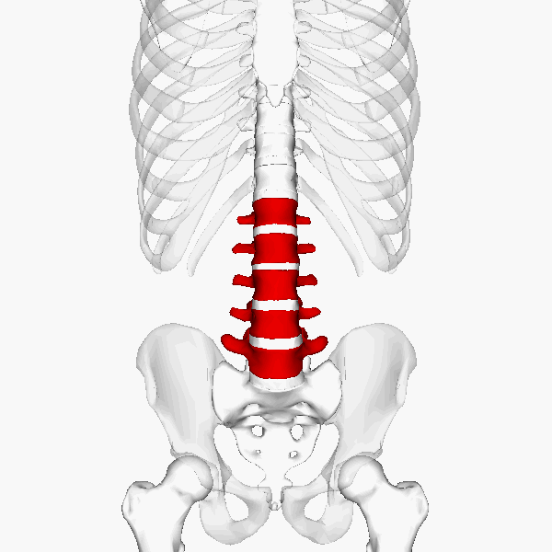
SPINAL CURVATURE
CAUSES OF LORDOSIS
Improper development of muscles
Improper environment
Imbalanced diet, obesity and diseases
Not performing exercise
Eating excessive food

Slide 14
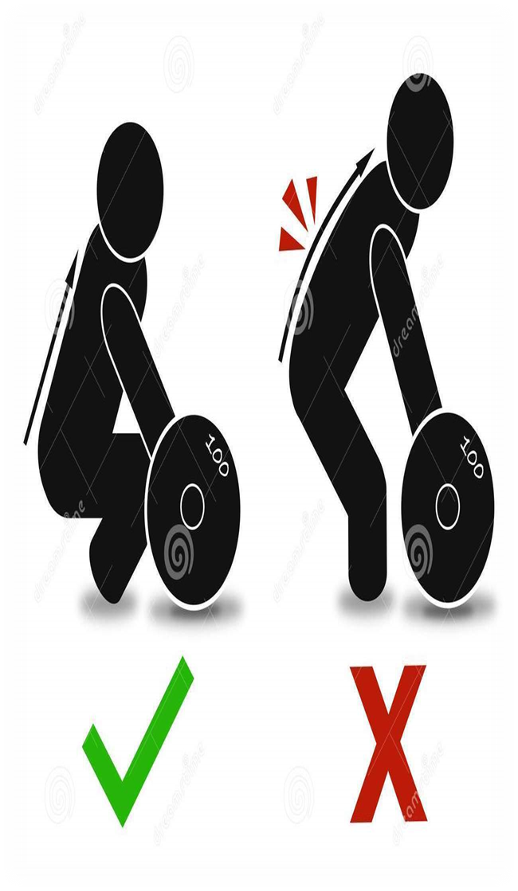
SPINAL CURVATURE
PRECAUTIONS FOR LORDOSIS
Balance diet should be taken
Obesity should be kept away in early age
Body should be kept straight while carrying weight
Excessive intake of food should be avoided

Slide 15
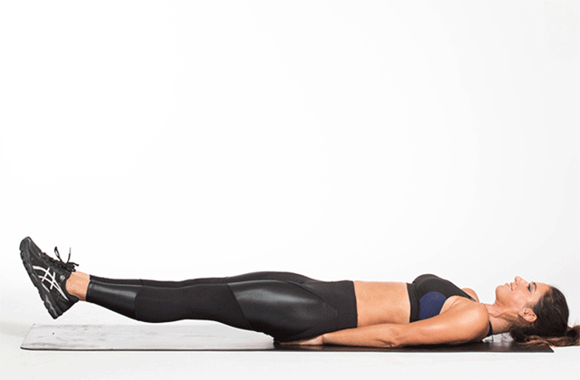
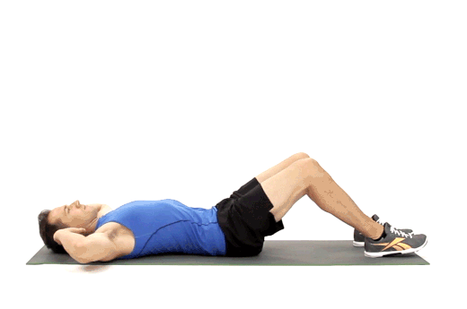
SPINAL CURVATURE
REMEDIES FOR LORDOSIS
Lie down on your back and raise your head and legs simultaneously for 10 times.
Perform sit-ups regularly.
HALASANA should be performed regularly.
Lie down on your back, then raise your legs 45 angle.

Slide 16
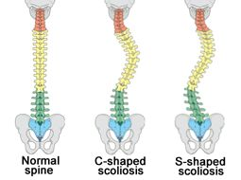
SPINAL CURVATURE
SCOLIOSIS
Postural adaptation of the spine in lateral position is called Scoliosis.
A sideways curvature of the spine.
The curvature of the back may develop as a single curve (shaped like the letter C) or as two curves (shaped like the letter S).

Slide 17
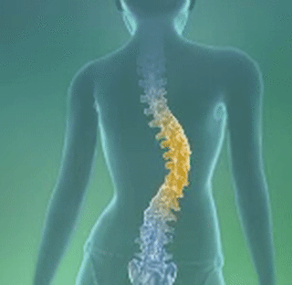
SPINAL CURVATURE
CAUSES OF SCOLIOSIS
Diseases in the joints of bones.
Under-developed legs, infantile paralysis, rickets.
Carrying heavy lodes on one shoulder.
Congenital or acquired abnormalities of vertebrae, muscles or nerves.

Slide 18

SPINAL CURVATURE
PRECAUTIONS FOR SCOLIOSIS
Balance diet should be taken.
Studying should be avoided in sideways bending position.
Avoid walking for long time while carrying weight in one hand.

Slide 19
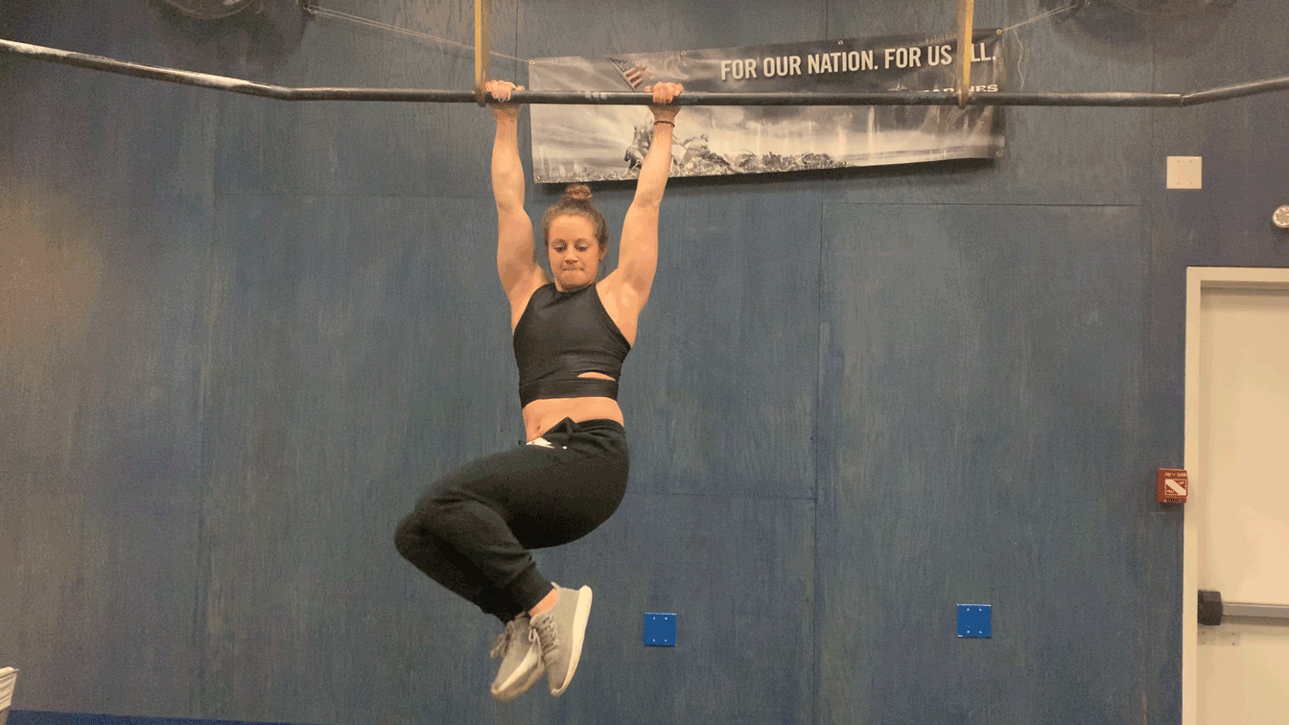
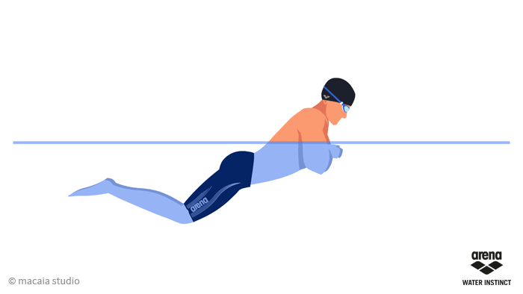
SPINAL CURVATURE
REMEDIES FOR SCOLIOSIS
Bending exercise should be done on the opposite side of the ‘C’ shaped curve.
Swim by using breaststroke technique.
Hold the horizontal bar with your hands and swing your body to the left and right sides.

Slide 20

1. Which one is NOT Spinal Curvature?
KYPHOSIS
LORDOSIS
SCOLIOSIS
ROUND SHOULDERS
2. I’m implies an increase or exaggeration of a backward or posterior curve. Who am I?
KYPHOSIS
LORDOSIS
SCOLIOSIS
ALL OF THESE
3. Which deformities is known as sideways curvature?
KYPHOSIS
LORDOSIS
SCOLIOSIS
NONE OF THESE

Slide 21

What is Kyphosis?
What is Scoliosis?
Enlist any three causes of Lordosis.
Explain all the precautions of Kyphosis.

Slide 22
THANKING YOU
ODM EDUCATIONAL GROUP

