Slide 1


PHYSIOLOGICAL CHANGES DUE TO AGEING
&
SPORTS INJURIES
SUBJECT : (PHYSICAL EDUCATION)
CHAPTER NUMBER: 7
CHAPTER NAME : PHYSIOLOGY AND INJURIES IN SPORTS

Slide 2

WHAT WE EXPECT TO LEARN?
We will be able to know about the ‘PHYSIOLOGICAL CHANGES DUE TO AGEING’.
We will be familiar, What are the causes of Ageing?
We will be able to know about the ‘SPORTS INJURIES’.
We will be described all the Classifications of Sports Injuries.
All the concepts will create interest among the students to #PrecautionIsBetterThanCure

Slide 3

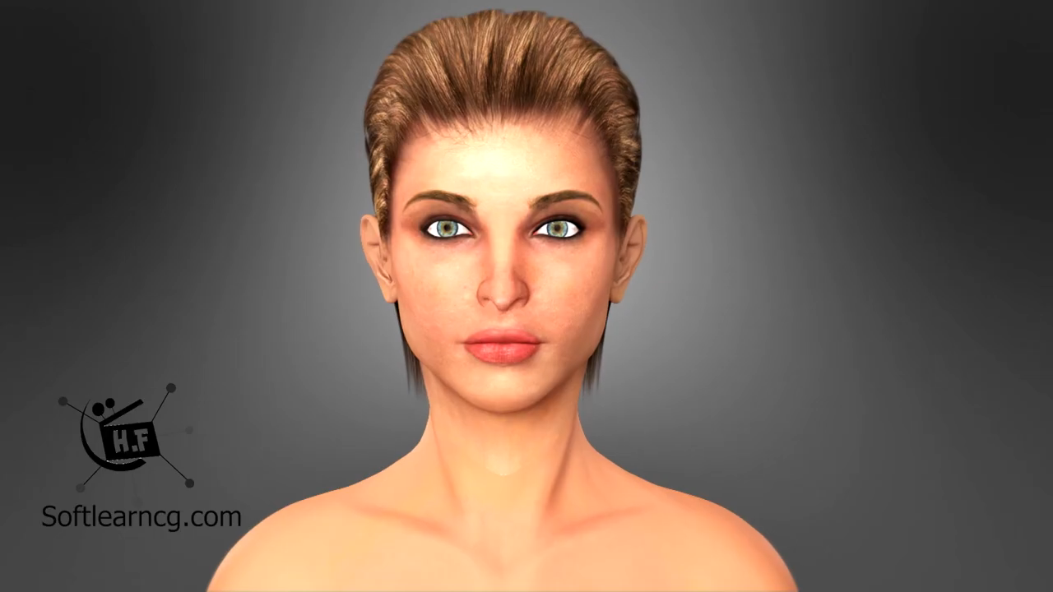
WHAT IS THE AGEING?

Slide 4
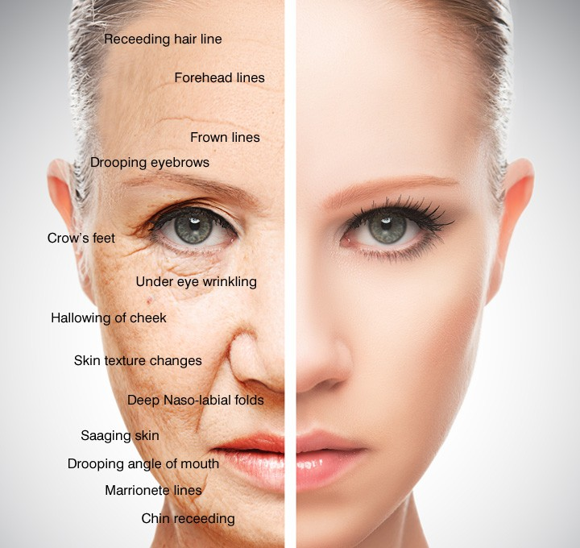
PHYSILOGICAL CHANGES DUE TO AGEING
Meaning Of Ageing :- Ageing is the process of gradual changes in the body with the passage of time. These changes are noticeable usually after 30’s. Ageing, in its broadest sense is the continuous & irreversible decline in the efficiency of various physiological functions.
Changes in Muscle Size & strength
Changes in Metabolism & Body Composition
Changes in Bone Density
Changes in Respiratory System
Changes in Cardiovascular System
Changes in Nervous System
Changes in the Gastrointestinal System
Changes in Urinary System
Changes in Flexibility
Changes in Senses
Changes in Vision
Changes in Hearing
Changes in Teste & Smell

Slide 5
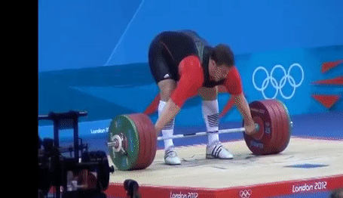
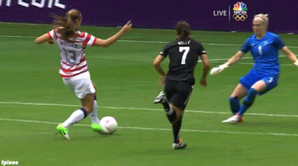
Sports injuries refer to the kinds of injury that occur during sports or exercise.
WHAT IS SPORTS INJURY?

Slide 6
CLASSIFICATION OF SPORTS INJURIES
SPORTS INJURIES
SOFT TISSUE INJURIES
BONE INJURIES
JOINTS INJURIES
CONTUSION
STRAIN
SPRAIN
ABRASION
BRUISES
SIMPLE
COMPOUND
COMPLICATED
GREENSTICK
COMMINUTED
IMPACTED
LOWER JAW
SHOULDER
HIP JOINT
WRIST

Slide 7
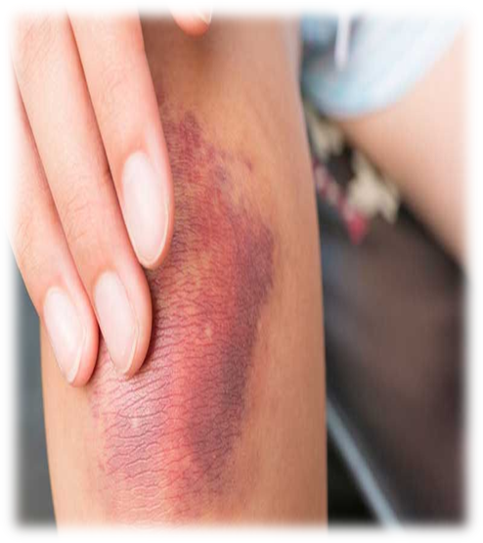
SOFT TISSUE INJURIES - CONTUSION
WHAT IS ?
Contusion is the muscle injury.
Blood or bleeding under the skin. (blood vessels are broken)
Blood capillaries have been ruptured.
CAUSES
Due to direct hit or kicked, any sports equipment.
Due to minor accidents to the skin, such as falling, bumping.
FEATURES/ SYMPTOMS
Stiffness & swelling.
Muscles fail to respond, muscles become completely inactive.
POSSIBILITY GAMES
Boxing, Wrestling and Kabaddi

Slide 8
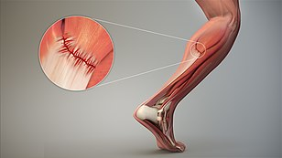
SOFT TISSUE INJURIES - STRAIN
WHAT IS ?
Strain is the muscle injury. (also called pulled muscle)
It’s may be mild or severe (complete muscle can be ruptured)
In case of complete rupture – not possible to movement.
CAUSES
Due to twisting or pulling a muscle or tendon.
Due to lifting heavy objects in the wrong way and over-stressing the muscles.
FEATURES/ SYMPTOMS
Pain, swelling, cramping, and limited range of motion.
POSSIBILITY GAMES
Football, hockey, boxing, and wrestling, long-distance running, etc.

Slide 9
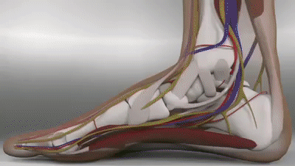
SOFT TISSUE INJURIES - SPRAIN
WHAT IS ?
A Sprain is a ligament injury.
A Sprain occurs at wrist and ankle joints
CAUSES
Due to overstretching or tearing of ligament.
Due to falling, twisting or getting hit.
FEATURES/ SYMPTOMS
Pain, inflammation, swelling, and limited ability to move the affected joint.
POSSIBILITY GAMES
Basketball, football, hockey, and long-distance running, etc.

Slide 10

MIND MAP

Slide 11
Soft tissue injuries
Contusion
Bone injuries (Fractures)
Simple Fracture
Compound Fracture
Complicated Fracture
Green Stick Fracture
Comminuted Fracture
Impacted Fracture
Joint injuries (Dislocation)
Dislocation Of Lower Jaw
Dislocation Of Hip Joint
Dislocation Of Shoulder Joint
Dislocation Of Wrist Joint
Strain
Sprain
Abrasion
Bruises

Slide 12

1. Sprain injury usually occurs over …..
SKIN
JOINT
BONE
MUSCLES
2. What is the common symptoms of Sprain?
SEVERE PAIN
TENDERNESS
INFLAMMATION
ALL OF THESE
3. ____________ are known as grazes or scraps.
ABRASION
BRUISES
CONTUSION
MILD ABRASIONS
4. Contusion is common in which sports?
BOXING
KABADDI
BOTH OF THESE
NONE OF THESE

Slide 13
What are the causes of contusion?
What do you mean by Ageing?
What are the common FEATURES/ SYMPTOMS of Strain?

Slide 14

Remember all the Physiological changes due to ageing.
Enlist and learn all the classification of sports injuries.

Slide 15
THANKING YOU
ODM EDUCATIONAL GROUP

