Slide 1


NUTRITIVE COMPONENTS OF DIET
SUBJECT : PHYSICAL EDUCATION
CHAPTER NUMBER: 2
CHAPTER NAME : SPORTS & NUTRITION

Slide 2


WHAT WE EXPECT TO LEARN?
We will be able to know about the ‘NUTRITIVE & NON-NUTRITIVE COMPONENTS OF DIET’.
We will be familiar with the various Components of diet.
We will be described the major components of diet.
All the concepts will create knowledge among the students of SOURCES & DEFICIENCY of various diet.

Slide 3
NUTRITIVE AND NON-NUTRITIVE COMPONENTS OF DIET
NUTRITIVE COMPONENTS OF DIET
PROTEINS – BUILDING BLOCKS OF LIFE
CARBOHYDRATES- FUEL OF BODY
NON-NUTRITIVE COMPONENTS OF DIET
FIBER OR ROUGHAGE
WATER
FATS – BACKUP ENERGY OF BODY
VITAMINS
MINERALS
COLOR COMPOUNDS
FLAVOR COMPOUNDS
PLANT COMPOUNDS

Slide 4
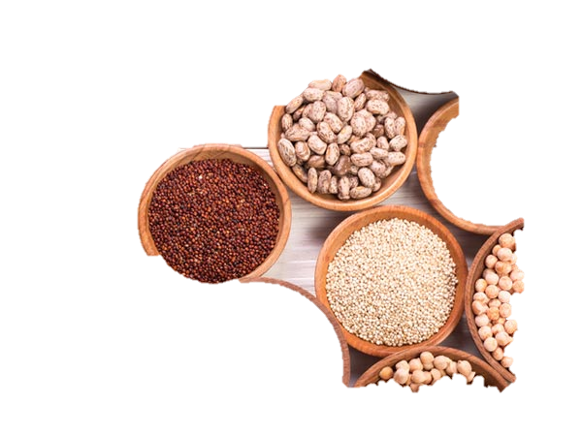
CARBOHYDRATES
CARBOHYDRATE
They are the main source of energy for all activities.
The ratio of hydrogen atoms to oxygen atoms is 2 : 1
CONTAIN CARBON
FUNCTION
Excessive intake of carbohydrates can lead to health conditions such as heart disease, hypertension, diabetes, obesity, and stroke.
Lack of carbohydrates on the other hand results in loose skin, weight loss, weakening of the body, and fatigue.
SOURCES
Food rich in carbohydrates includes cereals, pulses, dried peas, dates, potato, banana, sweet potatoes, Gur, bajra, etc.
CONTAIN HYDROGEN
CONTAIN OXYGEN

Slide 5
TYPES OF CARBOHYDRATES AND DIFFERENTIATE BETWEEN THE TYPES
Simple Carbohydrates
Glucose
Fructose
Complex Carbohydrates
Starch
Dextrin
Galactose
Sucrose
Maltose
lactose
Glycogen
Cellulose
These are insoluble in water.
These are not sweet.
These are not crystalline.
Large chain of chemical compositions
These are soluble in water.
These are sweet.
These are crystalline.
Small chain of chemical compositions

Slide 6
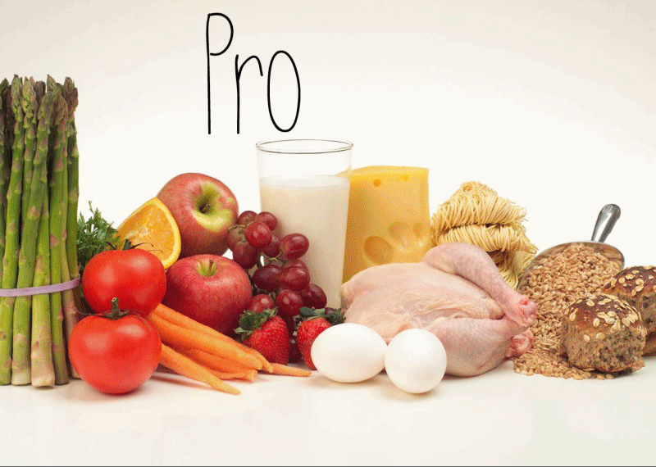
PROTEINS
Proteins contain – carbon, hydrogen, oxygen, nitrogen, and Sulphur.
It’s a very large molecule.
There are 23 amino acids. (9 amino acids must be available in the diet.
It is required to create blood, muscles, nails, skin, hair, and tissues.
The Body requires only 0.36 grams of protein per pound of the ideal body weight.

Slide 7

PROTEINS
Proteins are needed for the growth and development of the body.
It helps and replaces the worn-out tissues.
It does not provide energy under normal routine but gives energy under extreme starvation.
High intake of proteins can result in heart diseases, osteoporosis, stroke, and kidney stones.
Less intake of proteins may suffer from the deficiency of Marasmus & Kwashiorkor.

Slide 8
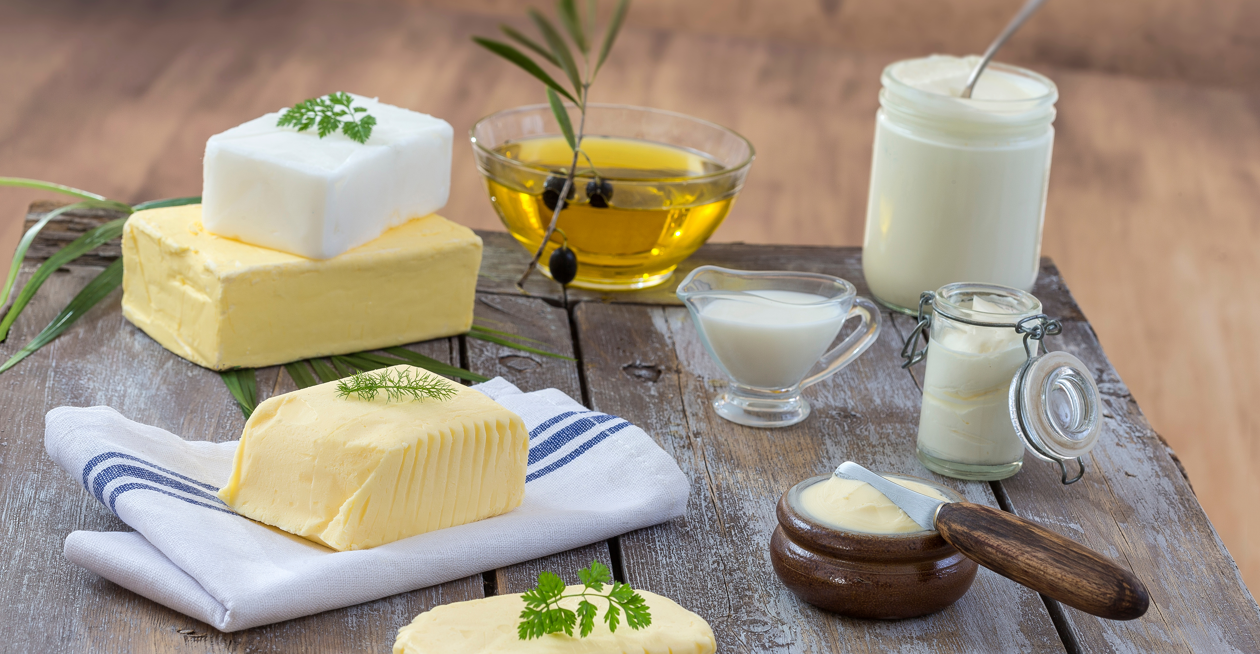
FATS
Fats are emergency sources of energy and stored in the body.
Fats carry Vitamins, A, D, E, K.
Our diet should consist of 20 to 25 % of fat more intake more risk of obesity and many heart diseases.

Slide 9


FATS
UNSATURATED FATS
POLY-UNSATURATED
MONO-UNSATURATED
SATURATED FATS
Coconut, Butter, Ghee
Sunflower Oil
Soybean Oil
Olive Oil
Avocado
TYPES OF FATS

Slide 10
COMPONENTS OF DIET
NUTRITIVE COMPONENTS OF DIET
PROTEINS
CARBOHYDRATES
NON-NUTRITIVE COMPONENTS OF DIET
FIBER OR ROUGHAGE
FATS
VITAMINS
MINERALS
WATER
COLOUR COMPOUNDS
FLAVOUR COMPOUNDS
PLANT COMPOUNDS
Simple Carbohydrates
Complex Carbohydrates
Saturated Fats
Polyunsaturated Fats
Mono –unsaturated Fats
Fat Soluble Vitamins(A,D,E,K)
Water Soluble Vitamins(B complex, C)
Macro Minerals
Micro Minerals

Slide 11
VITAMINS
FAT SOLUBLE
WATER SOLUBLE
VITAMIN A
VITAMIN D
VITAMIN E
VITAMIN K
VITAMIN B COMPLEX
VITAMIN B1
VITAMIN B2
VITAMIN B3
VITAMIN B5
VITAMIN B6
VITAMIN B7
VITAMIN B9
VITAMIN B12
TYPES OF VITAMINS

Slide 12
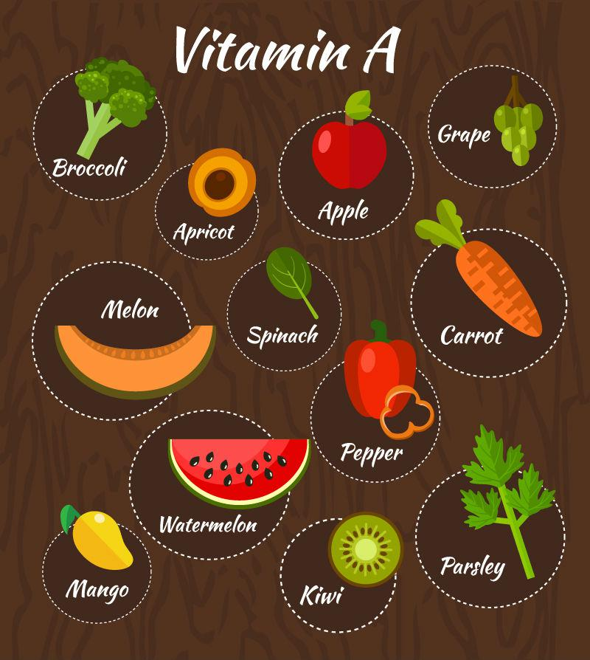
VITAMIN A (yellow)
It was the first vitamin that was discovered in 1913 by Elmer McCollum.
It is found in various forms such as retinol, retinal and retinoic acid.
The elements of hydrogen, carbon and oxygen.
It helps in the formation of bones and teeth.
It promotes normal growth and development of eyes and skin.
Provide resistance to infections.
The daily requirement is approx. 2mg.
DEFICIENCY
Night Blindness, keratomalacia, and xerophthalmia, teeth loss their brightness.
SOURCES
Liver oil, milk, egg, papaya, mango, etc.
FAT SOLUBLE VITAMINS

Slide 13
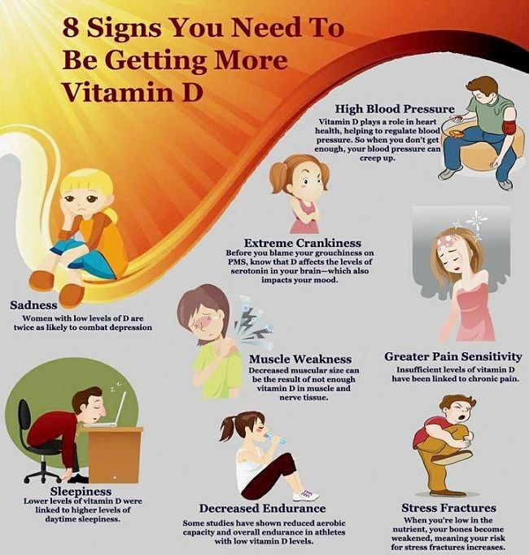
FAT SOLUBLE VITAMINS
VITAMIN D (white and odorless)
It is formed by carbon, hydrogen and oxygen.
It’s a written crystalline substance.
It helps in the absorption and maintenance of calcium and phosphorus.
It maintains hormone secretion by parathyroid glands.
DEFICIENCY
Rickets, dental cavities and osteoporosis.
SOURCES
Sunray, milk, butter, fish liver oil, etc.

Slide 14
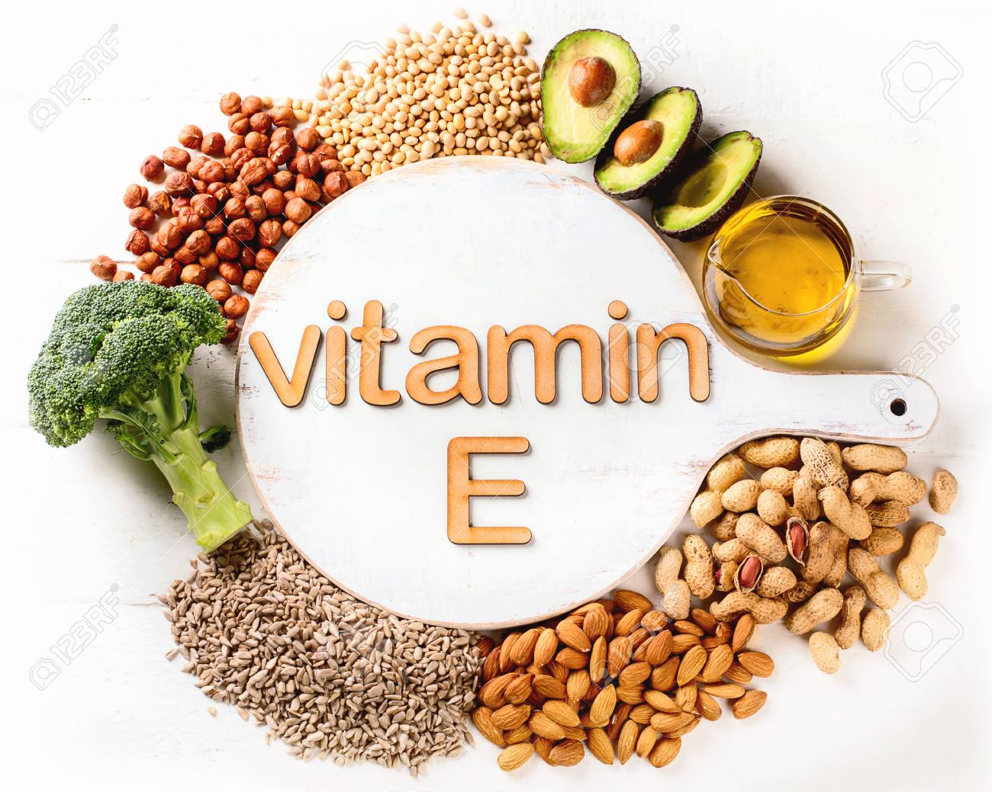
FAT SOLUBLE VITAMINS
VITAMIN E
It’s required for the growth of many organs in our body.
It strengthens the cell membrane.
It keeps skin healthy and helps in curing cancer.
It maintains the normal functioning of reproductive organs and prevents heart attacks.
DEFICIENCY
Genetic disorder, Anemia, paralysis, low RBC (ability to produce sex HORMONES)
SOURCES
Leafy green vegetables, egg, kidney, liver, heart, cottonseed, etc.

Slide 15
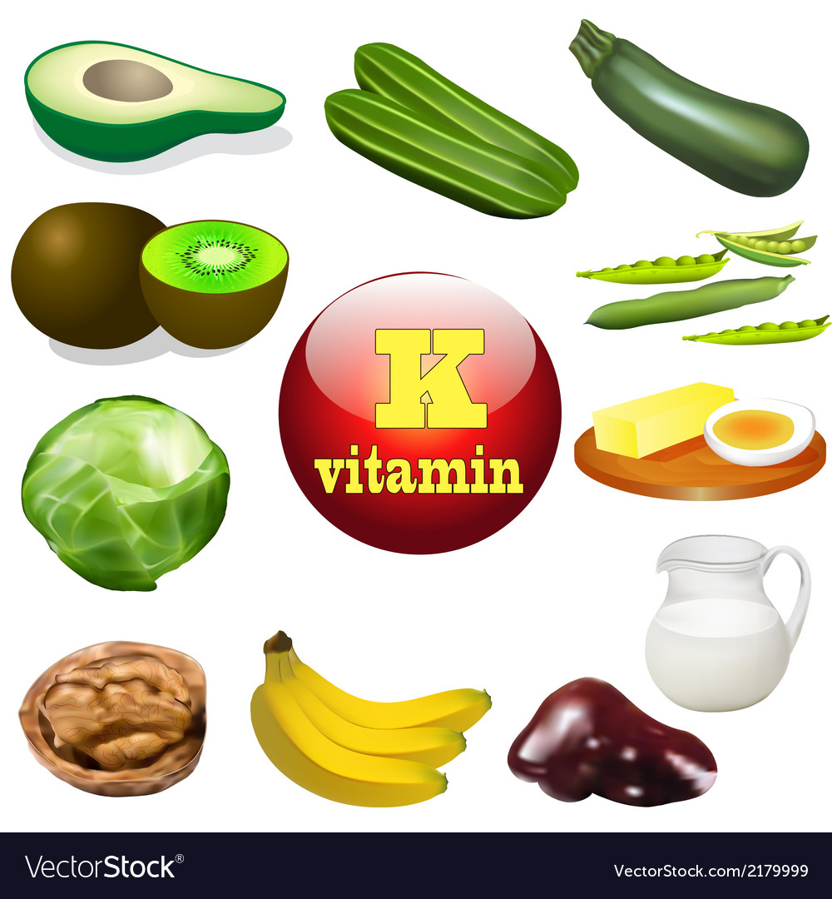
FAT SOLUBLE VITAMINS
VITAMIN K
It is derived from the word ‘coagulation’ which means clotting of blood.
It helps to clot the blood.
It plays a vital role In cell growth.
It helps in the prevention of hemorrhage and excessive bleeding in wounds.
It helps pregnant ladies.
DEFICIENCY
Heavy menstrual cycle, anemia.
SOURCES
Tomato, potato, spinach, cabbage, fish, egg, meat, etc.

Slide 16
THANKING YOU
ODM EDUCATIONAL GROUP

