Slide 1


FACTORS AFFECTING MOTOR DEVELOPMENT
SUBJECT : PHYSICAL EDUCATION
CHAPTER NUMBER: 05
CHAPTER NAME : CHILDREN AND WOMEN IN SPORTS

Slide 2

WHAT WE EXPECT TO LEARN?
We will be able to know about the ‘MOTOR DEVELOPMENT’.
We will be familiar with the various types of MOTOR DEVELOPMENT.
We will be described the FACTORS AFFECTING MOTOR DEVELOPMENT.

Slide 3
FACTORS AFFECTING MOTOR DEVELOPMENT
BIOLOGICAL FACTORS
ENVIRONMENTAL FACTORS
NUTRITION
PHYSICAL ACTIVITIES
OPPORTUNITIES
SENSORY IMPAIRMENTS
POSTURAL DEFORMITIES

Slide 4

FACTORS AFFECTING MOTOR DEVELOPMENT
BIOLOGICAL FACTORS
Biological factors are related to the genes.
These factors are also known as heredity or genetic factors.
The genes which we get from our parents are responsible for various types of motor development.
The percentage of FTF and STF depends on biological factors.
These factors are related to body weight, size, and strength.

Slide 5
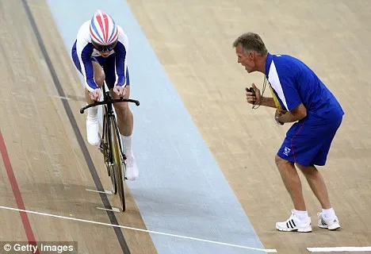
FACTORS AFFECTING MOTOR DEVELOPMENT
ENVIRONMENTAL FACTORS
Motor development takes place at a faster rate in children who are encouraged to explore their surroundings.
They are given more opportunities to take part in sports activities.
Encouragement, love and security push a child to take risks to explore fearlessly, which leads to better motor development.

Slide 6

FACTORS AFFECTING MOTOR DEVELOPMENT
NUTRITION
Nutritious food promotes good motor development.
Sensory motor development is dependent upon nutrition.
If children do not get proper nutrition they are found to be less energetic.

Slide 7

FACTORS AFFECTING MOTOR DEVELOPMENT
PHYSICAL ACTIVITIES
The physical activities must be according to the capabilities of children.
Motor development becomes slow in those children, who do not take part in physical activities regularly.
Not doing even minor physical activities results in delayed motor development in children.

Slide 8

FACTORS AFFECTING MOTOR DEVELOPMENT
OPPORTUNITIES
Opportunities to participate in motor activities give a better chance for developing sensory motor abilities.
Children should be given sports opportunities in schools, homes and neighborhoods.

Slide 9

FACTORS AFFECTING MOTOR DEVELOPMENT
SENSORY IMPAIRMENTS
Sensory impairments such as visual impairments, hearing impairments, etc., are likely to affect the motor development in children.
Due to hearing impairments, following instructions about any type of motor activity become more difficult.

Slide 10
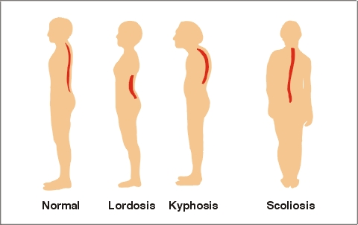
FACTORS AFFECTING MOTOR DEVELOPMENT
POSTURAL DEFORMITIES
If a children has any postural deformity, such as spinal curvature deformities, flatfoot, knock-knees, bow leg, etc., creates obstacles in the path of motor development of children.

Slide 11

FACTORS AFFECTING MOTOR DEVELOPMENT
OBESITY
Who are overweight or obese are not enthusiastic to do any motor activity and the may even feel uncomfortable to do it.
Such children take more time to perform motor movement.

Slide 12

Explain major factors affecting motor development.

Slide 13
THANKING YOU
ODM EDUCATIONAL GROUP

