Slide 1


PHYSIOLOGICAL FACTORS DETERMINING THE COMPONENTS OF PHYSICAL FITNESS
SUBJECT : PHYSICAL EDUCATION
CHAPTER NUMBER: 7
CHAPTER NAME : PHYSIOLOGY AND INJURIES IN SPORTS

Slide 2

WHAT WE EXPECT TO LEARN?
We will be able to know about the ‘COMPONENTS OF PHYSICAL FITNESS’
We will be familiar with the various types of Physical Fitness.
We will be described the PHYSIOLOGICAL FACTORS DETERMINING PHYSICAL FITNESS.
All the concepts will create interest among the students to boost-up strength, speed, endurance, and flexibility.

Slide 3
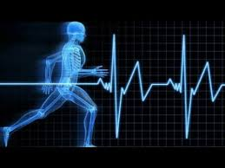
WHAT IS SPORTS PHYSIOLOGY
It is the study of the LONG and SHORT term effects of training and bodies conditions of athletes.
Sport physiology is the study of how exercise changes the function and structure of the body.
CERTAIN PHYSIOLOGICAL CHANGES ARE
Aerobic Capacity
Muscle Composition
Size of Muscles
Intensity of the Nerve Impulse
Lactic acid tolerance
Stroke Volume
Heart Rate
Blood Pressure

Slide 4
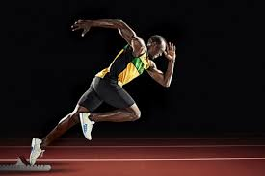



THE COMPONENTS OF PHYSICAL FITNESS
STRENGTH
SPEED
ENDURANCE
FLEXIBILITY
STRENGTH - The ability to carry out work against a resistance.
SPEED - The ability/capacity to perform a movement of the same pattern at a faster rate.
ENDURANCE - The ability to resist fatigue.
FLEXIBILITY - The range of movements of joints.

Slide 5
PHYSIOLOGICAL FACTORS DETERMINING STRENGTH
STRENGTH
SIZE OF MUSCLES
BODY WEIGHT
MUSCLE COMPOSITION
INTENSITY OF THE NERVE IMPULSE

Slide 6

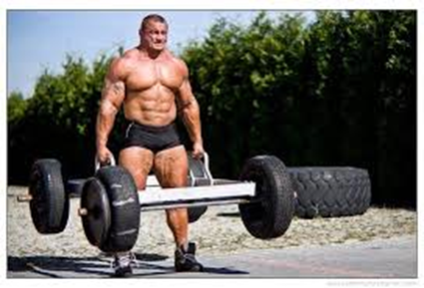
PHYSIOLOGICAL FACTORS DETERMINING STRENGTH
Its well-known fact that bigger and larger muscles can produce more force.
Males are found to be stronger.
The size of the muscle can be increased, with the help of different methods of training (weight training).
SIZE OF MUSCLES

Slide 7

PHYSIOLOGICAL FACTORS DETERMINING STRENGTH
BODY WEIGHT
Its well-known fact that the individual who are heavier are generally stronger than the individuals who are lighter.
A positive co-relation between body weight and strength (weightlifters).
The heavier weightlifters lift heavier weights.
MURALI KUMAR

Slide 8
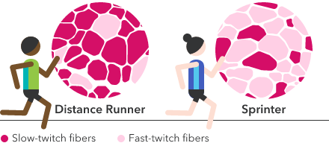
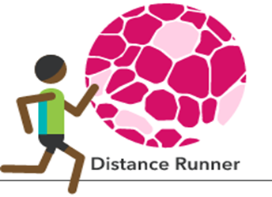
PHYSIOLOGICAL FACTORS DETERMINING STRENGTH
MUSCLE COMPOSITION
FAST TWITCH FIBRES (WHITE FIBRES)
SLOW TWITCH FIBRES (RED FIBRES)
THE FAST TWITCH FIBRES are capable to contract faster.
They can produce more force.
THE SLOW TWITCH FIBRES are NOT capable to contract faster.
They are capable of contracting for a longer duration.
Create energy anaerobically
(without oxygen)
Have more blood vessels
(for more oxygen and longer use)

Slide 9
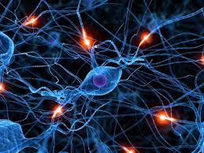
PHYSIOLOGICAL FACTORS DETERMINING STRENGTH
INTENSITY OF THE NERVE IMPULSE
A muscle is composed of a number of motor units.
The total force of the muscle depends on the number of contracting motor units.
Whenever a stronger nerve impulse from CNS excite more numbers of motor units.
The muscles will contract more strongly then produces more force.

Slide 10
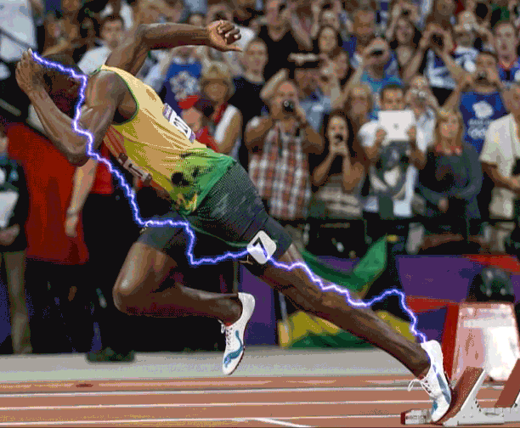
PHYSIOLOGICAL FACTORS DETERMINING SPEED
MOBILITY OF THE NERVOUS SYSTEM
Our muscles contract and relax at the maximum possible speed as seen in sprinting events.
The rapid contraction and relaxation of muscles is made possible by rapid excitation & inhibition of the concerned motor centers .
The nervous system can maintain only for a few seconds.
The excitation spreads to the neighboring centers causing tension in the entire body.
It can be trained but only to a limited extent.
Speed is determined to a great extent by genetic factor.

Slide 11


PHYSIOLOGICAL FACTORS DETERMINING SPEED
MUSCLES COMPOSITION
Muscle with greater percentage of FAST TWITCH FIBRES contract with more speed .
The muscle composition is genetically determined (can’t be changed by training).
Different muscles of the body have different % of fast twitch, so speed have different of body parts.

Slide 12

PHYSIOLOGICAL FACTORS DETERMINING SPEED
EXPLOSIVE STRENGTH
Explosive strength depends on muscle composition, muscle size and muscle coordination.
It also depends on the metabolic process.

Slide 13

PHYSIOLOGICAL FACTORS DETERMINING SPEED
FLEXIBILITY
Flexibility allows maximum range of movement without much internal resistance.
Flexibility also enable complete utilization of explosive strength.

Slide 14



PHYSIOLOGICAL FACTORS DETERMINING SPEED
BIO-CHEMICAL RESERVES AND METABOLIC POWER
If ATP & CP Store is less in contracting muscles, the muscle contraction due to insufficient energy supply become slow after a short time.
The energy supply also depends on certain enzymes which increase the metabolic power.

Slide 15

PHYSIOLOGICAL FACTORS DETERMINING ENDURANCE
AEROBIC CAPACITY
Oxygen intake
Oxygen transport
Oxygen uptake
Energy reserves

Slide 16
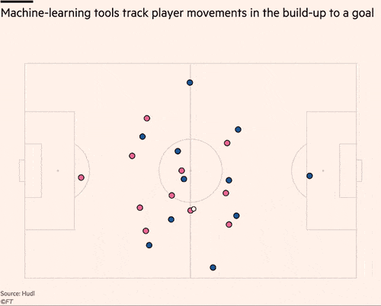
PHYSIOLOGICAL FACTORS DETERMINING ENDURANCE
MOVEMENT ECONOMY
Unnecessary movement are reduced movement economy
LACTIC ACID TOLERANCE
The ability to tolerate higher concentration of muscles.
MUSCLE COMPOSITION
Fast twitch and slow twitch muscles fibers.

Slide 17
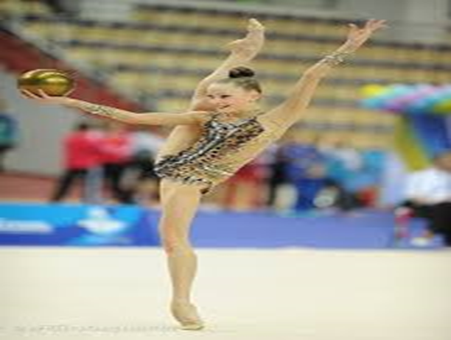
PHYSIOLOGICAL FACTORS DETERMINING FLEXIBILITY
The maximum range of movement possible at the joint enhance level of flexibility and that would be depends number of factor.
Muscle Strength :-
Strength of muscles must be possible to make movement specially against gravity or external force.
Internal Environment :-
High body (temperature/by environment) increase flexibility or Muscle Stretch ability .
Heredity :-
Biologically having more percentages of white muscle fibers .
Previous injuries :-
Injury led to thickening or fibrosing on the affect area, beside connective tissue & fibrous tissues are less elastic lead to reduced flexibility.
Joint Structure :-
Movable, Immovable, Slightly movable & Ball & socket joint.
Age and Gender :-
Flexibility decreases with the advancement of age.
Gender also determining flexibility females tend to be more flexible than male.

Slide 18

PHYSIOLOGICAL FACTORS DETERMINING
SR. NO. | COMPONENTS | PHYSIOLOGICAL FACTORS
1 | STRENGTH | Size of the Muscle Body Weight Intensity of the Nerve Impulse MUSCLE COMPOSITION
2 | SPEED | Mobility of the Nervous System Explosive Strength Flexibility Bio-chemical Reserves and Metabolic Power MUSCLE COMPOSITION
3 | ENDURANCE | Aerobic Capacity – O2 Intake, O2 Transport, O2 Uptake, Energy Reserves. Lactic Acid Tolerance Movement Economy MUSCLE COMPOSITION
4 | FLEXIBILITY | Muscle Strength Joint Structure Age and Gender Stretchability of Muscles Internal Environment Previous Injury
MIND MAP

Slide 19

1. How many components of Physical Fitness?
4
5
6
7
2. How many types of Muscle Composition?
2
3
4
5
3. ‘Joint Structure’ is a physiological Factor determine ______
STRENGTH
SPEED
ENDURANCE
FLEXIBILITY
4. The ability to resist fatigue is known as ______
STRENGTH
SPEED
ENDURANCE
FLEXIBILITY

Slide 20

Explain any three physiological factors determining strength.
Discuss any three physiological factors determining speed.
Elaborate any three physiological factors determining endurance.
Discuss any three physiological factors determining flexibility.

Slide 21
THANKING YOU
ODM EDUCATIONAL GROUP

