Slide 1


MOTOR DEVELOPMENT
SUBJECT : PHYSICAL EDUCATION
CHAPTER NUMBER: 05
CHAPTER NAME : CHILDREN AND WOMEN IN SPORTS

Slide 2


WHAT WE EXPECT TO LEARN?
01
What is Motor Development?
02
Meaning of Motor Development
03
Types of Motor Development
04
Motor Development in Children

Slide 3
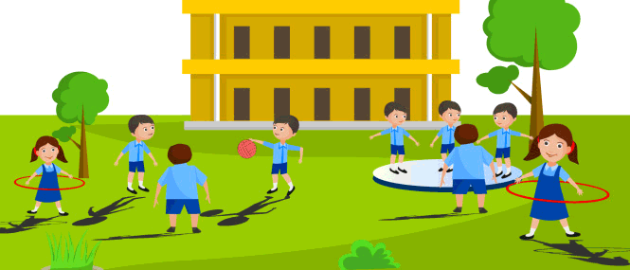
"You will be nearer to Heaven through football than through the study of the Gita."
-Swami Vivekananda

Slide 4

WHAT IS MOTOR DEVELOPMENT?
It is the development of a child’s bone, muscles movement abilities from birth till death.
Motor development is the progressive change in movement throughout one’s life.
Motor movement / motor skills are sitting, walking, running, climbing, etc.

Slide 5
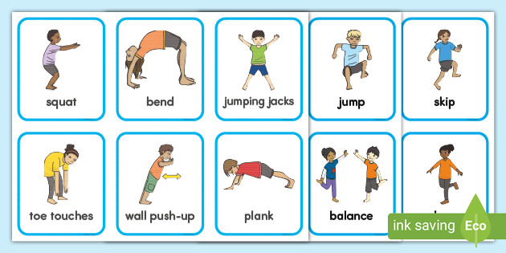
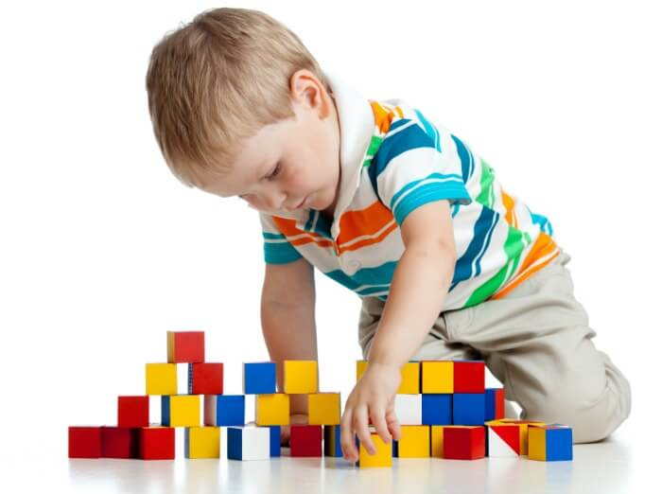
TYPES OF MOTOR DEVELOPMENT
GROSS MOTOR DEVELOPMENT
Gross motor development involves the development of the large muscles in the child’s body.
i.e. sit, stand, walk and run, among other activities.
FINE MOTOR DEVELOPMENT
Fine motor development involves the small muscles of the body, especially during the small movement of fingers and hands.
i.e. holding of ball, catching a ball, etc.
Macro Muscular Motor Development
Micro Muscular Motor Development

Slide 6
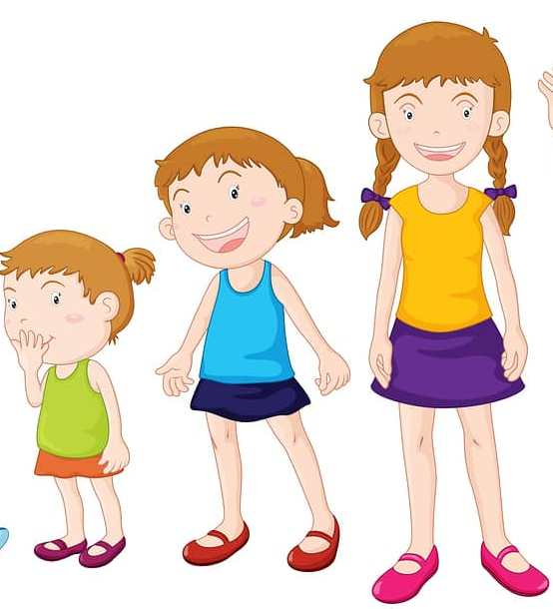
MOTOR DEVELOPMENT DURING VARIOUS STAGES OF CHILDHOOD
EARLY CHILDHOOD
MIDDLE CHILDHOOD
LATE CHILDHOOD
3 STAGES OF CHILDHOOD
03 TO 6 YEARS
7 TO 10 YEARS
11 & 12 YEARS

Slide 7
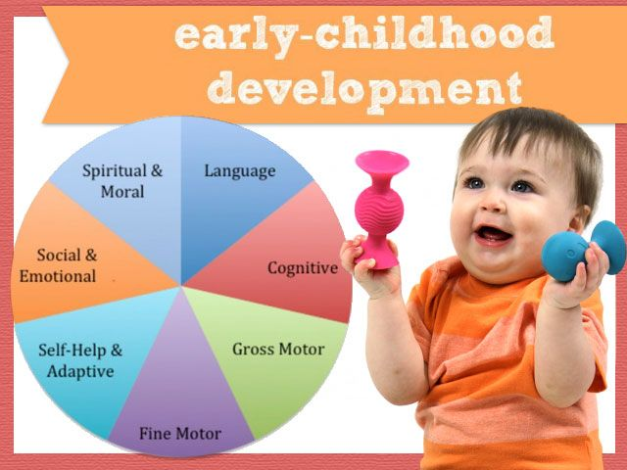
EARLY CHILDHOOD
MOTOR DEVELOPMENT DURING VARIOUS STAGES OF CHILDHOOD
This stage is known as the pre-school years.
Fundamental movements are running, jumping, throwing with mature pattern.
The systematic training of children in various sports are swimming and gymnastics with efficiently.
Competitions at this stage should be avoided.
3 TO 6 YEARS

Slide 8
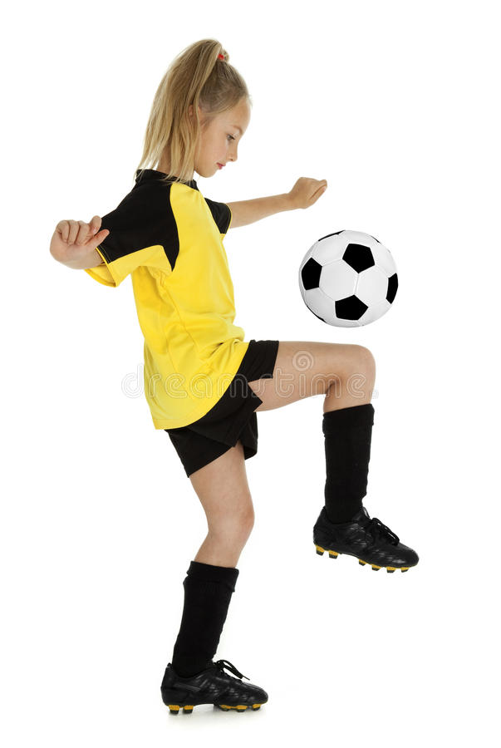
MOTOR DEVELOPMENT DURING VARIOUS STAGES OF CHILDHOOD
MIDDLE CHILDHOOD
They wish to compete with children of their own age group.
They try to improve their previous performance.
Their posture and balance become better then early childhood.
They performed differently for different aims. i.e. throwing for distance and height.
Speed abilities and co-ordination abilities also show a higher level.
GROSS MOTOR SKILLS
SPEED
FLEXIBILITY
BALANCE
AGILITY
FORCE
FINE MOTOR SKILLS
WRITING
DRAWING
7 TO 10 YEARS

Slide 9

MOTOR DEVELOPMENT DURING VARIOUS STAGES OF CHILDHOOD
LATER CHILDHOOD
Boys and girls are able to compete evenly.
They are ready to learn strategies and more complex play combinations.
All the basic movements are develop at a faster rate, with proper quantity as well as quality.
They able an increasing stress on strategies and tactics.
11 TO 12 YEARS OR BEGINNING OF PUBERTY

Slide 10

1. Development of child’s bone, muscles, and ability to move around to manipulate the environment is ____
Muscular Development
Motor Development
Behavior Development
Skill Development
2. Development of muscles helping child to sit, stand, walk and run can be named as __
Fine Motor Development
Learning Motor Development
Gross Motor Development
All the above
3. Below which is NOT the example of fine motor development of a child:
Walking on toes
Holding pencil to write
Turning pages of the book
Tie shoe lace

Slide 11

Explain about motor development.
Explain the motor development of children in early childhood.
Write any four milestones of baby’s life motor development in first year.
3. Ans.- Head control, Trunk control (sitting, rolling), leg control (crawling, standing), hands control (grasping, reaching out for toys).

Slide 12
THANKING YOU
ODM EDUCATIONAL GROUP

