Slide 1


BALANCED DIET AND NUTRITION
SUBJECT : PHYSICAL EDUCATION
CHAPTER NUMBER: 2
CHAPTER NAME : SPORTS AND NUTRITION

Slide 2


WHAT WE EXPECT TO LEARN?
We will be able to know about the ‘BALANCED DIET AND NUTRITION’.
We will be familiar with the various types of MACRO & MICRO NUTRITION.
We will be described the major components of diet.
All the concepts will create knowledge among the students of HEALTHY DIET.

Slide 3

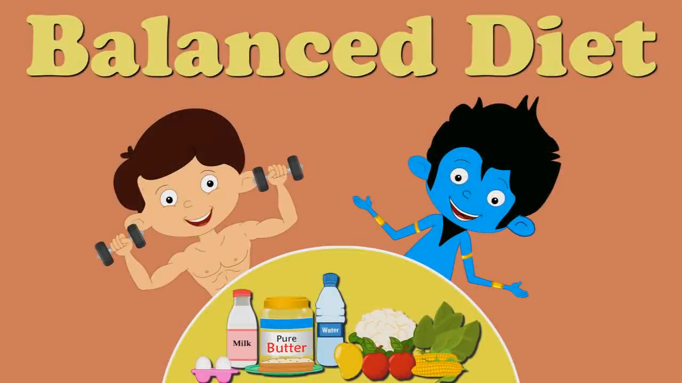

WHAT IS BALANCED DIET

Slide 4
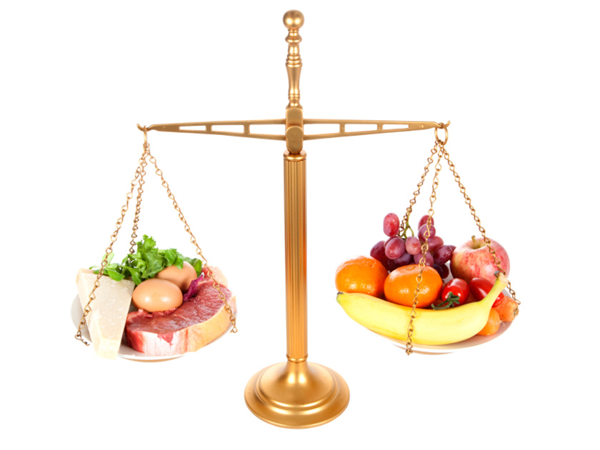
WHAT IS BALANCED DIET
“Balanced diet is that diet which consists of various constituents of food in accurate and appropriate quantity and quality according to the requirement of an individual.”
BALANCED DIET
PROTEINS
CARBOHYDRATES
FATS
VITAMINS
MINERALS
WATER

Slide 5
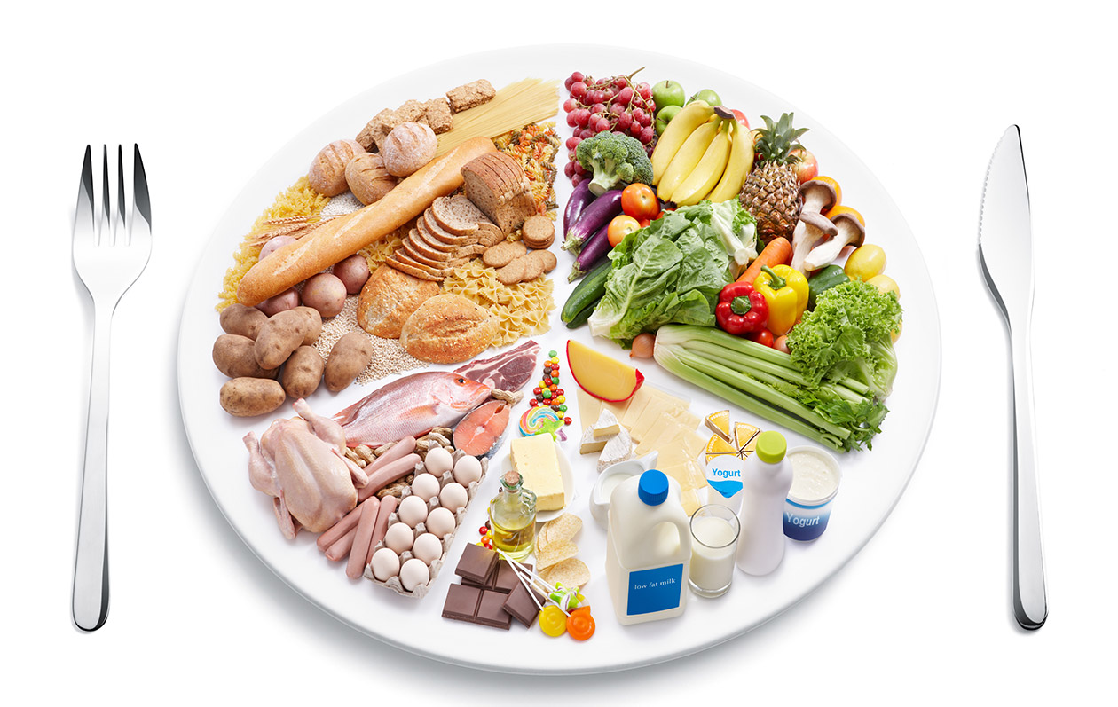
DEFINITION OF BALANCED DIET
Required appropriate quantity & quality
CARBOHYDRATES
PROTEIN
FAT
VITAMINS
MINERALS
WATER
“A diet which contains all necessary nutrients in right proportions & quantities which fulfills the todays’ requirement to function efficiently.”

Slide 6
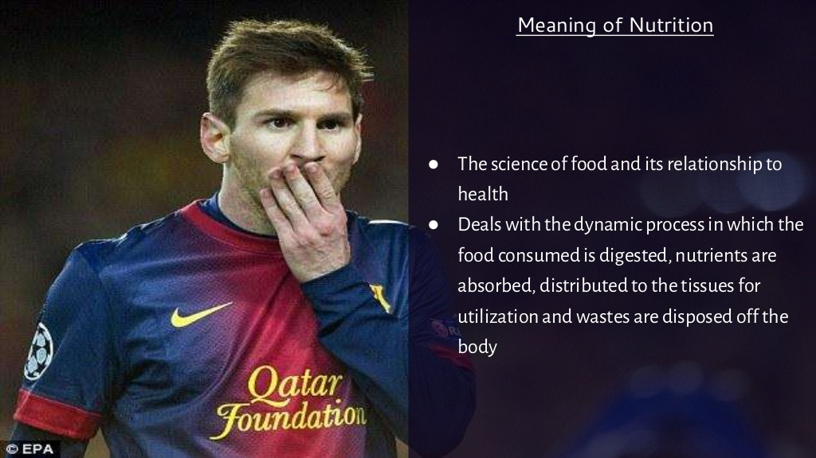
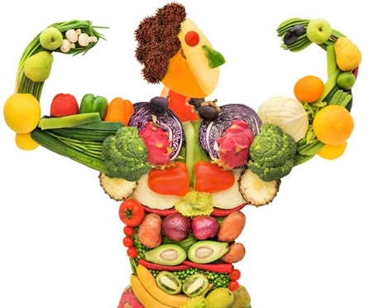
MEANING OF NUTRITION
NUTRITION is the process of obtaining & consuming food or breaking down food & substances taken in by the mouth to use for energy in the body.
NUTRIENTS
It’s a chemical substance that is found in the food those are used by the body for growth & health.

Slide 7
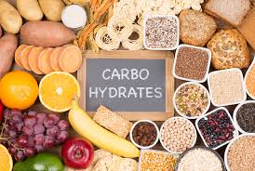
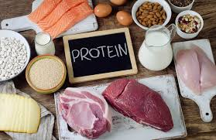
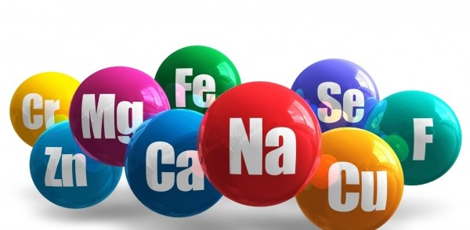
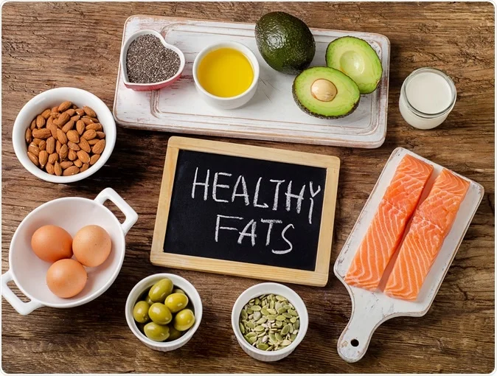
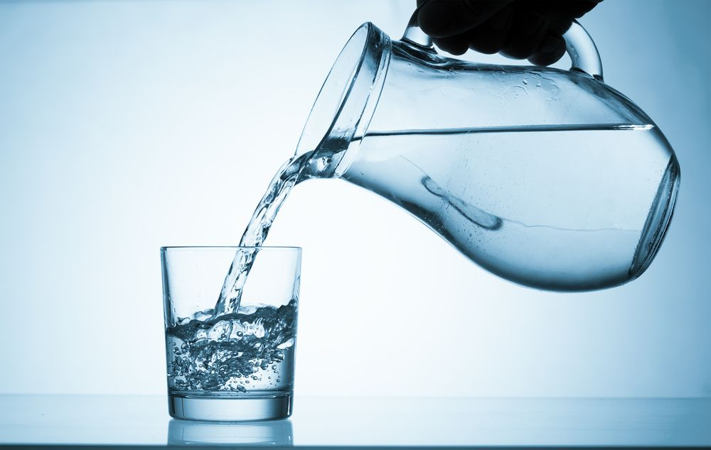
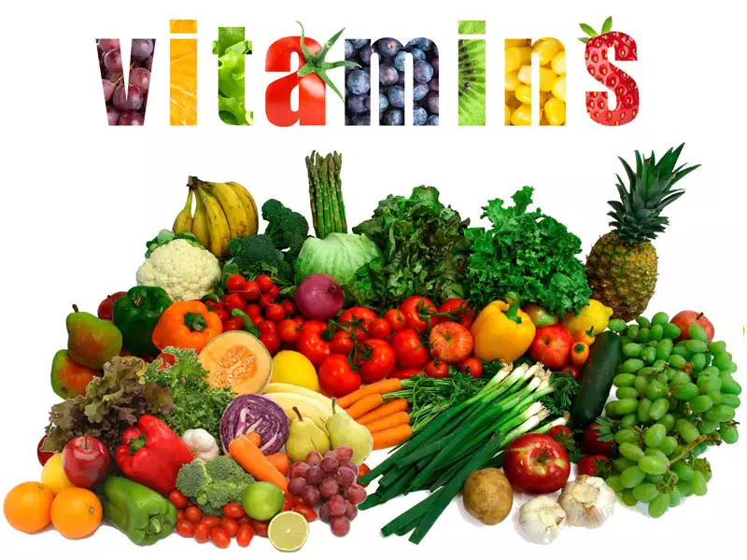
MACRO NUTRIENTS
Constitute the majority of individuals’ diet.
They are taken in large amounts.
They supply energy.
They are needed for the growth and maintenance of the body.
MICRO NUTRIENTS
They are required in a very small amount.
they are extremely significant for the normal functioning of the body.
They enable various good chemical reactions to occur in the body.

Slide 8
NUTRITION
MACRO NUTRIENTS
CARBOHYDRATES
PROTEINS
MICRO NUTRIENTS
MINERALS
FATS
WATER
VITAMINS
MIND MAP
MACRO MINERALS
MICRO MINERALS
CALCIUM
POTASSIUM
SODIUM
IODINE
IRON
CHROMIUM
MAGNESIUM
PHOSPHORUS
COPPER
COBALT

Slide 9
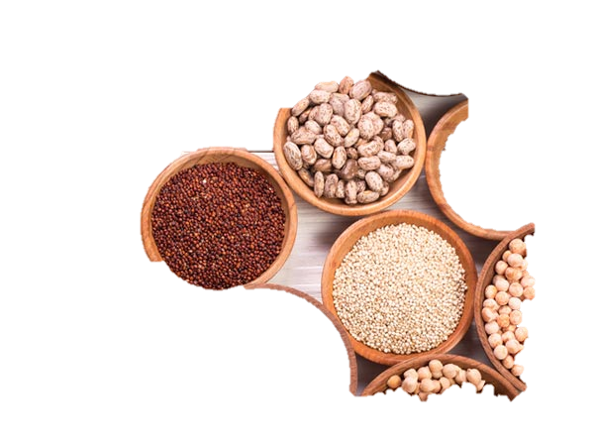
CARBOHYDRATES
CARBOHYDRATE
They are the main source of energy for all activities.
The ratio of hydrogen atoms to oxygen atoms is 2 : 1
CONTAIN CARBON
FUNCTION
Excessive intake of carbohydrates can lead to health conditions such as heart disease, hypertension, diabetes, obesity, and stroke.
Lack of carbohydrates on the other hand results in loose skin, weight loss, weakening of the body, and fatigue.
SOURCES
Food rich in carbohydrates includes cereals, pulses, dried peas, dates, potato, banana, sweet potatoes, Gur, bajra, etc.
CONTAIN HYDROGEN
CONTAIN OXYGEN

Slide 10
TYPES OF CARBOHYDRATES AND DIFFERENTIATE BETWEEN THE TYPES
Simple Carbohydrates
Glucose
Fructose
Complex Carbohydrates
Starch
Dextrin
Galactose
Sucrose
Maltose
lactose
Glycogen
Cellulose
These are insoluble in water.
These are not sweet.
These are not crystalline.
Large chain of chemical compositions
These are soluble in water.
These are sweet.
These are crystalline.
Small chain of chemical compositions

Slide 11

PROTEINS
Proteins contain – carbon, hydrogen, oxygen, nitrogen, and Sulphur.
It’s a very large molecule.
There are 23 amino acids. (9 amino acids must be available in the diet.
It is required to create blood, muscles, nails, skin, hair, and tissues.
The Body requires only 0.36 grams of protein per pound of the ideal body weight.

Slide 12

PROTEINS
Proteins are needed for the growth and development of the body.
It helps and replaces the worn-out tissues.
It does not provide energy under normal routine but gives energy under extreme starvation.
High intake of proteins can result in heart diseases, osteoporosis, stroke, and kidney stones.
Less intake of proteins may suffer from the deficiency of Marasmus & Kwashiorkor.

Slide 13

FATS
Fats are emergency sources of energy and stored in the body.
Fats carry Vitamins, A, D, E, K.
Our diet should consist of 20 to 25 % of fat more intake more risk of obesity and many heart diseases.

Slide 14


FATS
UNSATURATED FATS
POLY-UNSATURATED
MONO-UNSATURATED
SATURATED FATS
Coconut, Butter, Ghee
Sunflower Oil
Soybean Oil
Olive Oil
Avocado
TYPES OF FATS

Slide 15

WATER
Water is very essential for the body’s metabolism.
UNICEF says that water is not included in macronutrients but USDA includes it as a part of macronutrients.
It is an essential nutrient our body consists of 70% of water.
Water consists of 90% of blood.
Each person shall drink 8-10 glasses of water daily.
UNICEF – United Nations Children’s Fund
USDA – United States Dietary Association

Slide 16
WHAT IS THE IMPORTANCE OF WATER?
Water regulates body temperature
Water carries nutrients to the tissues
Water eliminates body wastes
Water lubricates & cushions body parts
Water involved in the absorption & digestion of food

Slide 17

1. Which one is macro nutrients as well as non-nutritive components of diet?
CARBOHYDRATES
PROTEINS
FATS
WATER
2. Which one is insoluble in water?
CELLULOSE
GALACTOSE
LACTOSE
GLUCOSE
3. How many amino acids are there in Proteins?
9
21
22
23
4. What is the ratio of hydrogen atoms to oxygen atoms?
1 : 2
1 : 1
2 : 1
2 : 2

Slide 18

What is a balanced diet? Explain the components of the diet.
What do you mean by macronutrients? Explain in brief about minerals as micro-nutrients in detail.

Slide 19
THANKING YOU
ODM EDUCATIONAL GROUP

