Slide 1


SPECIAL CONSIDERATION
SUBJECT : PHYSICAL EDUCATION
CHAPTER NUMBER: 05
CHAPTER NAME : CHILDREN AND WOMEN IN SPORTS

Slide 2


WHAT WE EXPECT TO LEARN?
01
What is Special consideration?
02
What is menarche?
03
What is osteoporosis?
04
What is Amenorrhea and eating disorder?

Slide 3
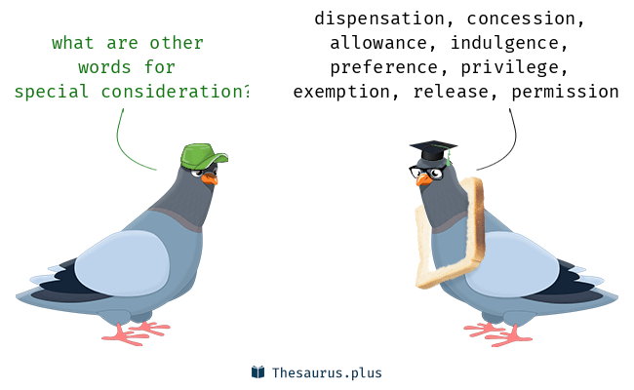
SPECIAL CONSIDERATION (MENARCHE AND MENSTRUAL DYSFUNCTION)
Many people opine that women have different anatomical & physiological structures and capacities which are not suitable for sports activities.
They even say that participation in sports leads to various problems during menarche, menstruation, pregnancy and menopause.
In order to evade the misconceptions and myths.

Slide 4
SPECIAL CONSIDERATION
FIRST MENSTRUATION OR MENARCHE
Menarche is a women’s first menstruation, which indicates the beginning of reproductive life.
The medical word for the age or date of someone’s first period (menstruation) is called menarche.
Menarche usually occurs approximately at the age of 12 years.
It can happen as early age (8 or 9 years).
It can happen as later age(16 years).
Delayed menarche may succeed in sports such as gymnastics.
Early menarche have an advantage in sports such as swimming and rowing because they get more adipose tissue or enough weight.

Slide 5
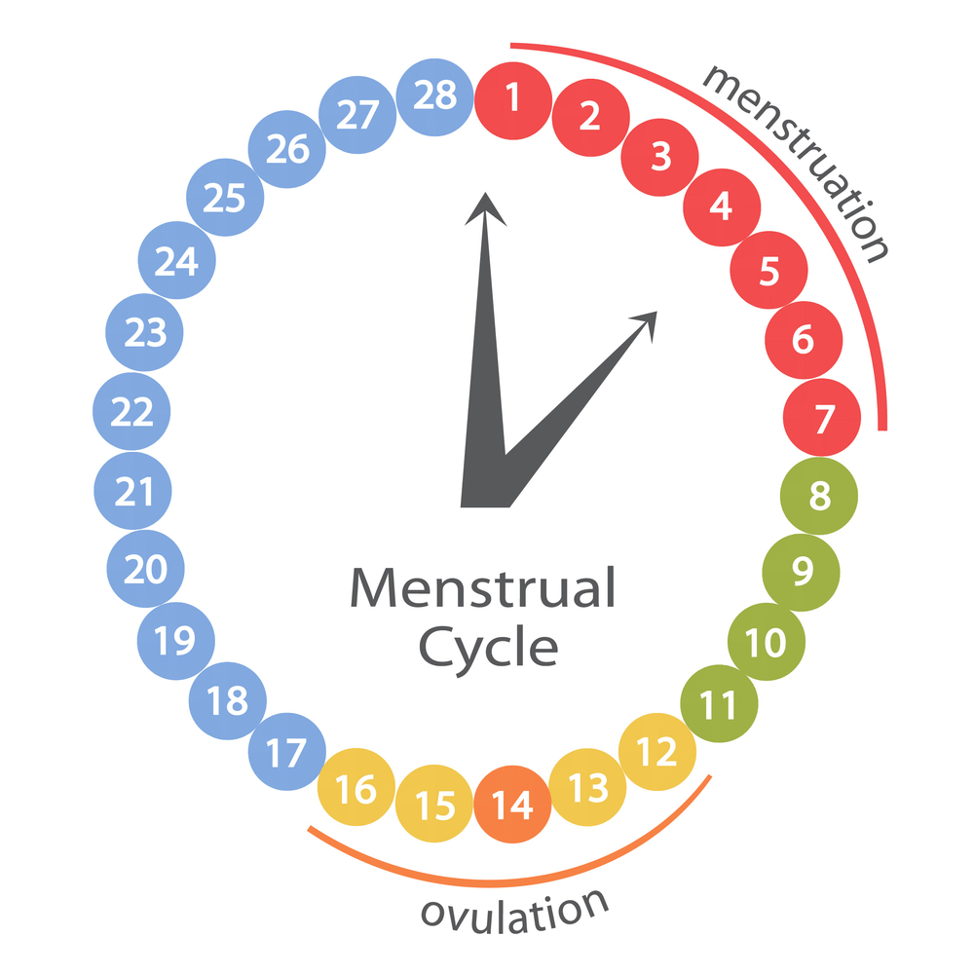
SPECIAL CONSIDERATION
MENSTRUAL DYSFUNCTION
It’s a disorder or irregularity in women’s menstrual cycle.
It can be defined as an ‘abnormal bleeding’ during the menstrual cycle.
Normal menstrual cycle varies from 21 to 35 days.(its flow 2 to 7 days)

Slide 6
MENSTRUAL DYSFUNCTION
GENERAL CAUSES
PRECAUTIONS
Disease
Genetical
High Anxiety
Miscarriage
Mental stress
Consumption of more medicines
Weakness
All nutritional food should be consume
Yoga should be done
Regular light activities should be done in the morning & evening
Get the doctor’s advice

Slide 7
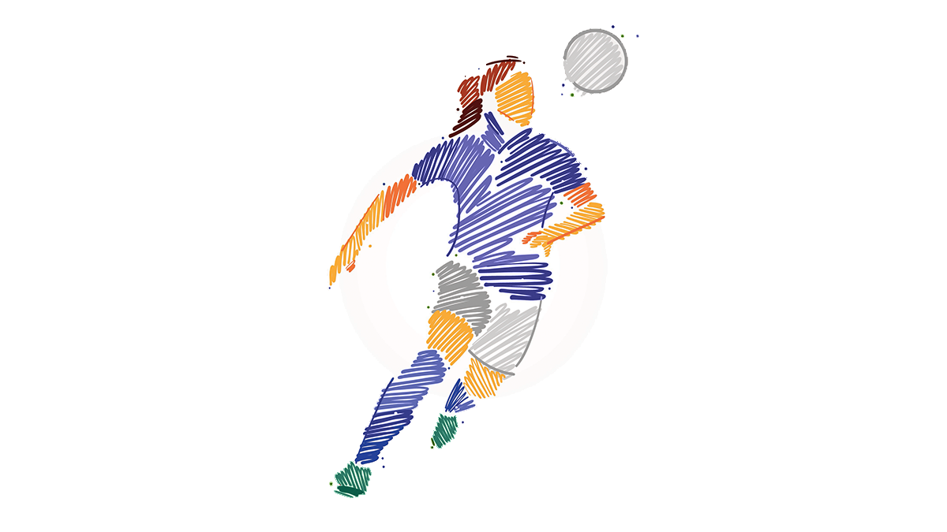
MENSTRUATION & SPORTS PARTICIPATION
Most of the people used to believe that participation in sports during menstruation could be physiologically harmful.
There has been no basis or evidence of dysmenorrhea of any result of intensive participation in sports.
Research studies indicate that sports participation is beneficial in reliving pain and preventing dysmenorrhea.
NOTE :- Menstruation is not a problem in the way of achieving top sports performance.

Slide 8
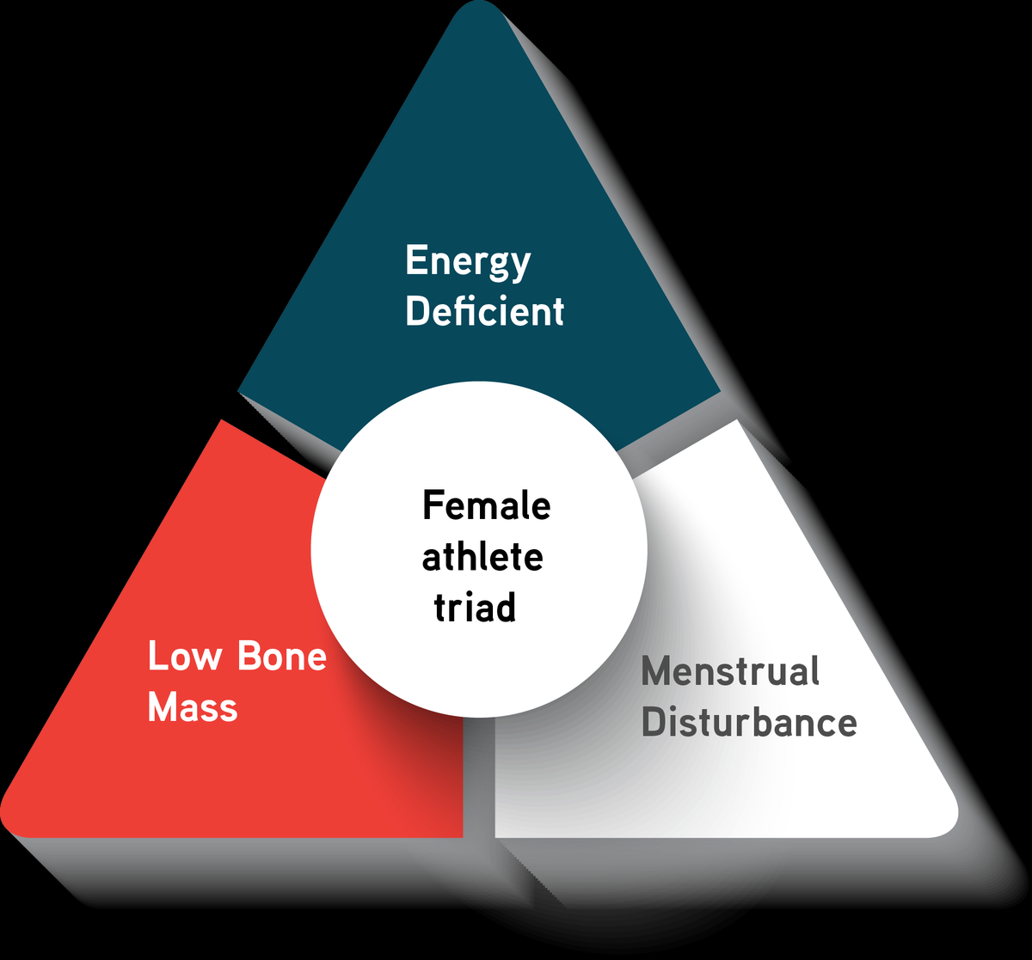
WHAT IS FEMALE ATHLETE TRIAD?
The ‘female athlete triad’ refers to a situation that is often seen among women who perform high performance sports.
The triad is a serious disorder or illness with lifelong health consequences and can be fatal.
It’s a syndrome in which osteoporosis, amenorrhea and eating disorder are included.

Slide 9
FEMALE ATHLETE TRIAD
OSTEOPOROSIS
AMENORRHOEA
EATING DISORDERS
SYMPTOMS OF TRIAD :-
Fatigue
Frequent injuries
Irritability
Loss of power & endurance
Enhanced chance of fracture
Low self-esteem
Discontinuation of menstruation
PRIMARY
SECONDARY
ANOREXIA NERVOSA
BULIMIA NERVOSA

Slide 10
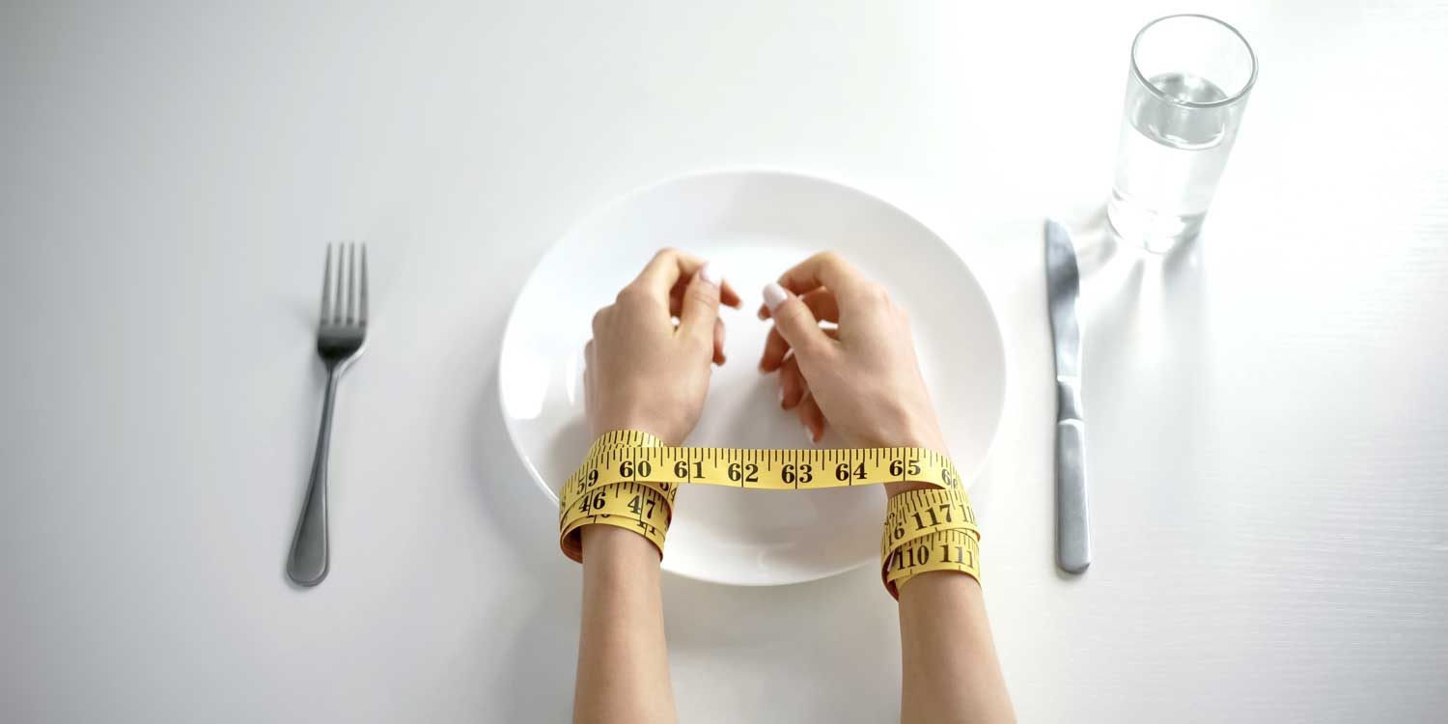
WHAT IS EATING DISORDERS?
Most of the girls try to loss their body weight as a way to improve their sports performance.
They may practice;-
      Unhealthy weight-control methods
      Restricted food intake
      self-undecided vomiting
      Consumption of appetite suppressants
      Diet pills
      Use of laxatives
Eating disorders are serious conditions related to persistent eating behaviors that negatively impact your health, your emotions and your ability to function in important areas of life.

Slide 11
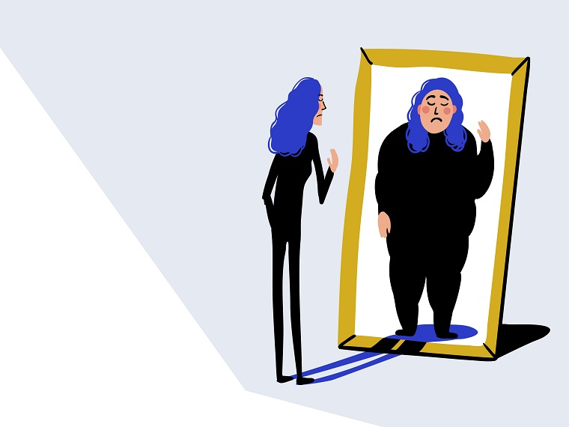
EATING DISORDERS
ANOREXIA NERVOSA
In front of the mirror they see themselves as obese.
The female athletes think only about food, dieting and body weight all the time.
They have deformed body structure.
They have fear of gaining weight or believe they are obese even when they are not.

Slide 12
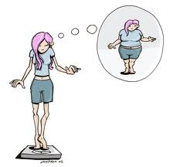
EATING DISORDERS
ANOREXIA SYMPTOMS
Refusal to maintain body weight
Fear of weight gain or being ‘fat’
Dramatic weight loss
Loss of menstrual periods
Extreme concern with body weight and shape

Slide 13
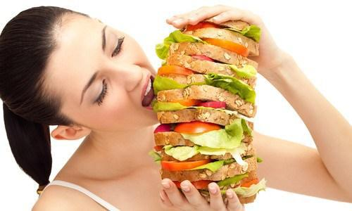
EATING DISORDERS
BULIMIA NERVOSA
The female athlete eats excessive amount of food and then vomits it in order not to gain weight.
It refers to eating a large amount of food in a short amount of time.
This may be done by vomiting or taking laxatives.
Bulimia is frequently associated with other mental disorder such as depression, anxiety, etc.
There is also a higher risk of suicide and self-harm.

Slide 14

WHAT IS AMENORRHOEA?
It’s a menstrual disorder or illness in women.
Long absence of no menstrual periods is called amenorrhea.
Either never began menstruating or absence of menstruation for 3 months or more.
Apart from this, any chronic disease can also cause this problem.

Slide 15
TYPES OF AMENORRHOEA?
PRIMARY AMENORRHOEA
It’s a characterized by delayed menarche which is the onset of first period during puberty.
SECONDARY AMENORRHOEA
When normal menstrual bleeding stops occurring for 3 months or more.

Slide 16
CAUSES OF AMENORRHOEA?
Physical & mental problems
Due to prolonged illness
Due to improper food habits
With the change in hormones
Due to high level training and competition
Irritability
Less consumption of calories

Slide 17
AMENORRHOEA
VARIOUS FACTORS WHICH MAY INSPIRE THE CHANCES OF AMENORRHOEA
Hormonal Changes
Intensive Exercises
Intake of less Calories

Slide 18
VARIOUS FACTORS WHICH MAY INSPIRE THE CHANCES OF AMENORRHOEA
HORMONAL CHANGES
Change in the output of gonadotropic hormones may lead.
The gonadotropic hormone stimulates the growth of secretion of sex hormones.
This hormone actually plays a vital role in stimulating estrogens release from ovaries.

Slide 19
VARIOUS FACTORS WHICH MAY INSPIRE THE CHANCES OF AMENORRHOEA
INTENSIVE EXERCISES
There are maximum chances of amenorrhea in female athletes, especially in long distance runners, swimmers and gymnasts.
Such athletes do intensive exercise or training which usually leads to decrease in estrogen which is mainly responsible to regulate the menstrual cycle in females.

Slide 20
VARIOUS FACTORS WHICH MAY INSPIRE THE CHANCES OF AMENORRHOEA
INTAKE OF LESS CALORIES
If a women athlete takes less number of calories in comparison to her requirement, she may suffer from amenorrhea.
Intake of insufficient calories can lead to decrease in estrogen hormone.

Slide 21
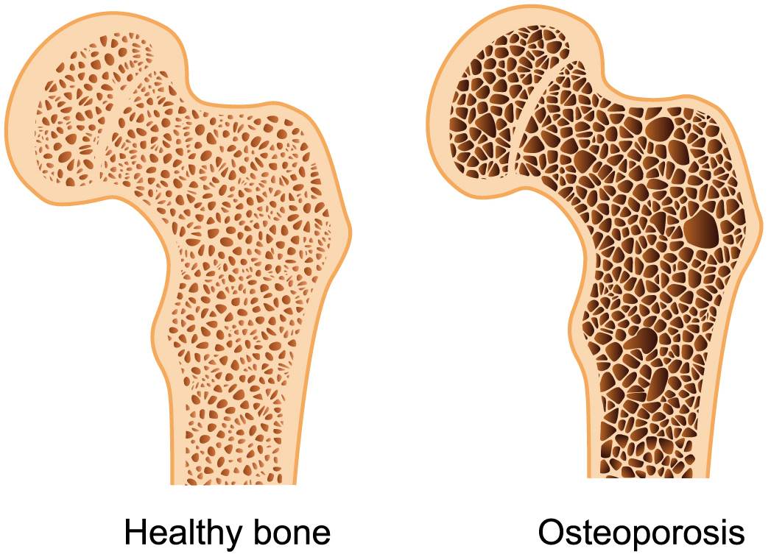
WHAT IS OSTEOPOROSIS?
It’s a skeletal disorder.
Its refers to decreased bone mineral density.
Osteoporosis usually has no symptoms until a fracture occurs, this is why it is often called the “Silent Diseases”.
It is one of the significant triad of female athlete.

Slide 22
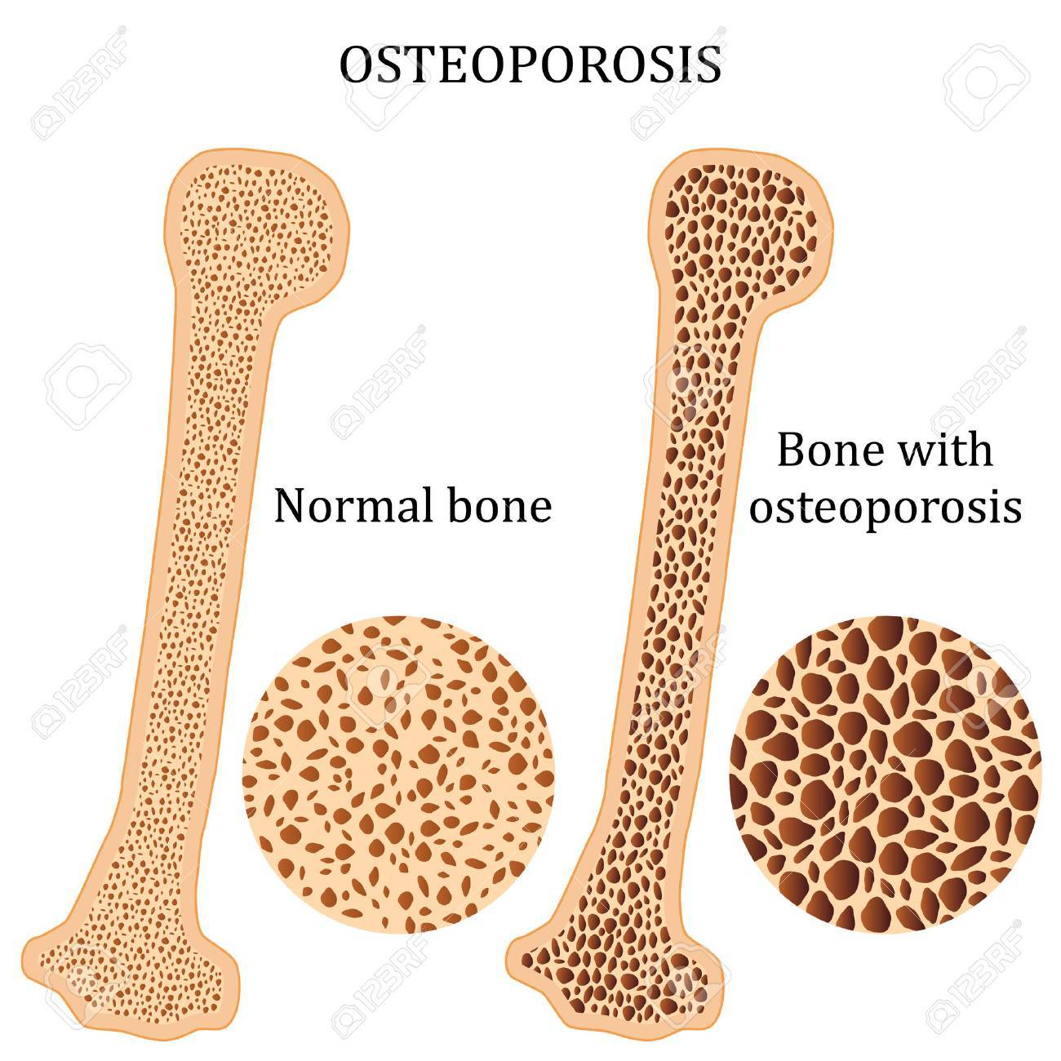
VARIOUS FACTORS WHICH LEAD THE OSTEOPOROSIS
OSTEOPOROSIS
INSUFFICIENT CALCIUM IN THE DIET :-
  Insufficient intake of calcium
  Insufficient o vitamin D
II. AMENORRHOEA :-
III. EATING DISORDERS :-

Slide 23
THANKING YOU
ODM EDUCATIONAL GROUP

