Slide 1


ORGANIC CHEMISTRY
STEREOCHEMICAL ASPECT OF SN2,ELIMINATION REACTION,REACTIONS WITH METALS
SUBJECT : CHEMISTRY
CHAPTER NUMBER: 10
CHAPTER NAME : HALOALKANES AND HALOARENES

Slide 2
Learning Outcome
Students will be able to Articulate the various Stereochemical structures involved in SN2 Reaction
. Students will be able to explore new ways of naming Haloalkanes
They will understand how retention and Inversion occurs in a Reaction
They will understand about Elimination Reaction and and Reaction of Alkyl Halides with Metals

Slide 3
Lecture06
Stereochemical Aspects of SN2 Reaction, Elimination Reactions : Dehydrohalogenation (Formation of Alkenes), Reaction with Metals
Optical activity:Rotation of plane polarised light either clockwise (dextrorotatory) or anti clock wise(Laevorotatory) by the compound .
The objects which are non- superimposable on their mirror image (like a pair of hands) are said to be chiral and this property is known as chirality
The stereoisomers related to each other as nonsuperimposable mirror images are called enantiomers
Enantiomers possess identical physical properties namely, melting point, boiling point, refractive index, etc.
They only differ concerning the rotation of plane polarised light. If one of the enantiomers is dextrorotatory, the other will be laevorotatory.

Slide 4
Lecture06
Stereochemical Aspects of SN2 Reaction, Elimination Reactions : Dehydrohalogenation (Formation of Alkenes), Reaction with Metals
https://www.youtube.com/watch?v=FMRBRTmR6Jo

Slide 5
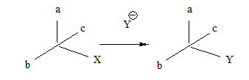
A mixture containing two enantiomers in equal proportions will have zero optical rotation, as the rotation due to one isomer will be cancelled by the rotation due to the other isomer.
Such a mixture is known as a racemic mixture or racemic modification.
A racemic mixture is represented by prefixing dl or (±) before the name, for example (±) butan-2-ol.
The process of conversion of enantiomer into a racemic mixture is known as racemization.
Retention: Retention of configuration is the preservation of the integrity of the spatial arrangement of bonds to an asymmetric center during a chemical reaction or transformation.
Walden inversion is the inversion of a chiral center in a molecule in a chemical reaction

Slide 6
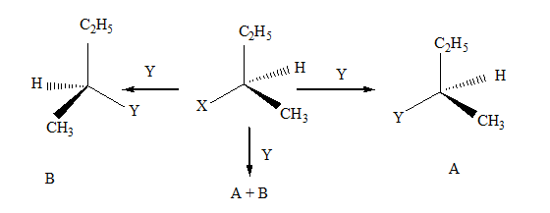
If (A) is the only compound obtained, the process is called retention of configuration.
If (B) is the only compound obtained, the process is called inversion of configuration.
If a 50:50 mixture of the above two is obtained then the process is called racemization and the product is optically inactive, as one isomer will rotate light in the direction opposite to another.

Slide 7
Stereochemical Aspects of SN2 Reaction
https://www.youtube.com/watch?v=dU3_d_xMGfI

Slide 8
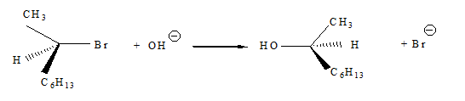
Stereochemical Aspects of SN2 Reaction
In the case of optically active alkyl halides, the product formed as a result of the SN2 mechanism has an inverted configuration as compared to the reactant.
This is because the nucleophile attaches itself to the side opposite to the one where the halogen atom is present
SN2 reactions of optically active halides are accompanied by inversion of configuration.

Slide 9
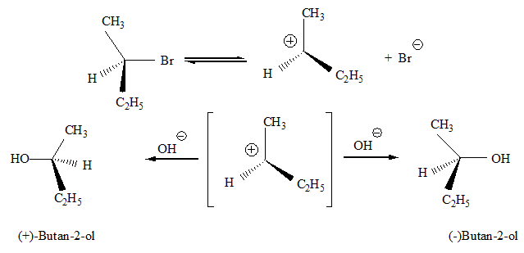
Stereochemical Aspects of SN1 Reaction
SN1 reactions are accompanied by racemization.
The carbocation formed in the slow step being sp2 hybridized is planar (achiral).
The attack of the nucleophile may be accomplished from either side resulting in a mixture of products, one having the same configuration (the –OH attaching on the same position as halide ion) and the other having opposite configuration (the –OH attaching on the side opposite to halide ion).

Slide 10
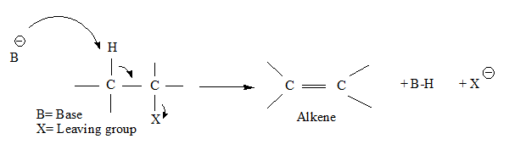

Dehydrohalogenation (Formation of Alkenes)
When a haloalkane with a ß-hydrogen atom is heated with an alcoholic solution of potassium hydroxide, there is an elimination of hydrogen atom from ß-carbon and a halogen atom from the -carbon atom.
As a result, an alkene is formed as a product. Since the ß-hydrogen atom is involved in elimination, it is often called ß-elimination
in dehydrohalogenation reactions, the preferred product is that alkene which has the greater number of alkyl groups attached to the doubly bonded carbon atoms

Slide 11
Dehydrohalogenation (Formation of Alkenes)
https://www.youtube.com/watch?v=o3lk77sdFHY

Slide 12




Reaction of haloalkanes with magnesium metal in dry ether.
the carbon-magnesium bond is covalent but highly polar, with carbon pulling electrons from electropositive magnesium; the magnesium halogen bond is essentially ionic.
Wurtz reaction: Reaction of Alkyl halides with sodium in dry ether to give hydrocarbons

Slide 13
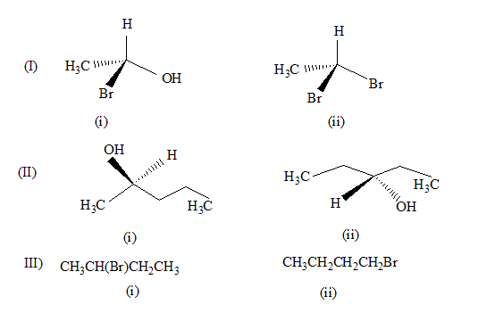
Answer the following questions:
Identify chiral and achiral molecules in each of the following pair of compounds.

Slide 14
THANKING YOU
ODM EDUCATIONAL GROUP

