Slide 1


ORGANIC CHEMISTRY
PROPERTIES OF HALOALKANES ,NUCLEOPHILIC SUBSTITUTION,MECHANISM
SUBJECT : CHEMISTRY
CHAPTER NUMBER: 10
CHAPTER NAME : HALOALKANES AND HALOARENES

Slide 2
Learning Outcome
Students will be able to explore the various Chemical Reactions of Haloalkanes
Students will bea able to understand the nature and Mechanism of , Nucleophilic Substitution Reactions(SN1 and SN2)
They will analyse and interpret the reactions of Haloalkanes in terms of Mechanism of Nucleophilic substitutions.
They will Formulate mechanism and determine the major products

Slide 3
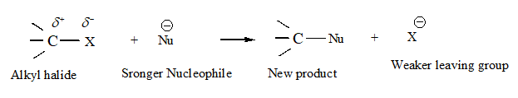

Lecture05
PROPERTIES OF HALOALKANES AND HALOARENES:Chemical Reactions of Haloalkanes, Nucleophilic Substitution Reactions, Mechanism (SN1 and SN2)
nucleophilic substitution reaction. A stronger nucleophile can replace weaker nucleophiles in such types of reactions.
ambient nucleophiles:Having two nucleophilic centres
Example:

Slide 4
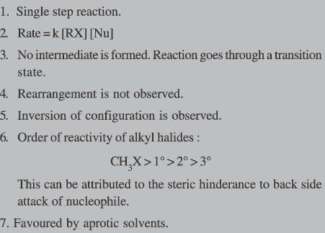
SN2 Reaction:Key features

Slide 5
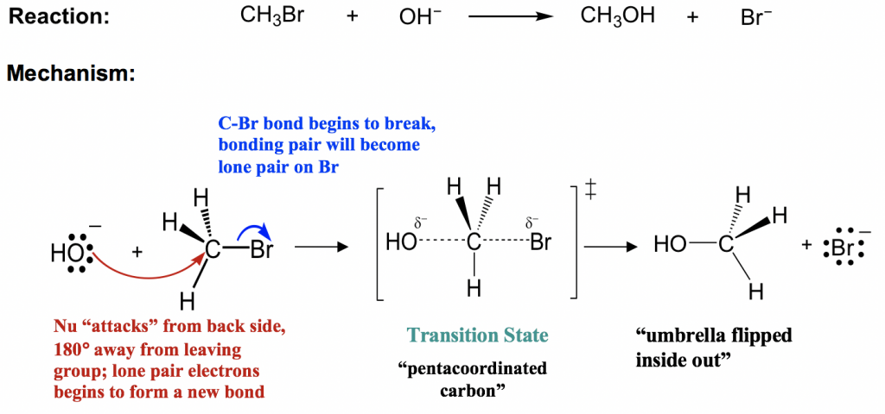
SN2 Reaction:Mechanism

Slide 6
SN2 Reaction:Mechanism
https://www.youtube.com/watch?v=h5xvaP6bIZI

Slide 7
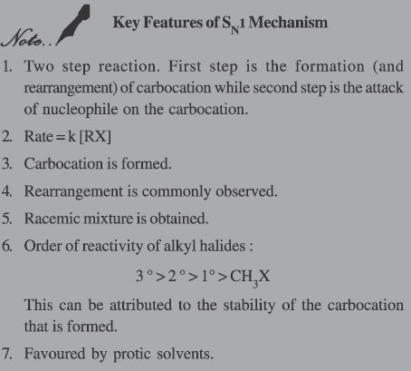
SN1 Reaction:Key features

Slide 8
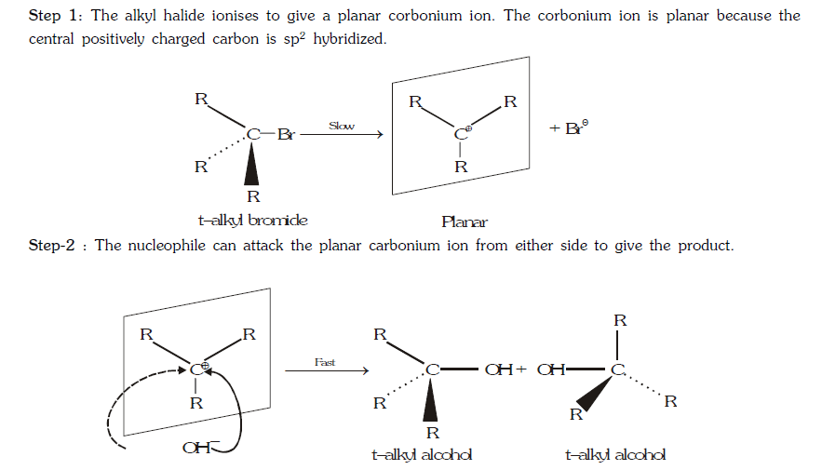

SN1 Reaction:Mechanism

Slide 9
SN1 Reaction:Mechanism
https://www.youtube.com/watch?v=JmcVgE2WKBE

Slide 10
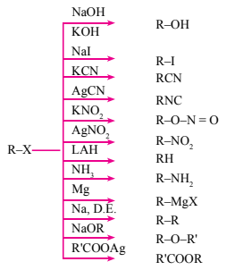
Chemical Reactions of Haloalkanes

Slide 11
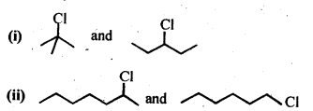
Answer the following questions:
1. Why alkyl halides undergo Nucleophilic substitution reaction?
2. What are ambident nucleophiles? Give examples.
3. Haloalkanes react with KCN to form alkyl cyanides as main product while AgCN forms isocyanides as the chief product. Explain.
4. Explain the order of reactivity of haloalkanes towards nucleophilic substitution reaction.
5.In the following pairs of halogen compounds, which compound undergoes faster S_{N}1 reaction?

Slide 12
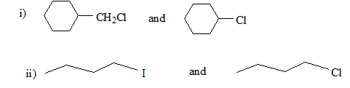
6.In the following pairs of halogen compounds, which undergo SN2 reaction faster?
7.How will you bring about the following conversions? (I) Ethanol to but-l-yne. (ii) Ethane to bromoethene. (iii) Propene to 1-nitropropane.
8.How will you bring about the following conversions? (iv) Toluene to benzyl alcohol. (v) Propene to propyne. (vi) Ethanol to ethyl fluoride.

Slide 13
THANKING YOU
ODM EDUCATIONAL GROUP

