Slide 1


ORGANIC CHEMISTRY
PREPARATION OF HALOARENES,PHYSICAL PROPERTIES
SUBJECT : (CHEMISTRY)
CHAPTER NUMBER: 10
CHAPTER NAME : HALOALKANES AND HALOARENES

Slide 2
Learning Outcome
Students will be able to explore the various Methods of Preparation of Haloarenes
Students will beable to recall their prior knowledge of Electrophilic Substitution of Aromatic Hydrocarbons
They will appreciate and understand the importance of Diazonium salts and their importance in organic synthesis

Slide 3
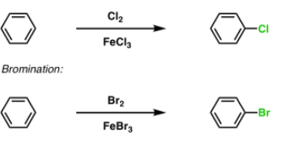
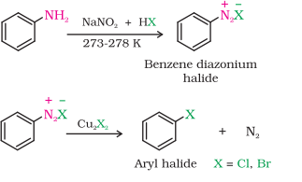
Lecture-04:
Preparation of Haloarenes, By Electrophilic Substitution of Aromatic Hydrocarbons, From Diazonium Salts (Sandmeyer’s Reaction), Physical Properties of Haloakanes and Haloarenes
1.By electrophilic substitution
2.Sandmeyer’s reaction

Slide 4
Physical Properties of Haloakanes and Haloarenes
The lower members CH3F, CH3Cl, CH3Br , C2H5Cl and C2H5F are gases at room temp.
CH3I and members upto C18 are colourless sweet smelling liquids.
Decreasing order of B.P. is :R – I > R—Br > R—Cl > R—F
among isomeric R—X decreasing order of B.P. is : Primary > Secondary > tertiary
R—X are polar co-valent compounds but insoluble i n water because the y can not form
H–bonds. They dissolve in organic solvents.
The stability order is : R—F > R—Cl > R—Br > R—I

Slide 5
Answer the following
1.Name the Lewis acids used in halogenation of aromatic hydrocarbon.
2.Why the iodination of Benzene requires oxidizing agents like HNO3 or HIO4?
3.Why is Fluorobenzene difficult to prepare by direct fluorination of benzene?
4. .How will you prepare Chlorobenzene and Bromobenzene starting from Aniline?
5.Convert Aniline to iodobenzene.
6.Convert Acetylene to Chlorobenzene.
7.Arrange each set of compounds in order of increasing boiling points.
i) Bromomethane, Bromoform, Chloromethane, Dibromomethane.
ii) 1-Chloropropane, Isopropyl chloride, 1-Chlorobutane

Slide 6
8.Complete the following:
9.Which one of the following has the highest dipole moment? (i) CH₂Cl₂ (ii) CHCl₃ (iii) CCl₄

Slide 7
THANKING YOU
ODM EDUCATIONAL GROUP

