Slide 1


ORGANIC CHEMISTRY
NOMENCLATURE OF HALOALKANES AND HALOARENES
SUBJECT : (CHEMISTRY)
CHAPTER NUMBER: 10
CHAPTER NAME : HALOALKANES AND HALOARENES

Slide 2
Learning Outcome
Students will be able to name the Haloalkanes and Haloarenes according to IUPAC.
Students will be well-acquainted with Isomerism of Haloalkanes and Haloarenes.
They will easily acknowledge the nature of C-X Bond.

Slide 3
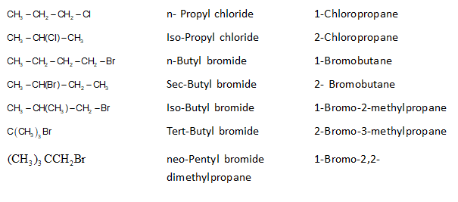
Lecture02:
Nomenclature, Chain Isomerism, Position Isomerism and Nature of C – X Bond.
NOMENCLATURE:
The halogenated hydrocarbons are commonly called as halo hydrocarbons.
Formula Common name IUPAC Name

Slide 4
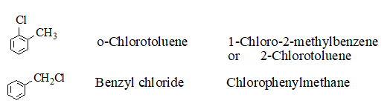
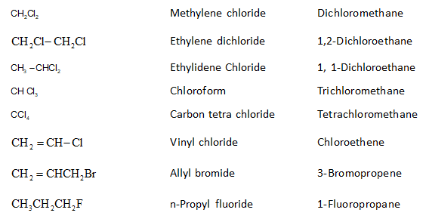

Slide 5
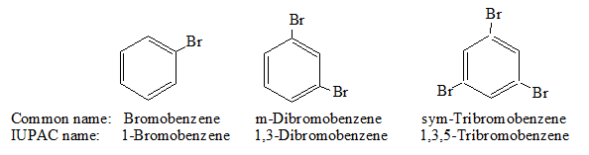
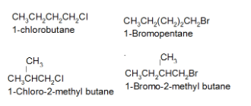
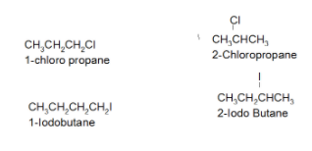
Chain Isomerism, Position Isomerism:
Halo alkanes can show chain and position isomerisms.
Chain Isomer
Position Isomer

Slide 6

Nature of C-X Bond
The C-X bond (carbon-halogen bond) is polar because halogens are more electronegative than carbon atoms.
the halogen atom acquired partial negative charge and the carbon atom acquired partial positive charge.
order of polar character: C-F > C-Cl > C-Br > C-I
bond length order: C-F < C-Cl < C-Br < C-I
bond enthalpies order C-F > C-Cl > C-Br > C-I
dipole moment order: C-F > C-Cl > C-Br > C-I

Slide 7
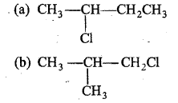

Answer the following
1.Write the IUPAC name of the following compounds
2.Write the order of bond lengths from R-F to R-I
3.Why the C-X bond in haloalkane is polar?
4. Write down the structure and IUPAC name for neo-pentylbromide.
5.Among the above compounds, which one has shortest C—Cl bond ?
(a) I
(b) II
(c) III
(d) IV

Slide 8
6.Write the IUPAC name of the following compound:
7. Write the IUPAC name of the following compound
8.Write the isomers of the following compounds
i) 2-Chloro-3-methyl pentane ii) 1-Chloro-4-ethyl cyclohexane iii) 4-tert.Butyl-idoheptane
iv) 1,4-Dibromobut-2-ene

Slide 9
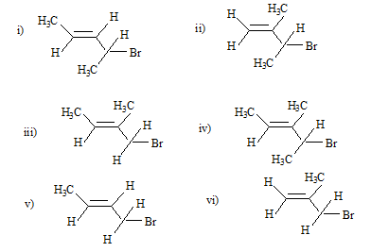
9.Write IUPAC names of the following:
10.How many isomers are possible for C4H9F₂ .and give their IUPAC names?·

Slide 10

11.Write the IUPAC name of the following compound:
12. Write the IUPAC name of the following compound:
13.Give the IUPAC names of the following compounds:
(i) CH3CH(Cl)CH(Br)CH3 (ii) CHF2CBrClF
(iii) ClCH2C=CCH2Br
(iv) (CCl3)3CCl (v) CH3C(p-ClC6H4)2CH(Br)CH3
14.Write the order of bond lengths from R-F to R-I
15.Why the C-X bond in haloalkane is polar?

Slide 11
THANKING YOU
ODM EDUCATIONAL GROUP

