Slide 1


ORGANIC CHEMISTRY
INTRODUCTION AND CLASSIFICATION
SUBJECT : CHEMISTRY
CHAPTER NUMBER:10
CHAPTER NAME :HALOALKANES AND HALOARENES

Slide 2
Learning Outcome
Students will be able to distinguish between Haloalkanes and Haloarenes.
Students will be able to classify types of Haloalkanes and Haloarenes.
Students will be able to acknowledge the importance of Haloalkanes and Haloarenes.
Students will be well-acquainted with types of Haloalkanes and Haloarenes.

Slide 3
Lecture-01:
Introduction & Classification of Halo alkanes and Halo arenes:
Introduction:
The Alkyl halides have the general formula CnH2n+1X or RX where X denotes chlorine, Bromine, or Iodine. Fluorine is not included since fluorides do not behave like other halides.
Uses of Halo compounds:
1.The chlorine-containing Antibiotic Chloromycetin (Chloramphenicol) is produced by soil microorganism used in treatments of typhoid fever.;
2.Fully fluorinated compounds are being considered as potential blood substitutes in surgery.
3.Some compounds like DDT, BHC are used as an insecticide,

Slide 4
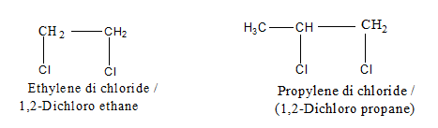
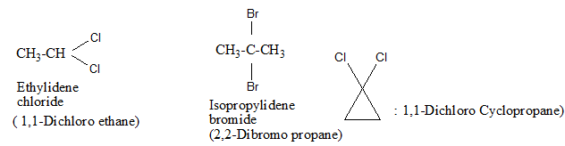
Alkyl halides : Halogen derivative of alkanes.
Alkenyl halides : Halogen derivative of alkenes.
Alkynyl halides : Halogen derivative of alkynes
Aryl halides : Halogen derivative of arenes (aromatic)
CLASSIFICATION OF HALO ALKANE AND HALO ARENES:
1. Based on the number of Halogen atoms
Alkyl halides : They are further classified on the basis of halogen atoms introduced in the molecule. e.g.
Mono halides: replacement of one H-atom by halogen atom.
General formula C_{n}H_{2n+1}X
Example : CH₃Cl Methyl chloride (Chloro methane)
CH₃CH₂Br Ethyl bromide (Bromo ethane)
Dihalides : Replacement of two H-atom by halogen atoms.
General formula C_{n}H_{2n}X₂
Vicinal dihalide
Geminal dihalide

Slide 5
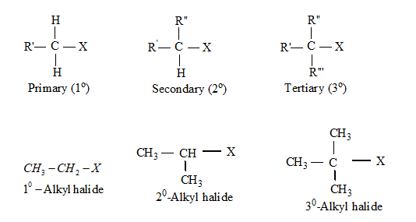
MONO HALIDES : Further classified on the basis of nature of C-atom carrying the halogen atom .
(A) Primary halide or 1° alkyl halides : Halogen atom attached with a primary or 1°° C-atom.
Example : C H 3 — X Halo methane or methylhalide
C H 3 — C H 2 — X Halo ethane or ethyl halide
C H 3— C H 2 — C H 2— X 1-Halo propane or n-propyl halide
(B) Secondary or 2° alkyl halides : Halogen atom linked with 2° C-atom.
(C) Tertiary halide or 3° alkyl halide : halogen atom linked with 3° C-atom.

Slide 6

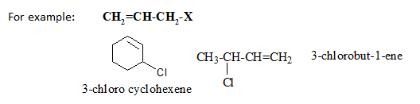
  Trihalides : Replacement of three H-atoms by halogen atoms. General formula - C_{n}H_{2n-1}X₃.
Example : CHX3 Trihalo methane or haloform
Tetra-halogen derivatives : replacement of four hydrogen atoms by four halogen atoms.
Halogen atom bonded with sp3-hybridized carbon:
Alkyl Halides or Haloalkanes
Allylic Halides: the halogen atom is bonded with sp3-hybridized carbon atom

Slide 7
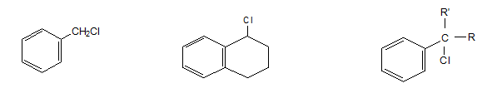
  Benzylic Halides: halogen atom bonded to an sp3-hybridized carbon atom

Slide 8
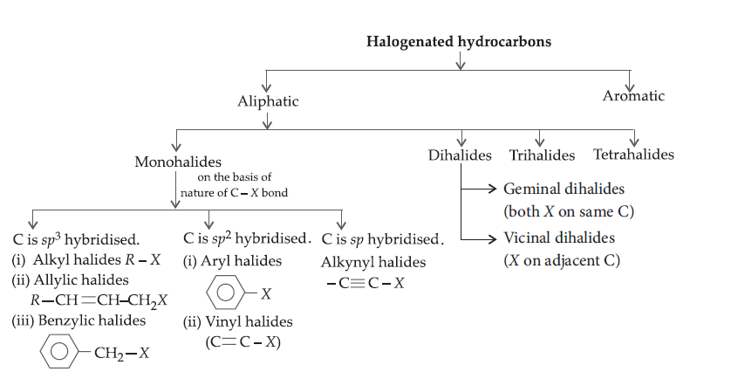
CONCEPT MAP : TYPES OF HALOGENATED HYDROCARBONS

Slide 9
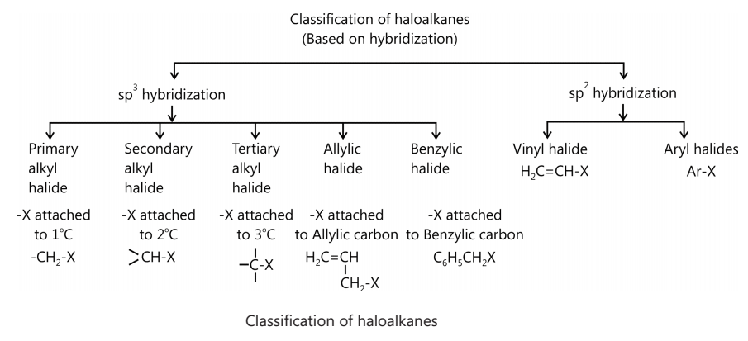

Slide 10
Answer the following:
1.Write the structures of the following organic halogen compounds. (i) 2-Chloro-3-methylpentane (ii) p-Bromochlorobenzene
2.Which of the following is an example of vie-dihalide?
(a)Dichloromethane(b)1,2-dichloroethane
(c) Ethylidene chloride (d) Allyl chloride
3.The position of -Br in the compound CH₃CH – CHC(Br)(CH₃)₂, can be classified as .
(a) allyl (b) aryl (c) vinyl (d) secondary
4. Haloalkanes contain halogen atom(s) attached to sp3 hybridised carbon atom of an alkyl group. Identify haloalkane from the following compounds.
(a) 2-Bromopentane (b) Vinyl chloride (chloroethene)
(c) 2-Chloroacetophenone (d) Trichloromethane
5.Which of the following compounds are gem-dihalides?
(a) Ethylidene chloride (b) Ethylene dichloride
(c) Methylene chloride (d) Benzyl chloride
6.Which of the following are secondary bromides?
(a) (CH₃),CHBr (b) (CH₃)₃C CH₂Br
(c) CH₃CH(Br)CH₂CH₃ (d) (CH₃)₂CBrCH₂CH₃

Slide 11
THANKING YOU
ODM EDUCATIONAL GROUP

