Slide 1



Slide 2

CLASS : 2
SESSION NO. : 17
SUBJECT : MATHEMATICS
TOPIC: CH-4 SUBTRACTION
SUB TOPIC: SUBTRACTION OF TWO 2-DIGIT NUMBERS.
.

Slide 3

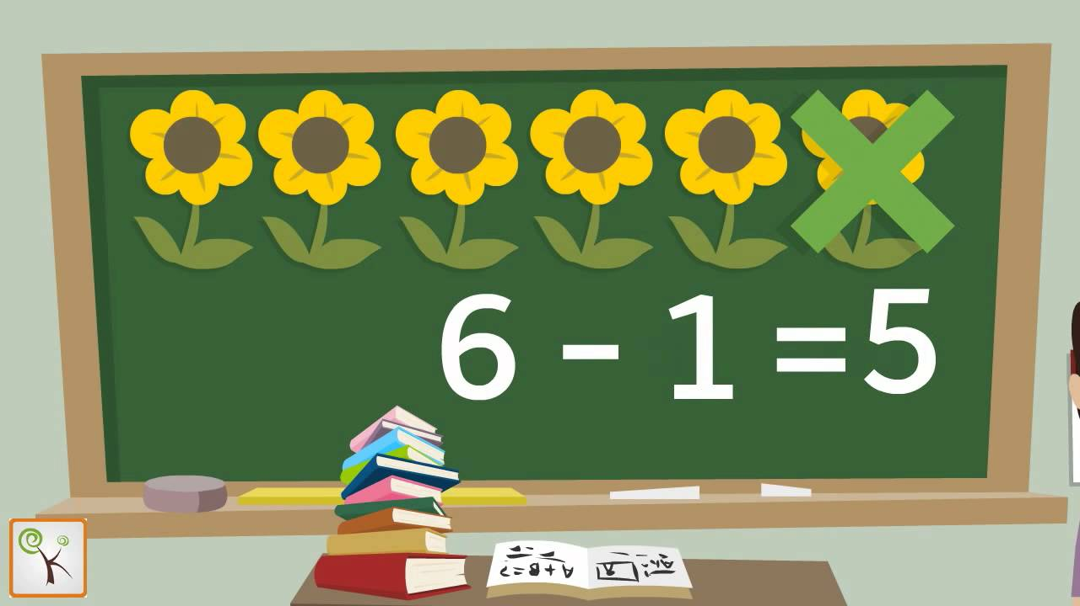
Taking away a number from another number is called SUBTRACTION.

Slide 4

TODAY’S TOPIC
Subtraction of two 2-digit numbers.

Slide 5

LEARNING OBJECTIVE:- Students are able to know the subtraction of two 2-digit numbers. .

Slide 6
JUST HAVE A RECAP
Match the following.
Subtracting 0
Predecessor
Subtracting 1
Subtraction
Take away
Number itself

Slide 7
Subtract 6 from 9
Subtract 25 from 67
T O
9
6 7
-
6
-
2 5
3
4
2

Slide 8
METHOD
Step1.Subtract the ones and write the difference under ones’ column.
Step 2.Subtract the tens and write the difference under the tens’ column.

Slide 9
CW
Subtract the following.
T O
T O
8 6
2 9
_
_
1 4
3 1
1
5
5
5

Slide 10
T O
T O
4 9
9 4
_
_
2 2
9 0
4
2
7
0

Slide 11
T O
T O
6 5
9 9
_
_
5 4
8 9
1
1
0
1

Slide 12
SUB | HOME ASSIGNMENT
Mathematics | ____________________

Slide 13
Expected learning outcome:-Students are able to know the properties of subtraction. .

Slide 14
THANKING YOU
ODM EDUCATIONAL GROUP

