Slide 1
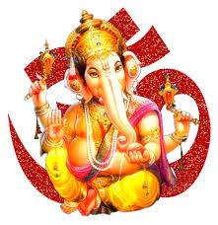


Slide 2

CLASS : 2
SESSION NO. : 14
SUBJECT : MATHEMATICS
TOPIC: CH-3 ADDITION
SUB TOPIC:CLASS TEST AND DOUBT CLEARING.
.

Slide 3

TODAY’S TOPIC
CLASS TEST &
DOUBT CLEARING

Slide 4

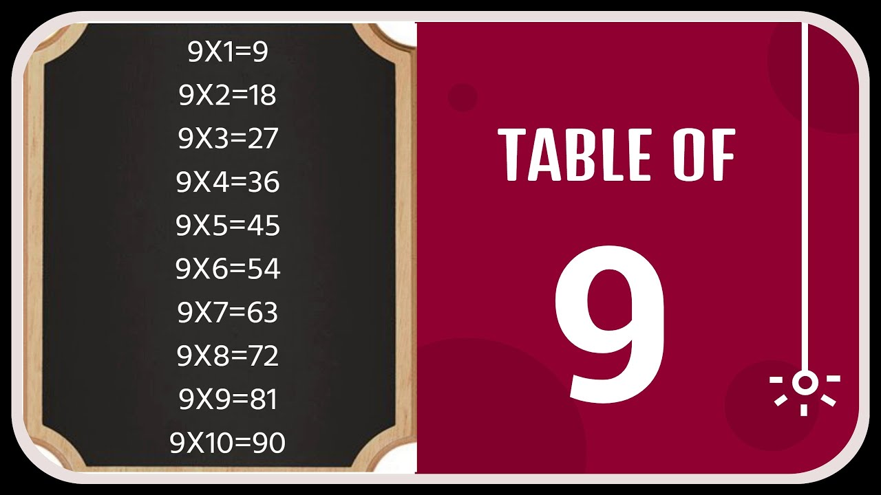

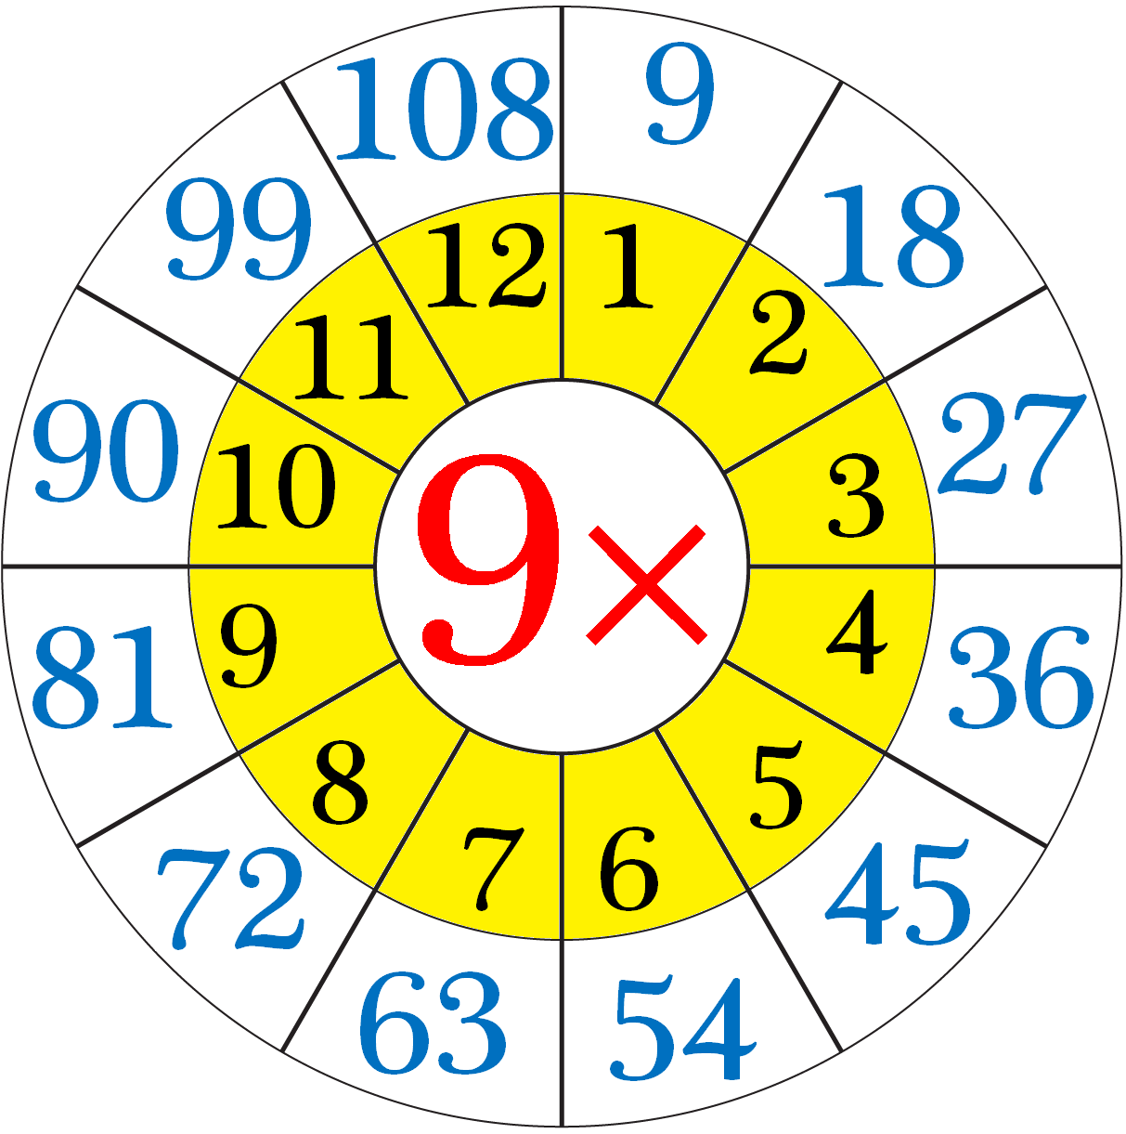

JUST HAVE A RECAP

Slide 5
CLASS TEST
Q1.Choose the correct answer and fill in the blanks.
sum
a.The answer we get after adding is called the ______ .( sum /difference)
itself
b.The sum obtained after adding 0 to any number is the number _____.
(successor/ itself)
1
c.10 ones = ______ ten + 0 ones.( 1/11)
d. 35 + 52 = 87
52 + ___ = 87 (35/53)
35
85
e. 85+0= _______ ( 58/85)

Slide 6
2.Add the following.
+ | T | O
 | 7 | 5
 | 1 | 6
+ | H | T | O
 | 4 | 8 | 9
 |  |  | 5
1
1
4
9
4
9
1

Slide 7
3.Solve the story problem.
322 men,312 women and 102 children live in a village.How many people live in the village?
Number of men= 3 2 2
3 1 2
Number of women= _____
+
Number of children= 1 0 2
7 3 6
Total number of people=
7 3 6
________ people live in village.

Slide 8
SUB | HOME ASSIGNMENT
Mathematics | ____________________

Slide 9
THANKING YOU
ODM EDUCATIONAL GROUP

