Slide 1
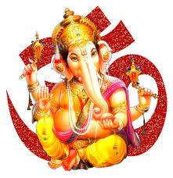


Slide 2

CLASS : 2
SESSION NO. : 15
SUBJECT : MATHEMATICS
TOPIC: CH-4 SUBTRACTION
SUB TOPIC:PROPERTIES OF SUBTRACTION.
.

Slide 3

TODAY’S TOPIC
Properties of subtraction.

Slide 4

LEARNING OBJECTIVE:- Students are able to know the properties of subtraction. .

Slide 5

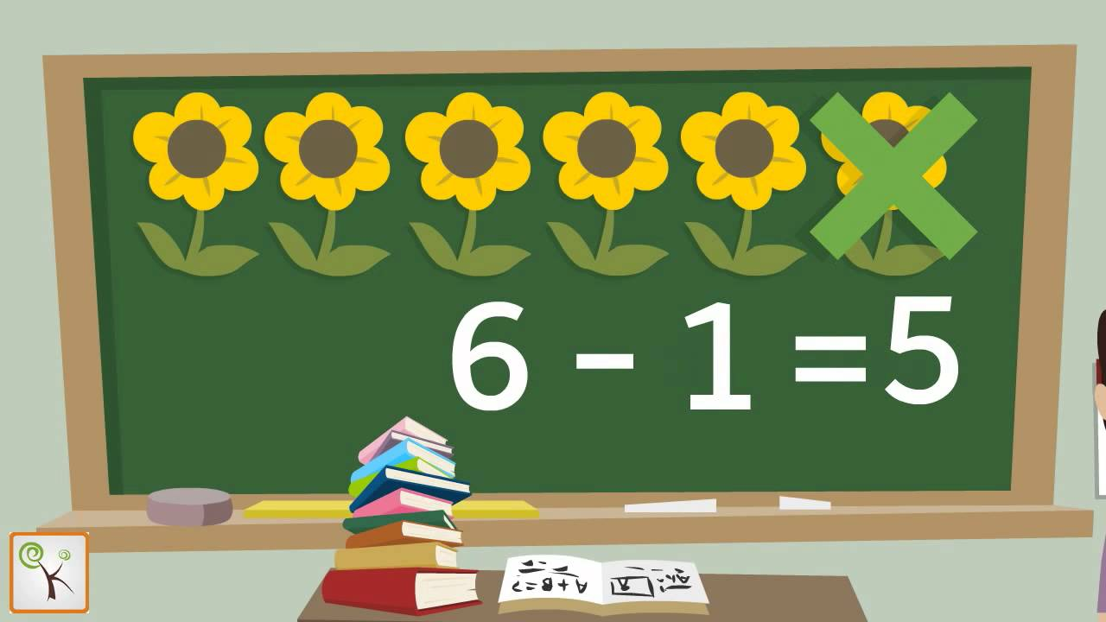
Taking away a number from another number is called SUBTRACTION.

Slide 6
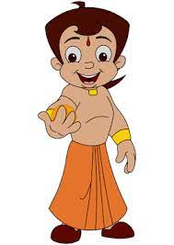
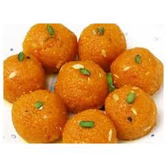
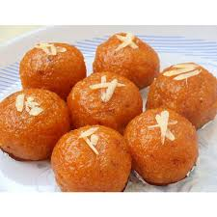
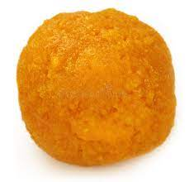
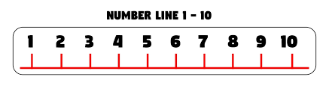
On subtracting 1from a number,the difference is the previous number, also called the predecessor of the number.
8-1=7
JUST BEFORE NUMBER
Predecessor

Slide 7
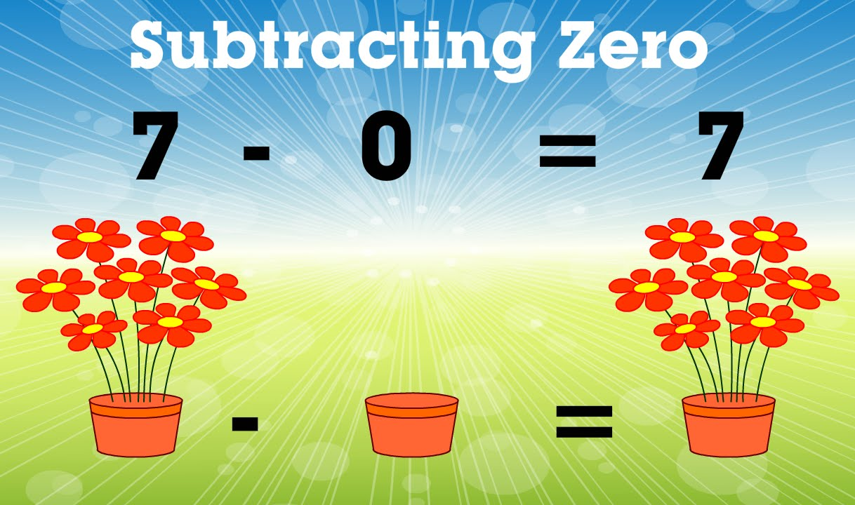
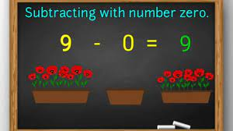
0
On subtracting 0 (zero) from a number, the difference is the number itself
8 - 0 = 8

Slide 8
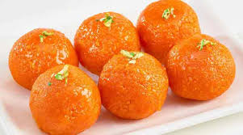
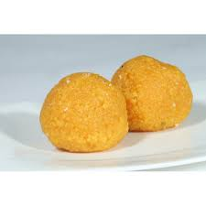
Change of order
Not possible

Slide 9
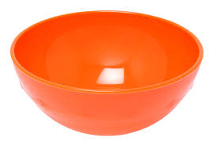
Activity
22- 0
15- 1
40- 1
60- 0
75- 1
45- 0
28- 1
Drag and match.
39
60
22
14
45
27
74
Previous number
Number itself

Slide 10
CW
Fill in the blanks.
subtraction
a. Taking away a number from another number is called ________ .
b.On subtracting 0(zero) from a number, the difference is the number _______.
itself
previous
c.On subtracting 1 from a number,the difference is the_______ number.

Slide 11
SUB | HOME ASSIGNMENT
Mathematics | ____________________

Slide 12
Expected learning outcome:-Students are able to know the properties of subtraction. .

Slide 13
THANKING YOU
ODM EDUCATIONAL GROUP

