Slide 1
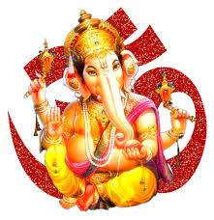


Slide 2

CLASS : 2
SESSION NO. : 16
SUBJECT : MATHEMATICS
TOPIC: CH-4 SUBTRACTION
SUB TOPIC:PROPERTIES OF SUBTRACTION.
.

Slide 3

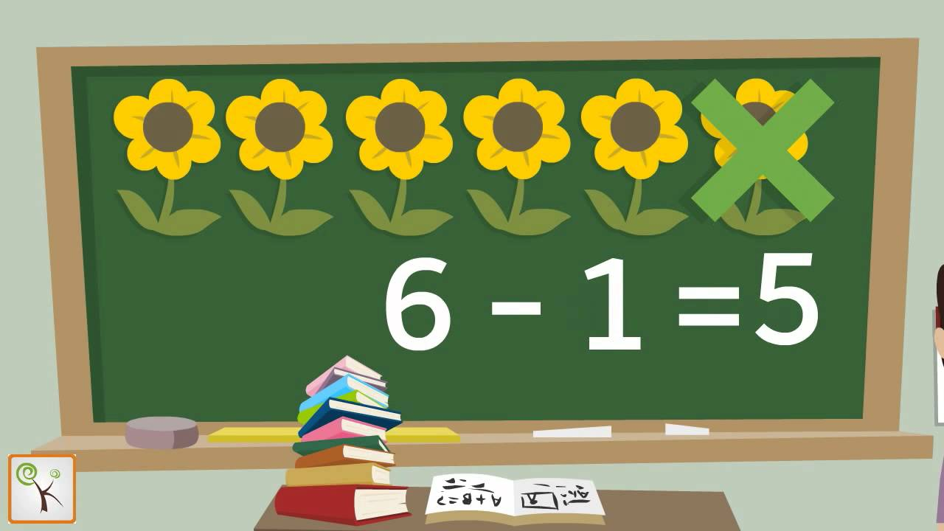
Taking away a number from another number is called SUBTRACTION.

Slide 4

TODAY’S TOPIC
Properties of subtraction.

Slide 5

LEARNING OBJECTIVE:- Students are able to know the properties of subtraction. .

Slide 6



JUST HAVE A RECAP.
ACTIVITY
For correct answer
For wrong answer
subtraction
a. Taking away a number from another number is called .
b.On subtracting 0(zero) from a number, the difference is the number.
previous
c.On subtracting 1 from a number,the difference is the itself.
Number
d.Predecessor is the just before number.

Slide 7

ADDITION
SUBTRACTION
The answer after adding is called the SUM
The answer after subtracting is called DIFFERENCE.
On subtracting 1 from a number, the difference is the previous number,also called the PREDECESSOR of the number.
The sum obtained after adding 1 to any number is the next number,also called the SUCCESSOR of that number.
On subtracting 0 from a number,the difference is the number itself..
The sum obtained after adding 0 to any number is the number itself.

Slide 8
cw
1.Subtract 0 from the following.
44
93
e.44 – 0 =
a.93 – 0 =
3
47
f.3 – 0 =
b.47 – 0 =
14
77
g.14 – 0 =
c.77 – 0 =
h.58 – 0 =
36
58
d.36 – 0 =

Slide 9
2.Find the predecessors of the following.
a)87
-1=86
f)42
-1=41
b)55
-1=54
g)31
-1=30
c)85
-1=84
h)3
-1=2
d)65
-1=64
i)80
-1=79
j)63
-1=62
e)14
-1=13

Slide 10
SUB | HOME ASSIGNMENT
Mathematics | ____________________

Slide 11
Expected learning outcome:-Students are able to know the properties of subtraction. .

Slide 12
THANKING YOU
ODM EDUCATIONAL GROUP

