Slide 1

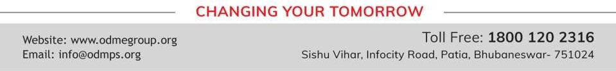
MOMENTS
STD-IX
SUBJECT : ENGLISH
CHAPTER NUMBER: 03
CHAPTER NAME : ISWARAN THE STORYTELLER BY R.K.LAXMAN

Slide 2
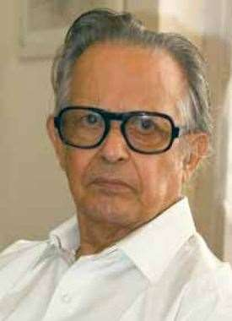


INTRODUCTION TO THE WRITER
R.K.Laxman (24 October 1921-26 January 2015) was an Indian cartoonist, Illustrator and humourist. He was best known for his creation ‘The Common Man’ and daily cartoon strip ‘You Said It’ in the Times of India, which was started In 1951.
He was awarded Padma Bhusan in 1973 and Padma Vibhushan in 2005 by Government of India.

Slide 3
THEME OF THE STORY
Nobody is free of fears. Everybody accepts the presence of ghosts and spirits but feels hesitant to express this truth openly. If fear lies in our heart , we should try to know the proper cause of this fear. In fear we may take some wrong decisions and put our life in problems. Therefore, we have to be bold enough to take good decisions in all circumstances.

Slide 4
INTRODUCTION: TO THE CHARACTERS
ISWARAN
A Cook and private help to Mahendra. He read Tamil stories and made up new stories,
full of thrill and horror for Mahendra. He played the role of a TV and Washing Machine in Mahendra’s life.
MAHENDRA
A Supervisor in a firm that hired supervisors at construction sites. He moved from one place to another place because of his job. He narrated this story about Iswaran to Ganesh.

Slide 5
STORY ABOUT TUSKER
Iswaran told this to Mahendra
A tusker escaped from the timber yard and began destroying things
It came to Iswaran’s school and created havoc.
It went beyond control
Iswaran snatched a cane from the teacher’s hand and faced the mad tusker boldly
He hit the animal on his third toenail and it shivered from head to foot and collapsed
The story was left at this point

Slide 6
STORY ABOUT A FEMALE GHOST
Iswaran linked the auspicious full moon night to the story of a female ghost
Mahendra chided him for such baseless stories and told him that they are only a part of an imagination
One night Mahendra heard some sound near his window
Mahendra saw a cloudy figure holding a bundle.
This affected Mahendra who could not sleep that night.
Next morning, Iswaran smilingly asked him about the sound and the woman ghost.
Mahendra was so upset that he gave the resignation and left the haunted place the
very next day.

Slide 7
WORD MEANINGS
QUARRY- open mining
SPRAWLED- spread arms and legs carelessly
DEPREDATION- damage
COLLAPSE- fell down
MUMBLING- speaking unclearly
SHRUG- to raise shoulders to express lack of interest.
CREDIBLE- trustworthy
INIMITABLE- which cannot be copied
CULINARY SKILL- cooking skill

Slide 8
CHARACTER SKETCH OF ISWARAN
ISWARAN: obedient- caring- hard working- good cook- great story teller
good at conversation- an asset to Mahendra- influenced by Tamil authors- good at creating suspense-
he had the quality of narrating even the smallest incident in an impressive way-
his main purpose was to create a suspense and surprise in a dramatic way

Slide 9
THANKING YOU
ODM EDUCATIONAL GROUP

