Slide 1

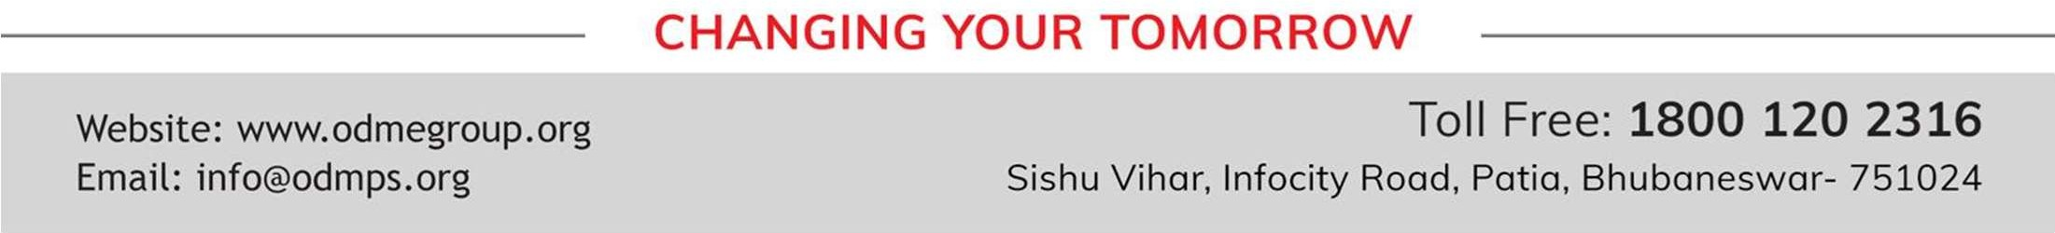
BEEHIVE
STD-IX
SUBJECT : ENGLISH CHAPTER NUMBER: 11
CHAPTER NAME : IF I WERE YOU

Slide 2


INTRODUCTION
1
This play follows the life of a playwright who is named Gerrard. This play by Douglas James is an account of how Gerrard escapes a killer through his sheer cleverness. In this play, we see Gerrard is ready to leave for a rehearsal when he encounters an intruder. Thus, upon finding himself in a fix, Gerrard manages to convince the intruder to not kill him. We learn that the intruder was planning to assume Gerrard’s identity as the police were looking for him. Lucky for Gerrard, his cleverness and wit save him from getting killed. Gerrard not only successfully saves his own life but also catches a criminal and finds a new plot for his next play too. Thus, it is a very interesting story to read.

Slide 3
Slide 2
1
@Format for content and slide heading is missing? Just like you have mentioned in DOC., We need to specify, for each slide's heading and text content, what will be the font style +amanrouniyar@odmegroup.org
_Assigned to you_
-Swoyan Satyendu
, 17-06-2020

Slide 4
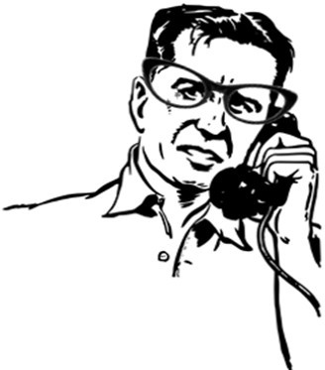
THE PLOT
The Intruder enters Gerrard’s house
The Intruder was a criminal. He had also killed a policeman. He was, now, being chased by police. He thought that he resembled Gerrard in body. He decided to kill Gerrard and then live himself as Gerrard. So, he broke into the cottage of Gerrard one day.
Gerrard ready to go out
Gerrard was then preparing to leave his house. He was going to attend a rehearsal of his drama. He had prepared his bag in which there were props for the rehearsal.

Slide 5
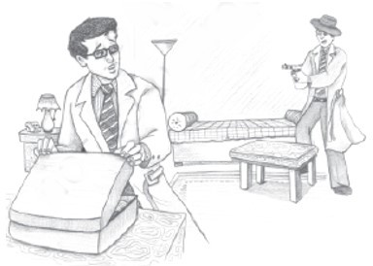
THE PLOT
Intruder threatens to shoot Gerrard
The Intruder threatened Gerrard with his revolver. He asked him to answer his questions. Then, he told him that he intended to kill him and then live in his house as Gerrard. He resembled Gerrard in body. Not many people came to see him. The Intruder thought he could live as Gerrard the rest of his life. He learnt to imitate Gerrard’s voice.
Gerrard cautions the Intruder
The Intruder was about to shoot Gerrard. Then Gerrard warned him to be careful and not to kill him. He told the Intruder that he was also a criminal and a murderer. In case, he killed Gerrard he was sure to be hanged. They would hang him if not as himself then as Gerrard.

Slide 6
THE PLOT
How the Intruder reacts
Hearing this, the Intruder began to think. This was an opportunity for Gerrard. He asked him to hurry and run with him in his car to a safer place. The police were likely to come there soon. He opened a door which was, in fact, the door of a cupboard. The Intruder looked in to see what it was.
How the Intruder is trapped
Just then, Gerrard gave him a push. The revolver fell as the Intruder stepped into the cupboard. Gerrard shut the door in a moment and picked up the revolver. Then he telephoned to call in the police to arrest the Intruder.

Slide 7
VOCABULARY
Intruder: a person who intrudes, especially into a building with criminal intent. Paws: here, hands
Melodramatic: excessive emotions than are required for the situation Nonchalant: not showing anxiety, interest or enthusiasm
Gypsies: nomads
Inflection: a change in the modulation of voice Dandy: stylish, fashionable
gratuitous double: done without reason. Posh: rich, showy
Pantomime: to mime or copy someone
Tribute: to show gratitude, respect or admiration for someone or something Elude: escape
Dodge: to avoid someone, here, the police. Queer: strange
Invested in: taken up, adopted Cloak: cape, robe
Sunday-school teacher: used to indicate an honest man Muddled head: confused mind

Slide 8
THANKING YOU
ODM EDUCATIONAL GROUP

