Slide 1


IS MATTER AROUND US PURE
CLASS-IX
SUBJECT-CHEMISTRY
CHAPTER-02
SUSPENSION, COLLOIDS AND ITS PROPERTIES, TYPES OF COLLOIDS
PERIOD-6

Slide 2

LEARNING OBJECTIVE
Students will be able to
Understand suspension and its properties.
Familiarize themselves with the colloidal solution and its properties.
Get aware of the various types of Colloidal solution.

Slide 3
WARM UP QUESTION
Recapitulate the previous concept of true solution and its properties.
Activate their minds by asking them to solve some numerical on concentration and solubility.
Ask them the mathematical expression of concentration of solution.

Slide 4
PROPERTIES OF SUSPENSION
A suspension is a heterogenous mixture.
The size of the particles of suspension is more than 100 nm.
Particles of suspension can be easily seen by the naked eyes.
The component particles can easily separated by filtration.
The particles of suspension scatters light.
The suspension is unstable.
Example:- A mixture of chalk powder and water.

Slide 5
PROPERTIES OF COLLOIDS
A colloid or colloidal solution is heterogenous but looks homogenous.
The size of the particles of a colloidal solution lies in between 1 nm and 100 nm in diameter.
Particles of a colloidal solution can be seen by a microscope.
The particles of a colloidal solution cannot be separated by filtration.
The colloidal solution scatter light.
The colloidal solution is less stable than true solution.
Example:-Blood

Slide 6
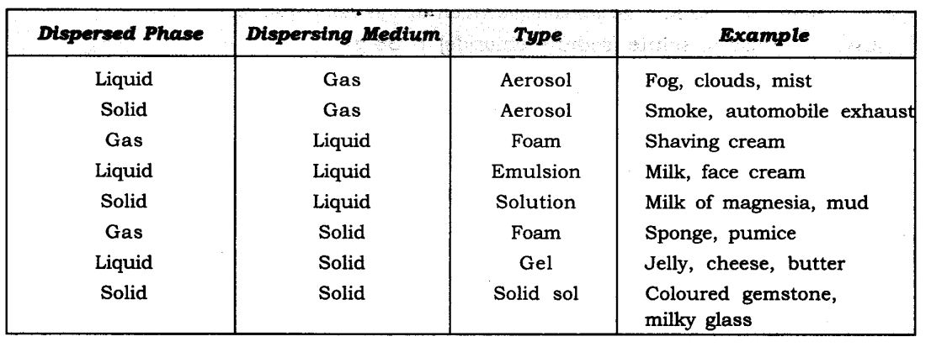
TYPES OF COLLOIDAL SOLUTION

Slide 7
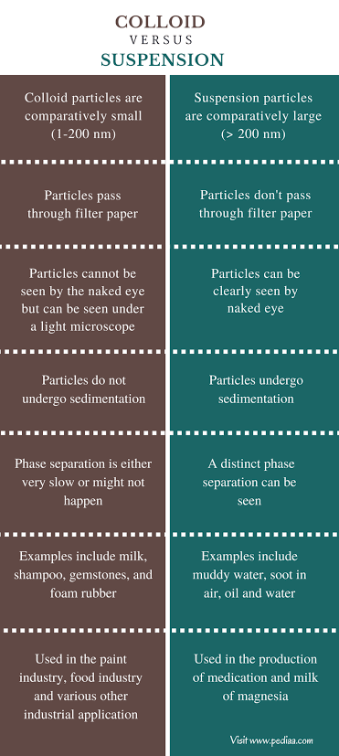
DIFFERENCE BETWEEN SUSPENSION AND COLLOIDS

Slide 8
HOME ASSIGNMENT
Exercise I Q12 to Q23 Name the type of colloid in the following. Mention the dispersed medium and dispersed phase in milk and gemstone What are Tyndall effects? Write its two applications

Slide 9
THANKING YOU
ODM EDUCATIONAL GROUP

