Slide 1


IS MATTER AROUND US PURE
CLASS-IX
SUBJECT-CHEMISTRY
CHAPTER-02
DISCUSSION OF THE PROCESS AND PRINCIPLE OF CENTRIFUGATION,CHROMATOGRAPHY AND WAY TO SEPARATE VARIOUS COMPONENTS OF AIR.
PERIOD-4

Slide 2

LEARNING OBJECTIVE
Students will be able to
Understand the process to separate the mixtures by centrifugation,.
Familiarize with the principle and process of chromatography.
Sensitize the method of paper chromatography in detail.

Slide 3
WARM UP QUESTION
Recapitulate the previous concept of the methods of distillation, fractional distillation and crystallisation etc.
Activate their minds by asking to justify the advantages of crystallisation over evaporation.
Ask them the principle involved in distillation.

Slide 4
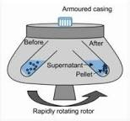
CENTRIFUGATION
If the solid particles are very small and pass through a filter paper, then centrifugation process is used for the separation of insoluble solid particles from a solid-liquid mixture.
Principle involved in centrifugation:
The principle is that when the liquid is spun rapidly, the denser particles are forced to the bottom and the lighter particles stay at the top.
Example: Centrifugation is used for blood and urine testing in diagnostic laboratories, in dairies to separate butter from cream, and in washing machines to squeeze out water from clothes.

Slide 5
VIDEO TIME
https://youtu.be/TEGvWNFrvqc

Slide 6
CHROMATOGRAPHY
Chromatography is a method used to separate mixture that comprises solutes that dissolve in the same solvent. This method gets its name from the Greek word for colour —Kroma, as it was first used for separating colours.
Principle:
Chromatography is based on differential affinities of compounds towards two phases, i.e. stationary and mobile phase.
The fraction with greater affinity towards stationary phase travels shorter distance while the fraction with less affinity towards stationary phase travels longer distance.
Chromatography is used for separating colours in a dye, pigments from natural colours and drugs from blood.

Slide 7
TYPES OF CHROMATOGRAPHY
Based on nature of stationary and mobile phases chromatography is classified into following types
• Paper chromatography
• Column chromatography
• Thin layer chromatography
• Gas chromatography

Slide 8
PAPER CHROMATOGRAPHY
In paper chromatography the stationary phase is paper and the mobile phase is any suitable liquid.
Separation of components of ink:
• First take a thin, long strip of filter paper. Use a pencil to draw a line on it, about 3 cm above the lower edge. Then, put a small drop of black ink.
• On the filter paper in the centre of the line and allow it to dry.
• Finally, lower the filter paper into a jar containing water so that the drop of ink on the paper is just above the water level. Don’t disturb the jar.
• After some time you will observe different coloured spots on the paper.
The ink has water as the solvent and the dye is soluble in it. As the water rises, it takes the particles of dye along with it. Since a dye is made of two or more colours, the colour which is the most soluble rises faster and higher. This is why there are differently coloured spots on the paper.

Slide 9
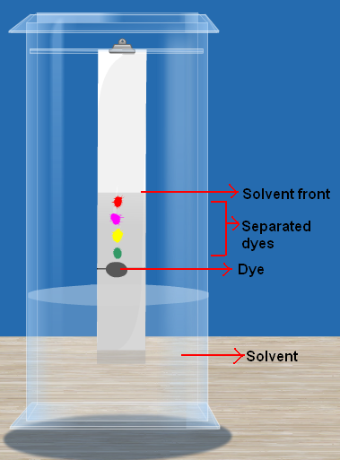
DIAGRAM SHOWING PAPER CHROMATOGRAPHY

Slide 10
SEPARATION OF DIFFERENT CONSTITUENTS OF AIR
The gases in the air are separated from one another by the fractional distillation of liquid air.
Air is made up of different gases like nitrogen, oxygen and carbon dioxide. These gases are separated from one another by the fractional distillation of liquid air.
Steps involved are,
Air is compressed in the compressor and cooled in the refrigeration unit. Thus, the air gets liquefied.
The liquid air is passed through a filter to remove impurities and then fed into a tall fractional distillation column.
On warming, liquid nitrogen distils first because it has the lowest boiling point of -196 ⁰C. Liquid argon has a slightly higher boiling point of -186 ⁰C, so it distils next. Liquid oxygen has the highest boiling point of -183⁰C, it left behind.

Slide 11
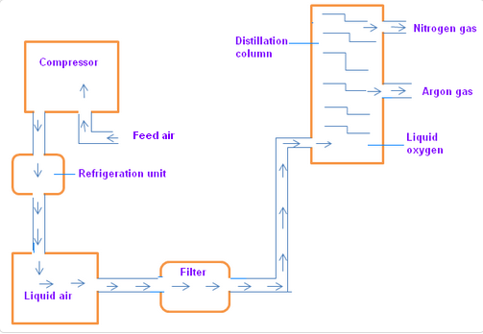
DIAGRAM SHOWING SEPARATION OF DIFFERENT CONSTITUENTS OF AIR

Slide 12
HOME ASSIGNMENT
Exercise-II Q13 to Q17 Mention two application of centrifugation. Show with neat diagram how to separate different components of air. Explain paper Chromatography.

Slide 13
THANKING YOU
ODM EDUCATIONAL GROUP

