Slide 1


IS MATTER AROUND US PURE
CLASS-IX
SUBJECT-CHEMISTRY
CHAPTER-02
CONCEPTUAL KNOWLEDGE ON THE SEPARATION PROCESS BY SEPARATING FUNNEL,SUBLIMATION,DISTILLATION,FRACTIONAL DISTILLATION AND CRYSTALISATION
PERIOD-3

Slide 2

LEARNING OBJECTIVE
Students will be able to
Understand the process to separate the mixtures using separating funnel.
Familiarize with various separation processes like sublimation, distillation and fractional distillation
Sensitize the method of crystallisation and get idea of its application.

Slide 3
WARM UP QUESTION
Recapitulate the previous concept of the traditional methods like magnetic separation, winnowing etc.
Activate their minds with the uses of the traditional methods in our day today life.
Ask them the principle involved in various traditional methods of separation.

Slide 4
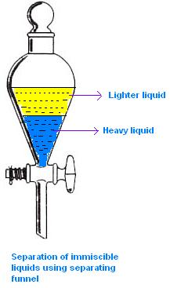
SEPARATING FUNNEL
When two liquids do not mix, they form two separate layers and are known as immiscible liquids. These two liquids can be separated by using a separating funnel. Examples: Kerosene and water mixture is separated by using separating funnel method. This method is also used to extract iron from its ore.

Slide 5
VIDEO TIME
https://youtu.be/7oqLUIHpqOc

Slide 6
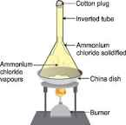
SUBLIMATION
Sublimation is the process in which solid directly changes to gaseous state. Example: Salt and a sublimable solid such as ammonium chloride, can be separated by the process of sublimation

Slide 7
DISTILLATION
This method is used for the separation of a mixture containing two miscible liquids that boil without decomposing and have a large difference between their boiling points. Process of conversion of a liquid into vapour by boiling, and then recondensing the vapour into liquid is called distillation. Apparatus:
Distillation process requires a distillation flask, thermometer, heating assembly, a receiver flask and condenser as the apparatus. A distillation flask is a round-bottomed flask with a tube at its neck. This tube is attached to a Liebig condenser. The Liebig condenser is a long glass tube within a glass jacket, with an inlet and outlet for water. The open end of the flask is fitted with a one-holed rubber cork through which a thermometer is introduced.

Slide 8
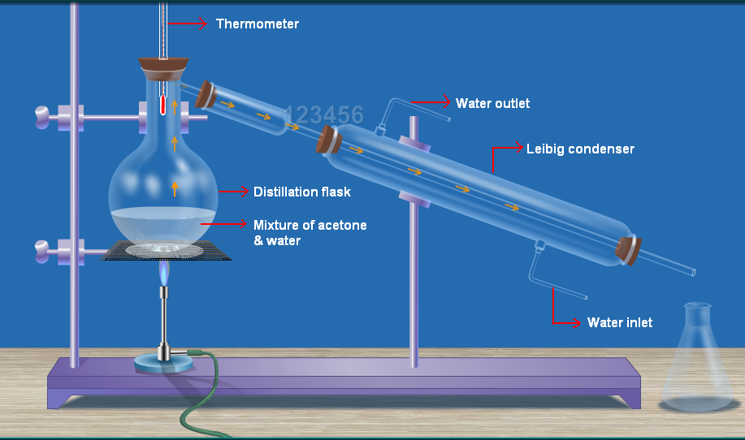
DIAGRAM SHOWING DISTILLATION

Slide 9
FRACTIONAL DISTILLATION
In case the difference in the boiling points of the liquids is less than 25K temperature, we use the fractional distillation method. The apparatus is almost the same as used in distillation. The only difference is that a fractioning column is fitted in between the distillation flask and the condenser. A simple fractioning column is made up of a tube packed with glass beads. The beads provide the surface for the vapours to cool and condense again and again. The fractioning columns obstruct the smooth upward flow of vapours. Example: A mixture of n-hexane and n-heptane can be separated through the process of fractional distillation

Slide 10
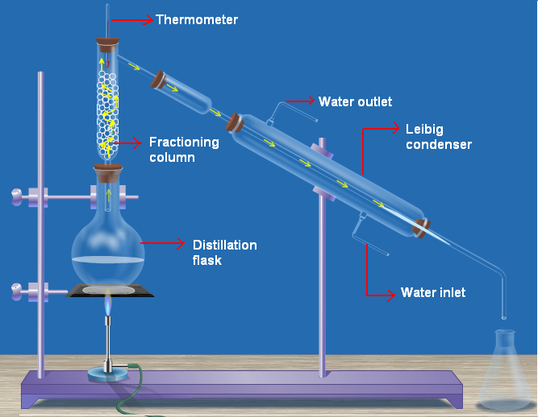
DIAGRAM SHOWING FRACTIONAL DISTILLATION

Slide 11
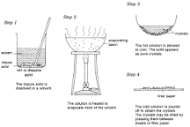
CRYSTALLISATION
Crystallisation is a separation and purification method which involves the precipitating of solid crystals from its saturated solution on cooling. In this process the impure sample is dissolved in minimum amount of suitable solvent. The formed solution is heated to get a saturated solution. On cooling, this saturated solution produces pure crystals of the sample. Crystallisation is used for:
Purification of salt that we get from sea water and separation of crystals of alum from impure samples.

Slide 12
HOME ASSIGNMENT
Exercise-II Q1to Q12 Which method is used to separate a mixture of mustard oil and water? What are the advantages of Fractional distillation over simple distillation? Explain how can we separate a mixture of acetone and alcohol.

Slide 13
THANKING YOU
ODM EDUCATIONAL GROUP

