Slide 1
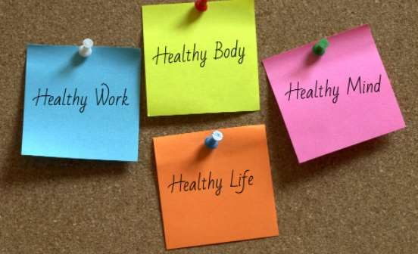
HEALTH
🠶 Health and disease in human communities are very complex issues, with many interconnected causes.
🠶 The World Health Organization has defined health as a state of complete physical, mental and social well-being.
🠶 Community health can be defined as "All the personal health along with the environmental services for the importance of health of community".

Slide 2

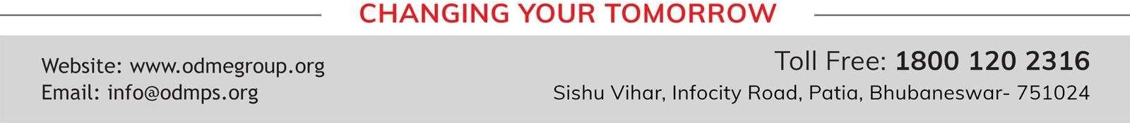
WHY DO WE FALL ILL?
SUBJECT-BIOLOGY CHAPTER NO-13
Causes of Diseases(Activity-13.3 ),Infectious agents, Means of spread
PERIOD-3

Slide 3
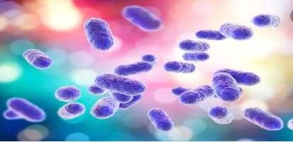
Causes of diseases :
🠶 It will be obvious that all diseases will have immediate causes and contributory
causes. Also, most diseases will have many causes, rather than one single cause.
🠶 Diseases are caused by :-
🠶 i) Pathogens like virus, bacteria, fungi, protozoans or worms.
🠶 ii) Poor health and under nourishment.
🠶 iii) Malfunctioning of body parts.
🠶 iv) Environmental pollution.
🠶 v) Genetic disorders.

Slide 4
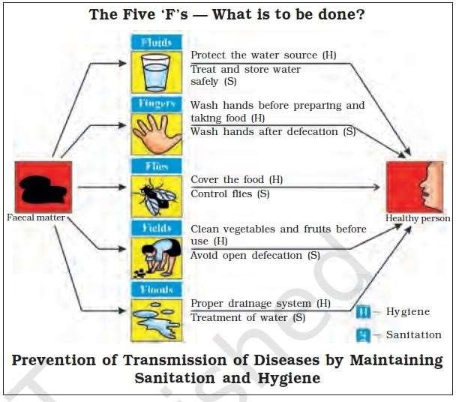
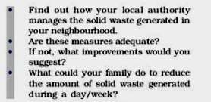
ACTIVITY- 13.1

Slide 5
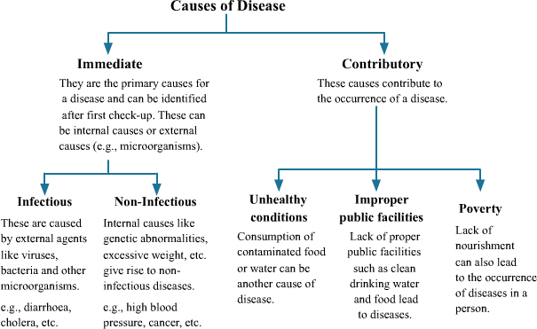

Slide 6
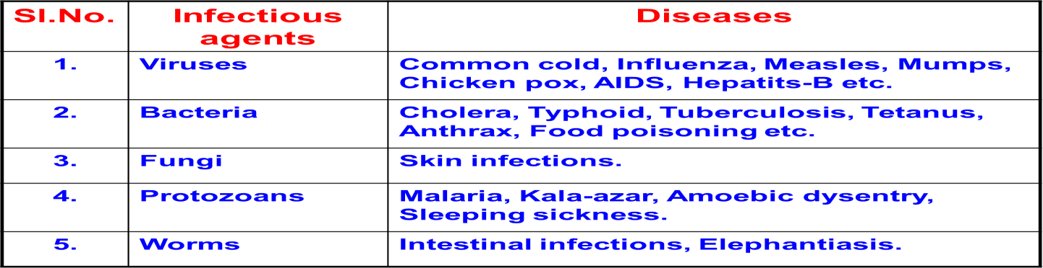
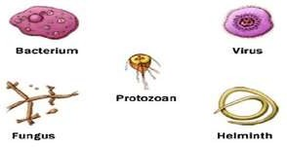
Infectious diseases :-
🠶 Infectious agents :-
The agents which cause infectious diseases are called pathogens. These are Viruses, Bacteria, Fungi,
Protozoans and worms.

Slide 7
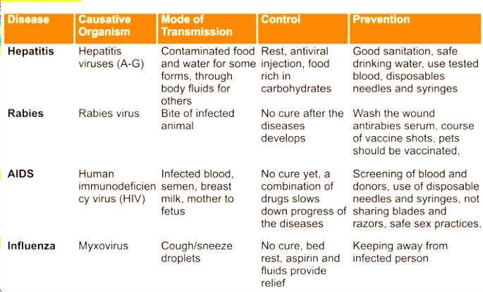

Slide 8
HOME ASSIGNMENT
Salmonella is what type of pathogen? In which foods is Salmonella more likely to be found?
Malaria is caused by what type of pathogen?
What is the incubation period of hepatitis B?
What is the cause of the disease beri-beri?
Name the disease caused by the deficiency of iodine.

Slide 10

THANKING YOU
ODM EDUCATIONAL GROUP

