Slide 1


WHY DO WE FALL ILL?
SUBJECT-BIOLOGY
CHAPTER NO-13
Health and its failure, Personal and community issues both matter for health.
PERIOD-1

Slide 2

LEARNING OBJECTIVES
Students will be able to-
Know the importance of total well being of an individual.
Understand the determinants of health.
Correlate the role of community in personal as well as public community health.
Identify the reasons for health failure.

Slide 3
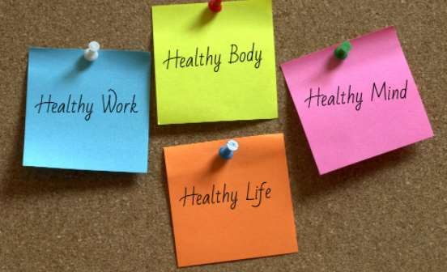
HEALTH
🠶 Health and disease in human communities are very complex issues, with many interconnected causes.
🠶 The World Health Organization has defined health as a state of complete physical,
mental and social well-being.
🠶 Community health can be defined as "All the personal health along with the environmental services for the importance of health of community".

Slide 4

Health and its failure :-
Health is a state of physical, mental and social well being.
The WHO defines health as a state of “complete physical, mental and social well- being and not merely the absence of disease or infirmity.”

Slide 5
Some of the health services are given below:
🠶 (i) Establishment of health care services like primary health centers, district hospitals, community health centers, medical colleges, all Indian institutes, regional hospitals etc.
🠶 (ii) Provision of safe drinking water and proper disposal of garbage.
🠶 (iii) Prevention of harmful insect breeding sites.
🠶 (iv) Management of different types of environmental pollution by
Central and State Pollution Control Boards.
🠶 (v) Preventive vaccinations against number of diseases like tuberculosis,
diphtheria, whooping cough, tetanus, measles, hepatitis, etc.
🠶 (vi) Provision of family planning advices and services.
🠶 (vii) Provision of medical care to school going children.
🠶 (viii) Prevention of food adulteration.
🠶 (ix) Health education.

Slide 6
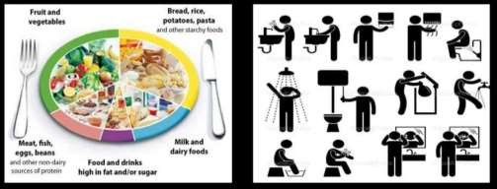

CONDITIONS ESSENTIAL FOR GOOD HEALTH
There are several conditions which have to be fulfilled for good health. The important ones are
🠶 (i) Nutrition,
🠶 (ii) Proper habits, and
🠶 (iii) Exercise and relaxation.

Slide 7
PERSONALAND COMMUNITY ISSUES BOTH MATTER FOR HEALTH
Health is a state of physical, mental and social well being. The conditions necessary for
good health are
i) Good physical and social environment.
Good physical and social environment includes clean surroundings, good sanitation,
proper garbage disposal and clean drinking water.
ii) Good economic conditions.
Good economic conditions includes job opportunities for all for earning to have
nutritious food and to lead a healthy life.
iii) Social equality and harmony.
Social equality and harmony are necessary for a healthy and peaceful life

Slide 8
PERSONALAND COMMUNITY ISSUES BOTH MATTER FOR HEALTH
Health is a state of physical, mental and social well being. The conditions necessary for
good health are
i) Good physical and social environment.
Good physical and social environment includes clean surroundings, good sanitation,
proper garbage disposal and clean drinking water.
ii) Good economic conditions.
Good economic conditions includes job opportunities for all for earning to have
nutritious food and to lead a healthy life.
iii) Social equality and harmony.
Social equality and harmony are necessary for a healthy and peaceful life

Slide 9
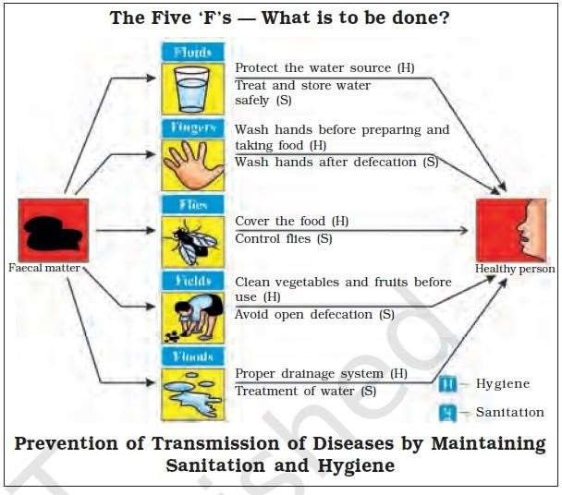

Slide 10
HOME ASSIGNMENT
What is personal health and community health?
List any four essential factors that must be taken care of by an individual for
keeping good health.
What do signs and symptoms indicate if a person is suffering from any disease ?
State any two conditions essential for good health.
State any two conditions essential for being free of disease.

Slide 11
THANKING YOU
ODM EDUCATIONAL GROUP

