Slide 1


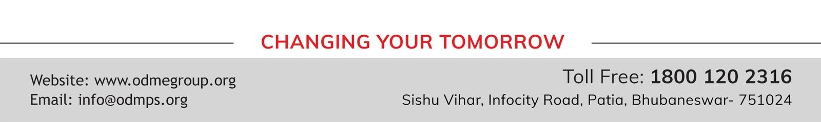
STD-IX
SUBJECT- LITERATURE CHAPTER - 4
TOPIC- IN THE KINGDOM OF FOOLS PERIOD-3

Slide 2

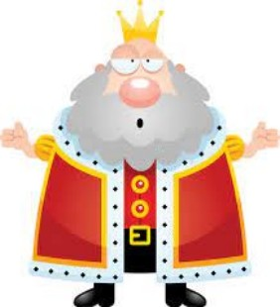





Slide 3
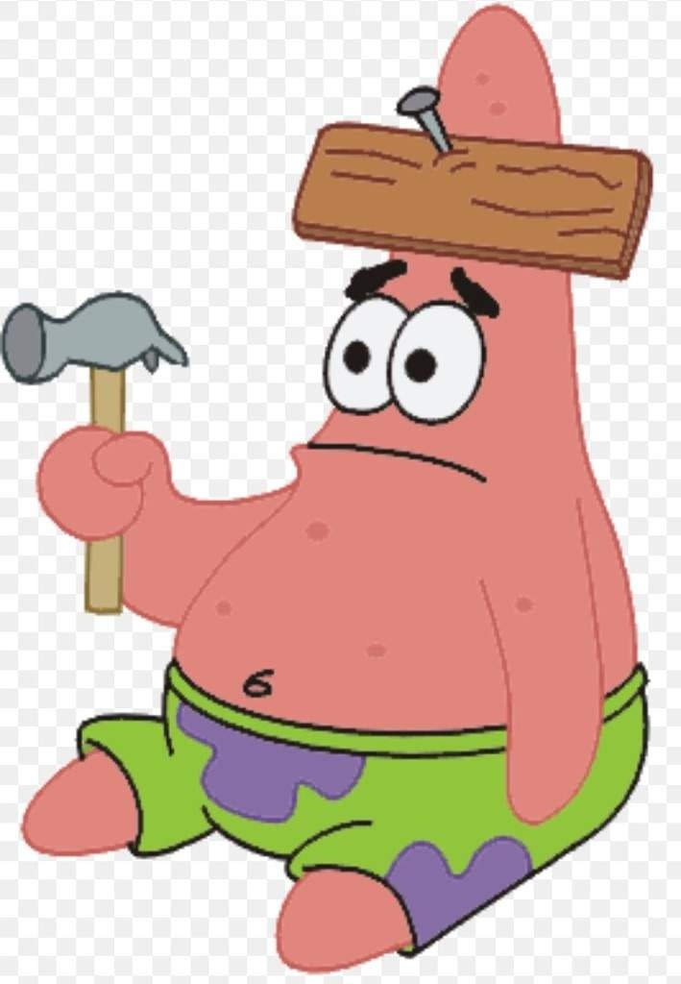
EXPECTED LEARNING OUTCOMES:
GENERAL OBJECTIVES
Understanding the concept
Being acquainted with prose and author’s biography
Understanding the idea
Appreciate the language of the prose
Developing LSRW Skills
SPECIFIC OBJECTIVES/ EXTENDED OBJECTIVES
Understanding the concept
Being acquainted with prose and author’s biography
Understanding the idea
Appreciate the language of the prose
Developing LSRW Skills

Slide 4
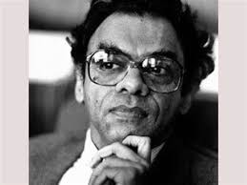
THE AUTHOR:
Attipate Krishnaswami Ramanujan (March 16, 1929 – July 13, 1993) also known as A. K. Ramanujan was a scholar of Indian literature who wrote in both English and Kannada.
Ramanujan was an Indian poet, scholar and author, a philologist, folklorist, translator, poet and playwright. His academic research ranged across five languages: Tamil, Kannada, Telugu, Sanskrit, and English. He published works on both classical and modern variants, and also argued strongly for giving local, non-standard dialects their due.

Slide 5
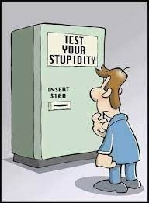
THEME OF THE STORY:
“In the Kingdom of Fools” is a folktale that brings to light the dangers posed by foolish people.
It also emphasizes the view that foolish people can be very difficult to manage.
They can be dealt with only by the wise and calm people. The story is about a kingdom where the king and the ministers are nothing but fools.
They reversed the order of the day and night and punished anyone who violates the laws.
A learned Guru and his disciple arrive in the kingdom only to find that everyone performed the chores after evening and slept at night.
After this a series of events follows which lead to the downfall of the king and his minister.

Slide 6

THE GOLDSMITH AND HIS PLEA
The king now ordered to summon the goldsmith.
The goldsmith replied that there was a wedding in the rich man’s house. He had to make jewellery for him.
So he could not finish the jewellery of the dancing girl in time.

Slide 7

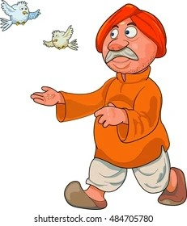

The king declared the rich man to be the murderer. He was also the owner of that house.
But he said that his father had ordered the jewellery. The king consulted his minister. He decided that the owner be punished in his father’s place.
The king asked for a new stake to be made ready for the owner to die. But the owner was very thin. He could not be executed. The king was worried about it. Then he ordered to search a man who was fit for the stake. He should be executed.

Slide 8
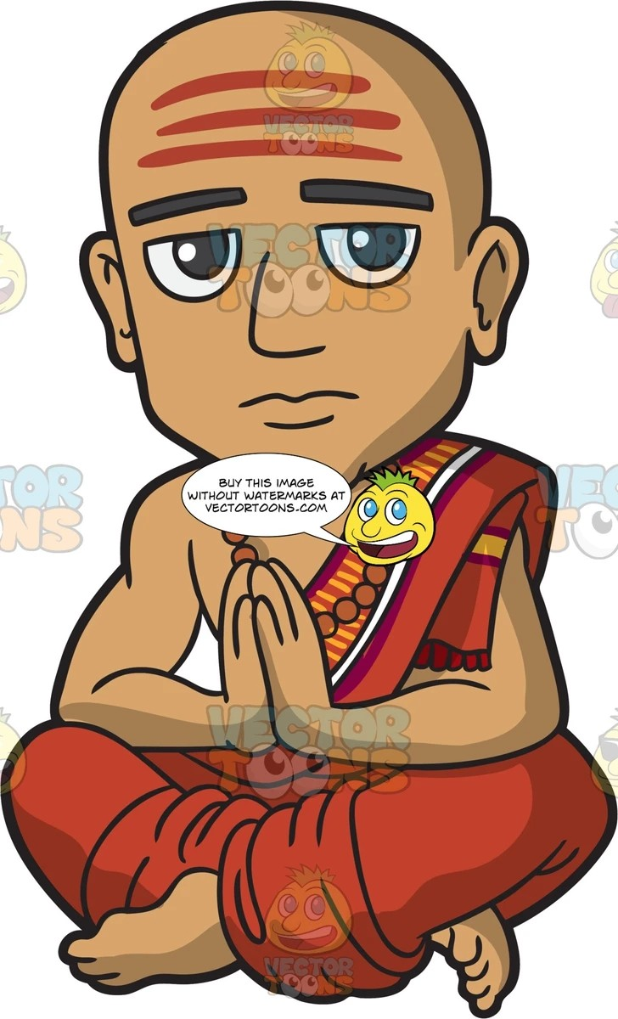

The disciple was found fit for the stake. He was brought to the place of execution.
The disciple now remembered his wise guru’s words. He prayed to his guru. The guru had magic powers to see the past and the future.
He saw everything. He arrived at once to save his disciple. He told his disciple something in a low voice. The disciple understood this.

Slide 9
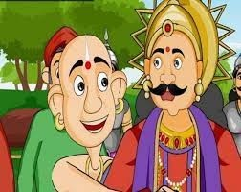
The guru and the disciple now started fighting. The guru wanted to die first.
The king asked the guru why he wanted to die. The guru told the king in his ears that their city was unique.
This was the stake of god of justice. The stake was new. It was never used earlier on criminals.
Whoever died on it first, would be born a king. Whoever died next would be born as a minister.

Slide 10
VOCABULARY
damned: a word used to express anger with someone or something
culprit: a person responsible for a crime or other misdeed
bailiffs: law officers
accusation: a statement saying that someone has done something morally wrong, illegal, or unkind
impatient: someone who wants something to happen as soon as possible
inherited: receive money, property, or possessions from someone after the person has died
impaling: to kill someone by fixing on a stake
execution: legal punishment of killing someone
complicated: difficult
distracted: unable to concentrate or give attention to something
evidence: something that makes a belief plain or clear
vision: dream

Slide 11
THANK YOU
ODM EDUCATIONAL GROUP

