Slide 1


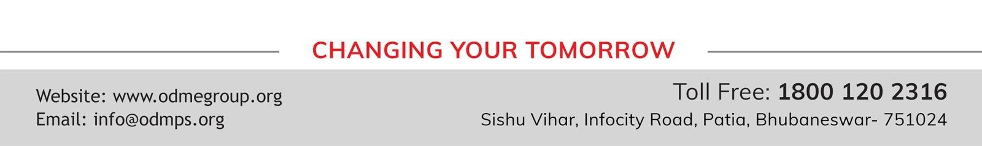
STD-IX
SUBJECT- LITERATURE CHAPTER - 4
TOPIC- IN THE KINGDOM OF FOOLS PERIOD-2

Slide 2

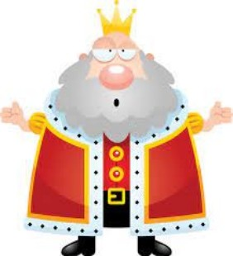





Slide 3
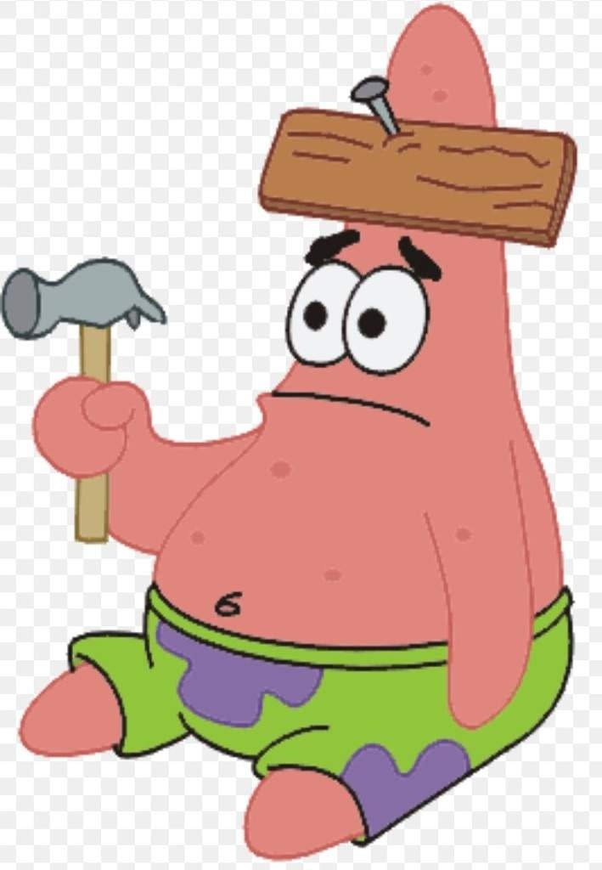
EXPECTED LEARNING OUTCOMES:
GENERAL OBJECTIVES
Understanding the concept
Being acquainted with prose and author’s biography
Understanding the idea
Appreciate the language of the prose
Developing LSRW Skills
SPECIFIC OBJECTIVES/ EXTENDED OBJECTIVES
Understanding the concept
Being acquainted with prose and author’s biography
Understanding the idea
Appreciate the language of the prose
Developing LSRW Skills

Slide 4
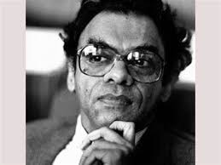
THE AUTHOR:
Attipate Krishnaswami Ramanujan (March 16, 1929 – July 13, 1993) also known as A. K. Ramanujan was a scholar of Indian literature who wrote in both English and Kannada.
Ramanujan was an Indian poet, scholar and author, a philologist, folklorist, translator, poet and playwright. His academic research ranged across five languages: Tamil, Kannada, Telugu, Sanskrit, and English. He published works on both classical and modern variants, and also argued strongly for giving local, non-standard dialects their due.

Slide 5
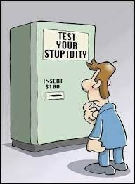
THEME OF THE STORY:
“In the Kingdom of Fools” is a folktale that brings to light the dangers posed by foolish people.
It also emphasizes the view that foolish people can be very difficult to manage.
They can be dealt with only by the wise and calm people. The story is about a kingdom where the king and the ministers are nothing but fools.
They reversed the order of the day and night and punished anyone who violates the laws.
A learned Guru and his disciple arrive in the kingdom only to find that everyone performed the chores after evening and slept at night.
After this a series of events follows which lead to the downfall of the king and his minister.

Slide 6
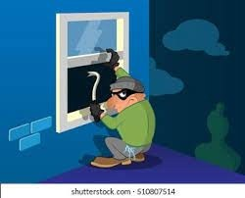
A THIEF BREAKS INTO A RICH MERCHANT’S HOUSE
One day a thief broke into a rich merchant’s house. He was taking out the stolen things.
Just then the wall of the old house fell on his head. He was killed instantly.
The brother of the thief complained to the king about his death. He blamed the owner of the house for his brother’s death

Slide 7
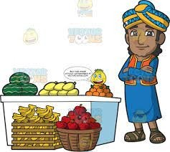
The king heard the accused. He accused him of killing the thief.
But the owner said that he was innocent. He said that the person who built the wall was responsible.
He didn’t make the good wall. The king decided to summon the bricklayer.

Slide 8

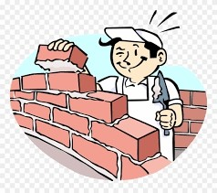
The king asked the bricklayer if he had built the wall.
He accused him of killing the thief. Before the king could order his death, the bricklayer pleaded innocence.
He told the king that he could not concentrate while building the wall. A dancing girl moved in the street. So, she was responsible for it.

Slide 9
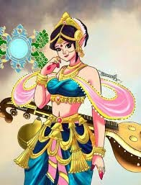

The king charged the dancing girl of killing the thief.
The dancing girl said that the goldsmith was responsible for it. She had given some gold to him.
He had to make some jewellery for her. He was lazy. He did not make the jewellery early. So she had to walk up and down the street. So, it was the goldsmith’s fault.

Slide 10
VOCABULARY
complicated: difficult
distracted: unable to concentrate or give attention to something
damned: a word used to express anger with someone or something
culprit: a person responsible for a crime or other misdeed
bailiffs: law officers
accusation: a statement saying that someone has done something morally wrong, illegal, or unkind
impatient: someone who wants something to happen as soon as possible
inherited: receive money, property, or possessions from someone after the person has died
impaling: to kill someone by fixing on a stake
execution: legal punishment of killing someone
complicated: difficult
distracted: unable to concentrate or give attention to something

Slide 11
THANK YOU
ODM EDUCATIONAL GROUP

