Slide 1


CLASS 7
GEOGRAPHY
HYDROSPHERE

Slide 2
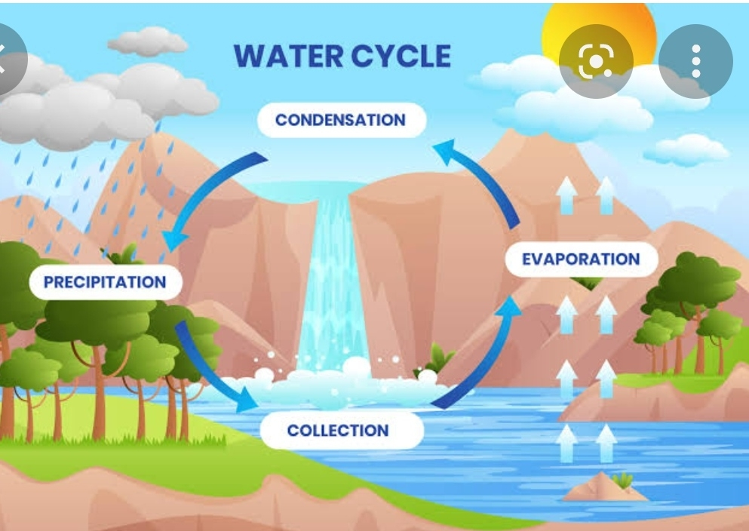
The Water Cycle
The continuous interchange of the form of water on Earth is called water cycle pr hydrological cycle.
Water from the surface of the Earth evaporates on heating and changes into water vapour.
The water vapour is carried up in the air, where it cools. On cooling water vapour in the atmosphere condenses changes into liquid state and form clouds.
When cloud particles get too heavy to remain suspended in the air, they fall back to the Earth as precipitation.
° Precipitation are of various types- rain, snow,
hail, fog, sleet,most and dew.

Slide 3
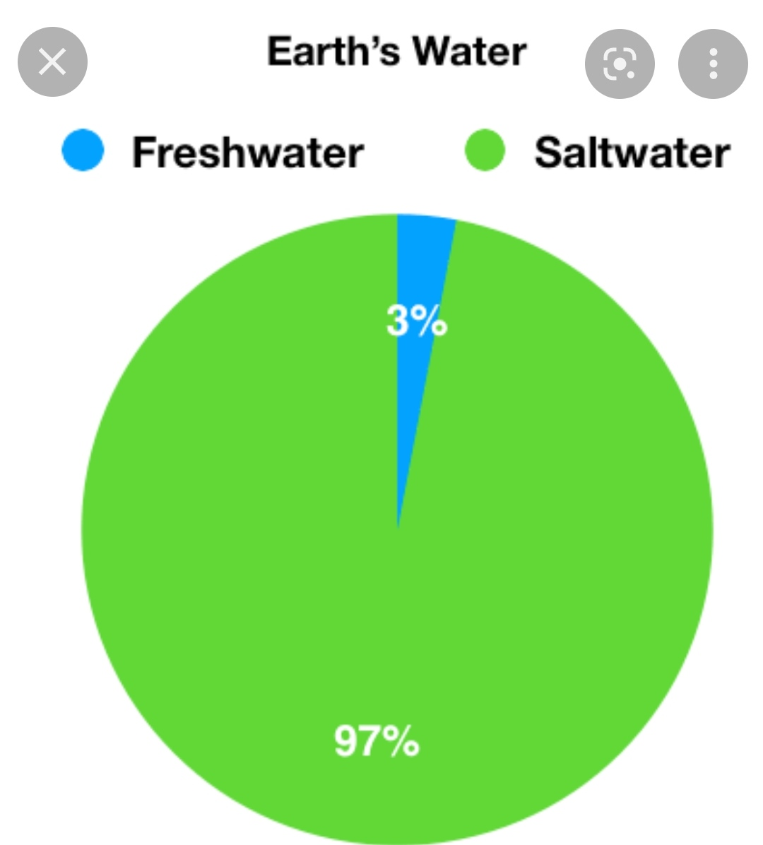
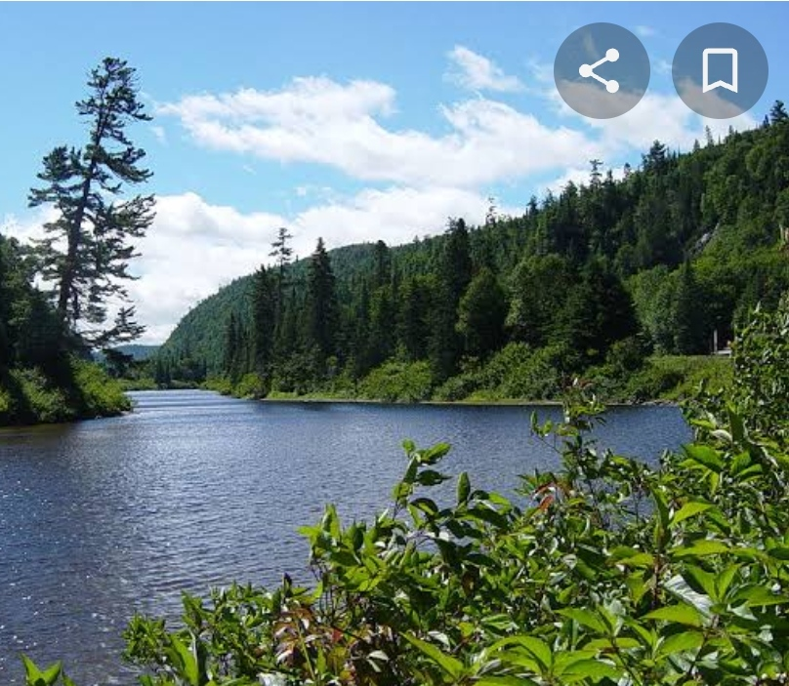
Distribution of water on the surface of the Earth
•The water available on the Earth‘s surface is of two types- fresh water and salt water.
•97% of the Earth’s water is found in the oceans and only 3% is fresh water.
•69% of fresh water is frozen in the form of ice sheets and glaciers.
• 30% in the form of underground water.
• Only 1% of fresh water is found in liquid form on the surface of the Earth in the form of streams and lakes.
• The biggest source of fresh water is precipitation
from the atmosphere in the form of
rain and snow.

Slide 4
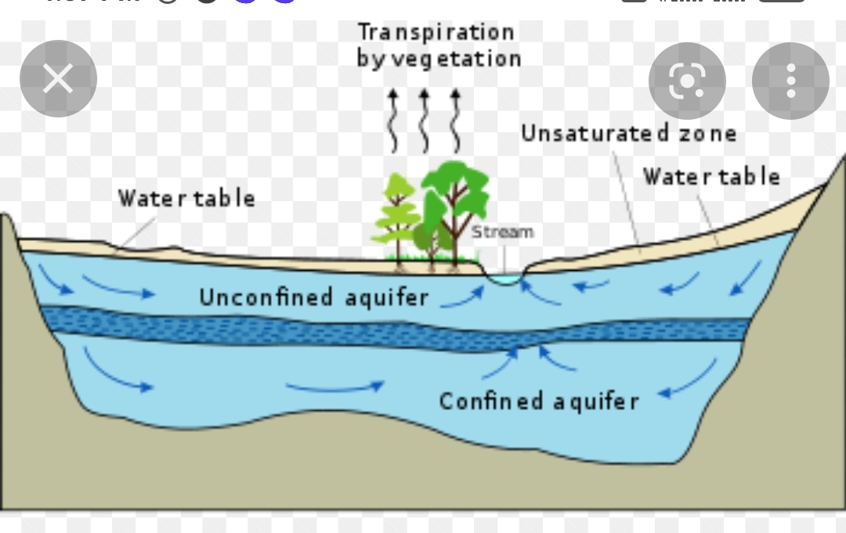
Surface water and Ground water
•The water which is found in ponds, lakes, rivers and streams is called surface water.
•Some water gets collected beneath the surface of the Earth through seepage. This is underground water.
•The point ay which water is found beneath the Earth’ surface at any given place is called water table.
• Aquifers situated below the water table are a rich source of fresh water.

Slide 5
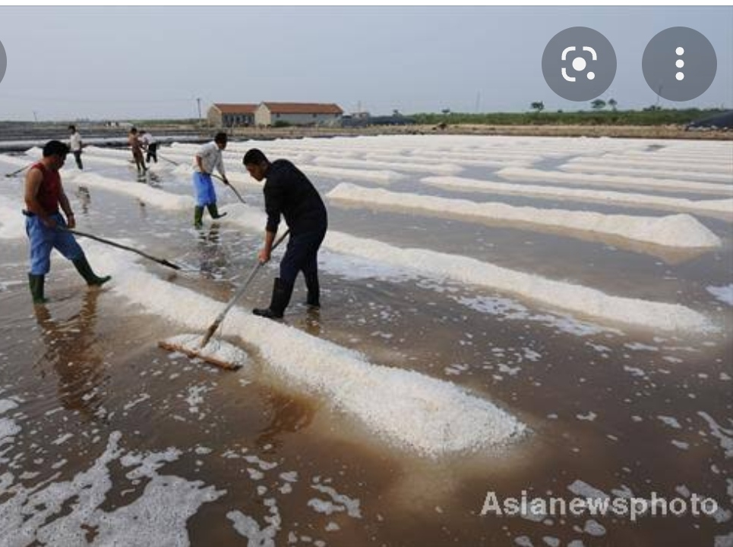
Ocean waters
• Oceans are huge water bodies that support marine life. The help in international trade.
• Salt makes up 3.5% of the oceans.
• Rivers and underground streams carry dissolved salts with them and empties into the ocean.
• The salts that come from volcanic eruption in the mid ocean ridge also contribute. Global warming has increased the rate of evaporation and made oceans saltier by the day.

Slide 6
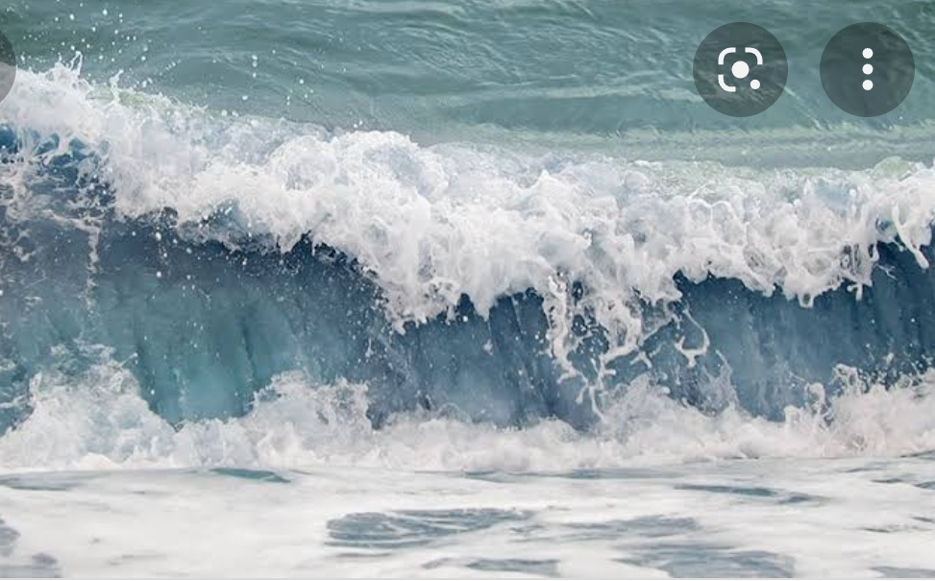
Movement of ocean water
• Oceanic or marine waters are always moving.
• It is due to the force of wind, temperature differences and gravitational forces.
•The three main movements noticed in the oceans are waves, tides and currents.
•The rhythmic up and down movement of water
on the surface of the ocean causes waves.
• As a wave moves it forms a succession of crest
and trough. The horizontal distance between two crest is called wavelength.

Slide 7
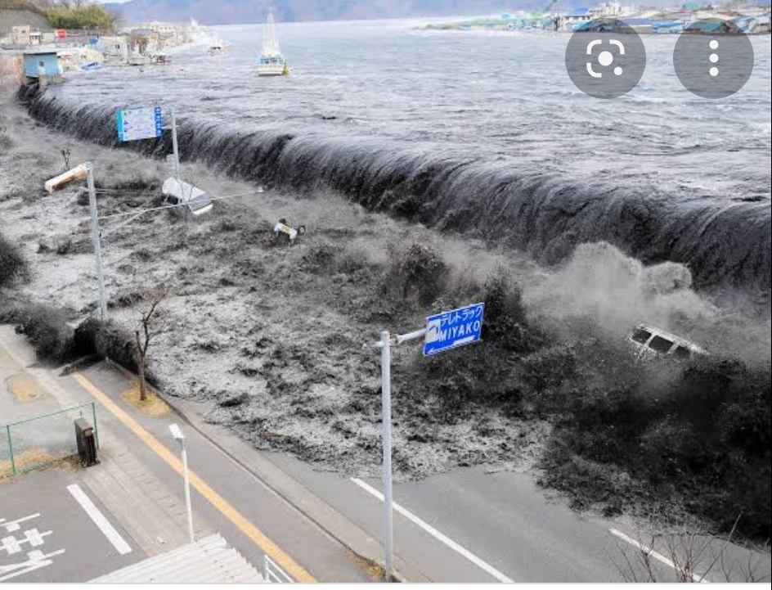
•The height of the wave is determined by three factors-
• The length of time for which the wind has blown over water.
• Distance of open water over which the wind had blown , called fetch.
• Wind speed
• Sometimes the waves is caused by tremors below the ocean floor. Tsunamis, the most destructive of waves is caused by severe undersea earthquake.
• The breaking wave is called swash and the
receding wave is called backwash.

Slide 8
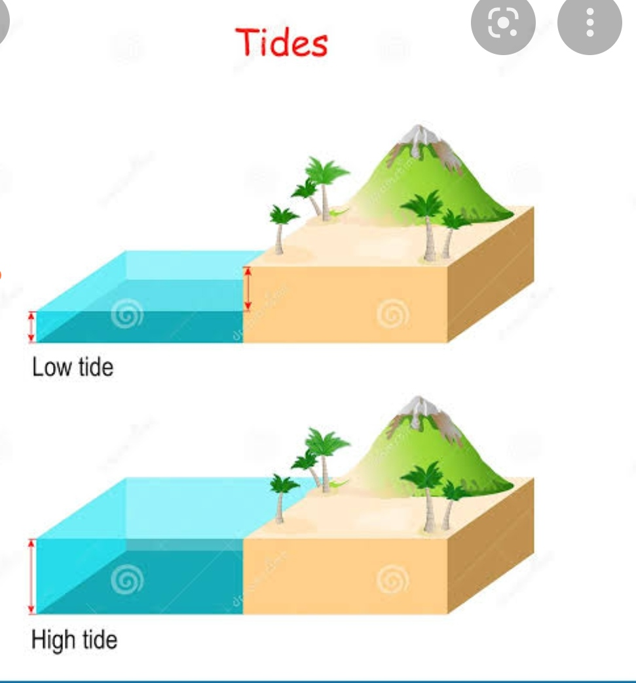
Tides
•Tides are the periodic rising and falling of the sea level due to the gravitational pull of the Moon and Sun acting on the rotating Earth.
•Tides are of two types – high tides and low tides
• During high tides, the water rises in the tidal belt and rush in towards the land and flood it.
• During low tide the water level falls and sea water recedes.
•Areas that are alternately submerged and exposed by rising and falling tides are called tidal flats.

Slide 9
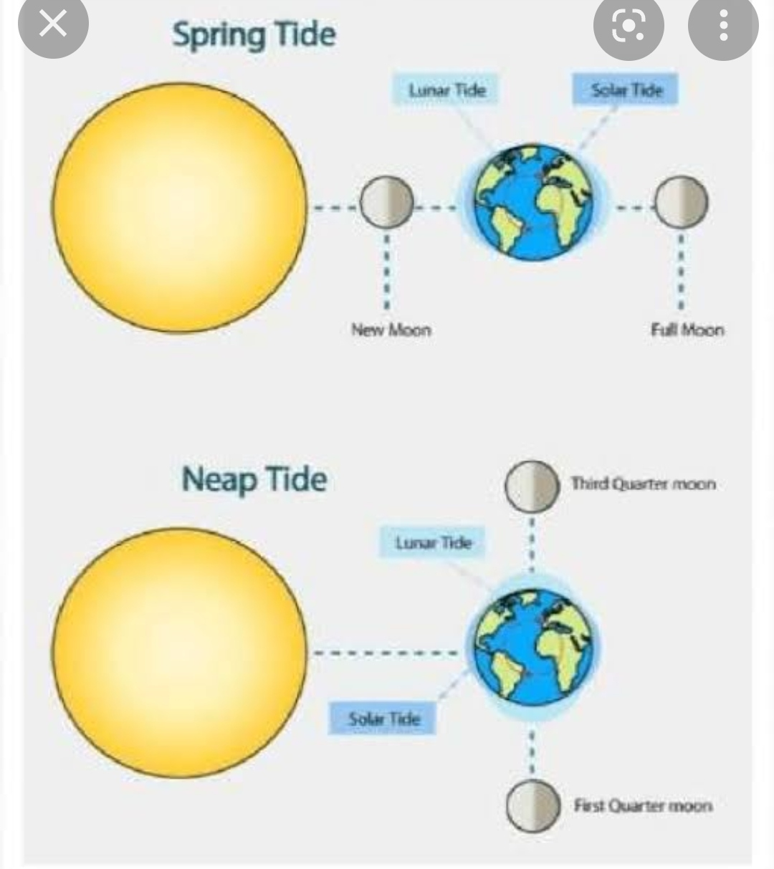
Spring tides and Neap tides
If the Sun, the Moon and the Earth are lined up in a straight line the Sun’s gravitational pull gets added to that of the Moon. The tides then have a higher tidal range. Such tides are called spring tides. They occur on full moon days and new moon days.
If the Sun and the Moon are at right angles to one another, the gravitational pull of the Sun on the Earth partially cancels that of the moon. Such situations occur during the quarter phases of the Moon. During these periods, high tides are not very high and low tides are not very low. These are called neap tides.

Slide 10
The uses of tides
•Tides help in navigation.
• Low tides are used by fishermen to go out into the open sea for fishing.
•Tidal power can be used to generate electricity.
•Tidal action helps mix up nutrientsand makes coastal regions in marine life. Such regions are excellent fishing grounds.
•Tides keep the mouths of the rivers free of sediments by carrying the sediments far away into the sea.

Slide 11
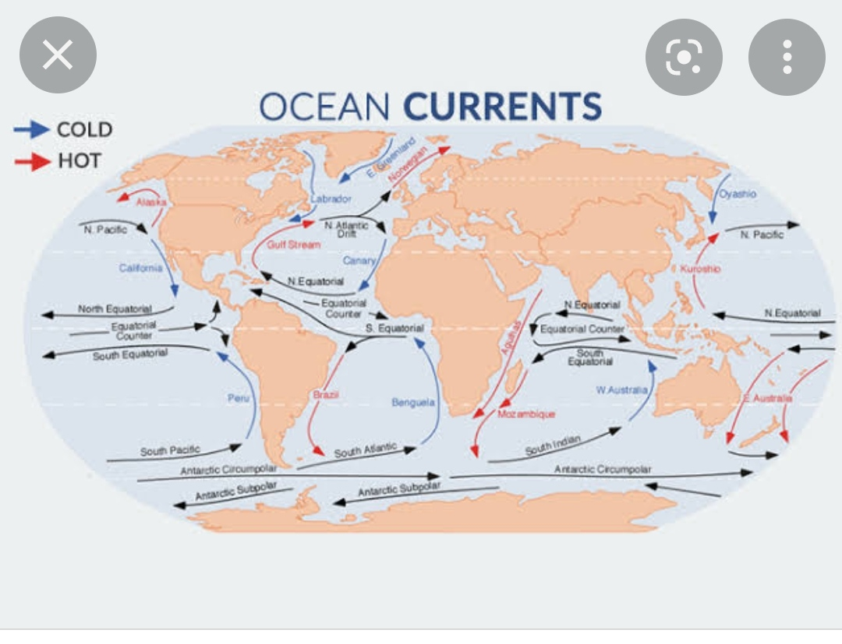
Currents
• Currents are streams of water flowing constantly through the ocean on definite direction.. They are caused by –
• variationsin temperature of ocean waters.
•the rotation of the Earth.
•the prevailing winds
•the shape of the land
Some of the important surface currents that love across the ocean are the Gulf Stream, the North Atlantic Ocean, the
California current, the Atlantic South Equatorial Current and the West wind Drift.

Slide 12
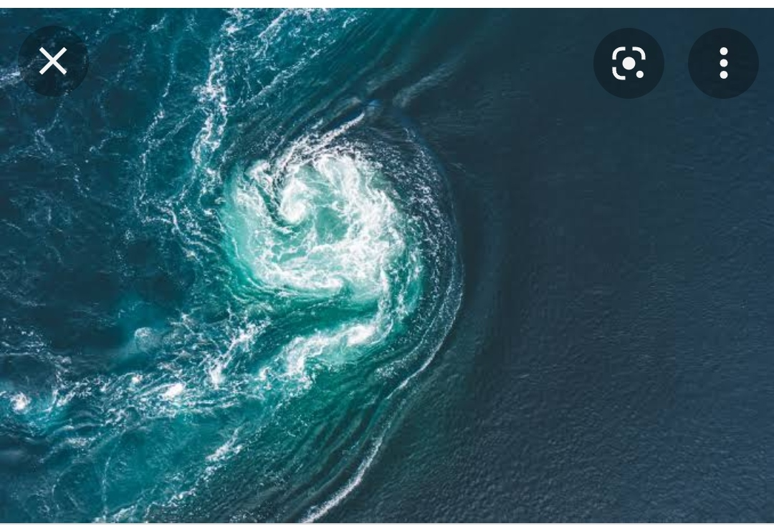
Effects of ocean currents
• Ocean currents influence the temperature of the region.
•The convergence of hot and cold currents leads to the formation of dense fog that can cause serious threat to ships.
• Areas of convergence make excellent fishing grounds because of the presence of planktons
• Ships that move along with ocean currents can move faster, and thus cut down travel time and the usage of fuel.

Slide 13
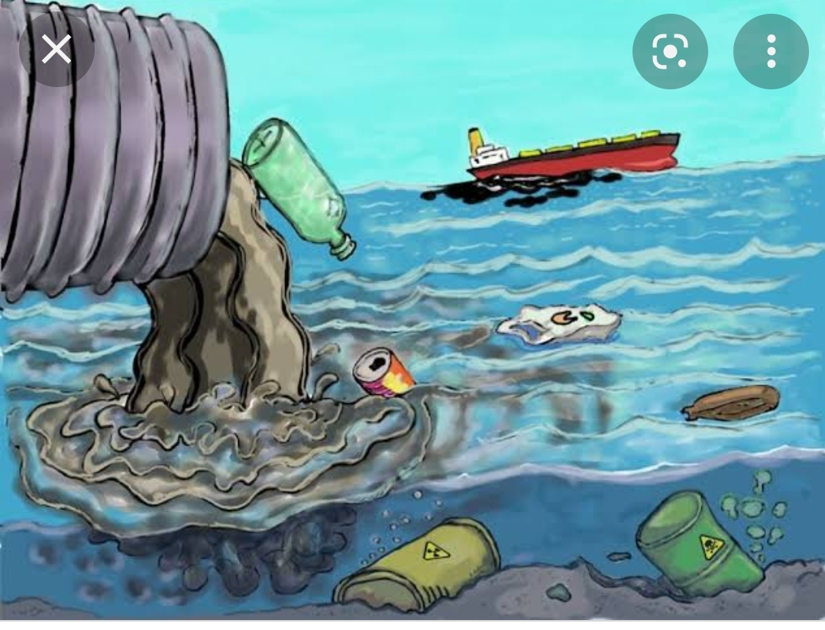
Water Pollution
Contamination of both underground and surface water is called water pollution. Contamination makes water unfit for use.
Polluted water may contain bacteria, parasites, animal wastes, toxic waste etc.
Water is a scarce resource. It therefore becomes our duty to conservr water and prevent further pollution.

