Slide 1



CLASS: NURSERY
DATE:08-11-21
SUBJECT: STORY
TOPIC: HUNGRY FOX

Slide 2
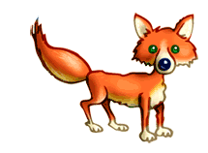
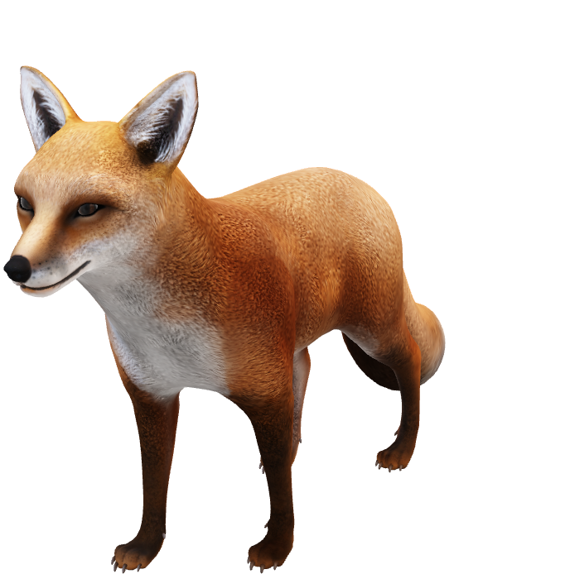
FOX

Slide 3
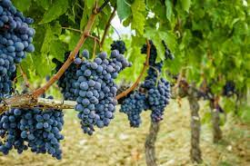
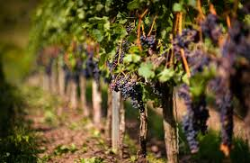
GRAPES

Slide 4
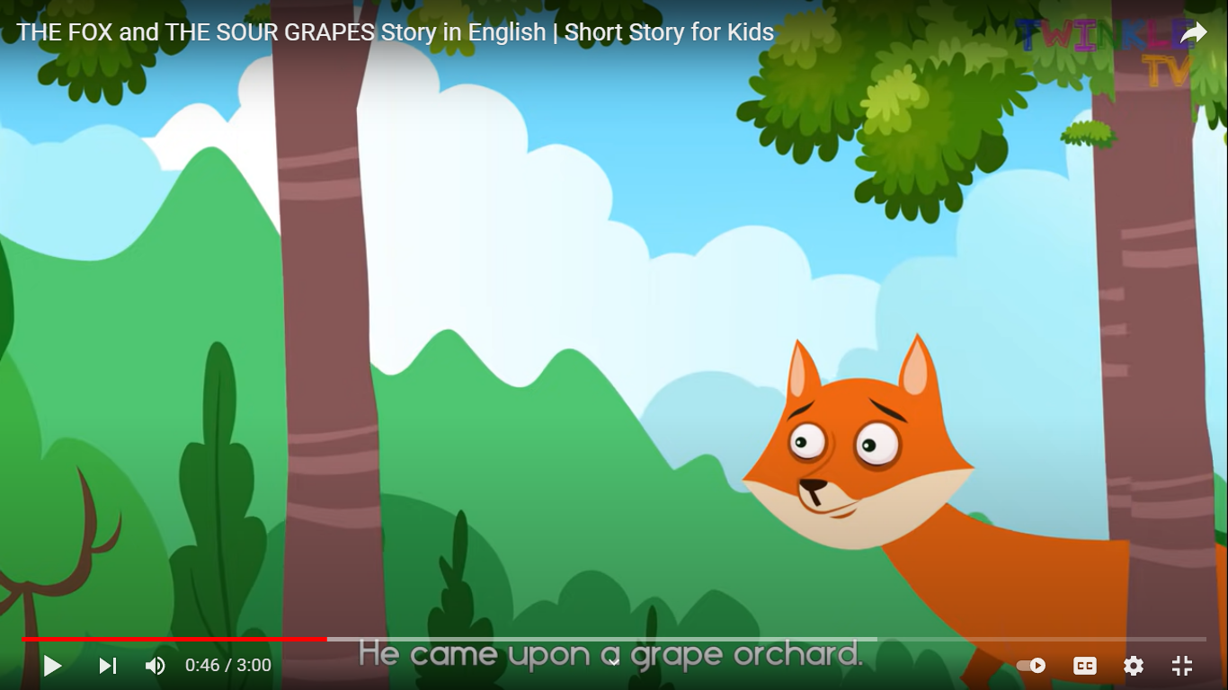
HUNGRY FOX

Slide 5
Once a fox was very hungry.

Slide 6
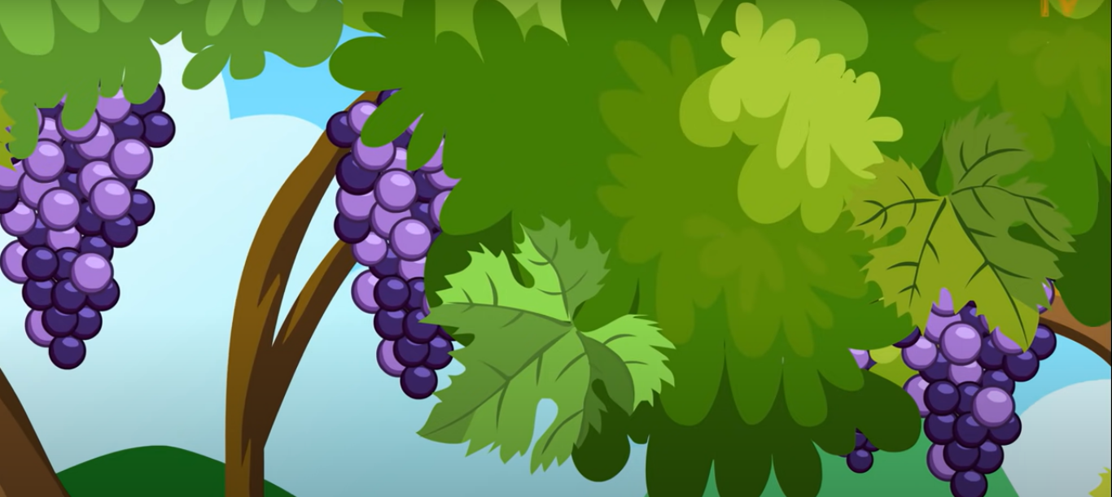
He went to a garden and saw some grapes.

Slide 7
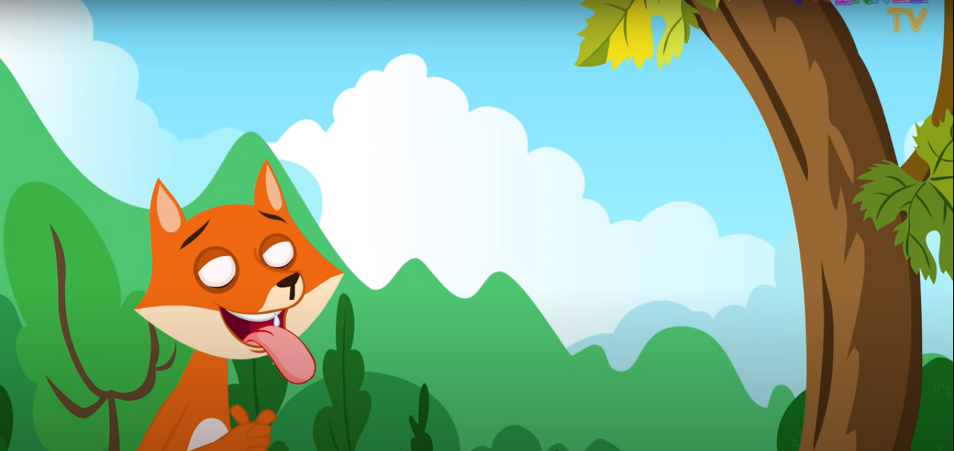
He wanted to eat them

Slide 8
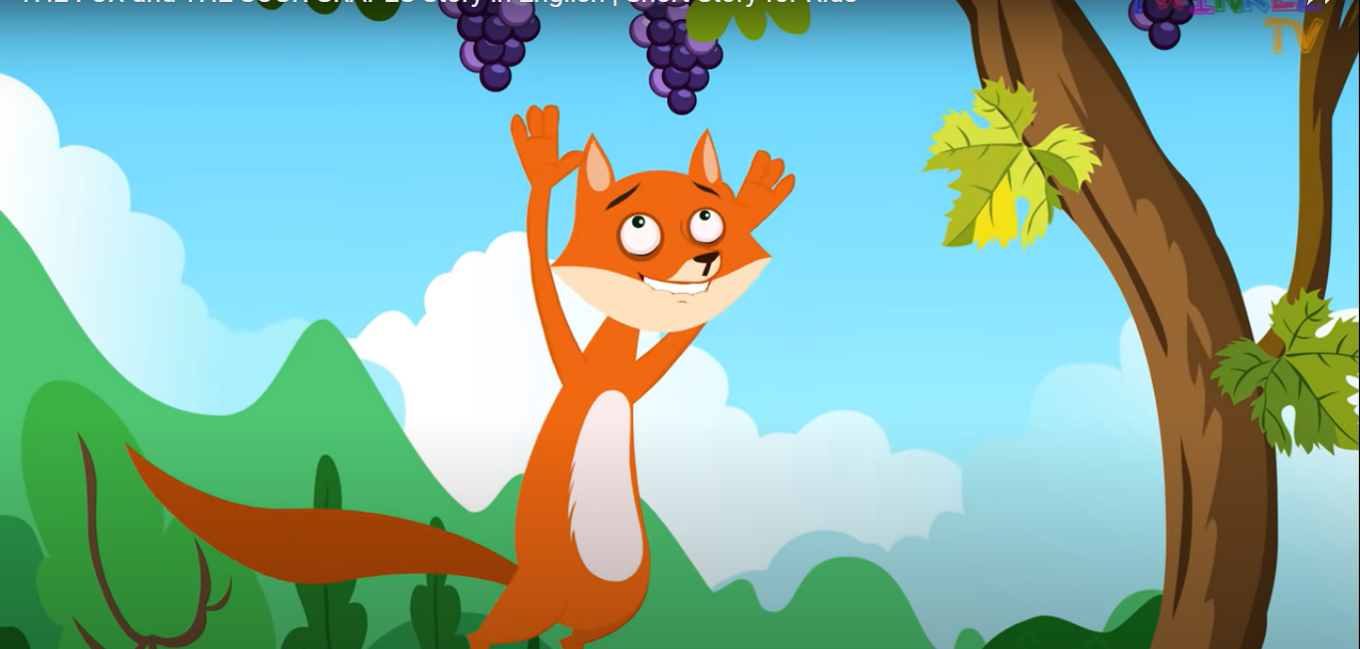
So he jumped again and again. But could not get at them.

Slide 9
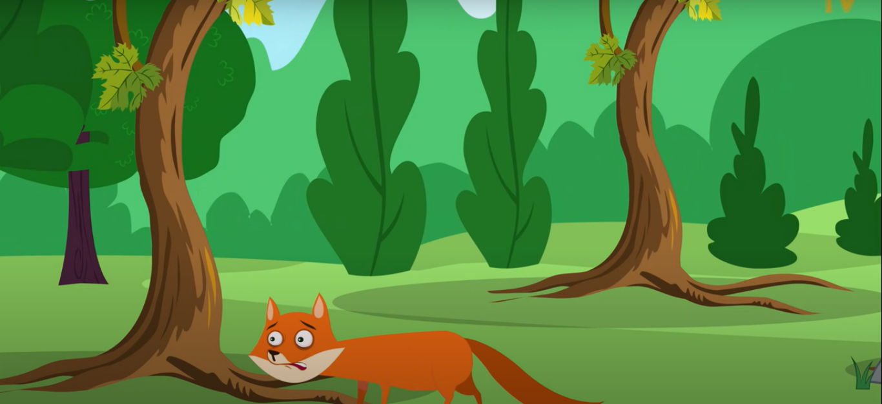
So he went away saying “The grapes are sour…….”

Slide 10
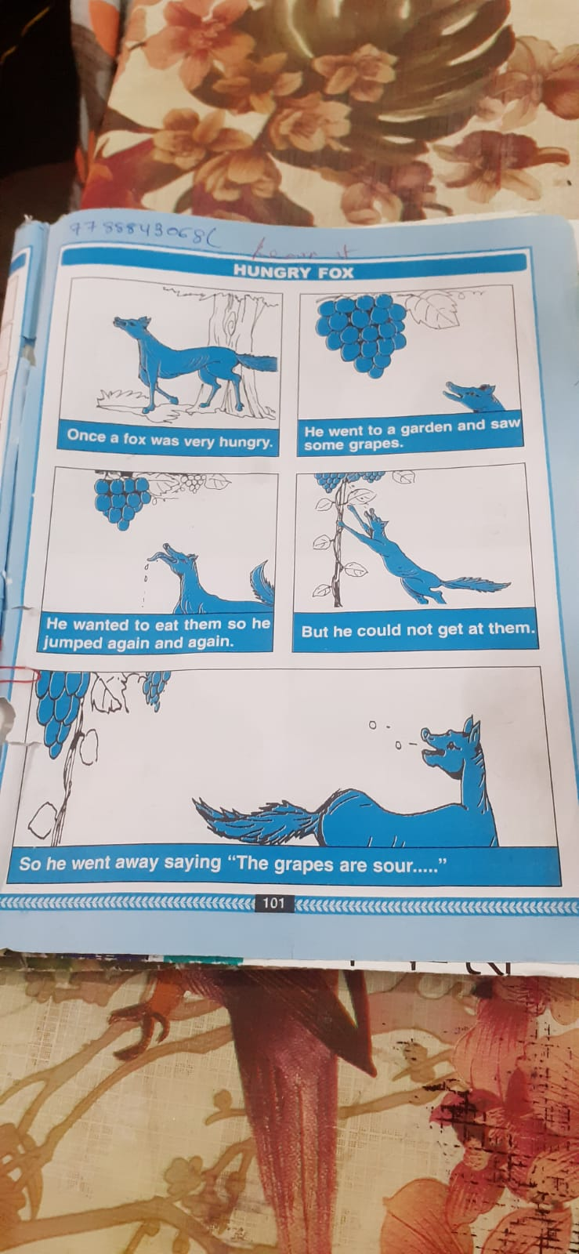

Slide 11

Home assignment
Practice the sentences of the story.

Slide 12
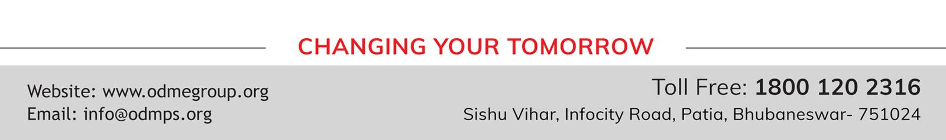
THANKING YOU
ODM EDUCATIONAL GROUP

