Slide 1


AND THEN, THE FIRST CITIES
SUBJECT : HISTORY
CHAPTER NUMBER: 4 PERIOD-1
CHAPTER NAME : AND THEN, THE FIRST CITIES

Slide 2
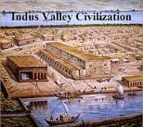
AND THEN, THE FIRST CITIES
LEARNING OBJECTIVES
INDUS VALLEY CIVILISATION
Period and Extent
City architecture
Life of the people
Trade and Commerce
Script
End of the civilisation

Slide 3
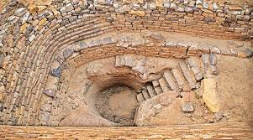
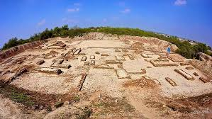
AND THEN, THE FIRST CITIES
INTRODUCTION
Human beings started to grow crops which lead them to change their life styles from nomadic hunters and food gatherers to live settlements.
They began to grow their own food, domesticate animals and live in clusters and groups near regions which provided water for their needs.
So people could now devote more time to other activities like leisure and thinking.
Writing was invented, art flourished, trade grew, and various inventions and discoveries changed life of humans.
Gradually, villages grew into towns, and towns into cities and the first great civilisations of the world were born.

Slide 4
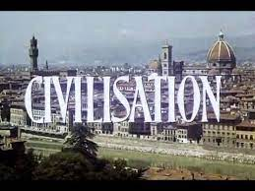
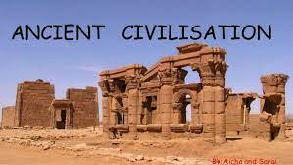
AND THEN, THE FIRST CITIES
WHAT IS CIVILISATION?
Civilisation is said to occur when a society is in advanced state of social development.
It includes many things, a society would have:
i) an advanced system of agriculture
ii) the comforts of city life
iii) the development of trade and commerce
iv) the art of writing
v) a good system of government.
The earliest civilisations of the world came up around 5000 BCE in river valleys. Four major river valley civilisations are:-
a) The Indus Valley Civilisation
b) The Chinese Civilisation
c) The Mesopotamian Civilisation
d) The Egyptian Civilisation

Slide 5
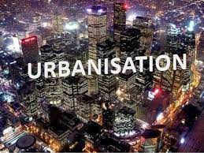
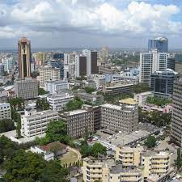
AND THEN, THE FIRST CITIES
URBANISATION AND CITIES
Urbanisation is one of the key feature of civilisation.
When more and more people start moving from villages to towns and cities, the process is called urbanisation.
The larger settlements grew in the form of cities. In cities many other occupations came into being other than farming.
There are traders, jewellery makers, writers, thinkers and artists. Rulers and ruling class people also stay.
Cities usually have well developed public facilities like roads, a drainage system, public halls and granaries.

Slide 6
AND THEN, THE FIRST CITIES
EXTRA QUESTIONS
Q1:- What is a Civilisation? What does a society need to occur civilisation?
Q2:- Name four major river valley civilisation of the world.
Q3:- What is urbanisation?
Q4:- Name the occupations of the people found in the cities besides farming.

Slide 7
THANKING YOU
ODM EDUCATIONAL GROUP

Slide 8
AND THEN, THE FIRST CITIES
SUBJECT : HISTORY
CHAPTER NUMBER: 4 PERIOD-2
CHAPTER NAME : AND THEN, THE FIRST CITIES

Slide 9
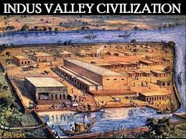
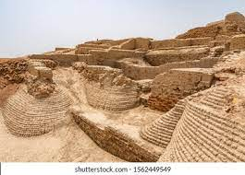
AND THEN, THE FIRST CITIES
INDUS VALLEY CIVILISATION
Indus valley civilisation flourished between 3,000 to 1,700 BCE. In all, over a, 1,000 sites have been discovered and about 100 have been excavated.
The earliest cities to be discovered were the Harappa and Mohenjodaro This civilisation stretched eastward from the current border of Iran areas beyond Delhi, and it stretched southward till Godavari river.
The important cities discovered are Mohenjodaro, Harappa and Mehrgarh (all in Pakistan), Dholavira and Lothal in Gujarat, Rakhigiri and Banawali in Harayana, Ropar in Punjab, Kalibangan in Rajastan, and Alamgirpur in Uttar pradesh.
.

Slide 10
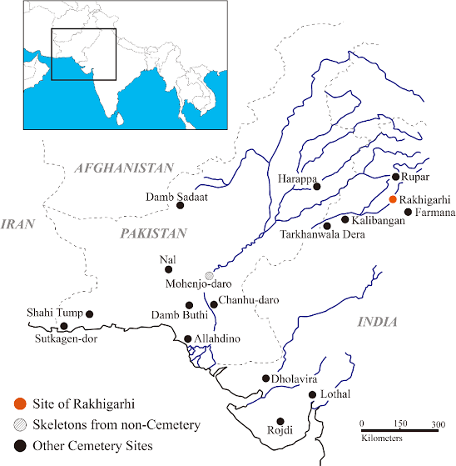
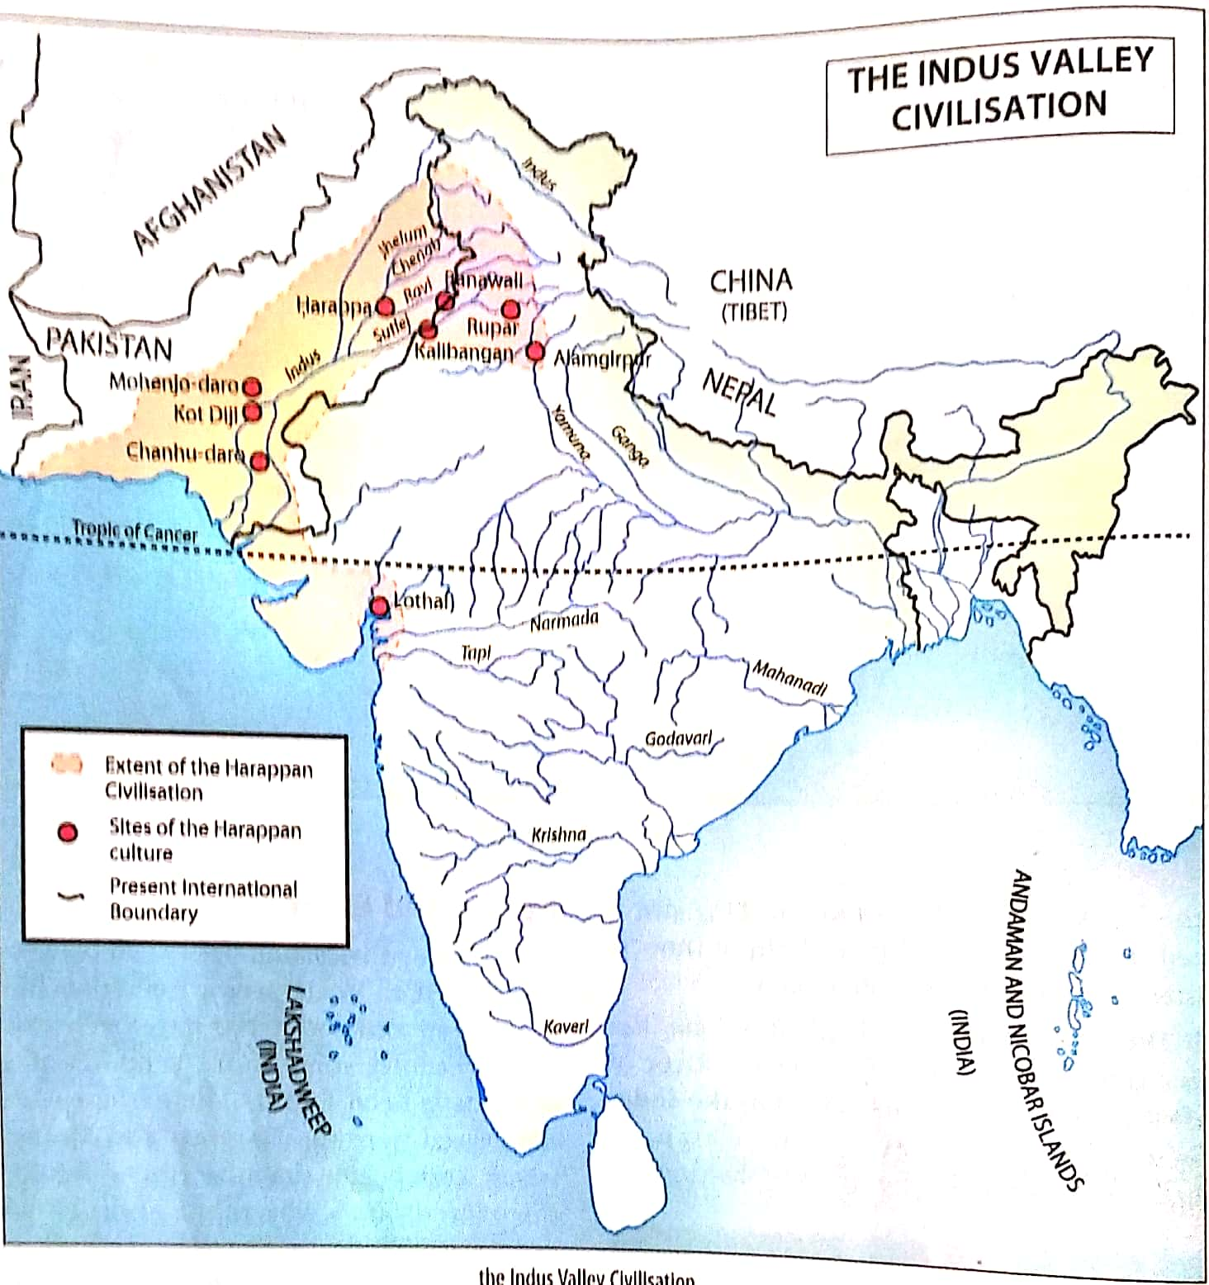
AND THEN, THE FIRST CITIES
SITES OF INDUS VALLEY CIVILISATION

Slide 11
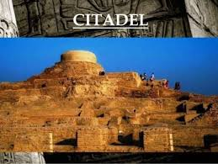
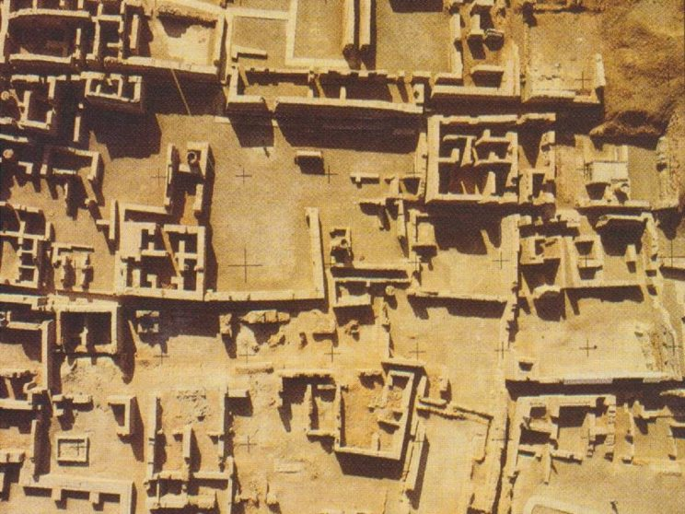
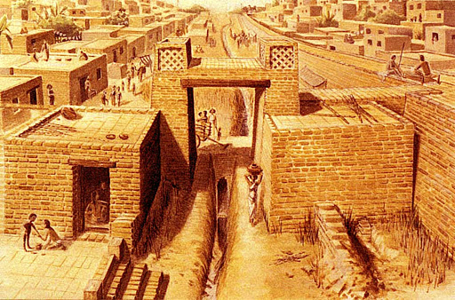
AND THEN, THE FIRST CITIES
TOWN PLANNING
The most striking feature of the Indus Valley civilisation was the well- planned nature of its cities.
The cities were divided into two parts. One part was at a higher level, it was built on a massive platform constructed of baked brick. Archaeologists call this area the citadel or acropolis.
The lower part of the city consisted of the houses of the common people.
The town planners of those times had made straight roads crossing each other at right angles at right angles and thus dividing the city into blocks.

Slide 12
AND THEN, THE FIRST CITIES
EXTRA QUESTIONS
Q1:-Name the river in which sites of Indus Valley Civilisation have been found.
Q2:-Why was the Indus civilisation known as Bronze Age?
Q3:-Name two cities of Indus Valley Civilisation found in India.
https://www.youtube.com/watch?v=juc3msgLMoc

Slide 13
THANKING YOU
ODM EDUCATIONAL GROUP

Slide 14
AND THEN, THE FIRST CITIES
SUBJECT : HISTORY
CHAPTER NUMBER: 4 PERIOD-3
CHAPTER NAME : AND THEN, THE FIRST CITIES

Slide 15
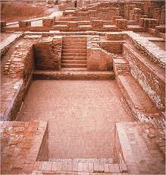
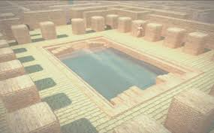
AND THEN, THE FIRST CITIES
GREAT BATH
The most important and impressive structure found at the citadel in Mohenjodaro is the Great Bath.
This was a rectangular tank made of fired bricks closely fitted together. This tank was made waterproof by a 3cm thick layer of bitumen(tar).
There were several rooms along the other two sides of the tank. In one of the rooms there was a large well, from which water was supplied to the tank.
Used dirty water was drained out through an outlet to a brick drain.

Slide 16
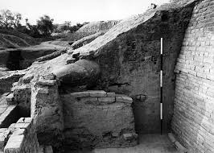
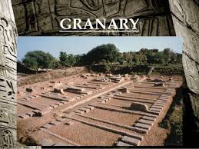
AND THEN, THE FIRST CITIES
THE GRANARY, DRAINAGE
To the west of the Bath, a massive brick platform has been excavated. The shape and size of this structure suggests that it might have been a granary.
Granaries have also been found at the citadels of nearly all civilisations. These were probably used as the store house for grains.
The town planners had devised a very good drainage system. Drains had a gradual slope to ensure flow of water. The drains along the main roads were covered and were inspected and cleaned regularly.

Slide 17
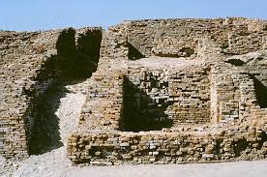
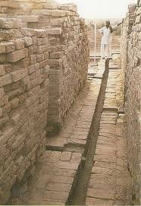
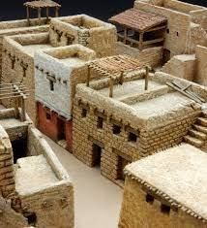
AND THEN, THE FIRST CITIES
STREETS, HOUSES AND BUILDINGS
The town planners of those times had straight roads crossing each other at right angles and thus dividing the city into blocks.
Houses were made of bricks and mud. Some two storeyed houses have also been found. The houses were built on both sides of the road and they had thick wall.
The bigger houses had a courtyard and the rooms were around the courtyard. They had a separate kitchen and a bathroom. Some houses had their own wells.

Slide 18
AND THEN, THE FIRST CITIES
EXTRA QUESTIONS
Q1:- Write a note on Great Bath found in Mohenjodaro.
Q2:-:- What do you know about the drainage system of the Indus Valley civilisation?
Q3:-Describe about the granary found in Harrapan city.
https://www.youtube.com/watch?v=opj4px4vK9s

Slide 19
THANKING YOU
ODM EDUCATIONAL GROUP

Slide 20
AND THEN, THE FIRST CITIES
SUBJECT : HISTORY
CHAPTER NUMBER: 4 PERIOD-4
CHAPTER NAME : AND THEN, THE FIRST CITIES

Slide 21
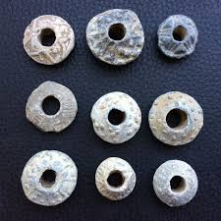
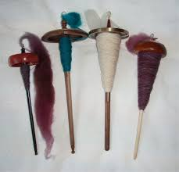
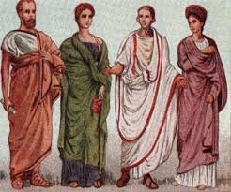
AND THEN, THE FIRST CITIES
FOOD AND CLOTH
The life of the people includes food, water, clothing, shelter and security.
A number of crops were cultivated- cereals like wheat and barley, pulsed, oilseeds like mustard and sesame, millets like bajra, ragi and jowar.
Remains of these crops have been found from the excavated sites.
Cloths:- The finding of spindles and spindle whorls show that thread was being made from cotton.
Types of cloth worn by men and women of Indus civilisation:- Men wore flowing length of cloth, while the women wore skirts.
Both men and women seem to have drapped a shawl over the shoulders.

Slide 22
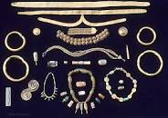
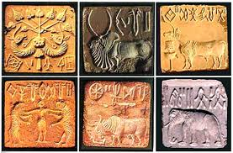
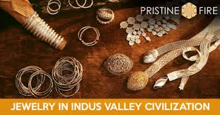
AND THEN, THE FIRST CITIES
ORNAMENTS, SCRIPT
Ornaments:- Both men and women ornaments made of gold, silver, faience, and beads of semi- precious stones like jade, lapis lazuli, cornelion and gate. Bangles, earrings and necklaces seem to have been popular.
Scripts:-The people of the Indus civilisation had developed a form of writing called as pictographic script. It is considered to be one of the world’s earliest known scripts.
Writing was in the form of brief inscriptions found mainly on seals of different materials like clay, baked clay and seatite. It is assumed that the script is written from right to left , but till now it has not been possible to deciphere it.
https://www.youtube.com/watch?v=yQEBflwLuLw script

Slide 23
AND THEN, THE FIRST CITIES
EXTRA QUESTIONS
Q1:- Name the ornaments used by the women of Indus civilisation.
Q2:-What type of cloths worn by the people of Indus civilisation.
Q3:-What do you know about the script of the Indus Valley Civilisation?

Slide 24
AND THEN, THE FIRST CITIES
SUBJECT : HISTORY
CHAPTER NUMBER: 4 PERIOD-5
CHAPTER NAME : AND THEN, THE FIRST CITIES

Slide 25
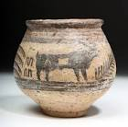
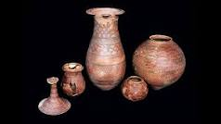
AND THEN, THE FIRST CITIES
POTTERY, ART AND CRAFT
Metallurgy:- The Indus people alloyed copper and tin to make bronze, which was more malleable and stronger than copper. Knives, axes, and chisels were made of stone. Copper tools like razors, hooks, sickles and axes were also made.
Pottery:- Pottery of different shapes, sizes and designs have been unearthed from these sites. A variety of pots, both plain and decorated, have been found. Many pots were painted red, with designs in black with geometric and figurative designs.

Slide 26
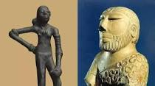
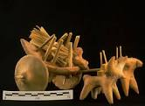
AND THEN, THE FIRST CITIES
ART AND CRAFT
Two finely sculpted works of art were recovered from Mohenjodaro. One is bust of a bearded man who has his robe thrown over one shoulder.
The other is that of the famed, dancing girl’ in bronze .
Many terracota figures of Animals, carts, toys & human figures were found.

Slide 27
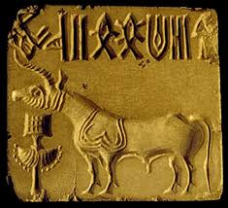
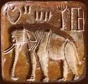
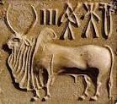
AND THEN, THE FIRST CITIES
SEALS
Seals :-Variety of seals have been found from the sites of Indus Civilisation.
They are of different shapes, but most of them are square or rectangular.
They have pictorial motifs and inscriptions on them. Most of the seals have either a bull, a peepal tree or a God which is widely believed to be Pashupati.

Slide 28
AND THEN, THE FIRST CITIES
EXTRA QUESTIONS
Q1:-What type of metals were used by the Indus people?
Q2:- What do you know about the seals of Indus civilisation?
Q3:- What type of pottery was found In Indus cities?
Q4:- Give two examples for the advancement of arts in the Indus civilisation.

Slide 29
THANKING YOU
ODM EDUCATIONAL GROUP

Slide 30
AND THEN, THE FIRST CITIES
SUBJECT : HISTORY
CHAPTER NUMBER: 4 PERIOD-6
CHAPTER NAME : AND THEN, THE FIRST CITIES

Slide 31
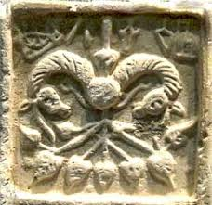
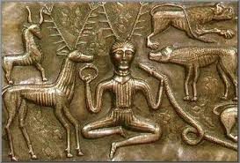
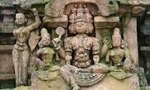
AND THEN, THE FIRST CITIES
RELIGION, TRADE AND END OF THE CIVILISATION
Religion:- The figures of Mother Goddess and the Seals representing a male figure sitting in the form of Yogi, a figure like a mother goddess and pipal trees tell us a little about the faith of the people.
The seals indicate that the people prayed to the bull, the peepal tree and the Pashupati (Shiva).
Evidence of burial practices has been found at cemetries at Harappa, Lothal and few other cities. The dead were burried wearing ornaments and with a few pots.

Slide 32
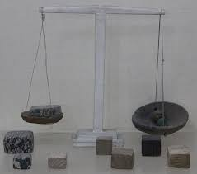
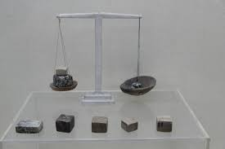
AND THEN, THE FIRST CITIES
RELIGION, TRADE AND END OF THE CIVILISATION
Trade and Commerce:- It is believed that trade also developed in Indus civilisation. It may have started in the form of barter system and gradually into proper trade.
The people of Indus civilisation had established a flourishing system of trade– both by land and by sea. The two large granaries found at Harappa and Mohenjodaro suggest the storage of grains.
The Indus river system might have been used for trade, as ornaments of Indus Valley have been found by archaeologists in Mesopotamian, which shows that the goods were exchanged between other civilisations.
Weighing scales, weights and measures (cube-shaped stone measures) have been found.

Slide 33
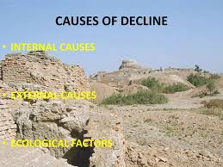
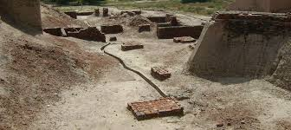
AND THEN, THE FIRST CITIES
RELIGION, TRADE AND END OF THE CIVILISATION
End of the civilisation:- The archaeologists and historians have observed that the civilisation probably came to and end around 2000 BCE.
It is guessed that there may have been massive floods which could have led the drainage systems to collapse and caused the whole region to be burried under mud.
Some scholars believe that river dried up and large scale deforestation took place. Extreme shortage of wood could have led the people to move away to settle elsewhere.
Environmental disasters like earthquakes might have caused rivers to change their course. It thus remains a mystery as to what brought an end to this civilisation.

Slide 34
AND THEN, THE FIRST CITIES
EXTRA QUESTIONS
Q1:- What were the religious beliefs of the Indus people?
Q2:-Give two examples to prove that trade and commerce developed during this period.
Q3:- What could be the reasons for the decline of the Indus Civilisation?

Slide 35
THANKING YOU
ODM EDUCATIONAL GROUP

