Slide 1



CLASS: NURSERY
DATE:30-11-21
SUBJECT:RHYMES
TOPIC: Hati Par Chanda
(page no-10)

Slide 2
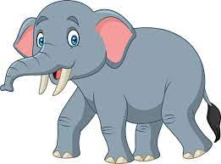
Elephant
Hati
हाथी

Slide 3

Chanda Moon

Slide 4
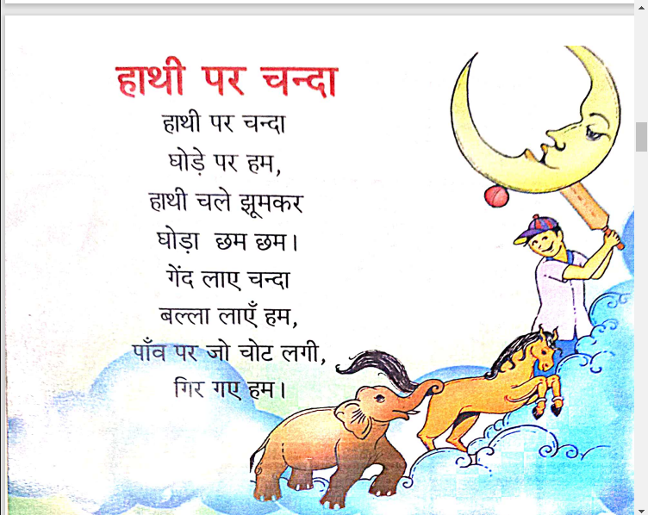

Slide 5
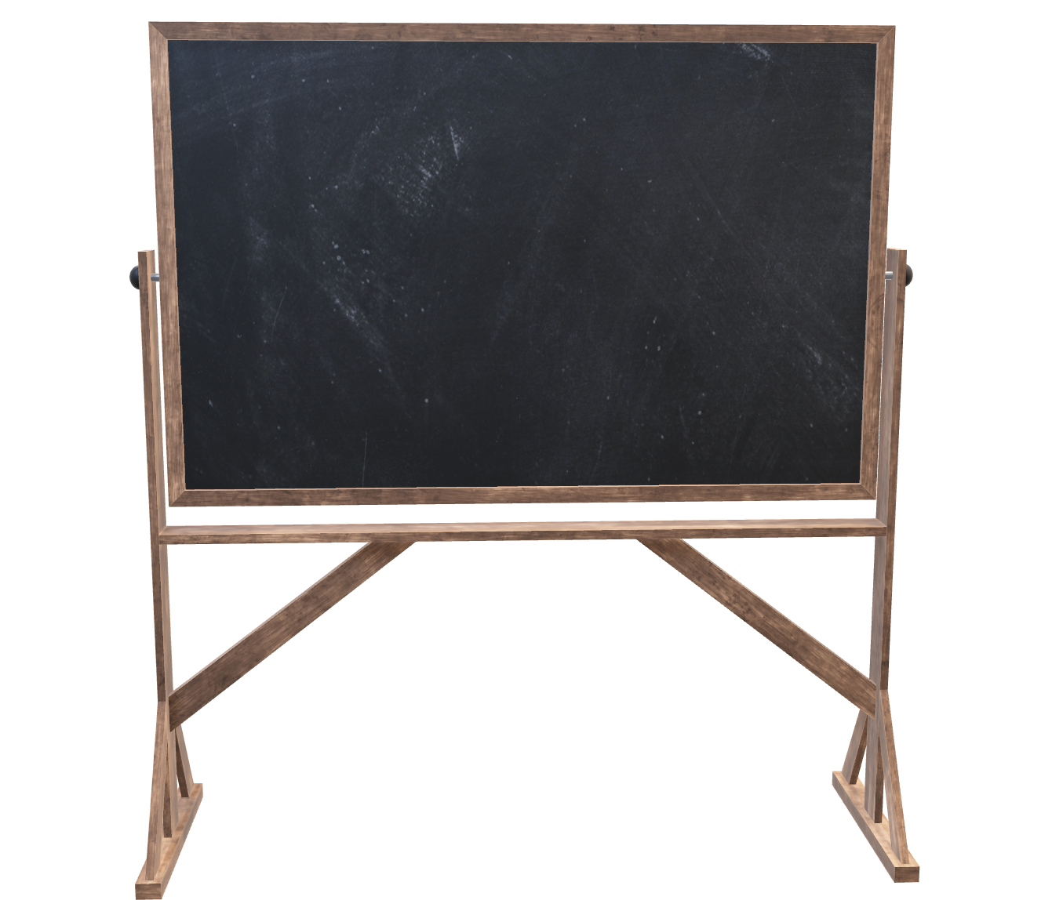
30/11/21
HOME ASSIGNMENT
Practice the ‘Hati par chanda ’ rhymes with proper tune and action (pg no-10)

Slide 6
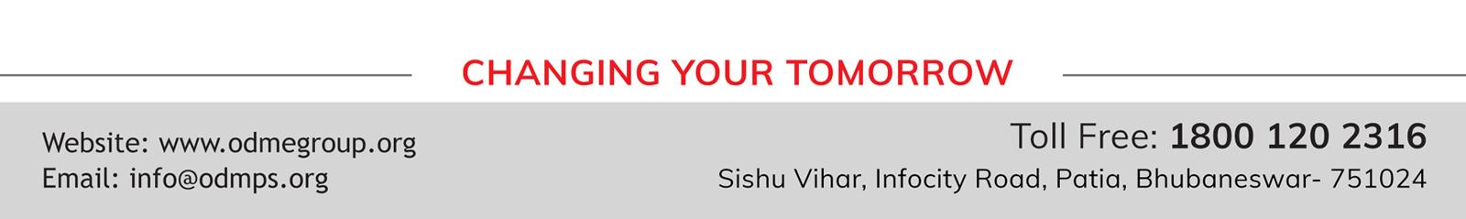
THANKING YOU
ODM EDUCATIONAL GROUP

