Slide 1

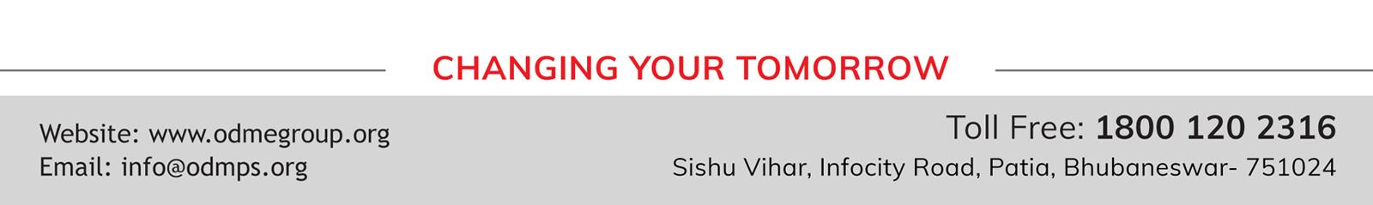
WELCOME TO ONLINE CLASS
SUBJECT : GK
OUR HELPERS

Slide 2
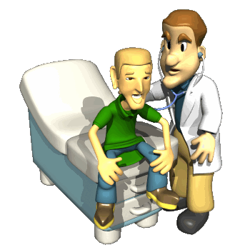

DOCTOR

Slide 3

NURSE

Slide 4

POLICEMAN

Slide 5

TEACHER

Slide 6

BARBER

Slide 7

TAILOR

Slide 8
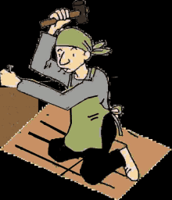
CARPENTER

Slide 9

POSTMAN

Slide 10
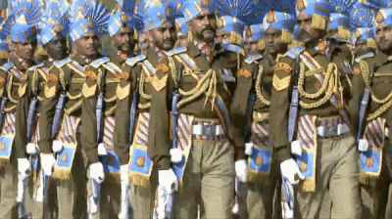
SOLDIER

Slide 11
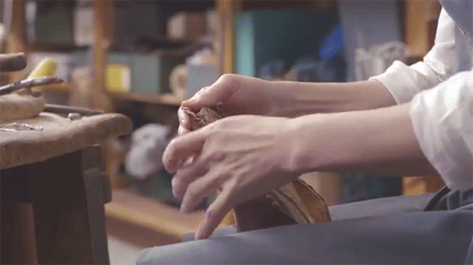
COBBLER

Slide 12

SWEEPER

Slide 13
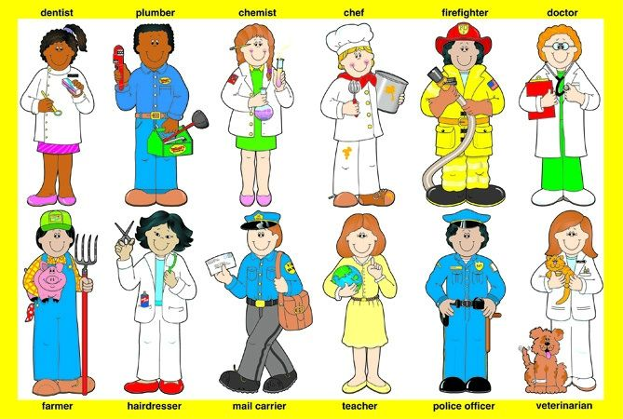
COMMUNITY HELPERS

Slide 14
THANKING YOU
ODM EDUCATIONAL GROUP

