Slide 1

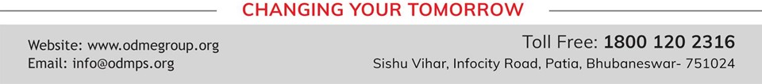
HEAT ENERGY
SUBJECT-PHYSICS CHAPTER NUMBER-6

Slide 2

HEAT
The form of energy that causes the perception of coldness and hotness is known as heat.
Heat energy flows from a higher temperature body to a lower temperature body.
The S.I. unit of heat is joule J.
The other units of heat are calorie (cal) and kilocalorie (kcal).
1 cal = 4.186 J

Slide 3
EFFECTS OF HEAT
Change in temperature
The change in temperature of a body depends on two factors.
Quantity of heat imparted to or rejected from a body.
Material of the body.
Change in state of the body
The process of change from one state to another at a constant temperature is called change of state.
1. Melting: The process in which a solids change to a liquid is called melting. The melting point is the temperature at which a solids change to a liquid.

Slide 4
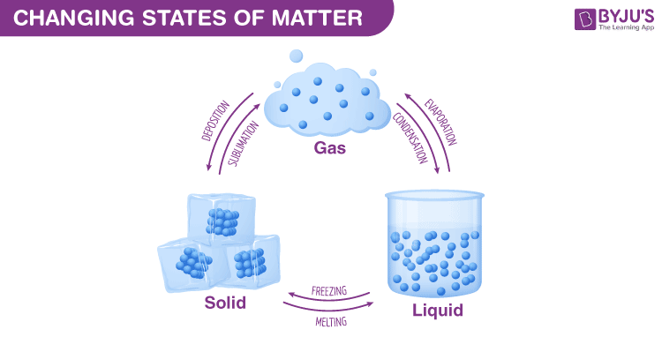
Change of state

Slide 5
2. Freezing: The process of liquid water changing to solid ice is termed as freezing. The temperature at which it occurs is known as the freezing point.
3. Vaporization: The process in which a liquid boils and changes to a gas is called vaporization. The temperature at which a liquid boils is its boiling point.
4. Condensation: This process in which a gas changes to liquid is known as condensation.
5. Sublimation: The process in which solids directly change to gases is known as sublimation.
6. Solidification or deposition: The process in which vapour is directly converted into solid is known as solidification.

Slide 6
3. Change in size of the body:
On heating, solids, liquids and gases expand. This is known as thermal expansion.

Slide 7
THANKING YOU
ODM EDUCATIONAL GROUP

