Slide 1


HEAT
STD-VII
SUBJECT-PHYSICS
CHAPTER NO- 05

Slide 2

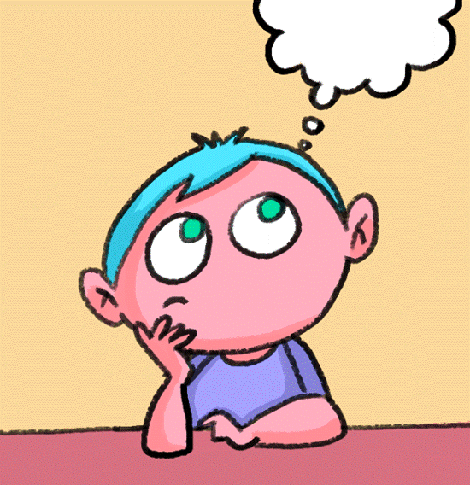
LEARNING OBJECTIVE
Students will be able to
Know about different scales of temperature
Explain about the effects of heat

Slide 3
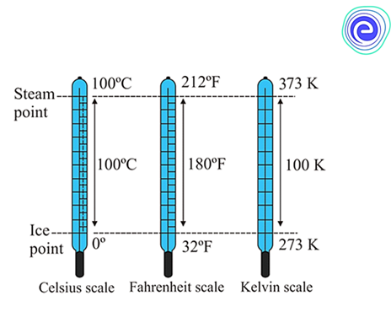
SCALES OF TEMPERATURE
Generally, we use the following three scales of temperature :
(i) The Celsius scale or centigrade scale,
(ii) The Fahrenheit scale, and
(iii) The Kelvin scale

Slide 4
The Celsius scale (or centigrade scale)
This scale was introduced by the Swedish astronomer Celsius and is known after his name.
On this scale, the ice point is marked as 0°C and the steam point is marked as 100°C.
The interval between the ice point and the steam point is divided into one hundred equal parts.
Each division is called one degree Celsius and is written as 1°C.

Slide 5
The Fahrenheit scale
This scale was introduced by Fahrenheit. This scale is generally used for clinical purposes.
On this scale, the ice point is marked as 32°F and the steam point is marked as 212°F.
The interval between the ice point and the steam point is divided into 180 equal parts.
Each division is called one degree fahrenheit and is written as 1°F.

Slide 6
The Kelvin scale
This scale was introduced by the scientist Kelvin.
It is also called the absolute scale of temperature.
On this scale, zero mark (i.e. 0 K) is at the temperature when no molecular motion can occur.
This scale has no negative temperature. 0 K is the lowest possible temperature.
The ice point is marked as 273 K and the steam point is marked as 373 K.
The interval between the ice point and the steam point is divided into 100 equal parts.
Each division of the Kelvin scale is equal to that of the Celsius scale.

Slide 7
EFFECTS OF HEAT
Heat produces mainly the following three effects:.
1.Change in temperature of the body,
2. Change in size or shape of the body, and
3. Change in state of the body.

Slide 8
Change in temperature of the body :
When a body is heated, its temperature rises and when it is cooled, its temperature falls.
The change in temperature of the body depends on (a) the quantity of heat imparted to (or released from) the body, (b) the material of the body, and (c) mass of the body.
2. Change in size of the body:
When a body is heated, it expands and when it is cooled, it contracts.
The increase in size of the body due to heating is called thermal expansion.

Slide 9
3. Change in state of the body:
Matter exists in three different states, namely solid, liquid and gas.
The process of change from one state to another at a constant temperature is called change of state

Slide 10

HOME ASSIGNMENT
Define thermometer
What are the effects of heat?

Slide 11

THANKING YOU
ODM EDUCATIONAL GROUP

