Slide 1


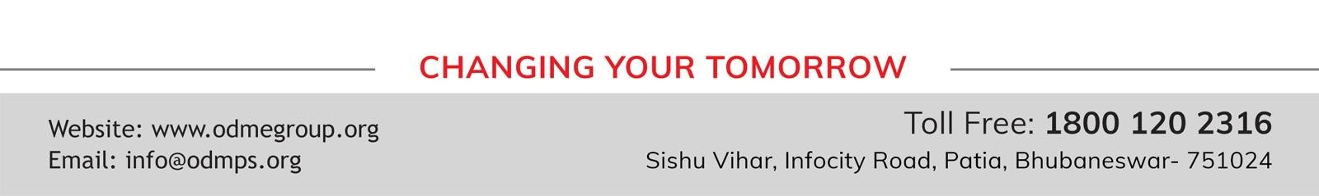
STD-IX
SUBJECT- LITERATURE CHAPTER - 5
TOPIC- THE HAPPY PRINCE PERIOD-4

Slide 2







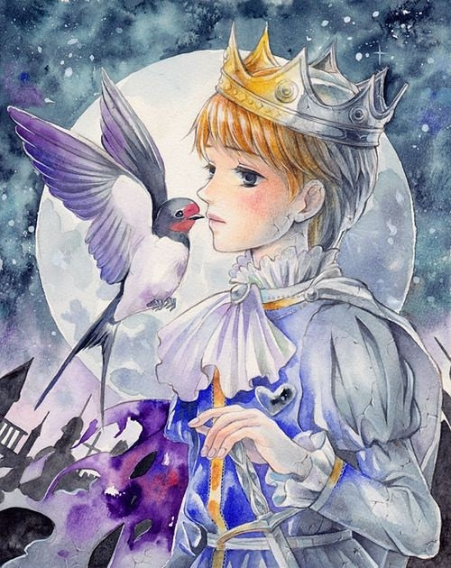







Slide 3
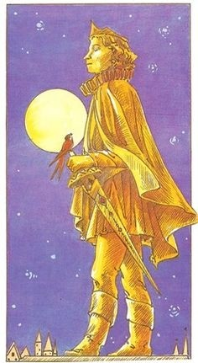
EXPECTED LEARNING OUTCOMES:
GENERAL OBJECTIVES
Understanding the concept
Being acquainted with prose and author’s biography
Understanding the idea
Appreciate the language of the prose
Developing LSRW Skills
SPECIFIC OBJECTIVES/ EXTENDED OBJECTIVES
Understanding the concept
Being acquainted with prose and author’s biography
Understanding the idea
Appreciate the language of the prose
Developing LSRW Skills

Slide 4
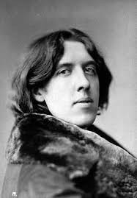
ABOUT THE AUTHOR
Oscar Wilde, in full Oscar Fingal O’Flahertie Wills Wilde, (born October 16, 1854, Dublin, Ireland— died November 30, 1900, Paris, France), Irish wit, poet, and dramatist whose reputation rests on his only novel, The Picture of Dorian Gray (1891), and on his comic masterpieces Lady Windermere’s Fan (1892) and The Importance of Being Earnest (1895). He was a spokesman for the late 19th- century Aesthetic movement in England, which advocated art for art’s sake.

Slide 5
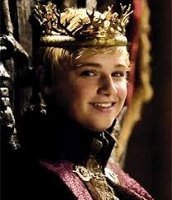
THEME
Of Oscar Wilde’s various short works for children, ‘The Happy Prince’ (1888) occupies a special place as his signature tale, and is perhaps Wilde’s definitive statement about the relationship between inner and outer beauty. ‘The Happy Prince’ is a sad tale that clearly owes much to earlier fairy stories, especially the tales of Hans Christian Andersen. However, it is also a typically Wildean story.

Slide 6
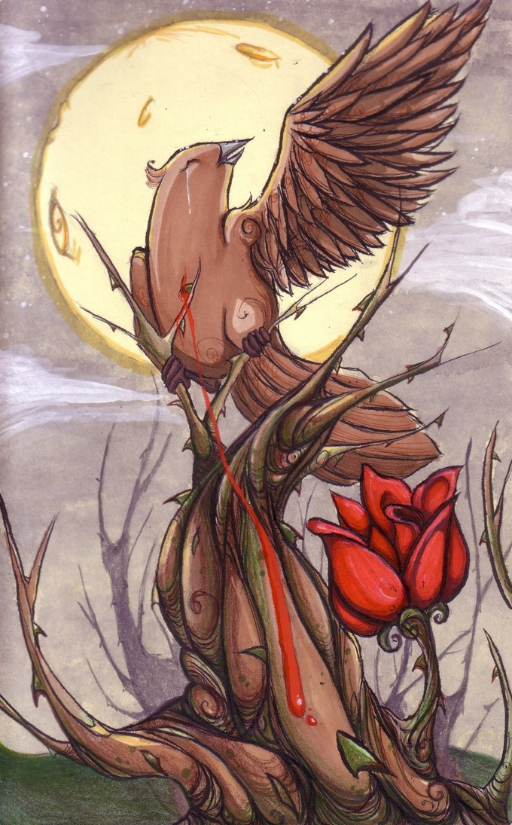
The swallow at last knew that he was going to die.
The swallow asked the Prince to let him kiss his hand.
The Prince told him that he was happy he was going to Egypt.
So he told him to kiss him on the lips.
But the swallow told him that he was not going to Egypt.
He was going to the house of Death. And he fell down dead.

Slide 7
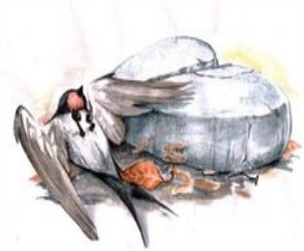
THE PRINCE’S HEART BREAKS
At that moment there appeared a crack in-side the statue.
The heart of the Happy Prince broke into two.
The dead swallow lay at its feet.
The next morning the Mayor and the Town Councillors came that way.
They looked at the statue.

Slide 8
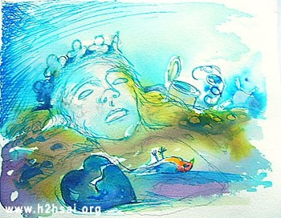
THE STATUE BREAKS AND IS MELTED
They declared that the Happy Prince was no longer beautiful.
So he was no longer useful.
Then they melted the statue in a furnace.
But the broken heart didn’t melt. It was thrown away.

Slide 9
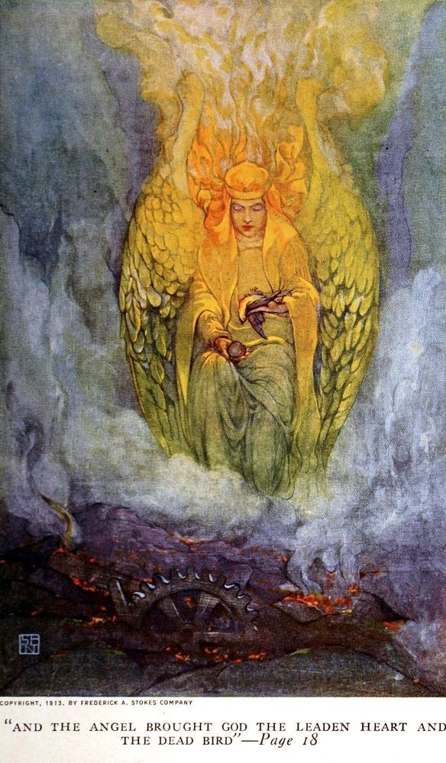
GOD ASKS FOR TWO MOST PRECIOUS THINGS
God asked one of His Angels to bring Him the two most precious things in the city.
The Angel brought Him the leaden heart of the Happy Prince and the dead bird.
God told that in the garden of Paradise the little bird would sing forever.
The Happy Prince would praise Him forever in His city of gold.

Slide 10
HOMEWORK
NCERT Textbook questions to be completed.

Slide 11
THANK YOU
ODM EDUCATIONAL GROUP

