Slide 1


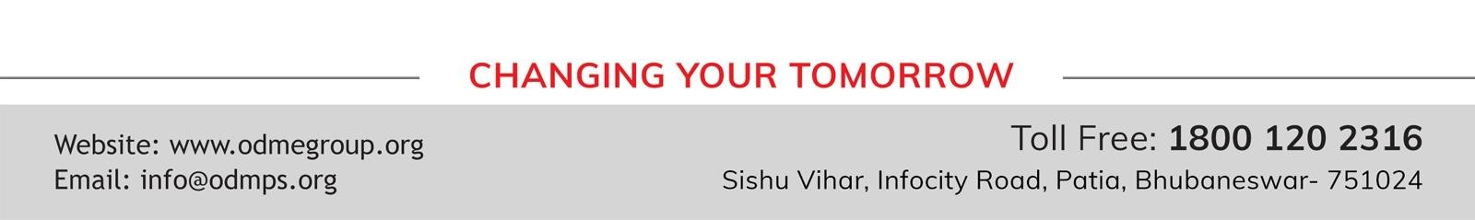
STD-IX
SUBJECT- LITERATURE CHAPTER - 5
TOPIC- THE HAPPY PRINCE PERIOD-2

Slide 2







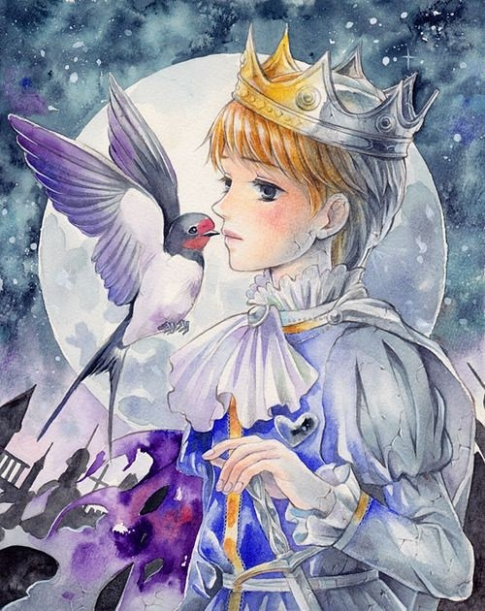







Slide 3
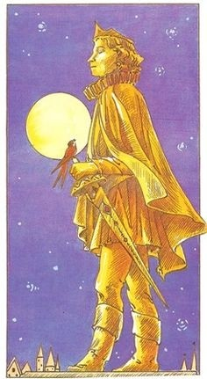
EXPECTED LEARNING OUTCOMES:
GENERAL OBJECTIVES
Understanding the concept
Being acquainted with prose and author’s biography
Understanding the idea
Appreciate the language of the prose
Developing LSRW Skills
SPECIFIC OBJECTIVES/ EXTENDED OBJECTIVES
Understanding the concept
Being acquainted with prose and author’s biography
Understanding the idea
Appreciate the language of the prose
Developing LSRW Skills

Slide 4
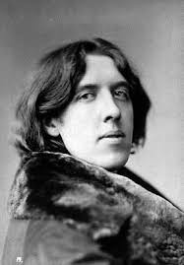
ABOUT THE AUTHOR
Oscar Wilde, in full Oscar Fingal O’Flahertie Wills Wilde, (born October 16, 1854, Dublin, Ireland— died November 30, 1900, Paris, France), Irish wit, poet, and dramatist whose reputation rests on his only novel, The Picture of Dorian Gray (1891), and on his comic masterpieces Lady Windermere’s Fan (1892) and The Importance of Being Earnest (1895). He was a spokesman for the late 19th- century Aesthetic movement in England, which advocated art for art’s sake.

Slide 5
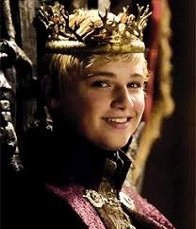
THEME
Of Oscar Wilde’s various short works for children, ‘The Happy Prince’ (1888) occupies a special place as his signature tale, and is perhaps Wilde’s definitive statement about the relationship between inner and outer beauty. ‘The Happy Prince’ is a sad tale that clearly owes much to earlier fairy stories, especially the tales of Hans Christian Andersen. However, it is also a typically Wildean story.

Slide 6
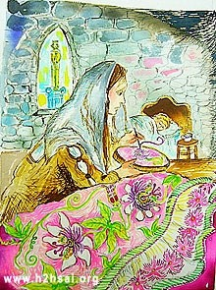
The Happy Prince told the swallow that there lived a woman far away. She was a seam¬stress.
She was embroidering flowers on the satin gown of the Queen’s maid of honour.
The maid was to wear it at the next Court ball. In the bed, there lay ill her little boy.
He was suffering from fever.
The Happy Prince asked the swallow to pick the ruby from his sword hilt. He should give that to the woman.

Slide 7
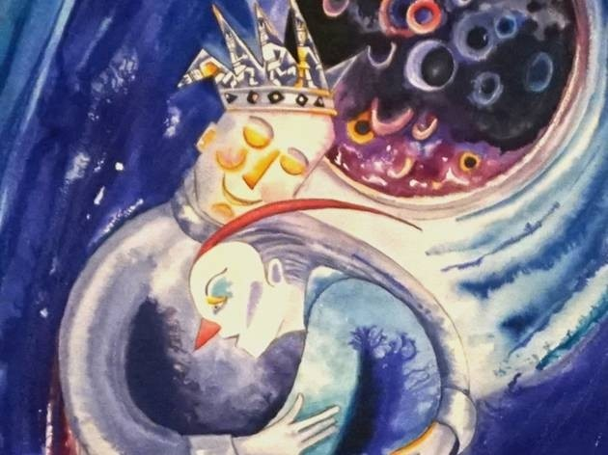
The Swallow reluctantly agrees.
He picked up the ruby and flew to the woman’s house. He put the ruby near the woman’s thimble.
He also fanned the boy’s forehead. The boy felt a bit better. He sank into a deep slumber.
When he returns, he tells the Happy Prince what he has done and that he feels warm, even though the air is cold.
The Happy Prince tells him that he has been warmed inside because he has done a good deed.

Slide 8
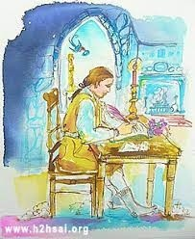
THE POOR PLAYWRIGHT EPISODE
The next day, the Swallow prepares to bid the Happy Prince farewell as he must fly to Egypt to join his friends.
But the Happy Prince persuades him to take the sapphire out of one of his eye sockets
And take it to the poor young man who is so poor he is freezing in his garret
He cannot finish the play he is writing.

Slide 9
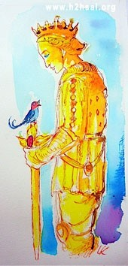
THE HAPPY PRINCE GIVES AWAY A SAPPHIRE
Once again, the Swallow does as the statue requests .
Though again, he does so reluctantly,
This time because he doesn’t want to rob the Happy Prince of one of his eyes.

Slide 10
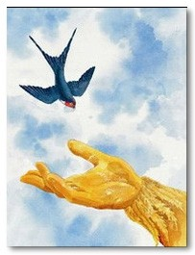
THE SWALLOW RETURNS TO THE HAPPY PRINCE
The playwright saw the sapphire. He was happy. Now he hoped to finish the play.
The swallow went to the Happy Prince. He told him that he had come to bid him goodbye.
But the Happy Prince asked him to stay one more night.

Slide 11
VOCABULARY
coarse: rough
seamstress: a woman who makes a living by sewing.
Cathedral : a church and on the church’s tower, white coloured marble angels were sculptured
mast: sail of the ship
tossing: turning left and right
sank: drown but here it means the boy in going to sleep
prospect: thought of something
Steeple: high tower of the church
garret: small dark room at the top of the house
withered: worn out
violet: kind of flower
faint: weak
darted: pushed himself insidE
grate: fireplace
HOMEWORK
Have you ever helped someone in need? Describe.

Slide 12
THANK YOU
ODM EDUCATIONAL GROUP

