Slide 1



STD-IX
SUBJECT- LITERATURE CHAPTER - 5
TOPIC- THE HAPPY PRINCE PERIOD-1

Slide 2







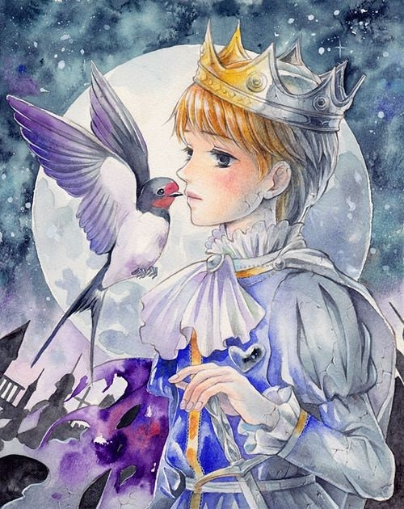







Slide 3
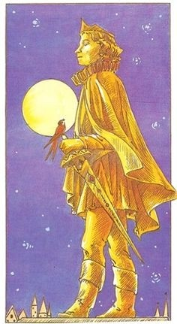
EXPECTED LEARNING OUTCOMES:
GENERAL OBJECTIVES
Understanding the concept
Being acquainted with prose and author’s biography
Understanding the idea
Appreciate the language of the prose
Developing LSRW Skills
SPECIFIC OBJECTIVES/ EXTENDED OBJECTIVES
Understanding the concept
Being acquainted with prose and author’s biography
Understanding the idea
Appreciate the language of the prose
Developing LSRW Skills

Slide 4
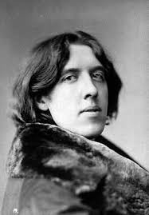
ABOUT THE AUTHOR
Oscar Wilde, in full Oscar Fingal O’Flahertie Wills Wilde, (born October 16, 1854, Dublin, Ireland— died November 30, 1900, Paris, France), Irish wit, poet, and dramatist whose reputation rests on his only novel, The Picture of Dorian Gray (1891), and on his comic masterpieces Lady Windermere’s Fan (1892) and The Importance of Being Earnest (1895). He was a spokesman for the late 19th- century Aesthetic movement in England, which advocated art for art’s sake.

Slide 5
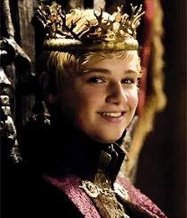
THEME
Of Oscar Wilde’s various short works for children, ‘The Happy Prince’ (1888) occupies a special place as his signature tale, and is perhaps Wilde’s definitive statement about the relationship between inner and outer beauty. ‘The Happy Prince’ is a sad tale that clearly owes much to earlier fairy stories, especially the tales of Hans Christian Andersen. However, it is also a typically Wildean story.

Slide 6
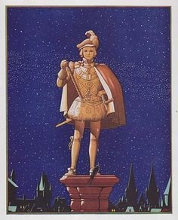

The Happy Prince of the story’s title refers to a statue, made of lead but painted all over with gold.
The statue’s eyes are sapphires, and in the hilt of the sword he holds is a bright red ruby.
The statue stands high above a city, and is admired by those who live there because he looks happy and ‘like an angel’.

Slide 7
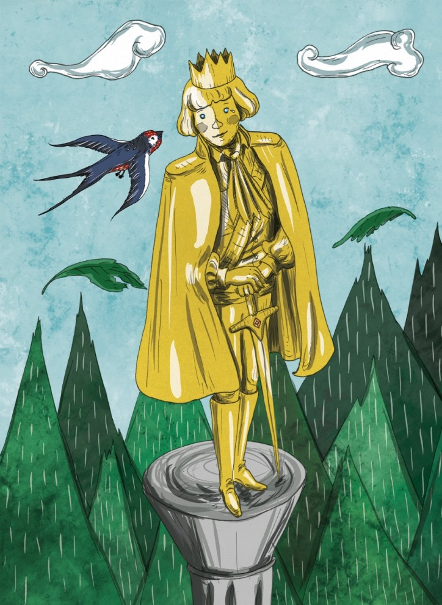
MEETING WITH THE SWALLOW
One night, a Swallow flies over the city, having stayed behind in northern Europe when his friends flew south to Egypt for the winter.
All day he flew and reached the city.
He decided to take shelter under the feet of the Happy Prince’s statue.

Slide 8
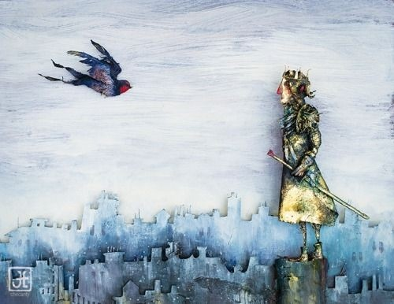
THE CONVERSATION
The Swallow flies south, stopping the following night to rest.
It just so happens that he arrives at the city where the statue of the Happy Prince is located.
He decides to sleep underneath the statue of the Happy Prince that night, but when the statue starts to cry on him, he strikes up a conversation with it.

Slide 9
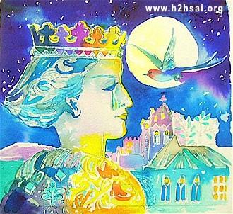
WAS HE HAPPY?
It turns out the Happy Prince isn’t so happy.
In life, he had been a wealthy and privileged man who had been sheltered from the misery and hardship of ordinary people in the city.
Only in death, when he became this statue looking down on the city and its inhabitants, has he come to realise how many people suffer and struggle.

Slide 10
VOCABULARY
swallow: a tiny bird
Alighted: descended
curious: strange
misery: sadness
HOMEWORK
Find out 5 synonyms and antonyms from the chapter and practice vocabulary

Slide 11
THANK YOU
ODM EDUCATIONAL GROUP

