Slide 1


SUBJECT : RHYMES
CHAPTER NAME :GOD’S LOVE

Slide 2

WELCOME TO NEW ENGLISH RHYMES

Slide 3
GOD’S LOVE

Slide 4


Slide 5



Slide 6
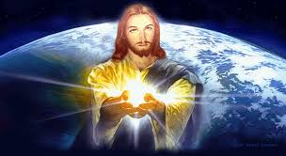

Slide 7




Slide 8
GOD’S LOVE, IS SO WONDERFUL,
GOD’S LOVE, IS SO WONDERFUL,
OH! WONDEFUL LOVE
IT’S SO HIGH ,WE CANN’T GET OVER IT,
IT’S SO DEEP, WE CANN’T GET UNDER IT,
IT’S SO WIDE WE CANN’T GET AROUND IT
OH! WONDERFUL LOVE
GOD’S LOVE IS SO WONDERFUL
GOD’S LOVE IS SO WONDERFUL
OHH WONDERFUL LOVE

Slide 9


THANKING YOU
ODM EDUCATIONAL GROUP

