Slide 1

WELCOME TO ONLINE CLASS
CLASS-UKG
SUBJECT-GK
TOPIC-VEHICLES
(LAND, AIR & WATER)

Slide 2
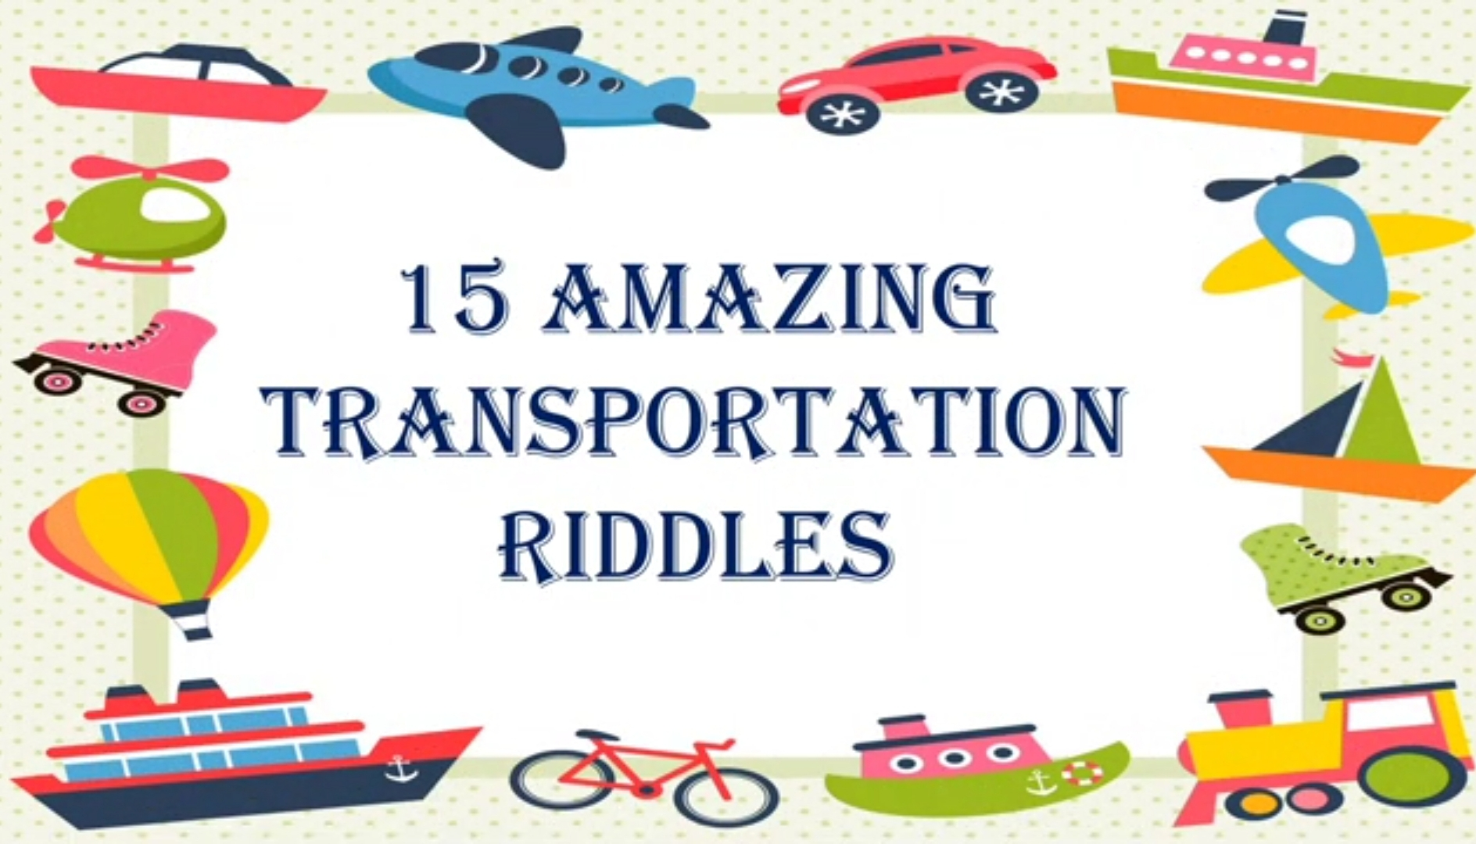
RIDDLES
WHO AM I

Slide 3
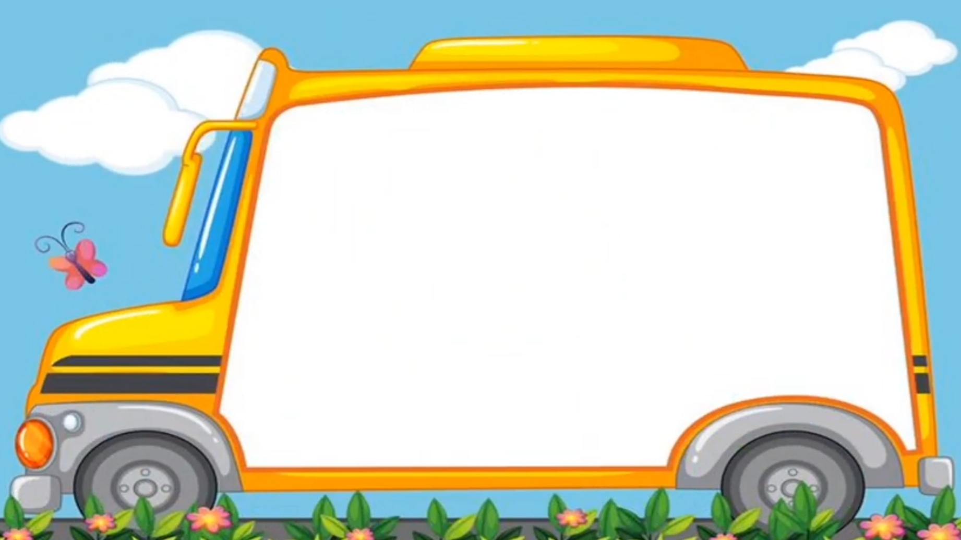
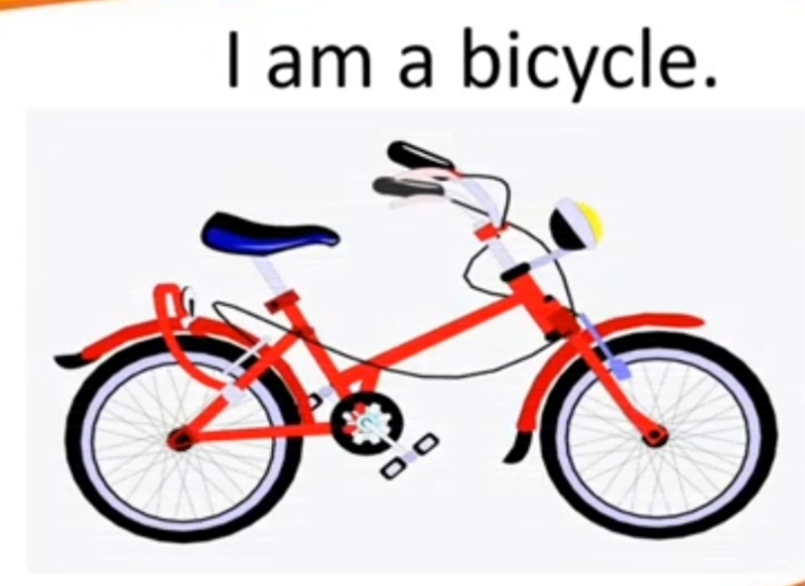
I have 2 wheels, and you have
to work hard to move me.

Slide 4
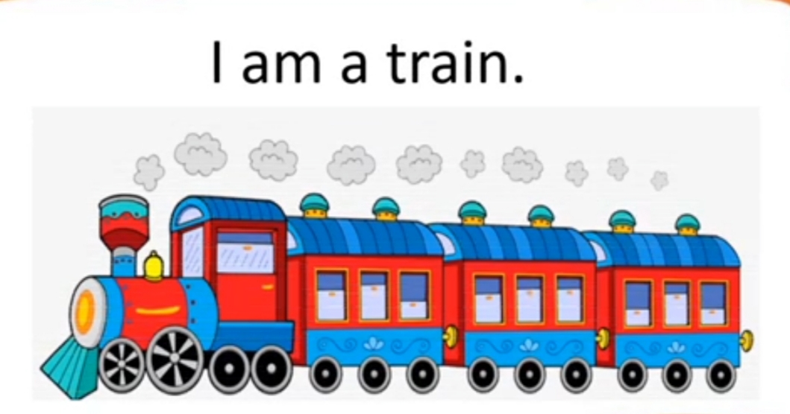
I can carry lots of people and things.
My wheels roll only on TRACKS.

Slide 5
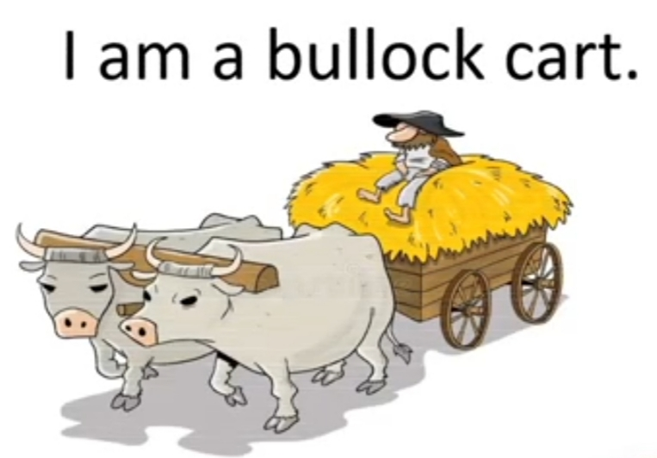
I am mostly found in villages. I need bulls to pull
me.

Slide 6
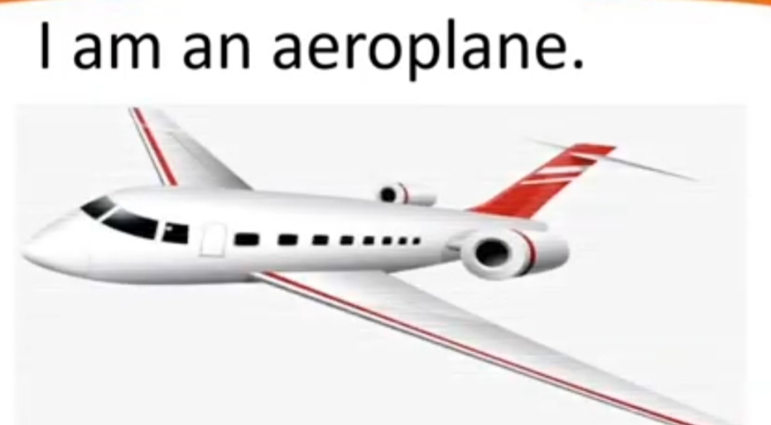
I am very fast. I carry people from
country to country.

Slide 7
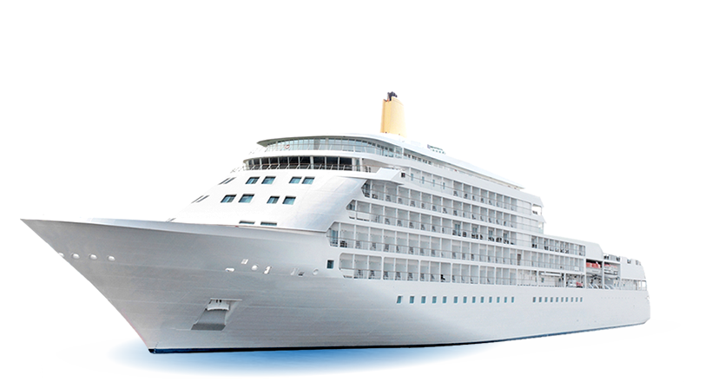
I am very big and sails on water.
I am a ship.

Slide 8
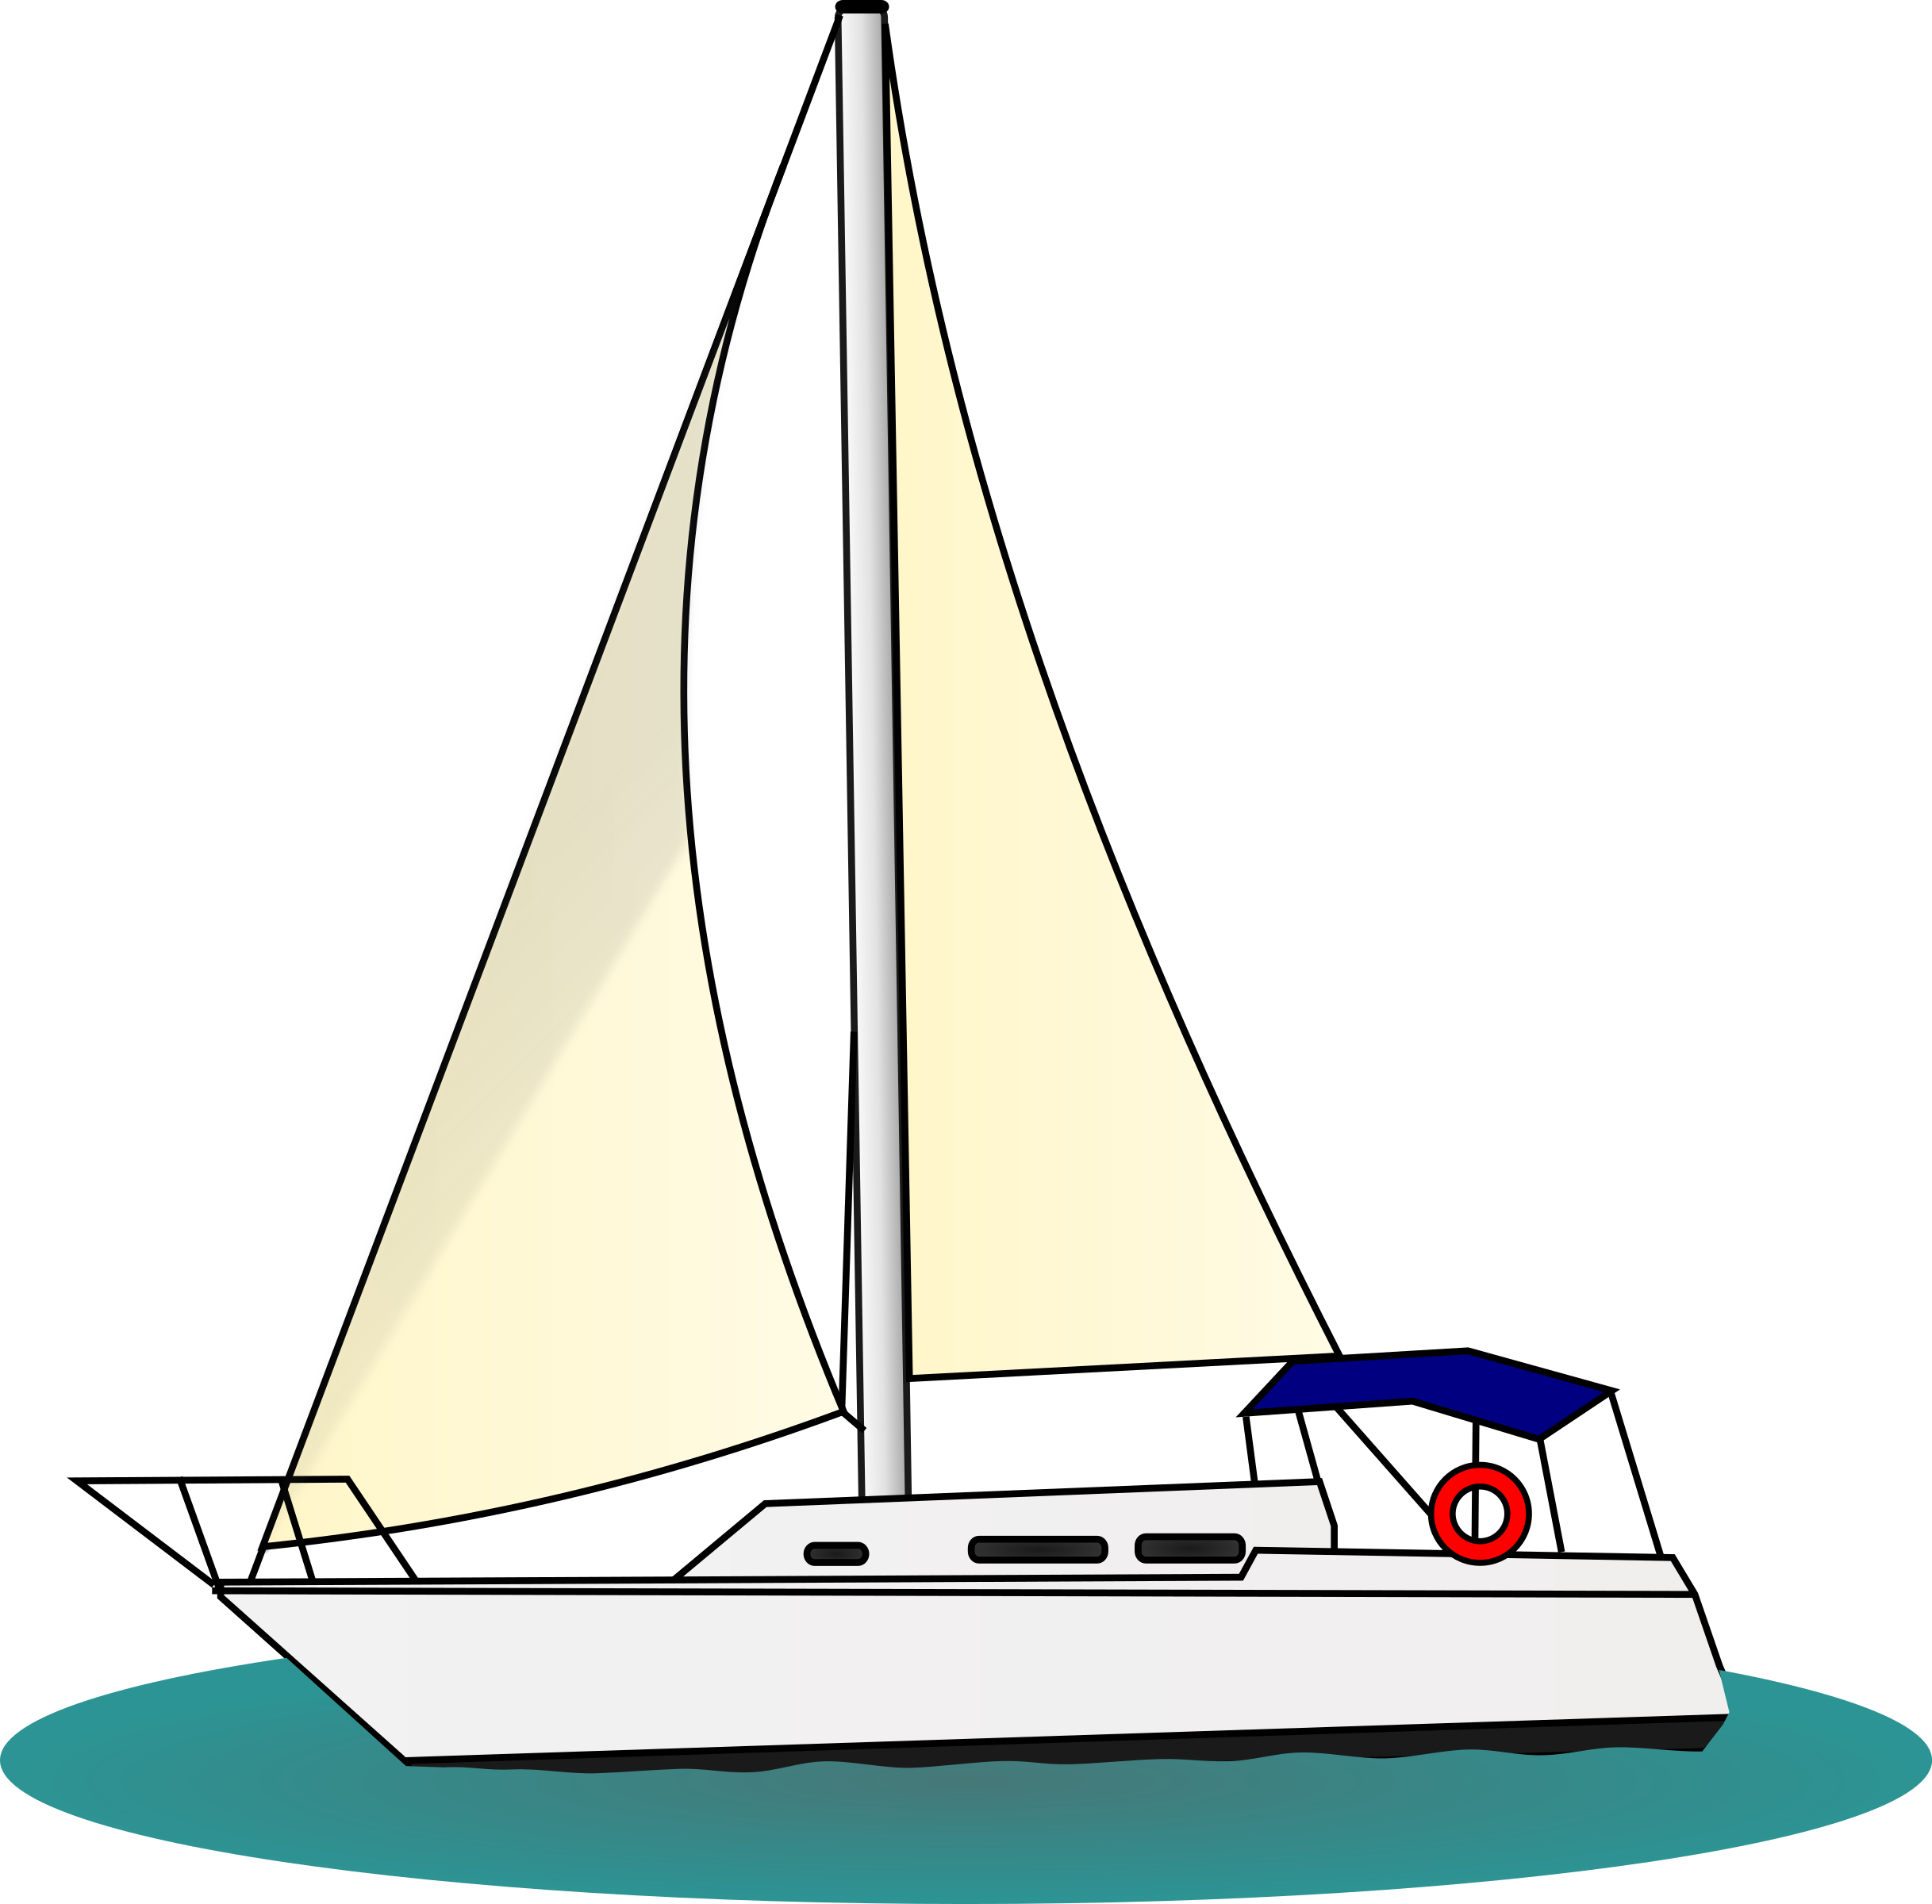
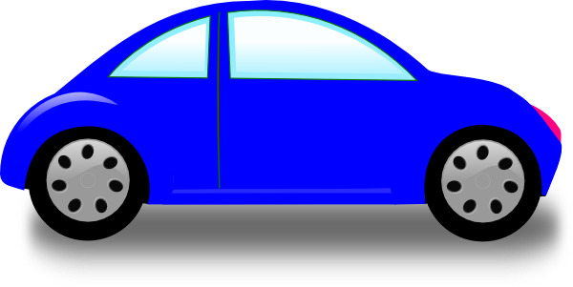
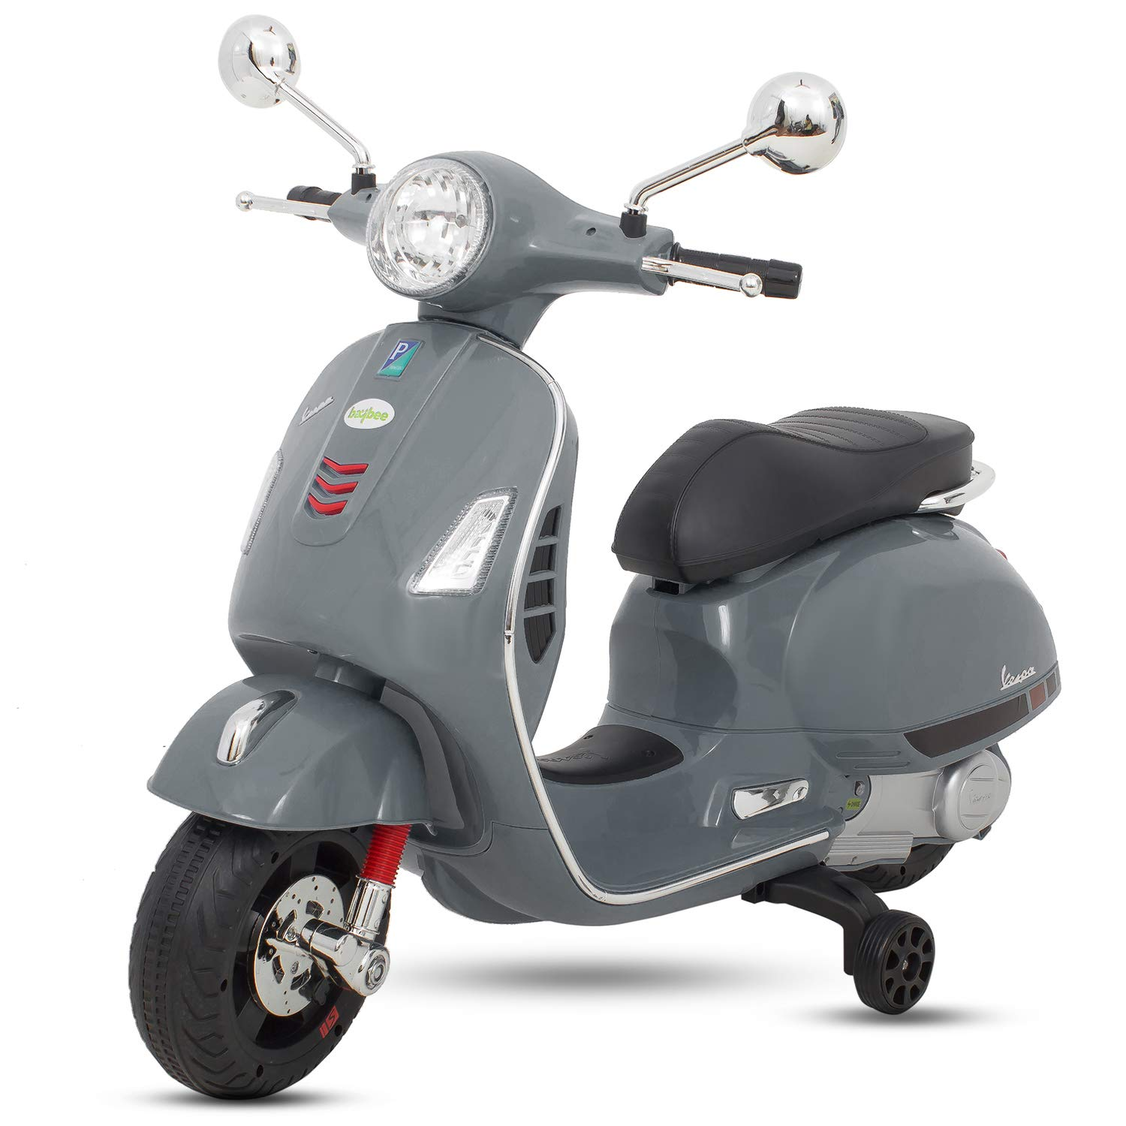
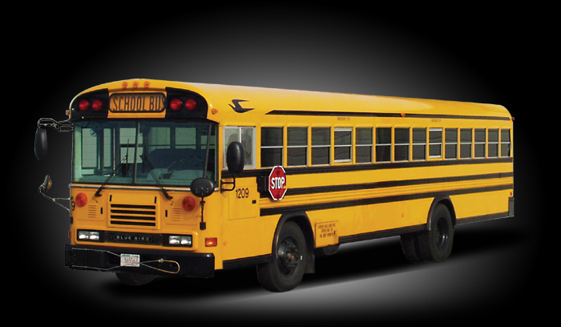
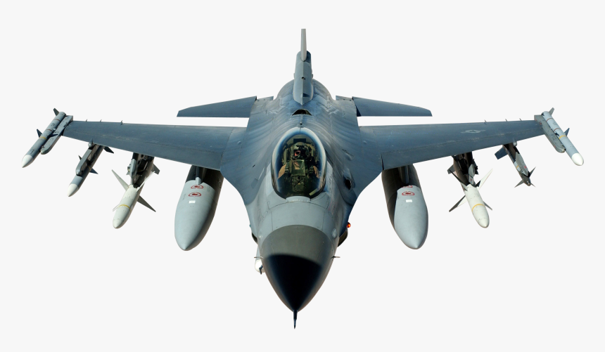
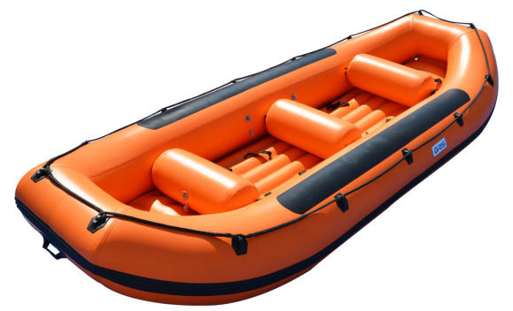
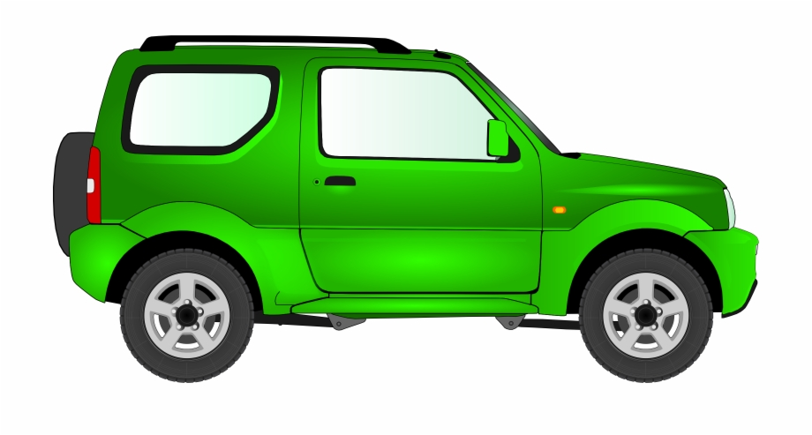
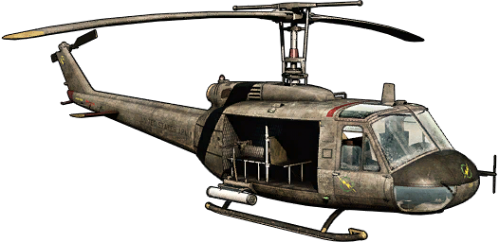
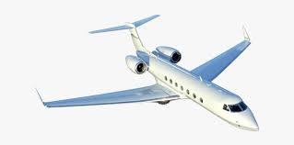
ACTIVITY

Slide 9
ARRANGE THE VEHICLES AS PER THEIR GROUP.
LAND
AIR
WATER

Slide 10
ASSIGNMENT
Paste 2 pictures from each group of vehicles in your note book.

Slide 11

THANKING YOU
ODM EDUCATIONAL GROUP

